Slide 1
Security and Safety
Georgia Kontos MS, MLS(ASCP)^{CM}
Blood Bank/SCTCT Safety Representative
Larry Waldron MT(ASCP)^{CM}
BB Specialist Technologist / Education Coordinator

Slide 2
Security Phone Number
Dial 6-9111 if you need Security
State your location: BLOOD BANK or SCTCT Lab
The security phone number can be found on the “Badge Buddy”. Take a minute to find it now!

Slide 3
Let Me In!
DO NOT buzz anyone into the Blood Bank, even if they have a badge.
If you do not know the person requesting access to the BB:
Handle the customers at the window requesting blood products FIRST
Ask the person their business
Do not let the person in unless you establish their business, even if a physician
Management should tell you if they are expecting an appointment
If unsure, call Management, Charge Tech, Security.

Slide 4
Feeling Unsafe…
If, at any time, for any reason you feel unsafe in the department…notify someone that can help you
NOTIFY MANAGEMENT IMMEDIATELY
NOTIFY LAB ADMINISTRATION IF YOU WANT
NOTIFY SECURITY IF NEEDED
MAKE APPOINTMENT WITH EAP IF YOU CANNOT TALK TO ANYONE.
The Blood Bank / SCTCT departments that you work in should be a safe environment for you!

Slide 5
Panic Buttons
There are two panic buttons in the Blood Bank that, if pressed, will automatically call security / police to the Blood Bank.
There are five panic buttons in the SCTCT Lab
Panic Buttons should be used when you feel threatened or trapped by an individual while in the Blood Bank.

Slide 6
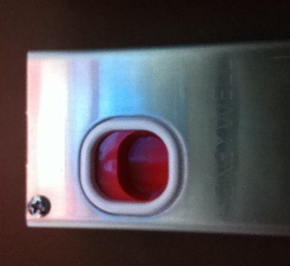
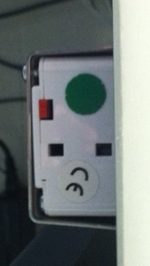
Blood Bank Panic Buttons
Front Desk:
Under FD desk, BBMONITOR side, to
right of door button
To activate: Reach under box, place finger into depression, pull forward
Front View
Underside View

Slide 7
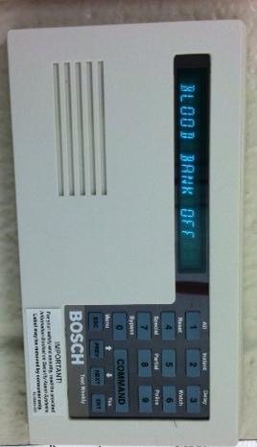
Blood Bank Emergency Key Pad
Outside Irradiator Room
Key pad above badge scanner
Key in the numbers 2 5 8 0 as if part of the normal access procedure to the irradiator room
Keying in this code will activate an alarm in security
Swipe badge, push door open as usual.

Slide 8
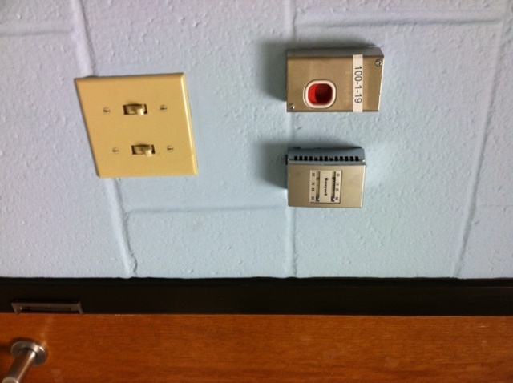
Blood Bank Panic Buttons
Inside Irradiator Room
The Irradiator Room is considered a “Safe Room”
Security cameras are in place to monitor the
activity inside the room
Directly to your right as you enter is a panic button that can be activated should you be caught in the irradiator room with an assailant.
To activate:
Place finger in depression
Push down on red button

Slide 9
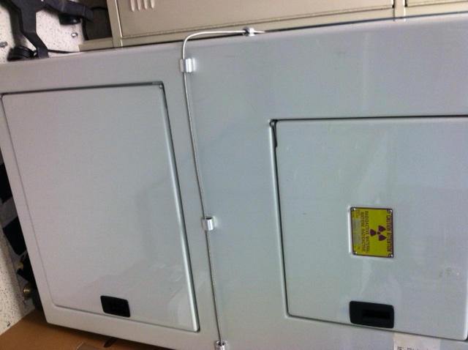
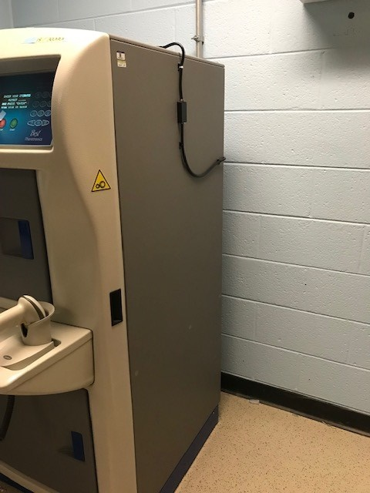
Blood Bank Panic Cords
Inside Irradiator Room
Around each irradiator is a panic cord
If you are caught in the irradiator room with an assailant and cannot get to the panic button, fall to the ground or lean forward and catch the panic cord. This will alert security.

Slide 10
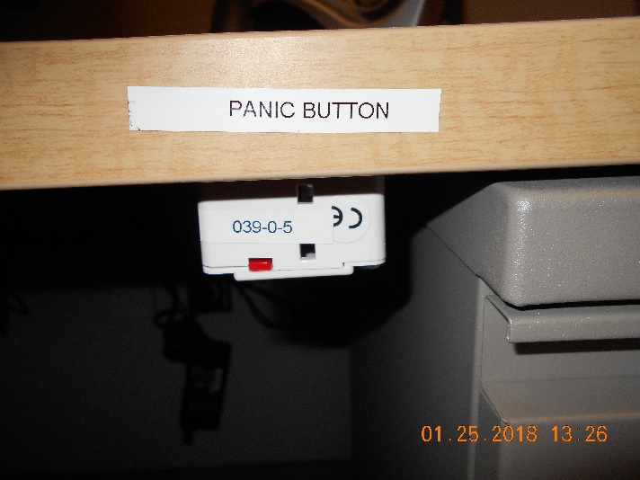
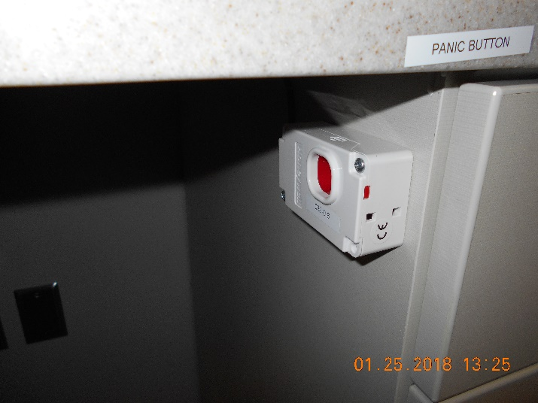
SCTCT Panic Buttons
SCTCT Office
Under the desk that is next to the door.
Specimen Receipt Area
Under the middle computer opposite the courier window.

Slide 11
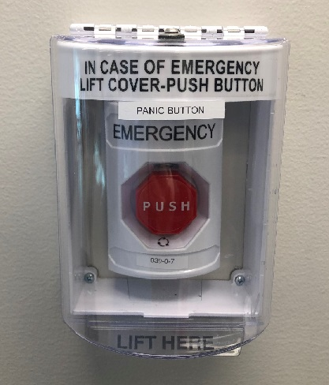
SCTCT Panic Buttons
Processing Room
Far corner of the room next to the intercom, to the right of the window.

Slide 12
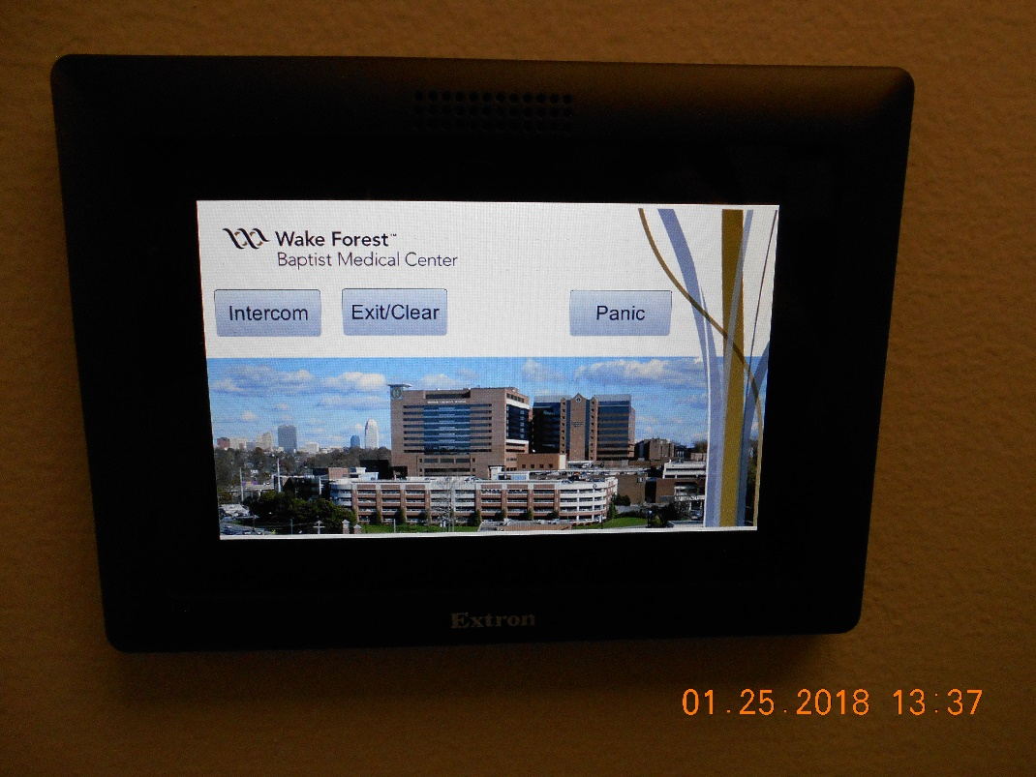
SCTCT Panic Buttons
Intercom system
There are also panic buttons on each of the 2 intercom systems located:
Cryo Room
Processing room

Slide 13
Blood Bank Key: Loss of Power
When there is a loss of electricity, the BB main door and the door to the irradiator room will not function.
An emergency key to access these doors is available in a lock box on the wall behind the Education Coordinator’s desk, to the left of the doorway that leads out into the hall.
Open the Safety envelope next to the lock box
Remove the code to unlock the lock box
Lock box contains key to access main door and irradiator room
Notify management if envelope security seal is broken

Slide 14
Blood Bank Key: Loss of Power
Security envelope containing
lockbox code
Lockbox containing
key to access BB
main door and
irradiator room

Slide 15
Irradiator Room Access
GammaCell irradiators contain CS137 as their radiation source which can be used by terrorists to make “dirty bombs”
The Radiation Officer of WFBH has mandated persons who access the irradiator room be cleared by background checks from various security databases. (Homeland, FBI, etc)
Process begins with fingerprints and complete background check of the person requiring access.
Fingerprints are sent to governmental databases for checking
Process takes approximately 6 weeks
Once cleared, employee badge will open irradiator room

Slide 16
Irradiator Room Access
Persons with valid security can take other UNCHECKED persons into the irradiator room. Under NO circumstances should the unchecked person BE LEFT IN THE IRRADIATOR ROOM ALONE.
Remember, you are on camera inside and outside the irradiator room but security is not always watching. Using the panic button, pushing violently on the door or pulling the panic cords on the irradiators will alert security to action.

