Slide 1
Lab Manager’s Meeting
February 2022
2.2023 | Department of Lab & Pathology

Slide 2
Days Since Last Serious Safety Event
WFB: 15
BCH: 40
DMC: 729
HPMC: 92
LMC: 22
WMC: 246
As of 2/16/2023

Slide 3
Good Catches in February
Great Work!
Thank you ALL!

Slide 4
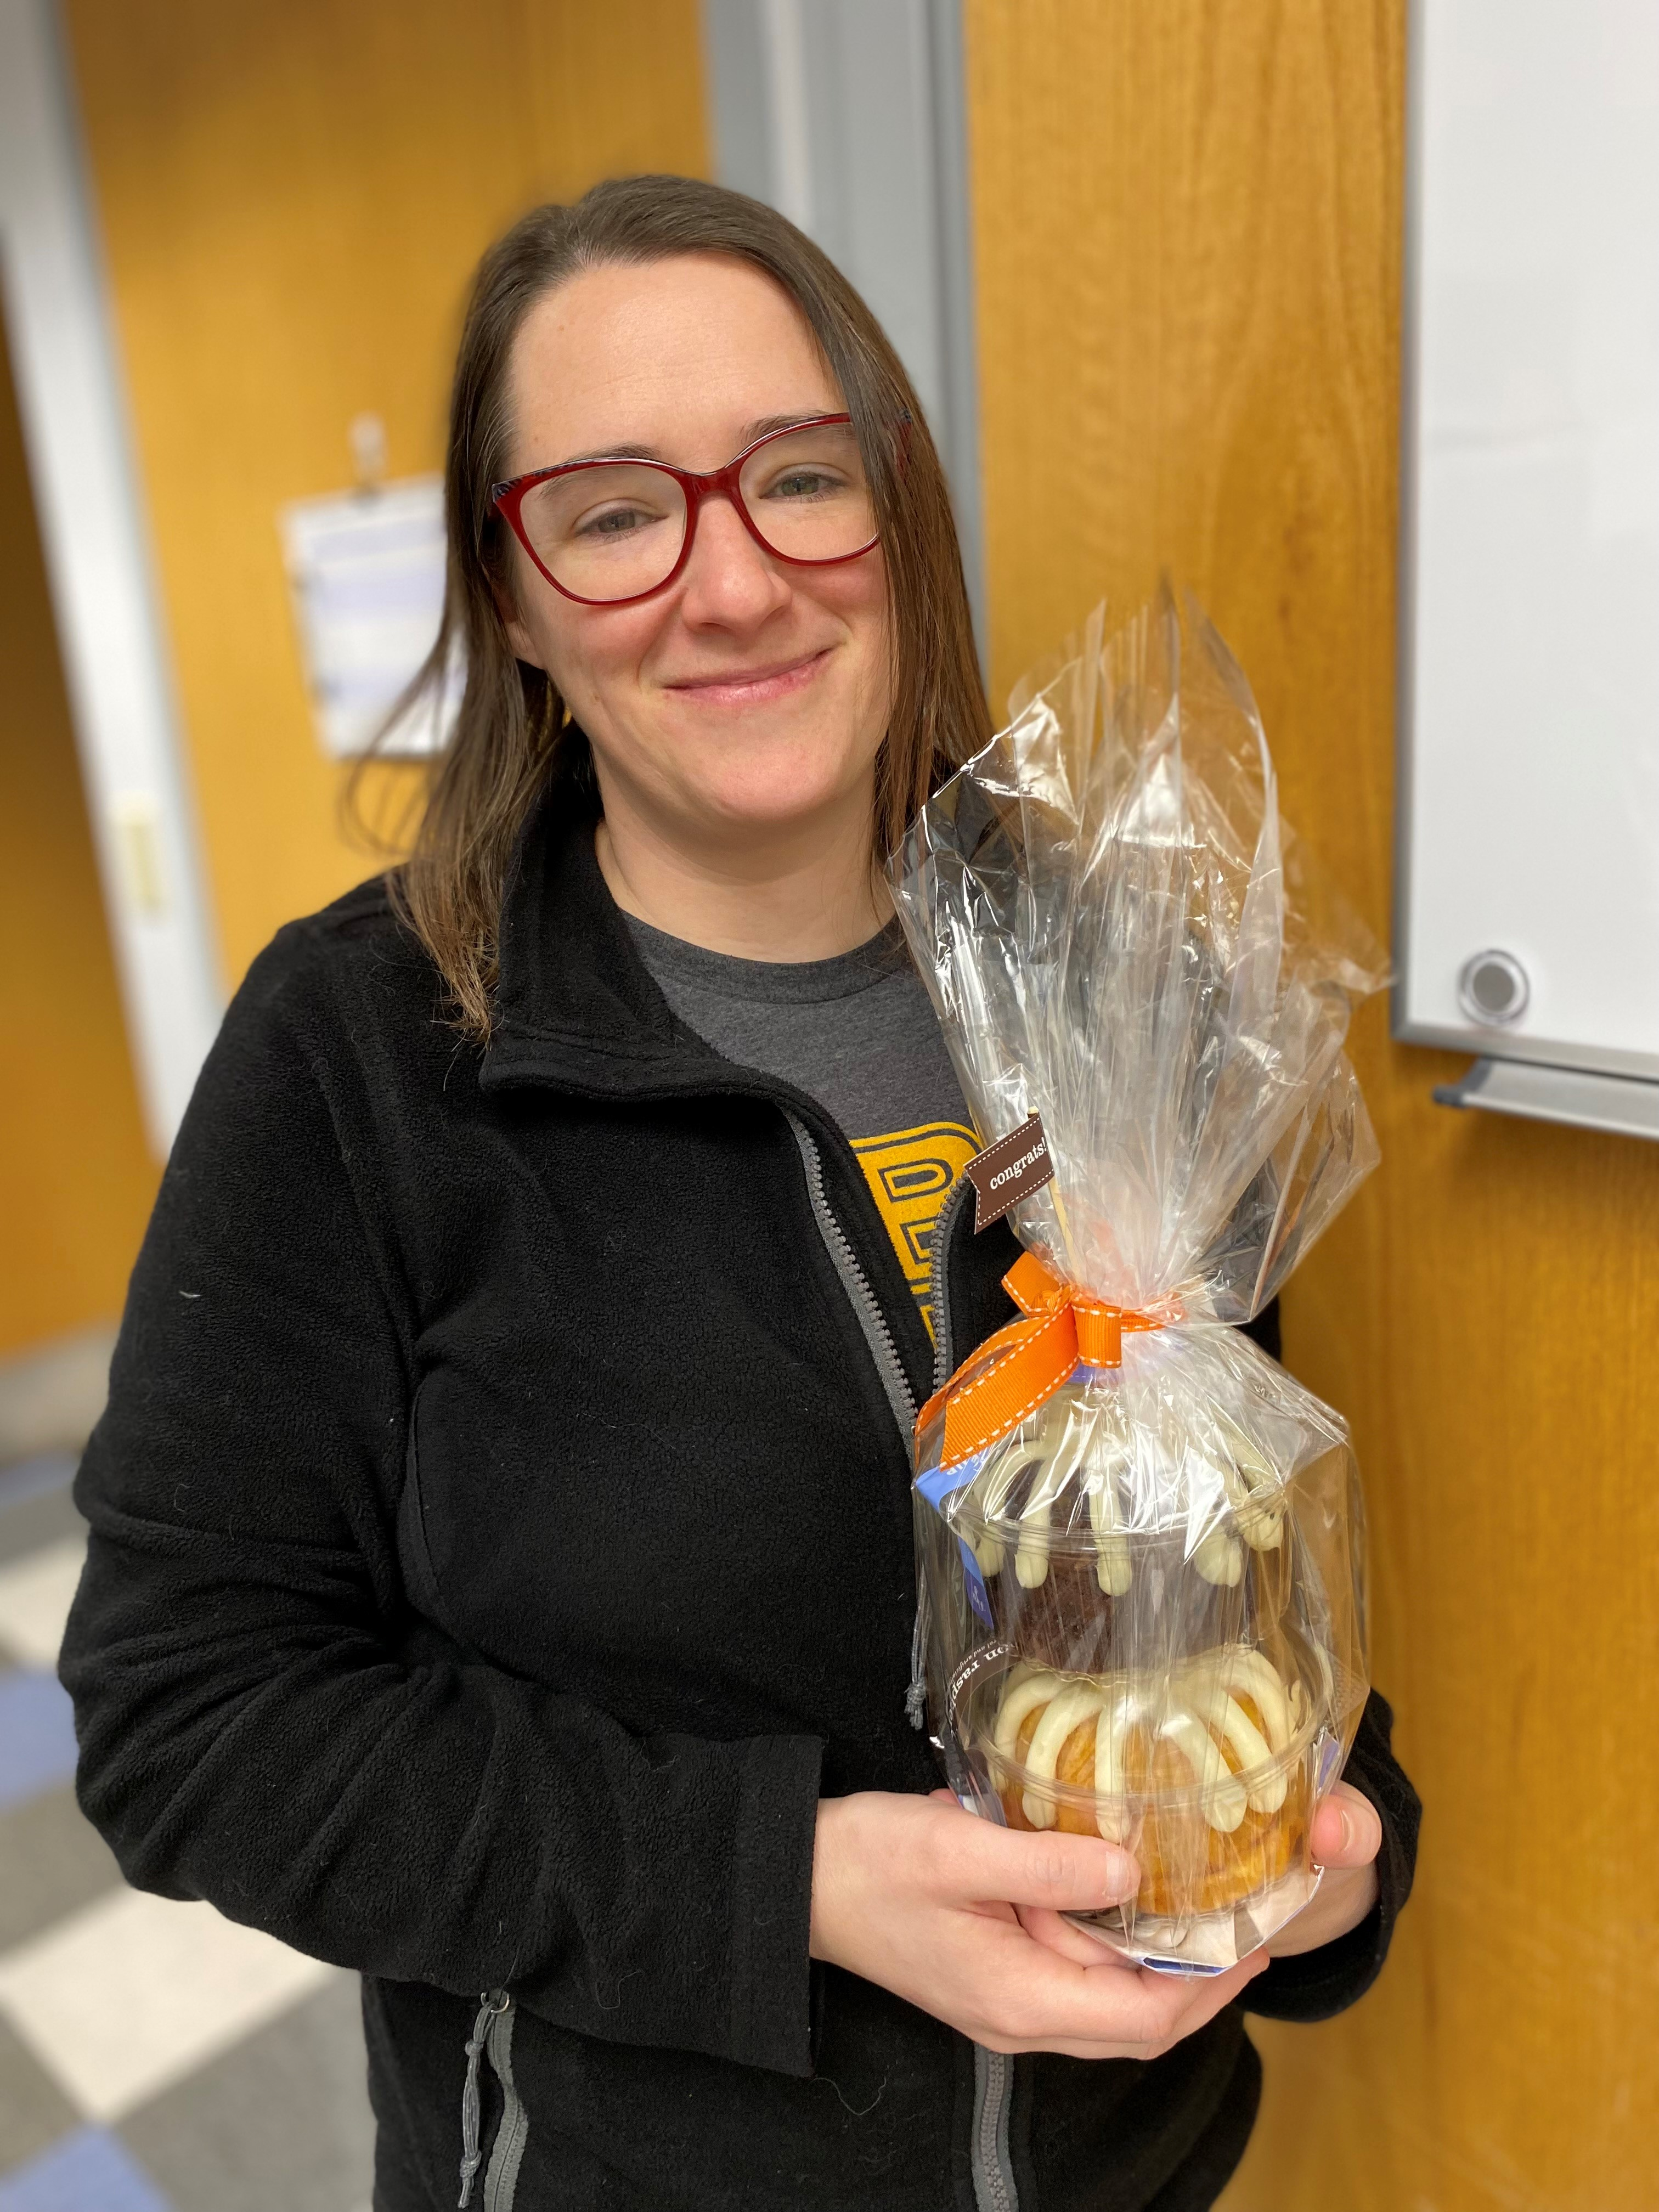
Good Catch Recipient for February
Christina Warren
Blood Bank

Slide 5
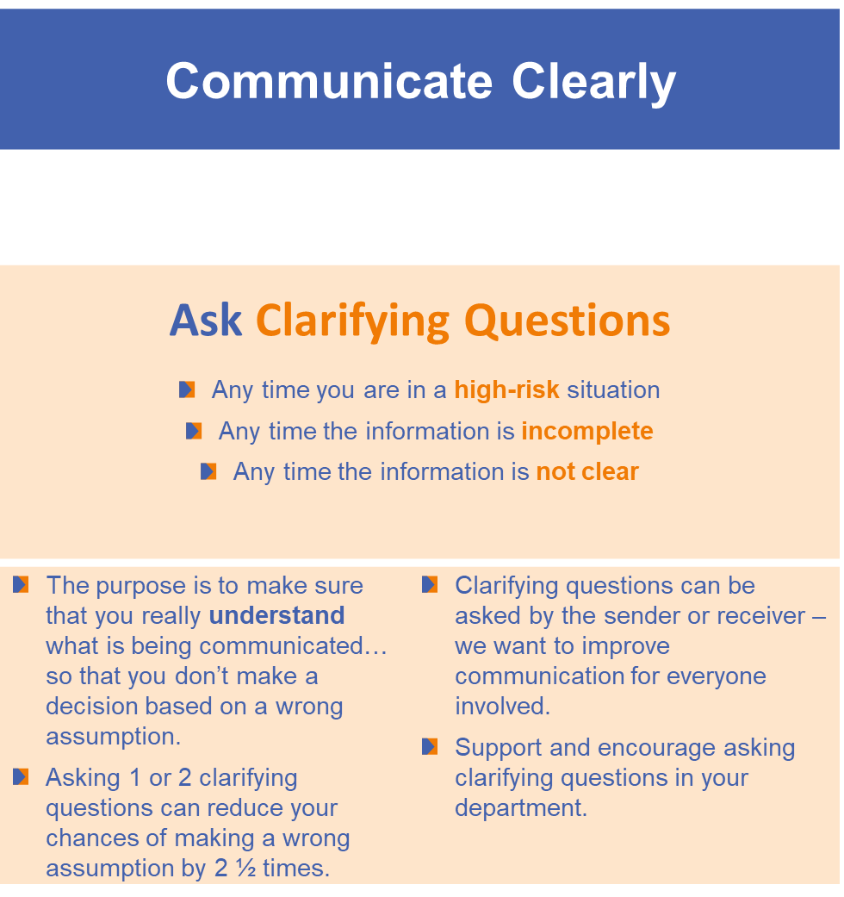
Safety Focus of the Month

Slide 6
Lab Employee Hazard Awareness
February’s Topic – Sharps Safety
Needles and Scalpels

Slide 7
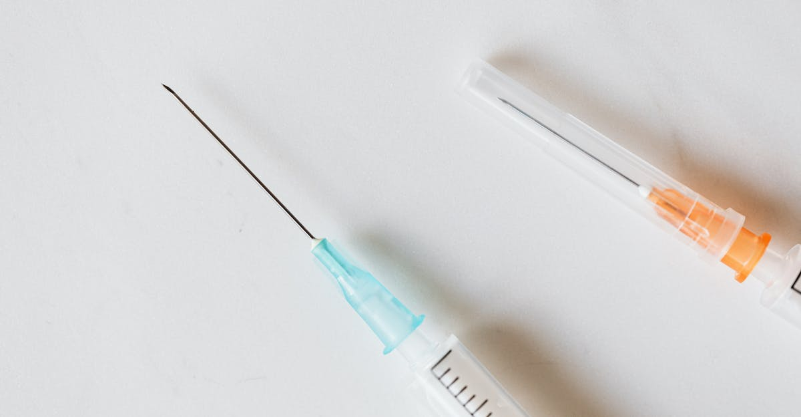
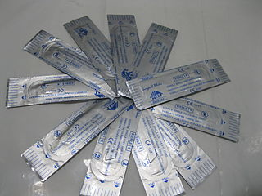
Needles
Scalpels
Do not recap
Do not bend
Do not remove needles from syringes with your hands
Dispose of immediately after use
When possible:
Use disposable blades
Use a fixed blade with a handle
Do not use excessive force or sawing motions

Slide 8
Safety Check
Are the sharps disposal containers in your lab too full?
  If container is too full, employees could be punctured or cut by protruding sharps
Are the sharps disposal containers in your lab close to areas where sharps are used

Slide 9

What to do if exposure occurs
Let it bleed
Wash it
Cover it
Report it by calling or visiting Employee Health
  336-716-4801

Slide 10

Please contact the Quality, Safety and Accreditation Team if you have any quality or safety concerns.
QS_A@wakehealth.edu

