Slide 1
Lab Safety Presentation
March 2023
3.2023 | Department of Lab & Pathology

Slide 2
Days Since Last Serious Safety Event
WFB: 35
BCH: 68
DMC: 23
HPMC: 11
LMC: 50
WMC: 274
As of 3/16/2023

Slide 3
Good Catches in February
CP | JoAnn Shields | A Bone Marrow sample was sent to the lab with a requisition for an Unlisted Lab that did not contain information regarding the sample type for the order. JoAnn recognized that a blood sample had been collected for the same order by OP Phlebotomy earlier in the day. JoAnn spoke to the Phlebotomist to confirm the blood draw then paged the physician to confirm the sample type desired for the test. The blood sample was already in Send out testing in the queue to be processed. By quickly recognizing the error, JPS was able to provide the correct sample to Send out testing and prevent the incorrect sample type from being shipped to the Reference Lab in error.
CCL | Travis Cline | Nurse called the lab asking for results on a patient. We had not received a specimen for that patient but had received a specimen for another patient and relayed this information. Travis assisted when he came in on 1st shift. He reviewed all the samples from 7NT and called the RN to question the identity of the samples. The nurse had mislabeled the samples.
AP Support | Lucy Hartman | Lucy received a paraffin block of tissue from an outreach client for HPV testing. She noticed the patient’s name was misspelled and notified our outreach business liaison to get it corrected. Lucy’s attention to detail kept this specimen from going to Mayo Clinic with an incorrect name. Good job Lucy!
Great Work!
Thank you ALL!

Slide 4
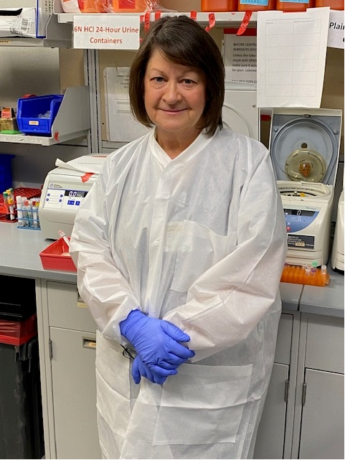
Good Catch Recipient for March
JoAnn Shields

Slide 5
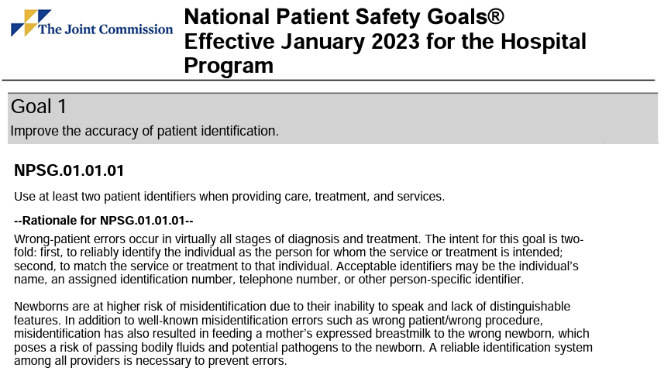
Safety Focus of the Month
Using Two Patient Identifiers

Slide 6

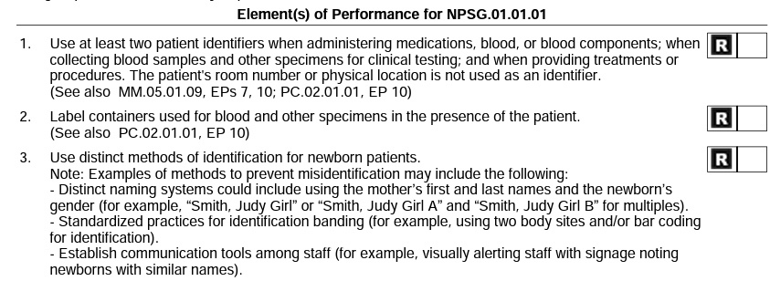

Slide 7
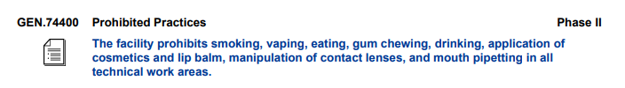
Lab Employee Hazard Awareness
CAP
Laboratory General Checklist

Slide 8

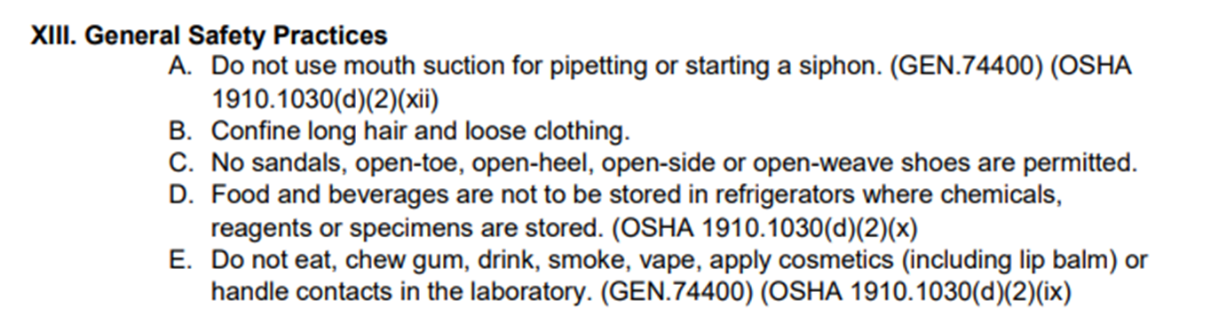
Laboratory Safety Manual
SAFE-POL-0003

Slide 9
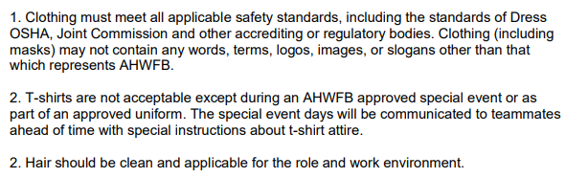
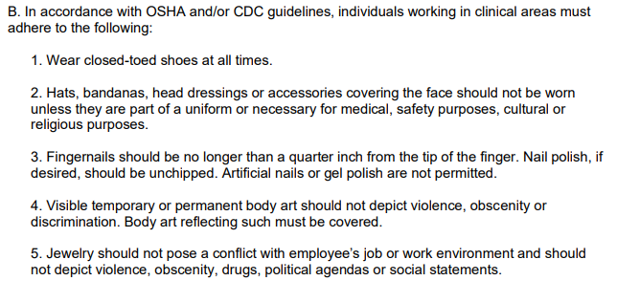
Dress Code Policy
All WFBH Facilities

Slide 10

Please contact the Quality, Safety and Accreditation Team if you have any quality or safety concerns.
QS_A@wakehealth.edu

