Slide 1
Lab Safety Presentation
April 2023
4.2023 | Department of Lab & Pathology

Slide 2
Days Since Last Serious Safety Event
WFB: 24 days
BCH: 89 days
As of 4/6/2023

Slide 3
Good Catches in March
CCL | Latasha Eshiet | Blood gas sent to Critical Care lab. Resulted into Beaker. Nurse called looking for results on patient A. Wrong label applied to syringe and requisition. Results deleted from the wrong patient's chart. The right patient was redrawn.
CCL | Brittany Ziglar | A mislabeled specimen was sent to the ICU Blood Gas lab on March 5th of 2023. The error was found when a lab tech questioned a critical potassium as an incorrect result.
OR Path Lab | Brandy Baker | Brandy saw a conical vial with a micro culture label on it with a tissue exam order after hours on Friday 03/24/2023. She contacted micro and they said they have a culture specimen already. She was not comfortable with going forward and held for her manager to look into. The OR Path Lab manager went to micro to look at their vial. She noticed the provider/nurse labeled the vials wrong. Tissue exam barcode beaker label was on the culture vial and the culture barcode beaker label was on the tissue vial.
Central Processing | Sublena Simpson | Patient had labwork collected on 3/28, blood was left in lab overnight and not sent to main lab until 3/29. Patient was contacted for recollection, however her samples from 3/28 were sent to the lab on 3/29 and ran for testing. When the patient showed up to the lab for recollection the orders were not there causing confusion as she was told orders would be in the system. The patient also was upset since she was getting results on her chart. That's when the main lab was called and found out the previous days blood had been resulted. More patients were involved as well.
Great Work!
Thank you ALL!

Slide 4

Good Catch Recipient for March
Brandy Baker
OR Path Lab

Slide 5
RLs with Deviation Believed to
Have Occurred in the Lab
March 87

Slide 6
Most Common Deviation
March 19

Slide 7

Patient Safety Tool of the Month

Slide 8
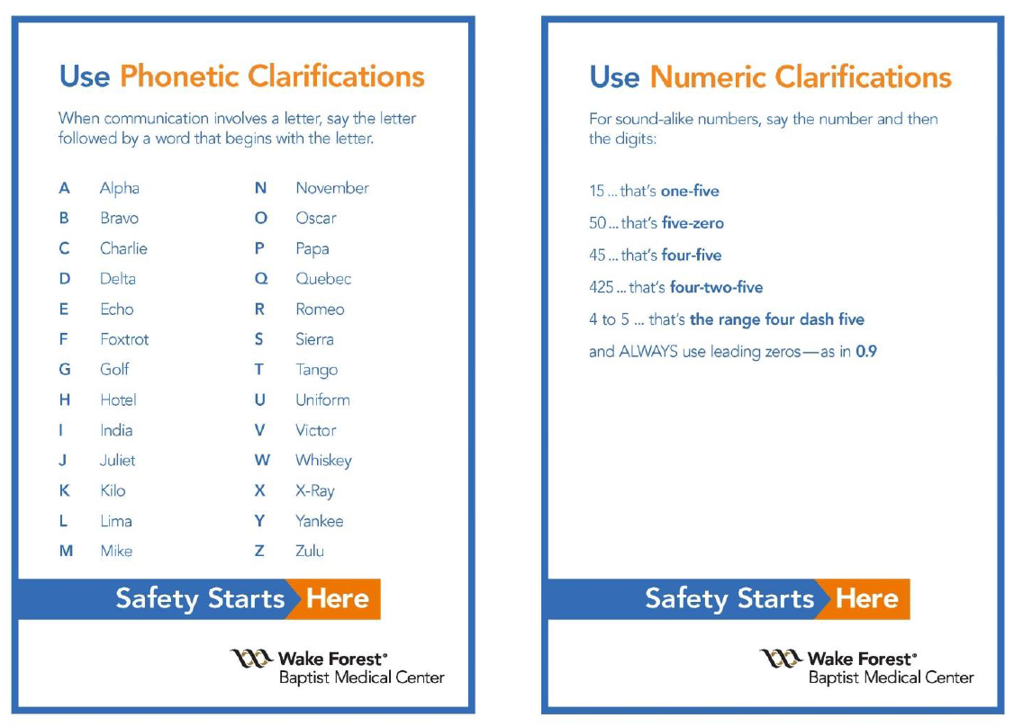
Safety Focus of the Month
April: Communicate Clearly Using Phonetic and Numeric Clarifications
Notes:
April

Slide 9
Lab Employee Hazard Awareness

Slide 10

Handling Contaminated Requisitions
Step 1:
It is the responsibility of the person first encountering the contaminated requisition to prevent any other person from being exposed.

Slide 11
Handling Contaminated Requisitions
Step 2:
Handle contaminated requisitions in one of the following ways:
Copy
Place the contaminated requisition in a plastic sheet cover.
Make a copy of the contaminated requisition.
Discard the contaminated requisition.
Use the requisition copy.

Slide 12
Handling Contaminated Requisitions
Decontaminate
Place the contaminated requisition on a dry paper towel.
Soak the spot on the requisition with a decontaminating solution such as 1:10 Clorox.
Allow the requisition to dry.
Beside the contaminated spot, write “decontaminated” – date and initial.

Slide 13
Handling Contaminated Requisitions
Replace
If the requisition is saturated with blood and/or body fluids or so contaminated that it cannot be easily handled, a new requisition should be requested.

Slide 14

Please contact the Quality, Safety and Accreditation Team if you have any quality or safety concerns.
QS_A@wakehealth.edu

