Slide 1
Lab Safety Presentation
May 2023
5.2023 | Department of Lab & Pathology

Slide 2

Good Catches in April
Central Processing | Kirsten Johnson | An unpreserved tissue specimen was received in Central Processing Lab after hours. The requisition and Beaker order were for a tissue exam, but there was a written request for a fungal culture on the req. Kirsten Johnson noticed this written request and relayed the information to the pathology resident. Orders were clarified with the requesting provider, and an order for a fungal culture was placed processed due to Kirsten's attention to detail.
Central Processing | Leatha Houston | Specimens for employee exposure testing were sent to the lab with orders placed in the source patient's chart. Orders for exposure testing must be placed in CareEvolve and not filed to the patient's chart or get charged to the patient. Leatha Houston in Central Processing caught this ordering error and placed the exposure orders correctly. She canceled the original orders. This prevented the patient from getting unnecessary orders and charges.
This Photo by Unknown Author is licensed under CC BY-NC-ND

Slide 3
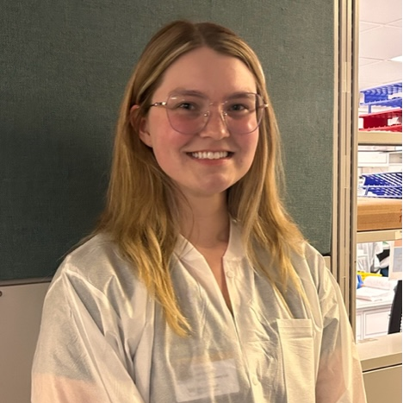
Good Catch Recipient for April
Kirsten Johnson
Central Processing Lab

Slide 4
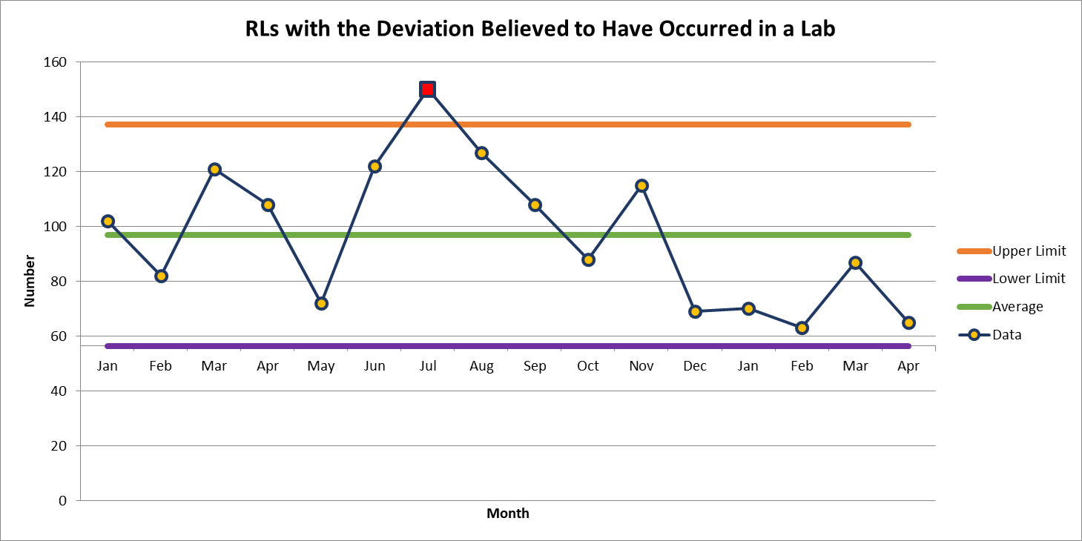
RLs with Deviation Believed to
Have Occurred in the Lab
April 65

Slide 5
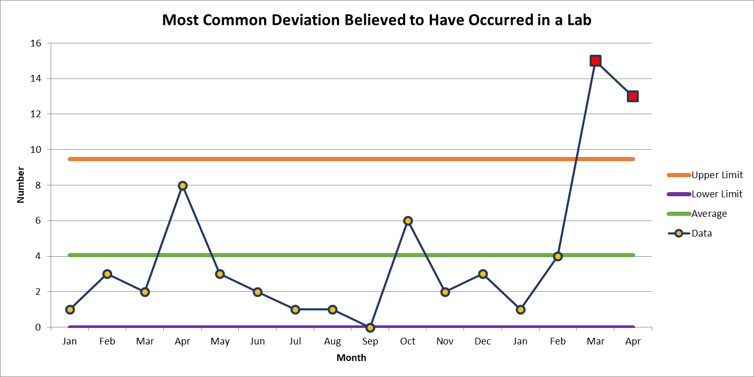
Most Common: Deviation in SOP
April 13

Slide 6
Second Most Common Deviation

Slide 7
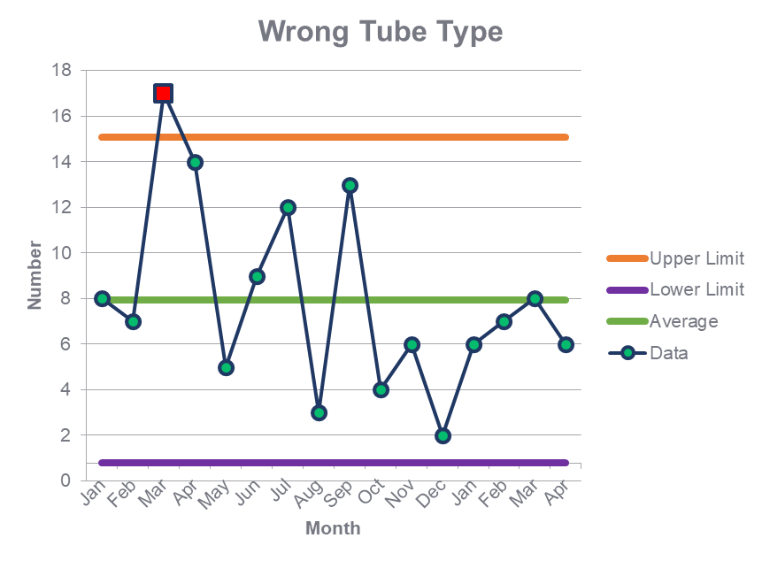
Second Most Common Deviation
March 8

Slide 8

Patient Safety Tool of the Month

Slide 9
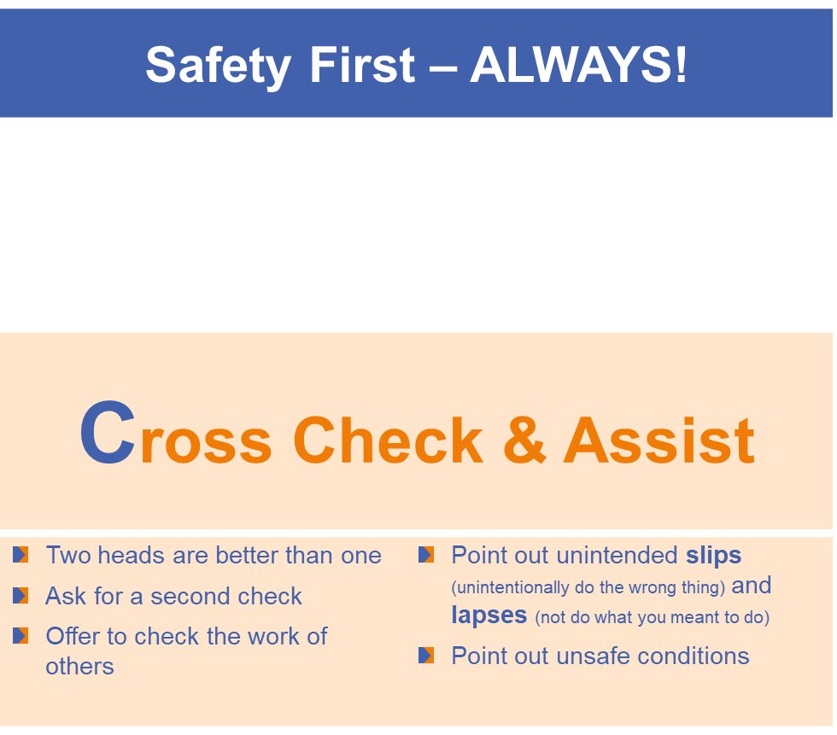
Patient Safety Tool of the Month

Slide 10
Lab Employee Hazard Awareness

Slide 11
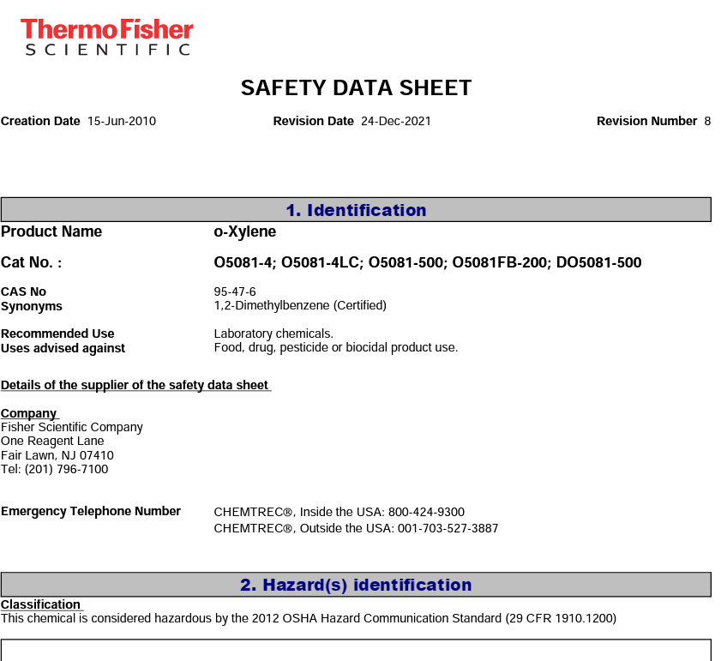
1. Safety Data Sheets
How do you find them in your lab?
Either is acceptable:
EH&S SharePoint site
Google
If you google a SDS make sure it is a current version. SDS are required to be updated every 3 years
.

Slide 12
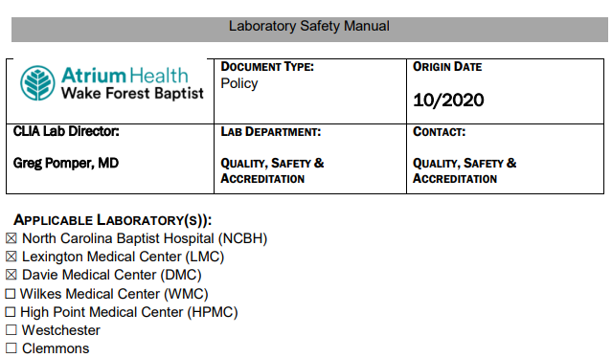
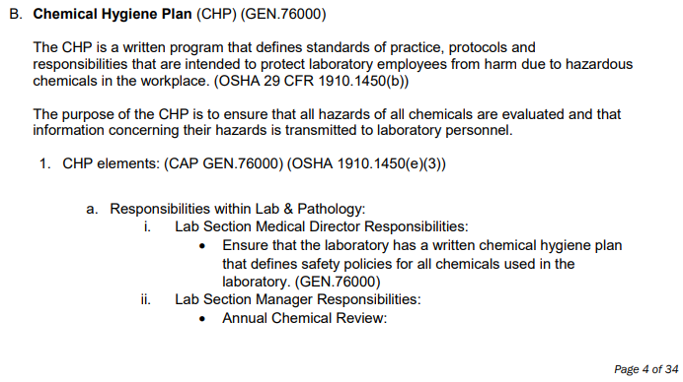
2. Chemical Hygiene Plan
Where is it located?
SAFE-POL-0003
Laboratory Safety Manual

Slide 13
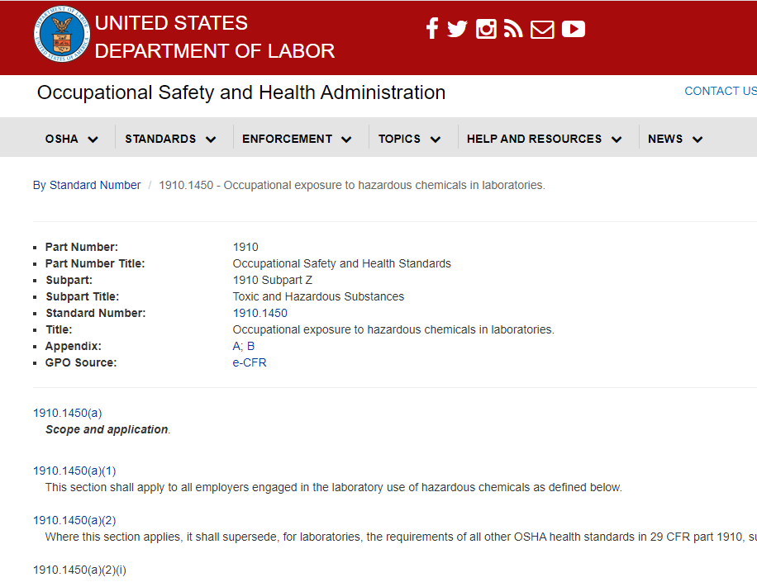
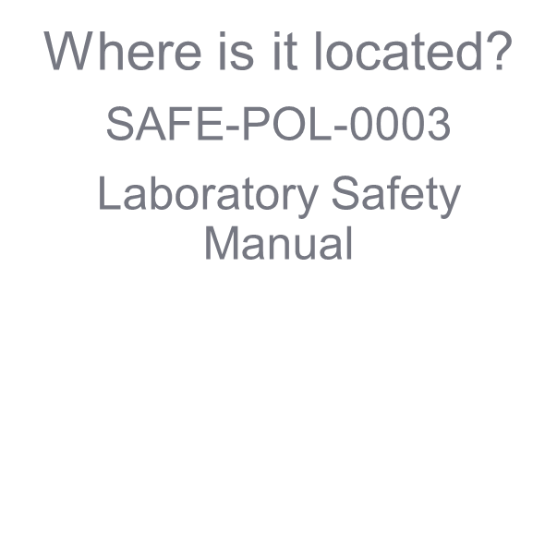
3. Code of Federal Regulations

Slide 14

Please contact the Quality, Safety and Accreditation Team if you have any quality or safety concerns.
QS_A@wakehealth.edu

