Slide 1
Lab Safety Team
6.2023 | Department of Lab & Pathology

Slide 2
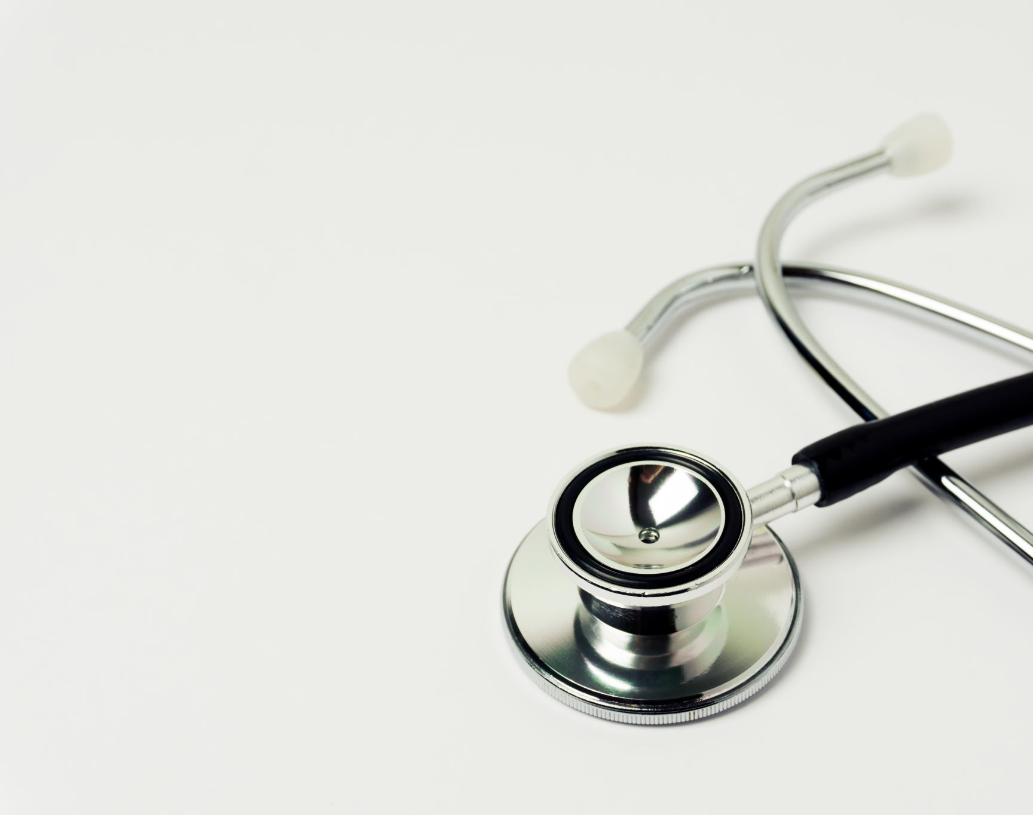
Patient Safety

Slide 3



Slide 4
Days Since Last Serious Safety Event
WFB: 15
BCH: 49
DMC: 107
HPMC: 37
LMC: 20
WMC: 67
As of 6/8/2023

Slide 5
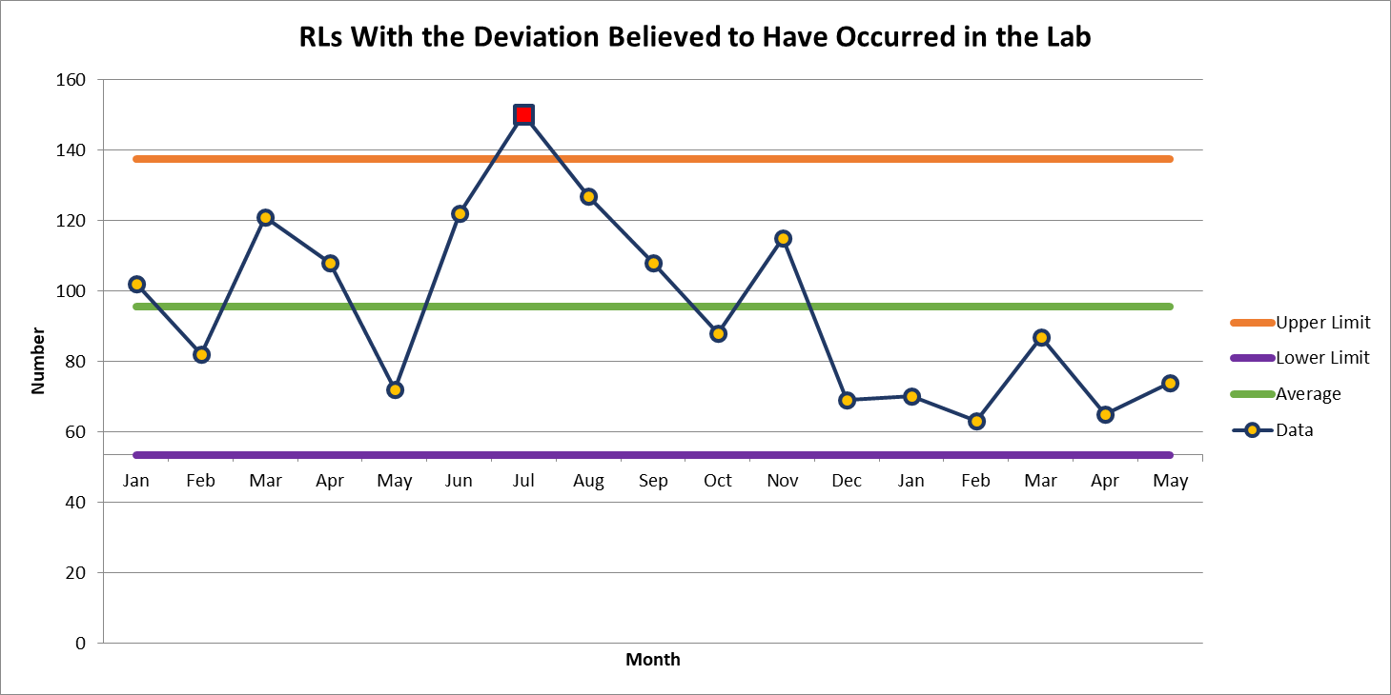
RLs with Deviation Believed Have Occurred in the Lab
May 74

Slide 6
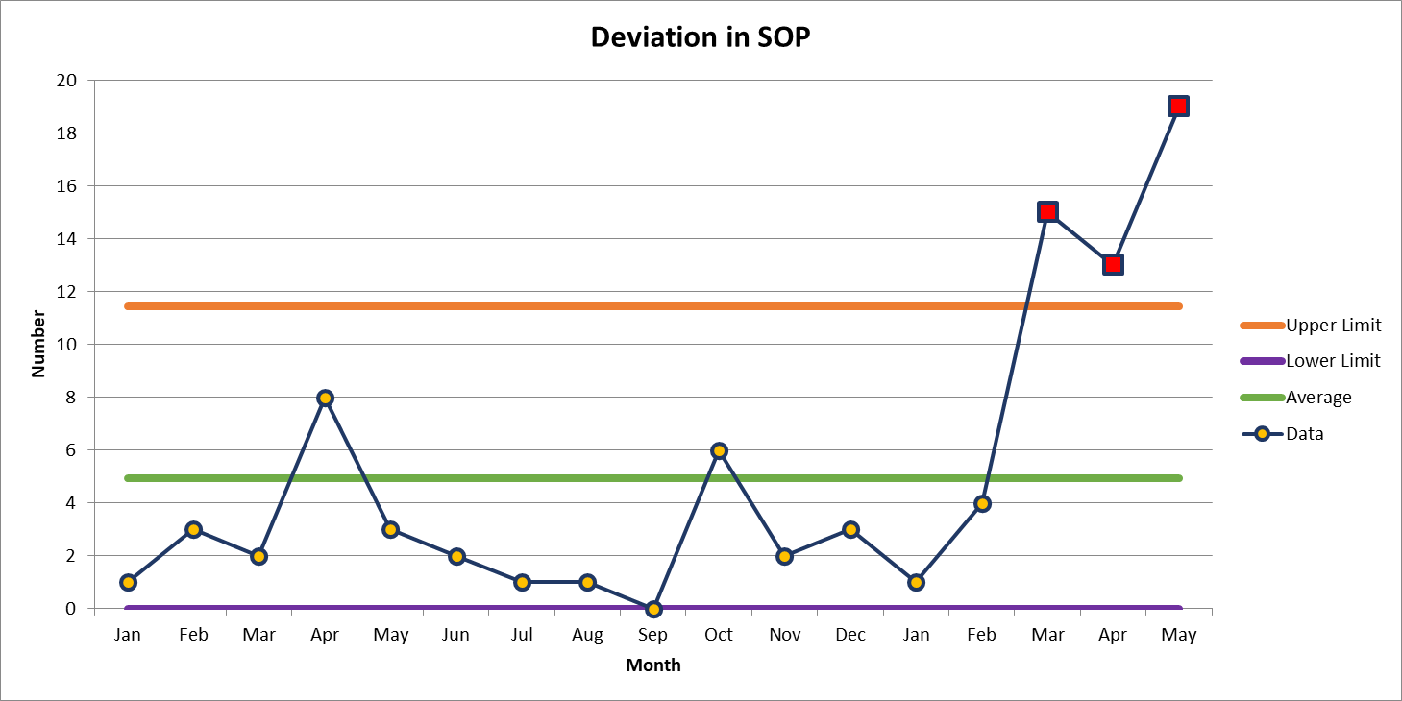
Most Common Deviation
May 19

Slide 7
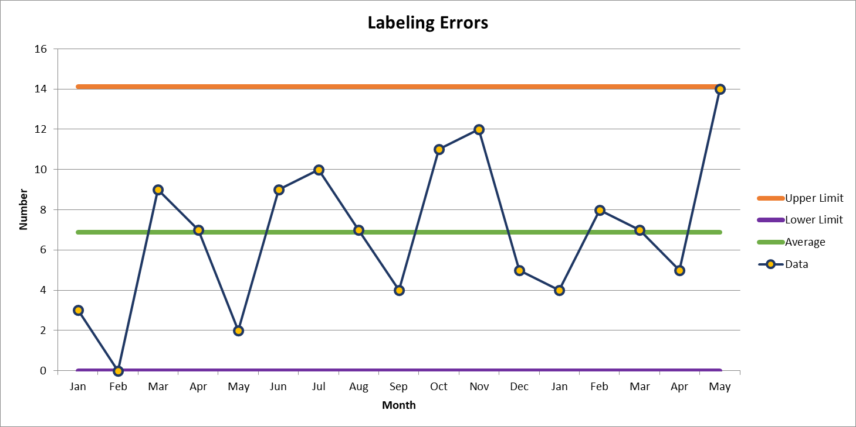
Second Most Common Deviation
May 14

Slide 8
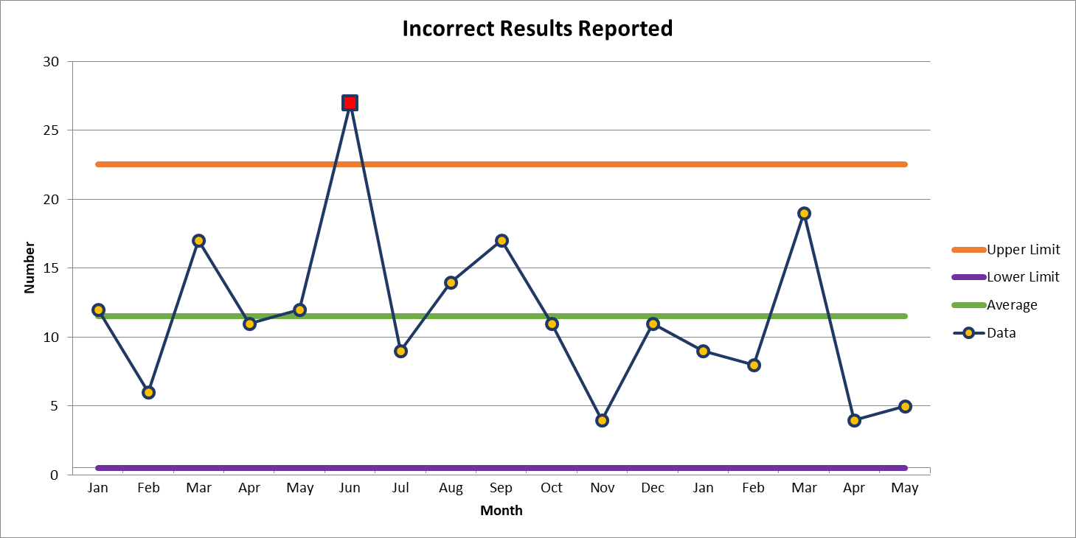
Third Most Common Deviation
May 5

Slide 9

Good Catches in May
Clemmons | Dana Strathman | Synovial fluid was received in a syringe with a requisition for a crystal exam. Staff asked if this was the only test, and nursing replied yes. Lab tech, Dana, decided to check in Epic and found out there was also a gram stain ordered. The specimen was split into the appropriate containers for each test. Had the staff not checked all the specimens would have been submitted in a green tube for crystal exam. The green top tube type would have been an unacceptable container for gram stain analysis.
Central Processing | Torie McHone | Torie McHone recognized that a new BB test that went live last week was listed incorrectly in the Test Catalog. The test catalog told providers to collect in a pink top tube when the sample should be collected in a green top tube. We have been able to alert providers to avoid an unacceptable collection and notified the EPIC team to correct the error.
Cytology | Tracy Justice Clark | Monti Keller in radiology noted that the patient was rescheduled for a repeat fine needle aspiration in ultrasound due an insufficient pathology diagnosis from the prior procedure. Monti pulled up the previous pathology report and it looked diagnostic to her. She contacted Tracy Justice Clark, a cytotechnologist about this and Tracy confirmed that there appeared to be a definitive diagnosis. The interpreting pathologist on the case Dr. Michael Beaty confirmed that no more information could be gleaned from another similar procedure . Tracy informed the Provider of this finding saving the patient from an unnecessary procedure. It appears that the original pathology report was not read in entirety. This is an example of great teamwork among consultative services and patient Provider. Monti and Tracy did an outstanding job!!Tracy made sure this was followed through and helped save the patient an unnecessary procedure.
This Photo by Unknown Author is licensed under CC BY-NC-ND

Slide 10
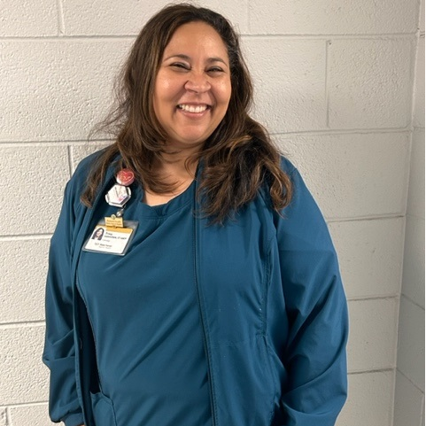
Good Catch Recipient for May
Tracy Justice-Clark
Cytology

Slide 11

Patient Safety Tool of the Month
Practice With & Accept Questioning Attitudes
STOP when you are uncertain
If you have a question about your planned action When you realize that the task does not follow the normal policy, procedure, protocol, plan, etc. | If something just doesn’t feel right If you hear someone say “I have a concern” STOP and address this genuine worry that we may cause harm

Slide 12
Lab Employee Hazard Awareness

Slide 13
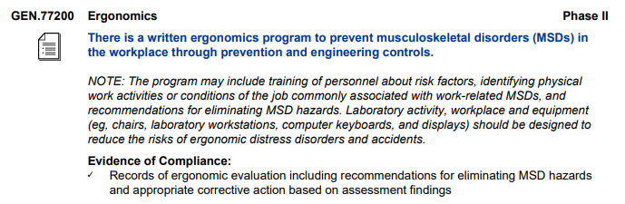
Ergonomics

Slide 14

Your turn
Issues
Concerns
Events

Slide 15
Roll Call

Slide 16
Next meeting: July 13th, 1-2pm
In person for on campus team members
Garvin conference room
Webex for off campus team members

Slide 17
Thank you for your participation!

Slide 18
May Lab Safety Team Meeting
If you are attending via Webex without a microphone, please also join by phone:
Call 1-415-655-0001
Meeting number (access code): 2429 588 8740

