Slide 1
Lab Safety Presentation
July 2023
7.2023 | Department of Lab & Pathology

Slide 2
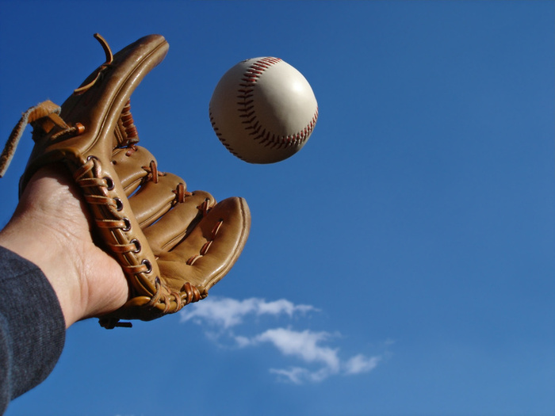
Good Catches in June
OR Path Lab | Brandy Baker | An accessioner received a vial that she was familiar with. She called micro because the tissue was fresh. Micro advised her it is probably an aneorobic tube and to keep fresh. The accessioner contacted her manager and her manager gave instructions to hold until next morning since it was the only tissue sample taken by surgeon for culture and tissue exam. Sample sent to micro and then back to OR Path Lab for submission. No patient harm.
IP Phleb | Michael Kornegay | The phlebotmist asked a patient his name and DOB, the patient recited the DOB backwards. He said 2/8/1989 and when Michael questioned that and asked him to repeat it the patient “August 2nd 1989”. In the Hispanic culture they say the day first and then the month. The patient has been here for several days (all labs drawn by nursing not us), and the nurses said it matches his chart and his arm band so it must be ok. Medical Records was notified and they have corrected everything, no harm to the patient, and I do not see any Blood Bank orders.
CP | Nieka Thomas | A lab order on a prescription pad was written for this patient with the last name misspelled. Name was subsequently misspelled on the specimen labels. DOB was entered as the father's DOB as his identification was provided for insurance purposes. Caught by Nieka Thomas the next day on manual orders audit. Results from the wrong account (the misspelled name and incorrect DOB) were removed and charges credited. This error originated at the doctor's office, and went through three sets of lab teammates before Nieka caught it at auditing. Great catch, Nieka.
CP | Melissa Beaman | On 6/19/23, patient presented for a blood draw. Specimens collected and labeled as patient's name spelled in Epic, one way. Patient's insurance card showed it spelled another way. This spelling error in Epic dated back to 2/15/23. Spelling error caught in Client Services on 6/19/23 by Melissa Beaman. Error forwarded to Medical Records for spelling correction.
This Photo by Unknown Author is licensed under CC BY-NC-ND

Slide 3
Good Catch Recipient for June
Michael Kornegay
IP Phlebotomy
Picture not available.

Slide 4
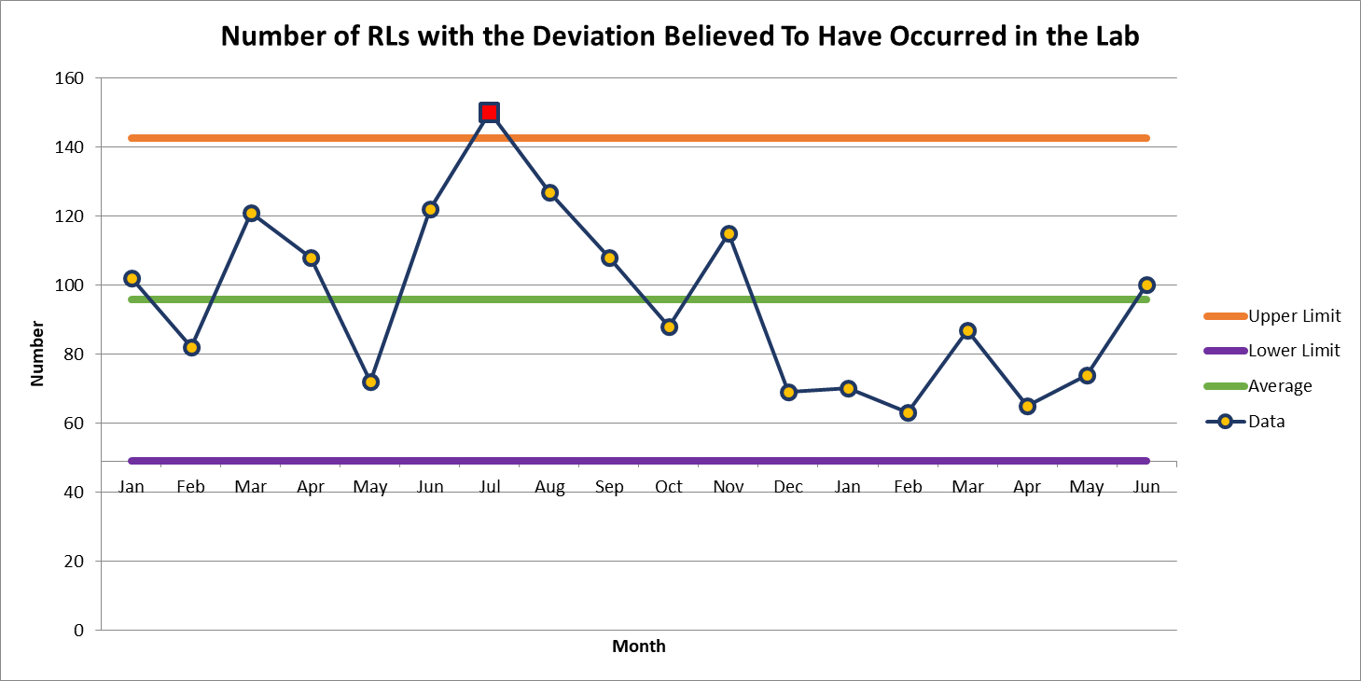
RLs with Deviation Believed Have Occurred in the Lab
June 100

Slide 5
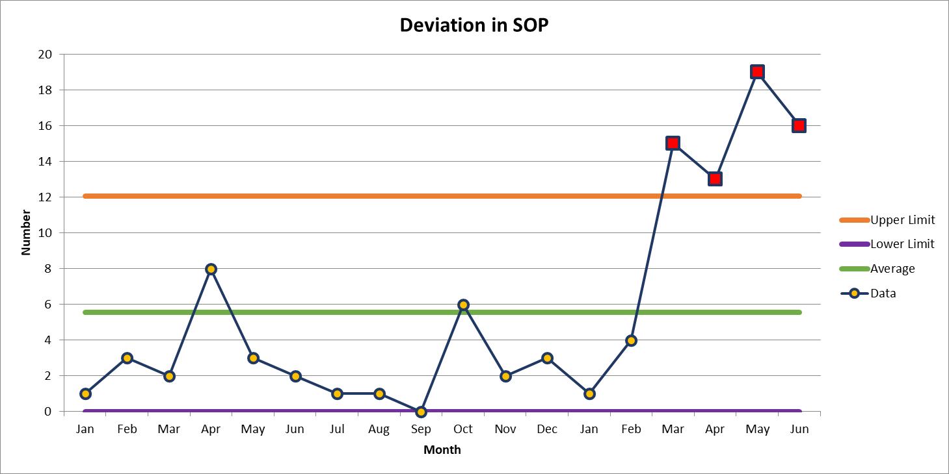
Most Common Deviation
June 16

Slide 6
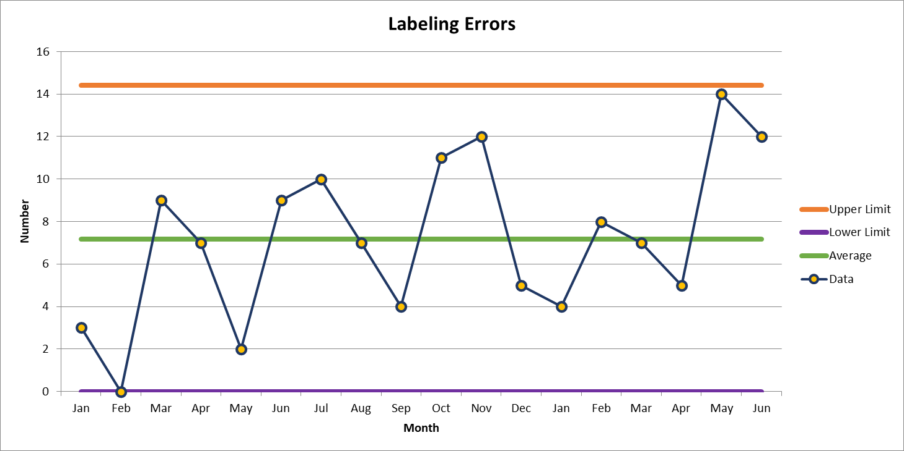
Second Most Common Deviation
June 12

Slide 7
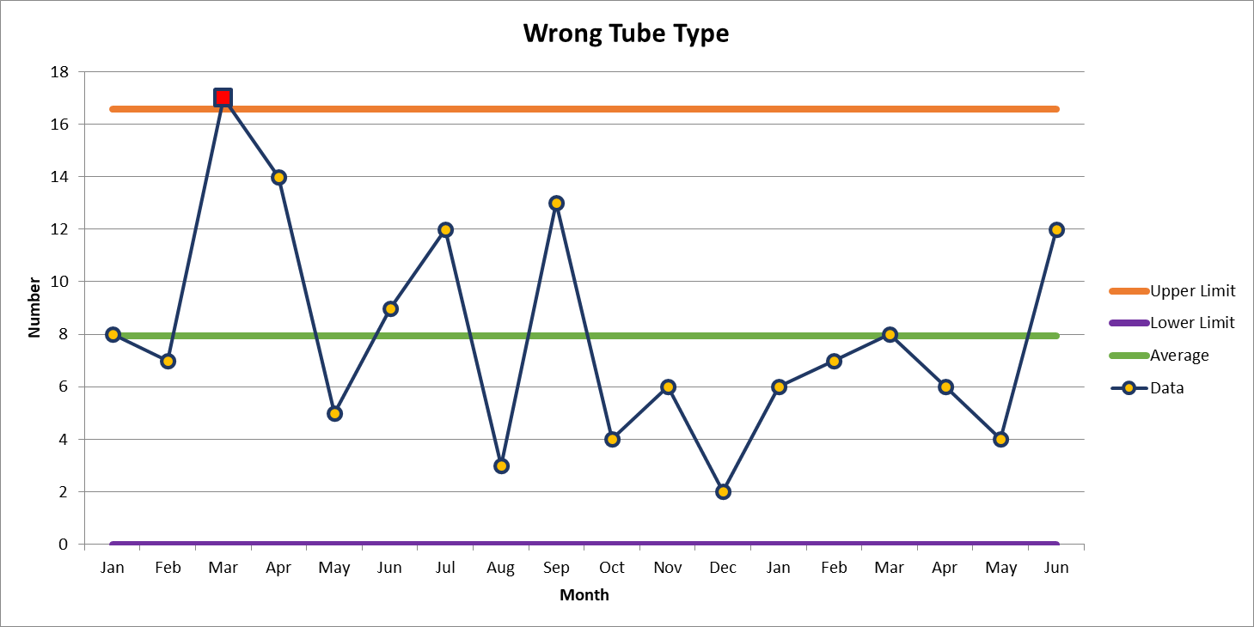
Third Most Common Deviation
June 12

Slide 8
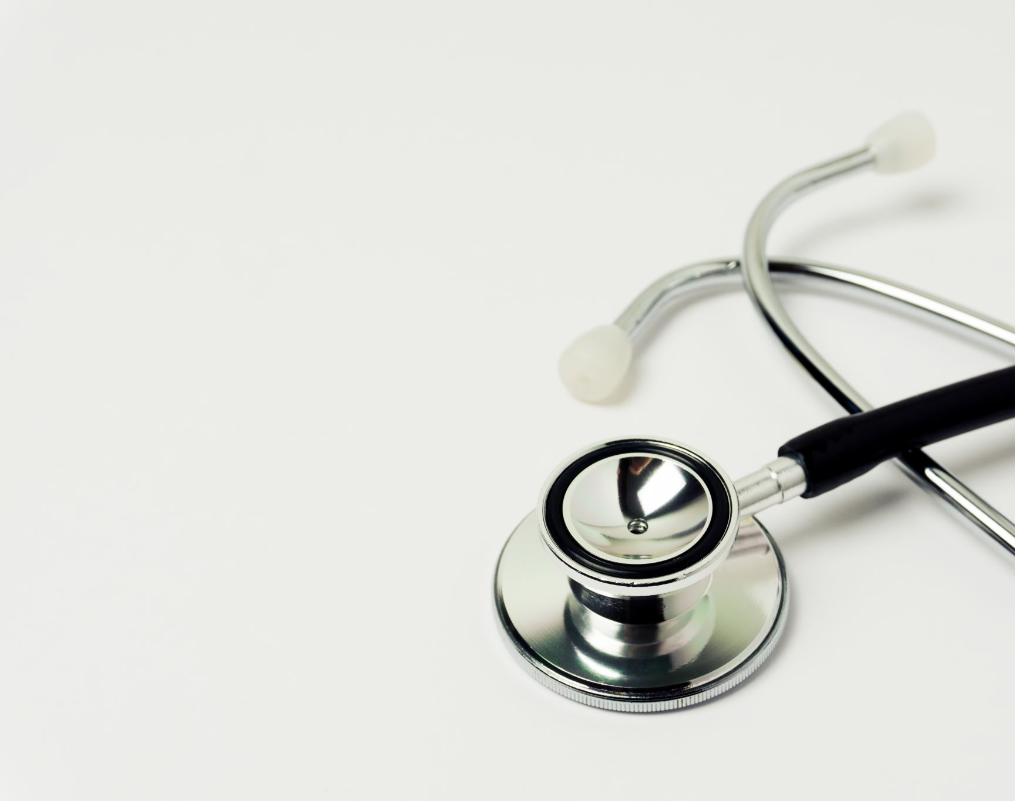
Patient Safety Tool of the Month

Slide 9
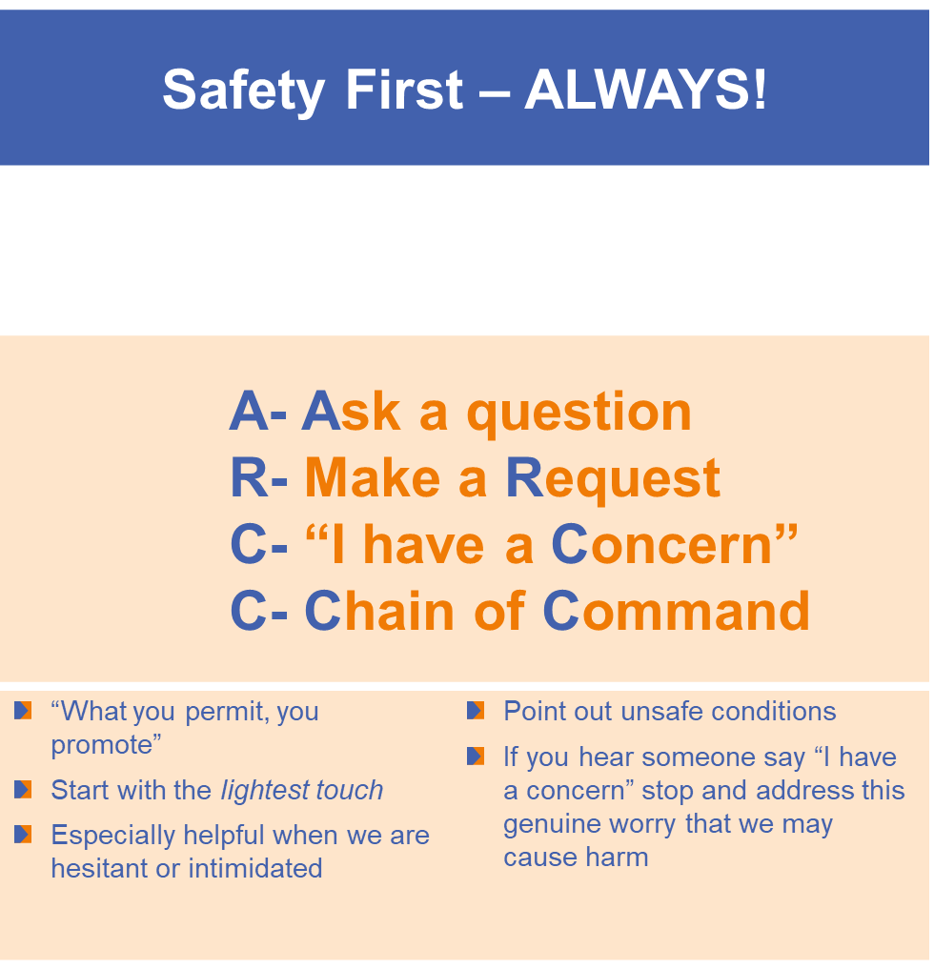
Patient Safety Tool of the Month

Slide 10
Lab Employee Hazard Awareness

Slide 11
Working Environment
GEN.60250
Working Environment Phase I
The following are adequate for the facility.
1. Lighting
2. Water taps, sinks, drains
3. Electrical outlets
4. Ventilation
5. Gas and suction, when applicable

Slide 12
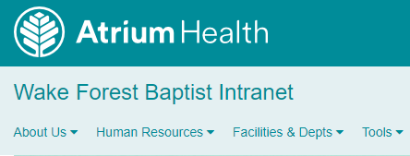
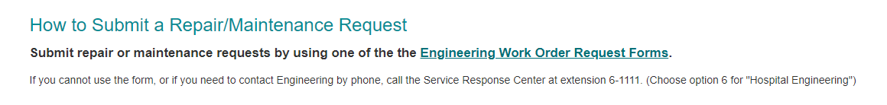
Issues with Working Environment
Notify Engineering
Intranet Page
Facilities & Depts
Engineering (Internal)
Submit Engineering Work Order

Slide 13

Please contact the Quality, Safety and Accreditation Team if you have any quality or safety concerns.
QS_A@wakehealth.edu

