Slide 1
Lab Safety Presentation
August 2023
8.2023 | Department of Lab & Pathology

Slide 2

New Regional Lab Safety Coordinator
Jasna Walton joined the Laboratory Medicine Quality, Safety and Accreditation team as the Regional Lab Safety Coordinator on July 17th, 2023.
She earned a Bachelor’s Degree in Biology with a Minor in Chemistry from the University of North Carolina at Greensboro followed by a HTL (ASCP)cm certification.
Prior to Jasna’s arrival she worked in Anatomic Pathology Management where her biggest passion was transforming laboratories and setting them up for successful patient testing as well as revamping policies and processes to obtain compliance with relevant accreditation bodies. She is excited to be a part of our team and hopes to bring positive attention to Laboratory Safety through dedication and hard work.
When she is not working, Jasna enjoys doing Yoga and spending time with her six-year-old daughter Natalija who has recently discovered a love for horseback riding and dancing!

Slide 3



Slide 4
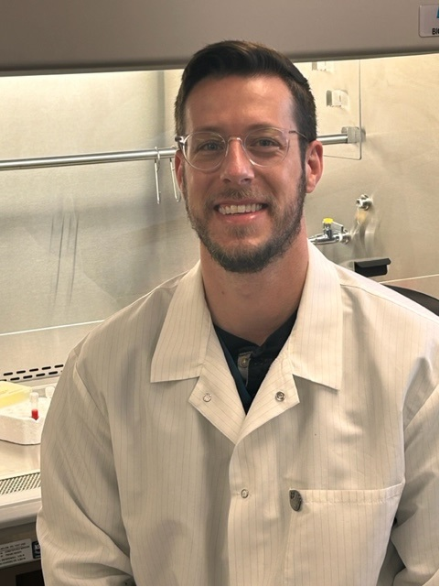
Good Catch Recipient for July
Charles Miller
SCTCT Lab

Slide 5
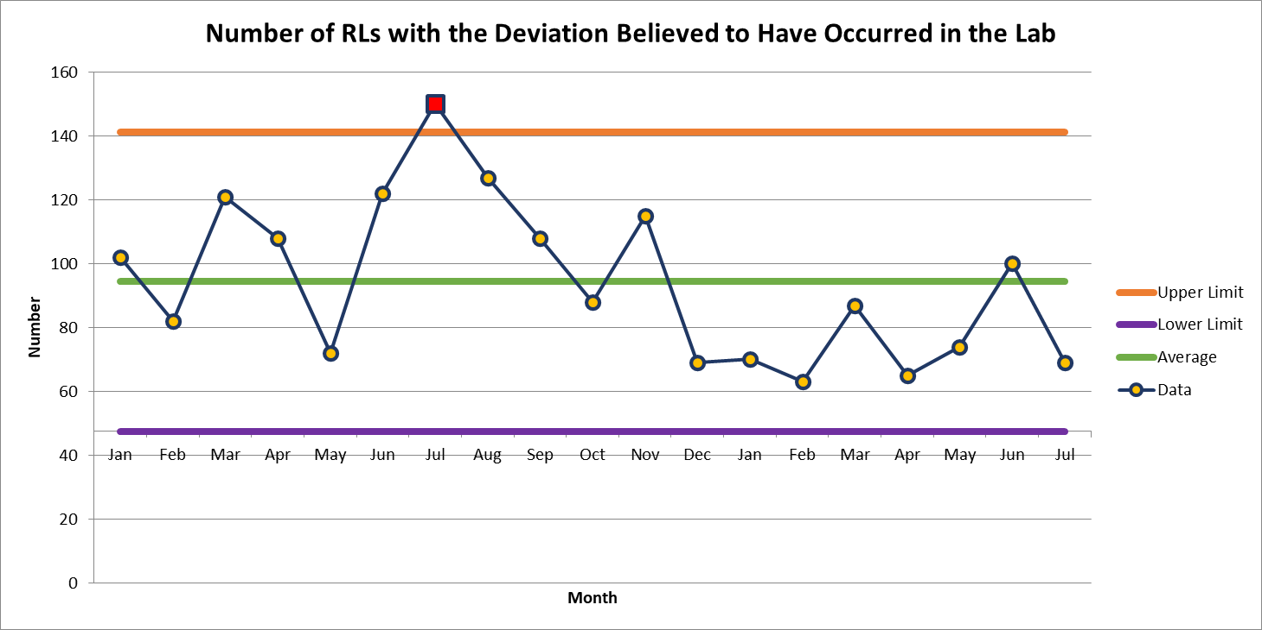
July 69

Slide 6
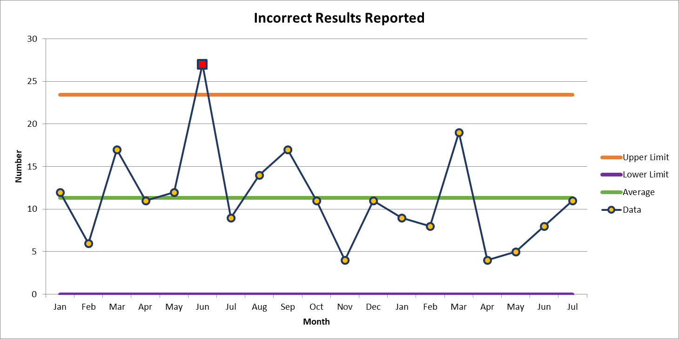
Most Common Deviation
July 11

Slide 7
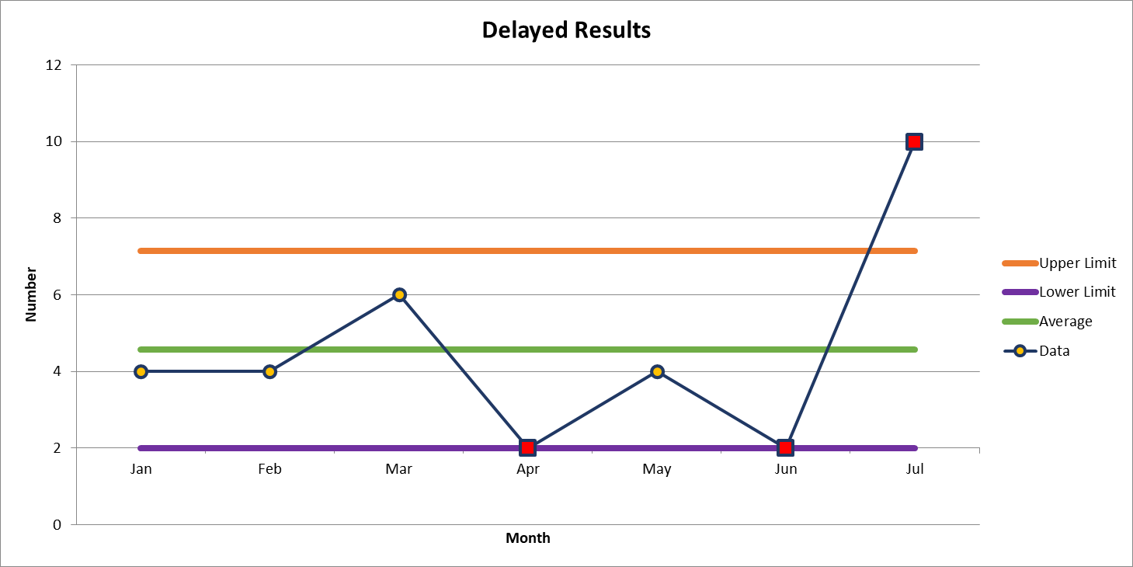
Second Most Common Deviation
July 10

Slide 8
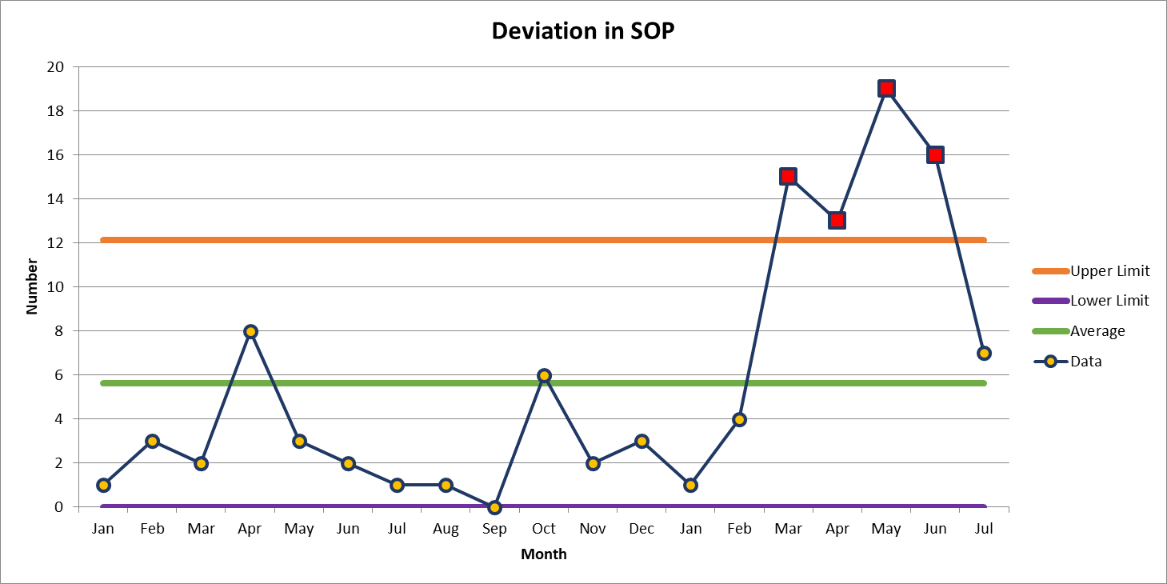
Third Most Common Deviation
July 7

Slide 9

Patient Safety Tool of the Month

Slide 10
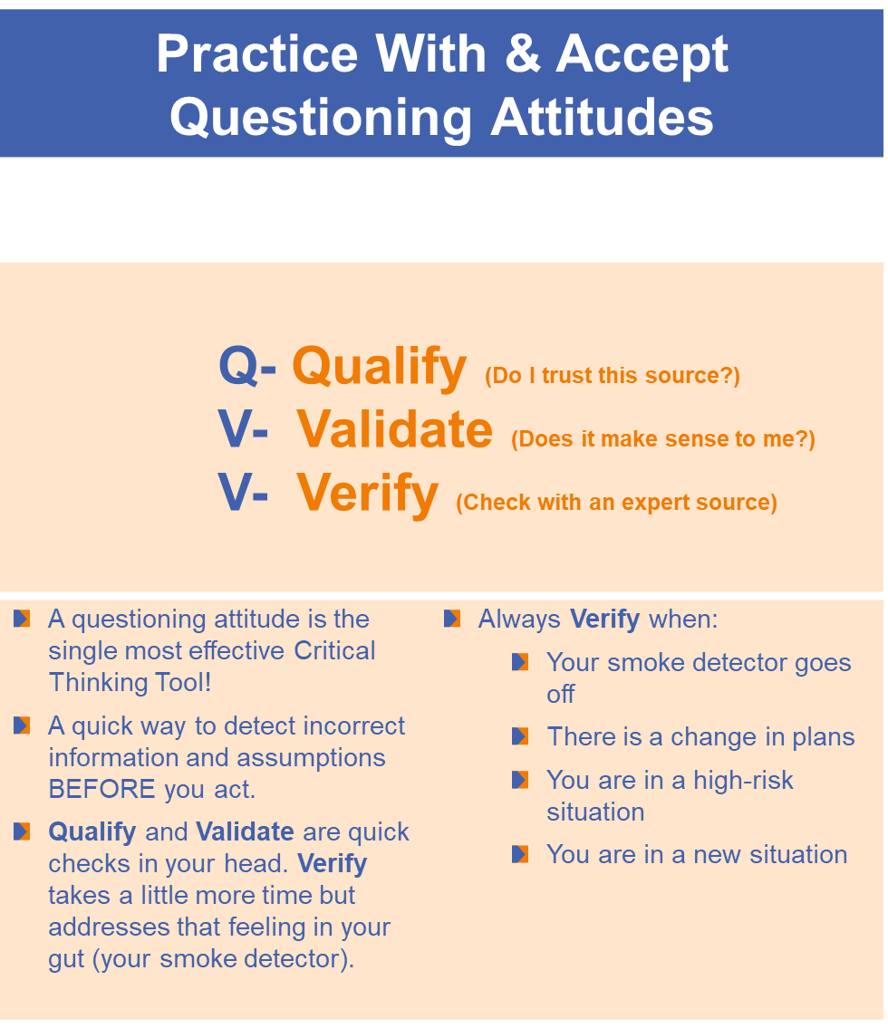

Patient Safety Tool of the Month
August 2023

Slide 11
Lab Employee Hazard Awareness

Slide 12

What is wrong with this picture?
No PPE to protect her eyes, mouth or nose (And much more!)
Holding tube up to eye level – should be on bench where appropriate engineering controls (splash guard or hood) are located.

Slide 13



PPE: Spotlight on Eye and Face Protection
Know when to use eye and face protection i.e., face shield, goggles, splash guard, ventilated fume hood
Personal eye and face protection should be used per the hazard risk assessment recommendations and in the absence of engineering controls. Proper eye protection should always be utilized with contact lenses per hazard risk assessment.
& Splash guard, no photo available

Slide 14
Please Note
Each task within the laboratory has been assessed for appropriate engineering controls and PPE to protect employees.
Each employee should have been educated on the appropriate engineering controls and PPE for the task they are doing.
Your manager is responsible for maintaining PPE supplies.
You are responsible for utilizing the appropriate engineering controls and complying with PPE standards to protect yourself.

Slide 15

Please contact the Quality, Safety and Accreditation Team if you have any quality or safety concerns.
QS_A@wakehealth.edu

