Slide 1
Lab Safety Team
9.2023 | Department of Lab & Pathology

Slide 2
Patient Promise

Slide 3
Good Catches
in
August
Employee Involved | Description of Event
Katie Koontz Kay Woollen | Two hematology techs took time to compile data to see how often a fibrinogen order was separate from a PT or PTT order. They showed me it was quite often, and frequently on tiny NICU and PICU patients. We were able to combine fibrinogen orders with other coagulation orders so that there would be less tubes drawn, especially on our tiny baby patients. We tested and it went live 8/7/2023.
Molly Honeycutt | Molly caught a missing intraoperative consultation dictation while grossing a specimen. Thanks to her attention to detail and watchfulness, she prevented a potential miss of the information by the pathologist and an amendment that would have had to have been done for billing and documentation. Great job, Molly!

Slide 4
Good Catch Recipients for August Katie Koontz Kay Woollen Hematology Lab No Photo Available at the Time of Recognition

Slide 5
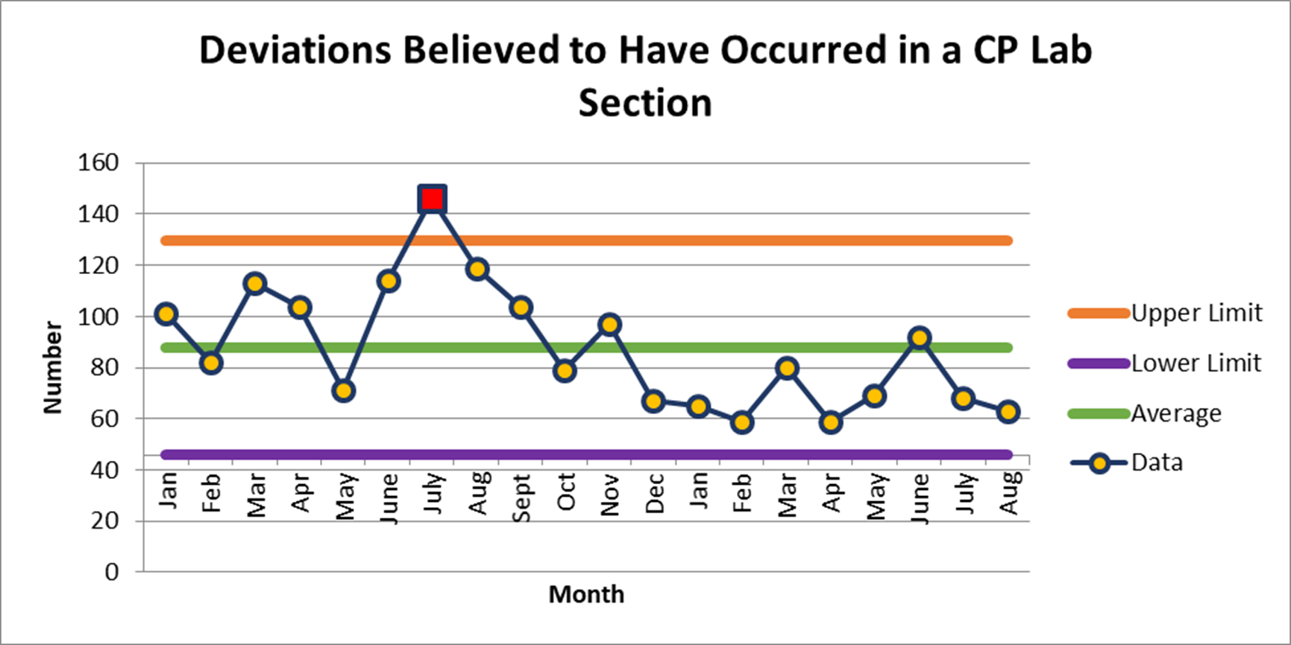
August 63

Slide 6
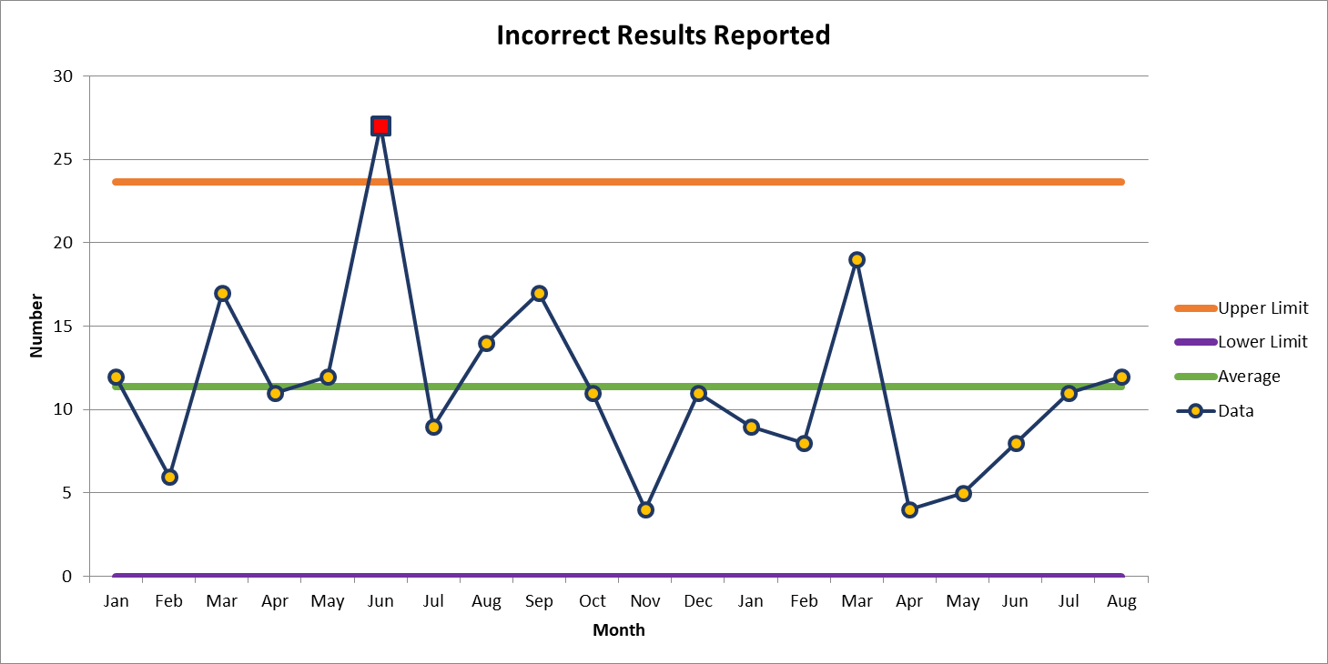
Most Common Deviation (1)
August 12

Slide 7
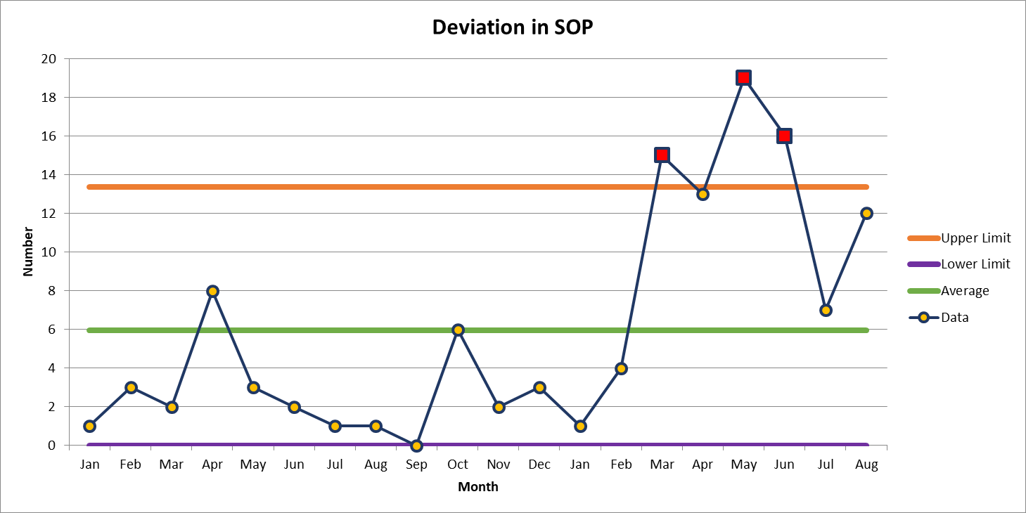
Most Common Deviation (2)
August 12

Slide 8
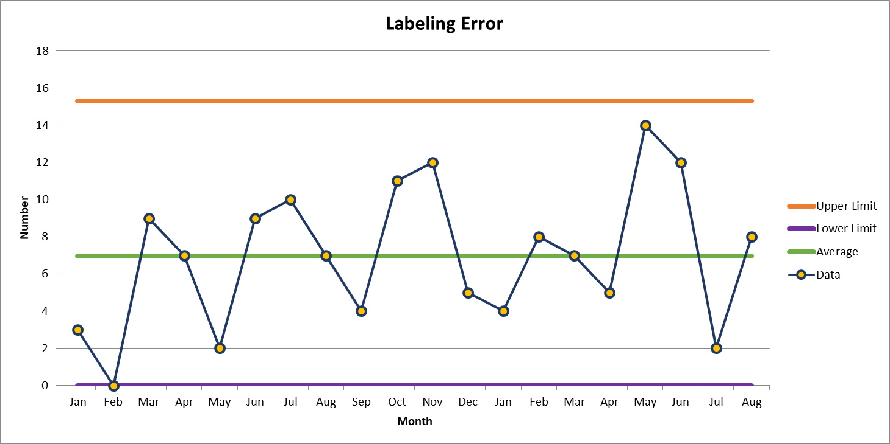
Second Most Common Deviation
August 8

Slide 9
Patient Safety Awareness

Slide 10
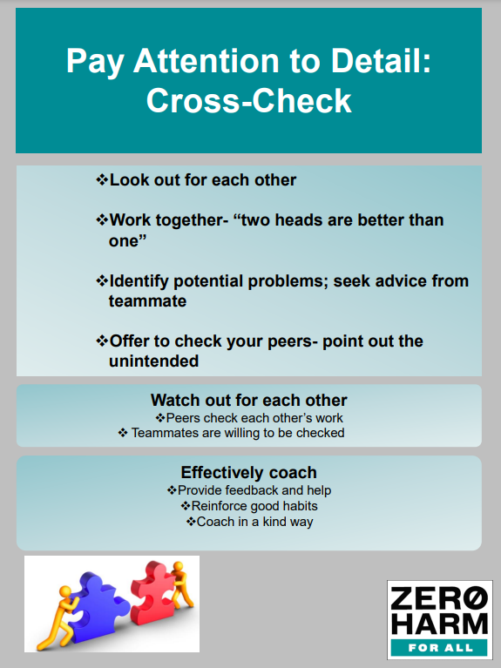
Patient Safety Tool of the Month September 2023
Coach each other in an effective way that is
kind and non-confrontational
*Remember we are a team in Patient Safety

Slide 12
Focus on: Blood and Body Fluid Exposure
Blood and/ or Body Fluid exposures can happen to anyone
Please note:
Take proper precautions when handling specimens
i.e. utilize engineering controls and appropriate
PPE
IF an exposure occurs: Immediately perform First Aid
Needle sticks/ sharps injury: Wash with soap and water
Splash to mucous membrane or broken skin (nose or mouth): Flush with water. (Do not use soap.)
Splash to eyes: Irrigate eyes with clean water, saline or sterile irrigation solution.
Then what?
https://intranet.wakehealth.edu/departments/employee-health/exposures/blood-body-fluid-exposures
<a href="https://www.freepik.com/free-vector/abstract-blood-stain-spill-splatter-texture-background_17569417.htm#query=blood%20splash&position=5&from_view=keyword&track=ais">Image by starline</a> on Freepik

Slide 13
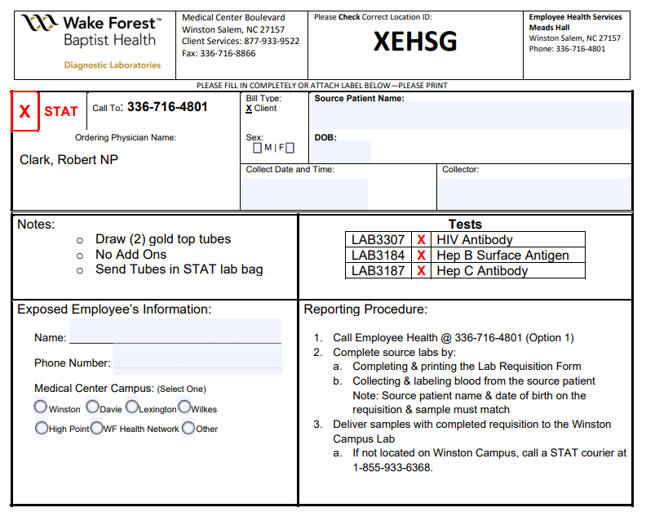
What to do when/if exposed?
1.
Perform First Aid immediately following exposure
Report Incident to your Manager and Call Employee Health
(336) 716-4801 option 1 (24/7)
Obtain labs as described here : https://intranet.wakehealth.edu/departments/employee-health/exposures/blood-body-fluid-exposures
Fill out Lab Requisition Form to completion
Deliver samples to Winston- Salem campus lab via
STAT Courier
6. You are responsible for reporting any exposures as soon as possible!
2.
3&4.
5.

Slide 15
Please contact the Quality, Safety and Accreditation Team if you have any quality or safety concerns.
QS_A@wakehealth.edu

