Slide 1

GxP Training

Slide 2

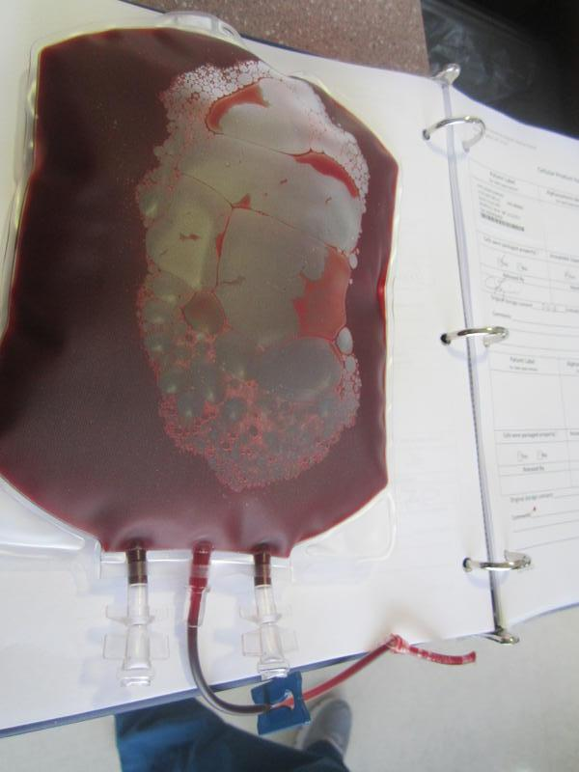
Regulations are written to ensure the safety and quality of Cellular Therapy Products.
Blood and blood component are considered both biological products and drugs.
Blood establishments are held to quality standards comparable to pharmaceutical manufacturers.

Slide 3

FDA is responsible for ensuring the safety of our nation’s blood supply under it’s two divisions: CBER ( Center for Biologics Evaluation and Research (CBER) and CDER ( Center for Drug Evaluation and Research (CDER).
  CBER regulates the collection of blood components used for transfusion or for the manufacture of pharmaceuticals derived from blood components.
  CDER regulates over- the- counter and prescriptions drugs, including biological therapeutics and generic drugs.

Slide 4
What is Gxp?
GxP is a set of regulations and quality guidelines formulated by the FDA to ensure the safety and quality of food and medical products throughout every stage of manufacturing, control, storage and distributions.
GxP abbreviation stands for “ good practice” following various quality standards and regulations. The “x” is variable:
  GMP (Good Manufacturing Practices)
  GTP (Good Tissue Practice)
  GDP (Good Documentation Practice)
  GCP (Good Clinical Practice)
The type of work that is being performed will define which GxPs should be followed.

Slide 5
Good Manufacturing Practice (GMP)
GMP is part of Quality Management which ensure that all products are consistently produced and controlled to the quality standards appropriate to their intended use or per product specification. These standards are set up by the FDA to ensure that a safe and effective product is manufactured.
GMPs apply to drug products, biologics, HCT/Ps, etc.
These regulations are published in the Code of Federal Regulations (CFR) and outlined in 21CFR 211 (drugs).
Staff must be knowledgeable of the GMPs that relate to their job duties.

Slide 6
Why are GMPs important?
Required by the FDA
Ensures a safe and effective product
Maintains consistency and conformity
Reduces product rejection or recall
Designed to minimize risk involved in any pharmaceutical production that cannot be eliminated through final product testing

Slide 7
What happens if GMPs are not followed?
The product is deemed adulterated. The product fails to conform to standards and cannot claim to be safe or contain the identity, strength, quality, or purity which it is represented to have.
GMP NOT FOLLOWED
Product may contain toxic substances or unexpected contamination.
Containers could be incorrectly labled
Product may contain insufficient or too much active ingredient

Slide 8
GMP Elements
Record Keeping
Organization & Personnel
Calibration & Validation
Error Management
SOPs
Production & Process Control
Packaging & Labeling Control
Building & Facilities
9. Holding & Distribution
10. Materials & Component Control
11. Equipment/Supplies
12. Returned & Salvaged Products
13. Quality Assurance
14. Auditing

Slide 9

1. Record Keeping
Written procedures must be established and followed
Product release criteria established
All actions must be documented in real-time
Data must be directly recorded into appropriate records
Calculations need to be recorded
Second person must review records
Deviations and OOS must be reported and investigated. Root cause should be identified

Slide 10

1. Record Keeping, cont..
Written procedure for record retention. Quality records are legal documents and shall be maintained.
  Records should provide complete history
  Product trackability (where the product is at all times)
  Product traceability (who performed what process)
  Consistent clinical documentation practices
Information must be recorded and signed for at the time of performance on the original record
Write down correct date. If you forget to sign something on a previous date, correct problem by writing: “Performed on 7/10/2022; written on 7/11/2022”
Sign only what you performed or verified

Slide 11
1. Record Keeping, cont..
Use black or blue indelible ink
Cross out entries with a single line; initial date
  If you find someone else’s error: correct error, initial & date. Have person who made original documentation also initial and date as soon as possible.
Do not use whiteout or scrap paper

Slide 12
1. Record Keeping, cont..
Examples of record keeping errors:
  Use of non-indelible ink on forms and labels
  Missing entries on forms (incomplete documentation)
  Documentation after the fact
  Using old version of a form
  No review of records
  Transcription errors on forms and labels

Slide 13
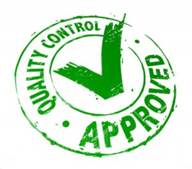
2. Organization & Personnel
Quality Control Unit
Responsible for approval or rejection of all components, raw materials, containers, closures, packaging, labeled finish products, process validation reports, procedure and product specification
Investigates non-conformances and out of specifications
Responsible for reviewing production records and ensuring no errors have occurred
Responsible for releasing materials/supplies for use
Independent of manufacturing

Slide 14
2. Organization & Personnel, cont.
Personnel
Qualifications and Training
Personnel must be qualified on specific assigned task through appropriate education, training, and expertise.
Personnel training is planned, organized, documented and consistent with individual job descriptions.
Training includes yearly GMP training
Relevant staff received REMS training
Competency
Annual competency evaluation and continuing education
Continuing Education
Relevant staff must complete at least 10 hours continuing education and submit updated logs at the end of the calendar year

Slide 15
3. Calibration & Validation
Calibration
Documentation of calibration for relevant equipment used in processing CTPs ( waterbaths, centrifuges, weighing scale, etc.)
Identification of the equipment and calibration standard used
Performed at suitable intervals, after major service and as required by regulation or manufacturer’s recommendations
Validations
Must consistently produce a result that meets pre-established quality and performance specifications
Critical processes are validated
Revalidation must take place following any significant changes in the equipment, process, or procedure.

Slide 16
4. Error Management
A system in place to prevent errors, and detect errors that have occurred and take appropriate corrective actions to avoid future occurrences
Includes Deviations, Accident/Error/Unexpected Event, Near Miss, Severe Adverse Event and Biological Product Deviation.
Must report to FDA if it may affect safety, purity or potency of blood product
  Blood collection or transfusion related fatalities must be reported to the FDA by phone or email within 24 hours and in writing within 7 days.

Slide 17
4. Error Management, cont.
Deviations are non-punitive.
Self reporting is encouraged
Designed to identify the cause of the event and detect trends so appropriate corrective action can be implemented (process modification or retrain personnel)

Slide 18
5. Standard Operating Procedures
Maintained for all steps to be followed in manufacturing of blood and blood products (collection, testing, storage, distribution)
Available for use in the areas where the procedures are performed
Only one version in use
Are reviewed, approved, and followed by applicable staff and departments
Deviations investigated and documented
TCTL SOPs are available on share drive and CHLA Sharepoint. In the event of computer down-time they are available in binders in the TCTL office.

Slide 19
6. Production and Process Controls
Change Control
  New or changed critical processes must be controlled and validated to ensure new process works
  Changes are communicated to relevant employees
  All staff trained prior to implementation
  Old versions of SOP removed and archived
Quality Control
  Ensure reagents, equipment and methods function as expected
  Results shall be reviewed and corrective action taken where appropriate

Slide 20
6. Production and Process Controls, cont.
Risk Evaluation
  Risk evaluations are documented to assess new and/or significant changes to processes for risk.
  Once a potential risk or known risk is identified, the QA Department under the guidance of the Program Director, evaluates the level of risk and if necessary CAPA (Corrective Action Preventative Action) is initiated.
Risk Assessment |  | Probability of Occurrence
Severity of Risk |  |  | Frequent | Likely | Occasional | Seldom | Unlikely
 |  | Category | Likely to Occur | Quite likely to occur | May occur | Not likely to occur | Unlikely to occur
 |  | Catastrophic May Result in death | E | E | H | H | M
 |  | Critical May cause severe injury | E | H | H | M | L
 |  | Marginal May cause minor injury | H | M | M | L | L
 |  | Negligible May cause minimal injury | M | L | L | L | L

Slide 21
7. Packing and Labeling Control
Labeling is display of a written, printed, or graphic matter upon the immediate container of any article
Packaging and labeling must be inspected prior to issuing to production
There must be a written procedure that document receiving, identity, storage, handling, sampling, and testing of labels and ensure that integrity is maintained throughout production and use of product
There must be label control. Labeling must be stored in a way to prevent mix-ups
All labels must be reconciled. Obsolete or unused labels must be destroyed

Slide 22
8. Building and Facilities
Only authorized personnel shall enter building and facilities
Building shall be of suitable size for manufacture, processing, packing, or hold of a drug product
There must be adequate space for equipment and material placement
Operations must be performed in specifically defined areas
There must be adequate lighting, environmental controls, potable water and air break on drains
Building shall be maintained in a clean sanitary manner
  Trash and other refuse disposed
  Free of pest infestations
There shall be SOPs for cleaning and waste disposal. Cleaning agents and pesticides used cannot affect product

Slide 23
9. Holding and Distribution
Quarantine product before release
Store products under appropriate conditions
Distribution of product First Expiration First Out
Traceability of product lot/batch. Can readily identify distributed lots in case of recall

Slide 24
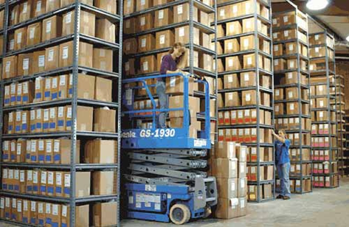
10. Materials/Component Control
Written procedures on receipt, handling, storage, testing, rejection
Suppliers must be evaluated, approved, and monitored for quality
Each lot of incoming materials shall be placed in quarantine until testing/examination is completed and released for use
Materials must be properly stored and off floor. Materials issued according to First in, First out

Slide 25
11. Equipment
Will be of appropriate design, adequate size, and suitably located
Equipment must be properly qualified (IQ, OQ, PQ)
Will be cleaned and maintained according to SOP and established schedule. Equipment will be cleaned after each use

Slide 26
12. Returned and Salvaged Products
Written procedures for product return, salvage, or destruction
Returned product shall be identified, documented, and quarantined
If returned product casts doubt on the safety, quality, identity, strength, or purity of the product, product must be destroyed
Products can be salvaged if laboratory tests show that product meets all applicable standards of safety, quality, identity, strength, and purity and is needed for urgent medical need.

Slide 27
13. Quality Assurance
Required to have a Quality department
Under the guidance of the TCLMD, the TCTQM or designee manages the implementation and effectiveness of the QM Plan
Goals of The TCT QM Plan:
  Reduce and prevent errors
  Collect and analyze outcome data
  Implement effective mechanisms to improve patient safety, quality of processes and patient satisfaction

Slide 28
13. Quality Assurance, cont.
Role and Responsibilities
The TCTLMD(or designee):
Reviews and reports quality management activities to staff, at a minimum, quarterly
Does not have oversight of his/her own work if performing other tasks in the Processing facility.
TCTQM:
Develop, review and approve all SOPs
Develop and approve validation protocols
Approval of training content
Approval of procedures used in QC
Error management
Internal audits

Slide 29

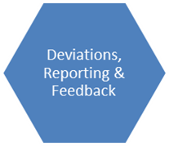
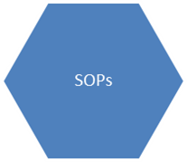
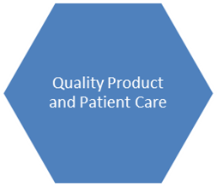



13. Quality Assurance, cont.
Quality Assurance is everyone’s responsibility!!!
Many components are required to create a true quality program, quality product and quality patient care

Slide 30
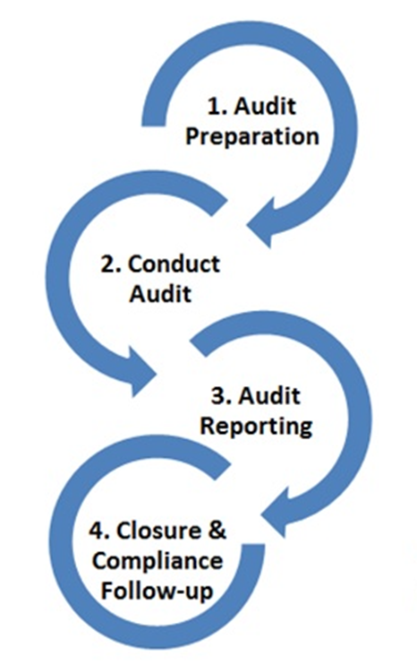
14. Auditing
Audits are completed to verify compliance with elements of the Quality Management Program and operational policies.
Results and audit findings are documented, reviewed by the TCTQM and are used to detect trends, identify performance improvement opportunities and implement timely corrective actions as necessary.

Slide 31

NON-COMPLIANCE
FDA 483
FDA warning letters
Product recall
Injunction
Closure

Slide 32
Good Tissue Practice (GTP)
GTPs are guidelines developed by the FDA specifically to establishments that manufacture Human Cell and Tissue Products (HCT/Ps). Written to be compatible with GMP.
Like GMP but taking into consideration that the nature of the product is very different (biologics vs drugs) and specific to tissue which has not been significantly modified such as stem cells for transplant.
Applies to the Stem Cell Processing Laboratory
Additional guidelines include:
  Donor eligibility requirements
  Focus on the prevention of the introduction, transmission or spread of communicable diseases

Slide 33
Why are GTPs important?
Required by the FDA
Ensures a safe and effective product
Prevents the introduction, transmission, or spread of communicable diseases by HCT/Ps

Slide 34
CGTP governs the methods used in, and the facilities and controls used for, the manufacture of HCT/Ps including all steps in recovery, donor screening, donor testing, processing, storage, labeling, packaging, and distribution
Outlined in 21 CFR 1271: Human Cells, Tissues, and Cellular and Tissue Based Products
Compliance with CGMP regulations results in compliance with CGTP requirements

Slide 35
351 Products
  More than minimally manipulated
  Intended for non-homologous use
  Systemic effect dependent upon metabolic activity (allo except close relative)
  Combined with a device, drug, or biologic
361 Products
  Minimally manipulated
  Homologous use
  Metabolic tissue for self or close blood relative
  Not intended to change tissue function or characteristics

Slide 36
GTP regulations not covered by GMP regulations:
  Donor Eligibility
  Communicable Disease Prevention
  Audits
  Processing
  Packaging and Distribution
  Record
  Labeling
  Tracking
  Complaints
  Reporting
  Recall

Slide 37
11. Donor Eligibilty
Eligibility based on donor screening
Statement whether donor is eligible or ineligible
Summary of records must include a statement that communicable disease testing was performed (IDM results)
Product container must include donor identification code
Product must be quarantined and stored in separate area
Product collected from ineligible donors can only be used due to urgent medical need and there is no comparable product
Retain records for at least 10 years after the date of the HCT/P’s distribution

Slide 38

2. Communicable Disease Prevention
Must “recover, process, store, label, package, and distribute HCT/Ps and screen test cell and tissue donors, in a way that prevents the introduction, transmission, or spread of communicable diseases”
Established Quality Program
  Maintain appropriate procedures for receiving, storing, processing, releasing, recalling, and destroying HCT/Ps; deviation reporting; and CAPA root cause investigation
Procedures must be designed “to prevent circumstances that increase the risk of the introduction, transmission, or spread of communicable diseases through the use of HCT/Ps”

Slide 39

3. Audits
Periodically performed
Review of activities related to core GTP requirements
Validation of computer software performance, if applicable

Slide 40
4. Processing and Process Controls
All process changes must be verified or validated
Validation activities and results must be documented, reviewed, and approved
“Procedures must include verification of label accuracy, legibility, and integrity”
HCT/Ps from two or more donors cannot be pooled
HCT/P expiration dates shall be based on product type, processing type, storage conditions, and packaging
Establish temperature limits
Record storage temperatures and continuously monitor temperatures

Slide 41

5. Receipt and Distribution
Inspect incoming products (accept, reject, or place in quarantine)
Review all processing and tracking records prior to distribution
Products processed under a departure from SOP cannot be distributed “unless a responsible person has determined that the departure does not increase the risk of communicable disease”

Slide 42
6. Records
“Maintain records concurrently with the performance of each step”
“Records must identify the person performing the work and the dates of the various entries
Records “must be as detailed as necessary to provide a complete history of the work performed” and relate the records to the corresponding HCT/P
Records must be retained for at least 10 years after their creation or product administration or distribution/disposition

Slide 43

7. Labels
Label HCT/P products
Labels must include:
  Unique identifier
  Product type
  Expiration date
  Warnings
Center name and address
Storage temperature

Slide 44

8. Tracking
Each HCT/P must have a unique identifier
HCT/P should be tracked from donor to the consignee or final disposition, and from the consignee or final disposition to the donor
Track all HCT/Ps in case of actual or suspected contamination

Slide 45
9. Complaints
All complaints must be documented, reviewed, and evaluated to determine if complaint is related to a deviation or adverse reaction
Investigate all adverse reactions involving a communicable disease
Report adverse reactions to the FDA if it is:
  Fatal
  Life threatening
  Results in permanent impairment
  Necessitates medical or surgical intervention
Complete form FDA-3500A and submit to FDA within 15 calendar days

Slide 46
10. Reporting
Investigate all deviations related to a distributed product that was processed
Report all HCT/P deviations that relates to a core CGTP requirement to the FDA within 45 days of event discovery. Complete form FDA-3486

Slide 47

11. Recall
Product shall be recalled if it was manufactured in violation of CGTP regulations
Product will be destroyed
Center can be ordered to stop processing until compliance with regulations
FDA can issue a written order to recall and destroy product within 5 working days from the date of receipt of the order

Slide 48

NON-COMPLIANCE
FDA 483
FDA warning letters
Product recall
Injunction
Closure

Slide 49
Good Documentation Practice (GDP)
What constitutes GDP?
Documentation and records should be sufficiently detailed and provide proof that something was done
Document in real time
Documents must be clear and legible
Do not leave blank spaces – write N/A if not applicable or cross out if not relevant
Correct errors in a legible way
Errors must be corrected immediately
Deviations should be captured and provide sufficient detail to tell a story
Confidentiality is crucial. Access to certain information and records should be restricted
Falsification is not tolerated. Information must be true and accurate

Slide 50

Signatures must be traceable. A signature list of maintained of all clinical employees
Complete/submit documents on time. Many documents are used by other departments to perform their tasks so process documents promptly and do not allow paperwork to pile up. Your work affects others!!
Records must be stored safely and securely and easily retrievable
GDP applies to all types of document media; paper and electronic
For the safety of staff, donors and patients: Do what you document and document what you do!!

Slide 51
Good Clinical Practice (GCP)
What is GCP?
GCPs are quality standards for the design, conduct, performance, monitoring, auditing, recording, analyses and reporting of clinical trials
It serves to protect the rights, integrity and confidentiality of human research subjects
Relevant clinical program faculty and staff involved in FDA regulated research or internal research with investigational drugs are required to complete CITI GCP training
Responsibility for following GCPs is shared among the following:
  Institutional Review Board (IRB)
  Investigator (study team)
  Sponsor
  Monitor

Slide 52
Investigator Responsibilities:
Follow approved protocol according to the signed agreement , investigational plan and FDA regulations
  Responsible for research team’s adherence as well
Protect human subjects
  Ensure informed consent (both via IRB approved form and research notes in the subject’s record)
Control investigational product, including disposal or return
Document study progress
  Maintain accurate, complete and current records
  Submit appropriate reports-progress, safety and final
  Retain records and make them available for review

Slide 53
Investigator Responsibilities:
Disclosure of Conflicts of Interest that affect the design, conduct, reporting, and analysis of the research (Disclose to Sponsor and UC San Diego Health)
Complete Form FDA 1572 – contract between the PI and FDA. Investigator:
  Agrees to personally conduct or supervise the study in accordance with the approved, relevant, current protocol
  Maintains adequate and accurate records
  Reads and understands the information in the investigator brochure
  Ensures all assisting in the study are informed of their obligations
  Ensures IRB complies with FDA requirements
  Promptly report all changes or unexpected problems to IRB
  Ensure changes are approved by IRB
  Ensure all site personnel are qualified and familiar with the product and it’s use

Slide 54
Investigator Responsibilities:
Investigator Responsibilities per Form 1572 cont’d:
  Sufficient resources, access to patients and time
  Adequate number of qualified personnel
  Adequate facilities and equipment
  Personnel trained on protocol, investigational product, and assigned duties and functions
  Medical decisions should be made by a qualified physician who is an investigator or sub-investigator for the study
  Adverse events and other medical issues should be managed adequately
  Subject’s Primary Care Physician should be notified of participation, with subject’s approval
  Withdrawn subjects should be assessed
  Accurate documentation and records

