Slide 1
Lab Safety Team
10.2023 | Department of Lab & Pathology

Slide 2
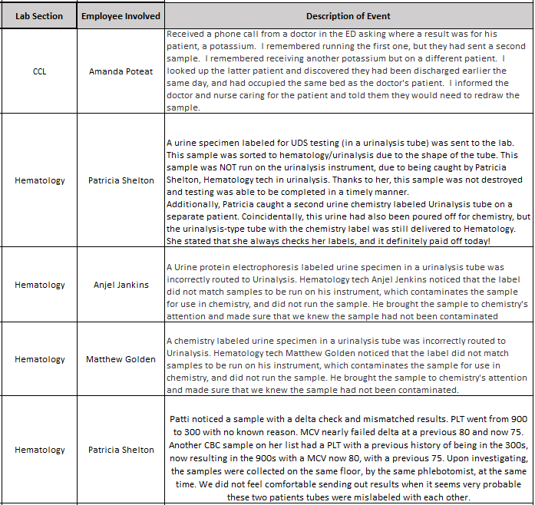
Good Catches
for
September

Slide 3
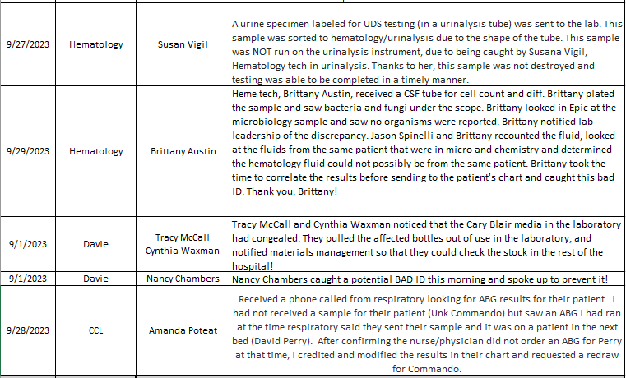
More Good Catches!

Slide 4
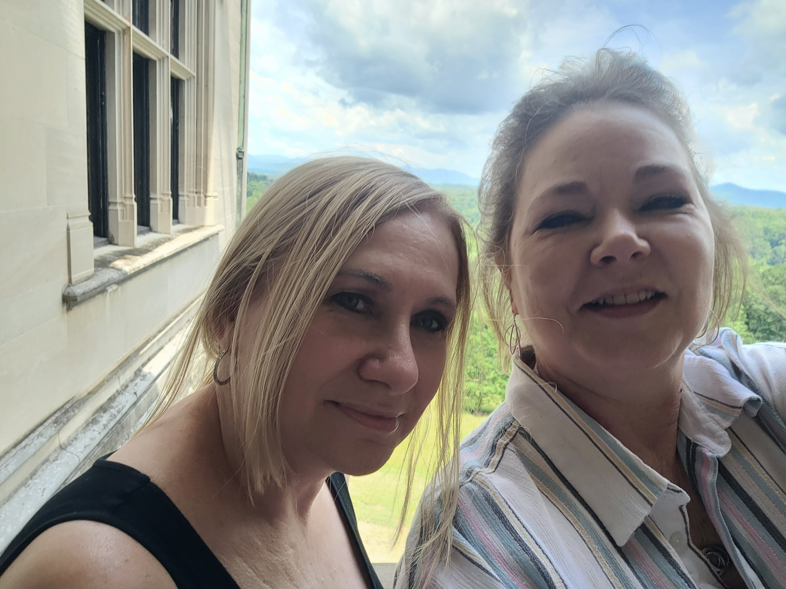
Good Catch Recipients for September Tracy McCall & Cynthia Waxman Davie Lab

Slide 5
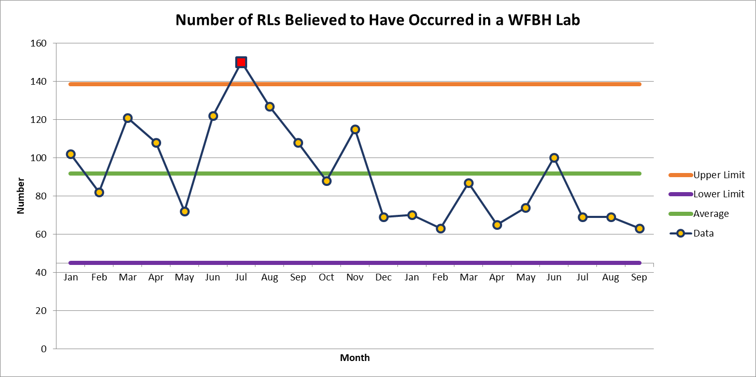
September 63

Slide 6
For September Only: Wake Market Labs data will be added to reporting (Davie, High Point, Lexington & Wilkes)
October and Moving Forward: Each location will have its own RL reporting data

Slide 7
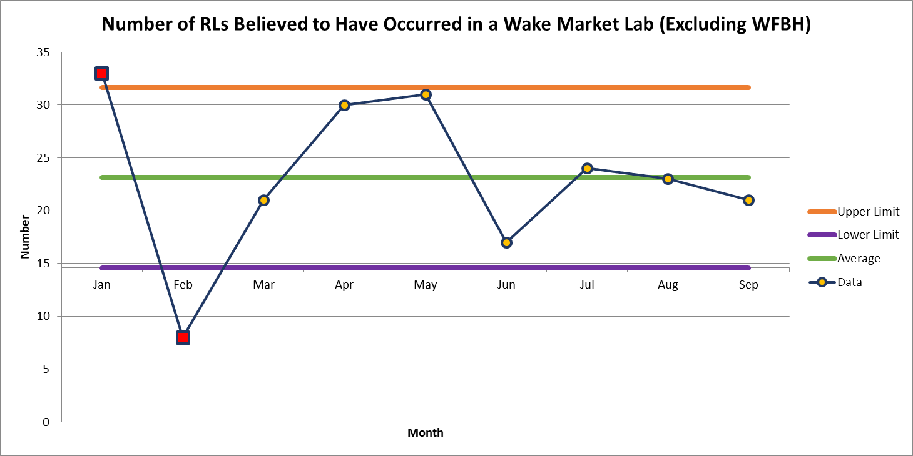
September 21

Slide 8
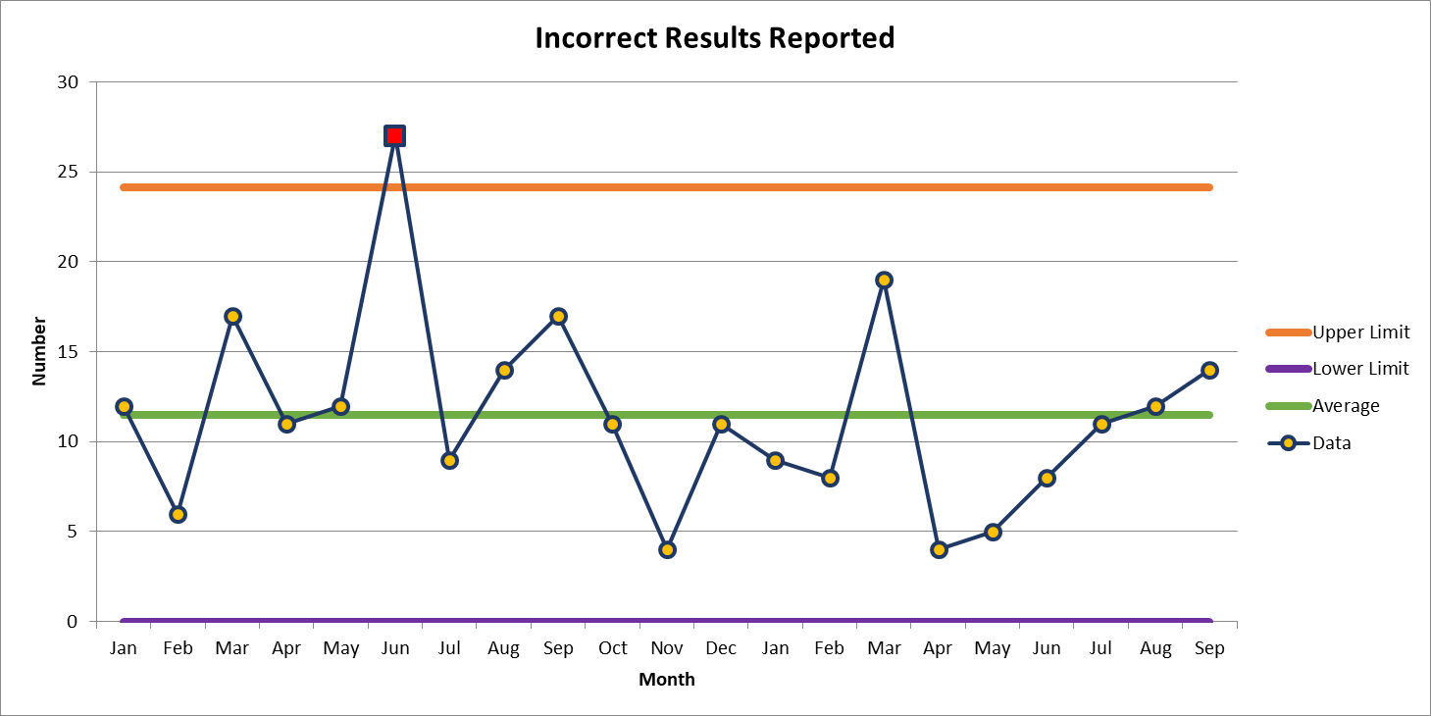
Most Common Deviation
September 14

Slide 9
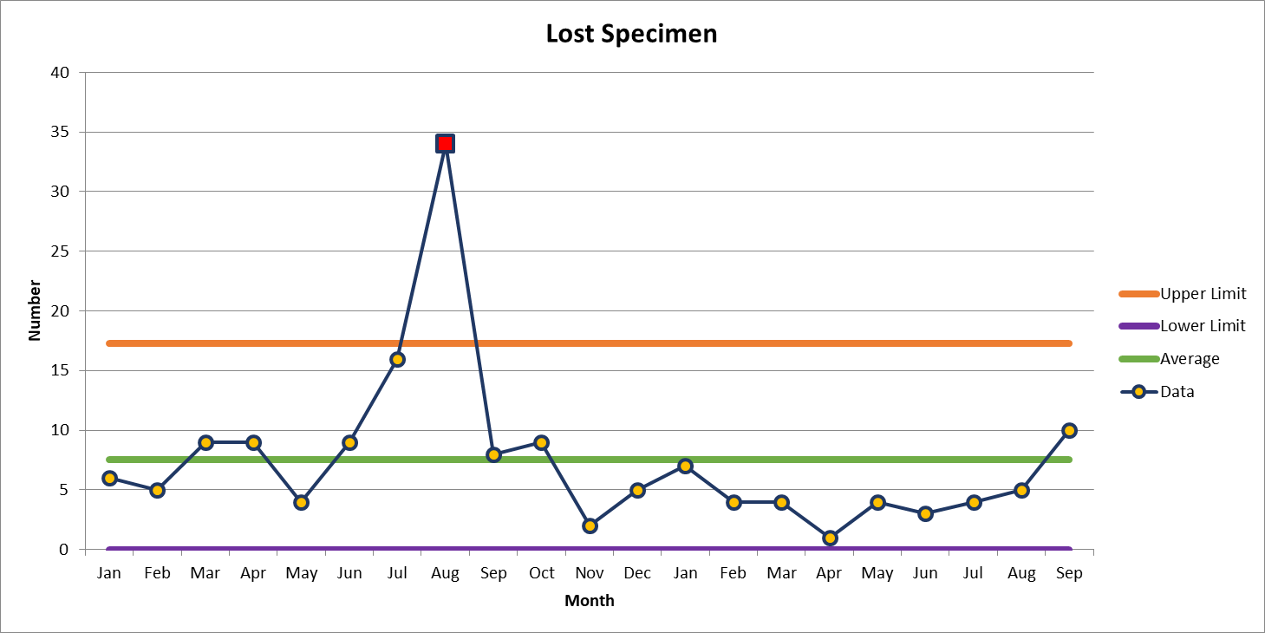
Second Most Common Deviation
September 10

Slide 10
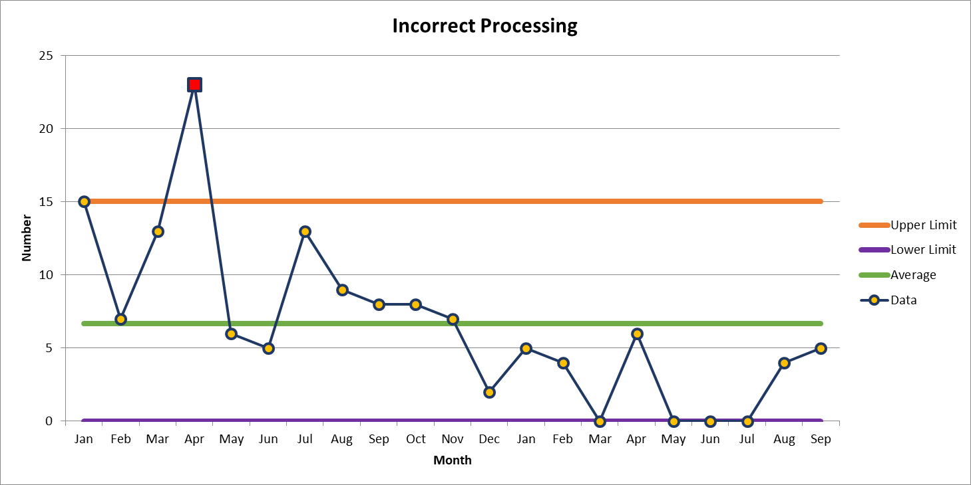
Third Most Common Deviation (A tie between Incorrect Processing and Delayed Collection)
September 5

Slide 11
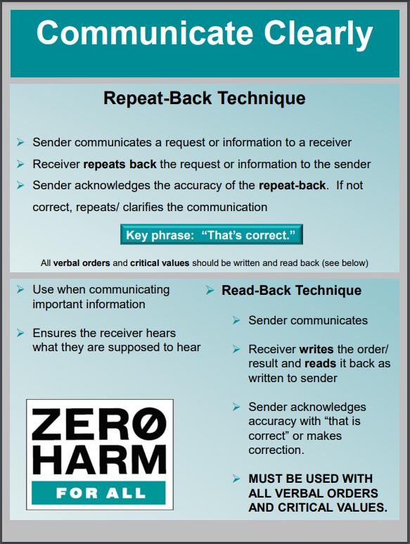
Patient Safety Tool of the Month October 2023

Slide 12
Lab Application of Repeat-Back Technique
Instances to use the Repeat-Back Technique
When manually entering information read off to you by someone else
When receiving a phone call and searching for a patient sample
Read-back the two patient identifiers
When calling critical values to ensure you have the correct patient
When drawing blood from a patient
When handing off information about a patient to the next shift
In all instances * Make sure that the other party acknowledges that you have repeated back the correct information
“That’s Correct”

Slide 14
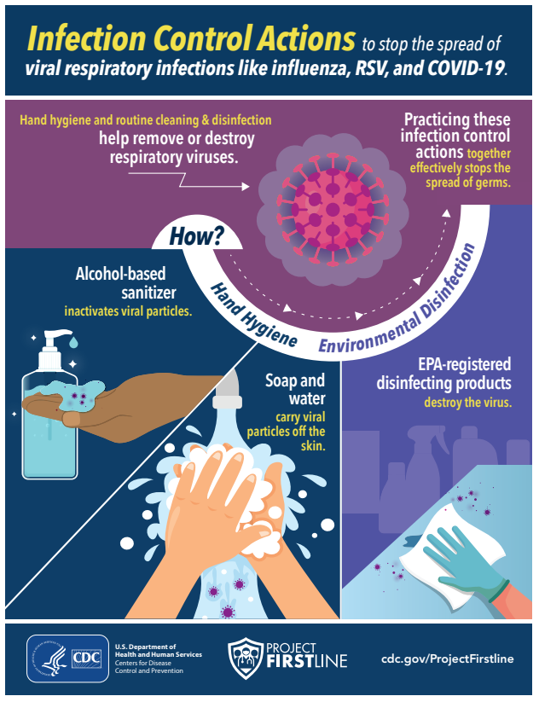
October Safety Focus: Respiratory Season Tips
Prevention Tips:
Practice Physical Distancing
Stay at home when you are sick and report through Teammate Health Portal: https://intranet.wakehealth.edu/campaigns/flu-program/how-tosand-forms/what-to-do-if-you-have-the-flu
Clean and Disinfect your environment regularly
Clean your hands often even when not visibly soiled
Avoid touching your eyes, nose or mouth

Slide 15
Do you know where to find Safety Information?
https://wakehealth.sharepoint.com/teams/Safety2
Safety SharePoint site above for quick access to pertinent information

Slide 16
Please contact the Quality, Safety and Accreditation Team if you have any quality or safety concerns.
QS_A@wakehealth.edu

