Slide 1
Lab Safety Team
11.2023 | Department of Lab & Pathology

Slide 2
Patient Safety

Slide 3
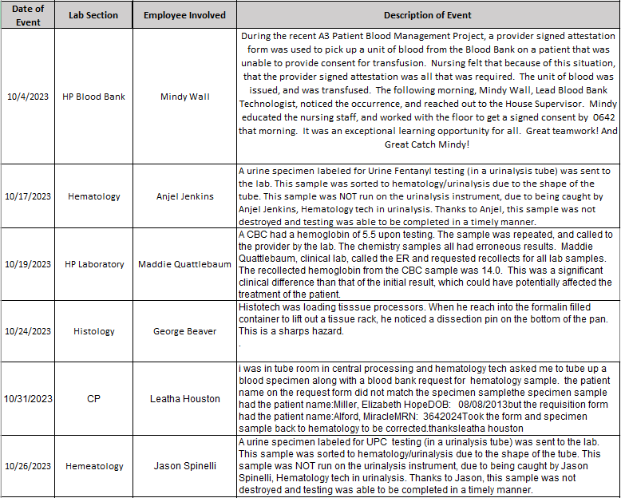
Good Catches
for
October

Slide 4
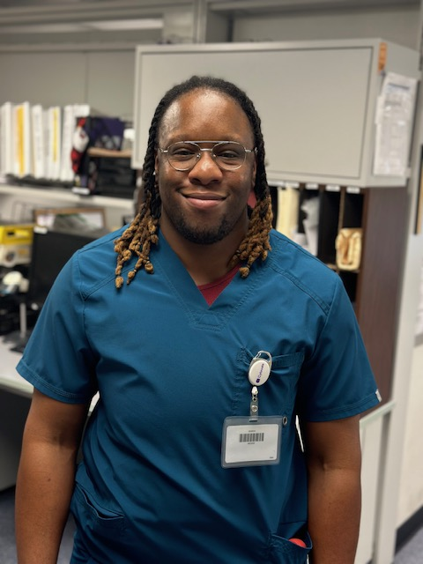
Good Catch Recipient
October 2023
Anjel Jenkins,
WFBH Hematology

Slide 5
Please Note
Staff should enter RLs whenever a deviation has been observed following the steps outlined in this presentation.
Thank you for helping to make the lab more reliable by reporting RL events.

Slide 6
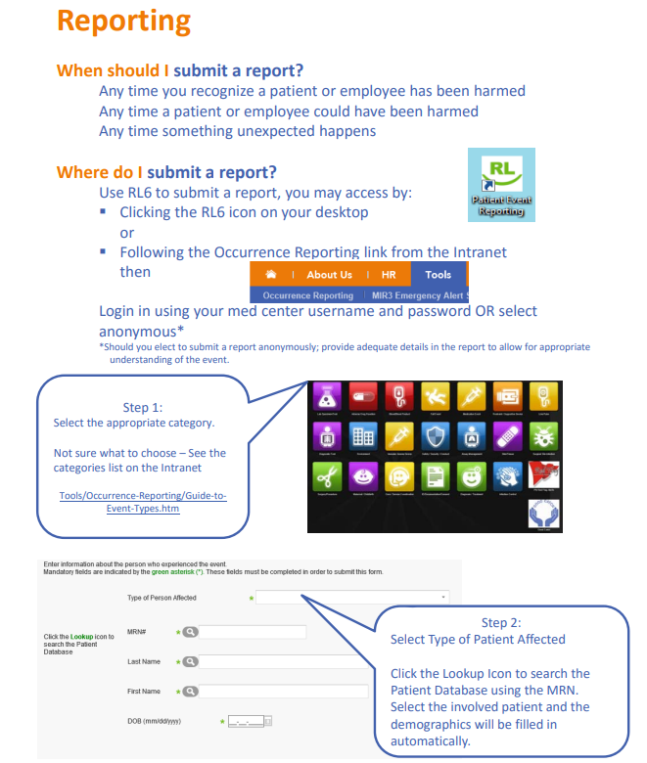

Slide 7
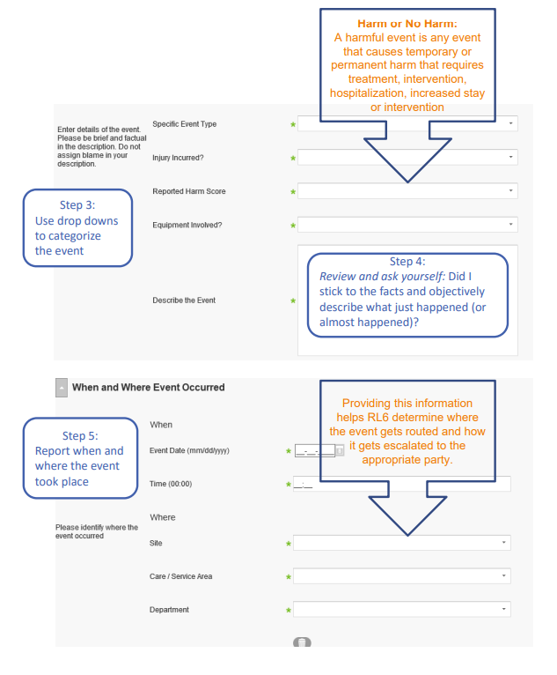

Slide 8
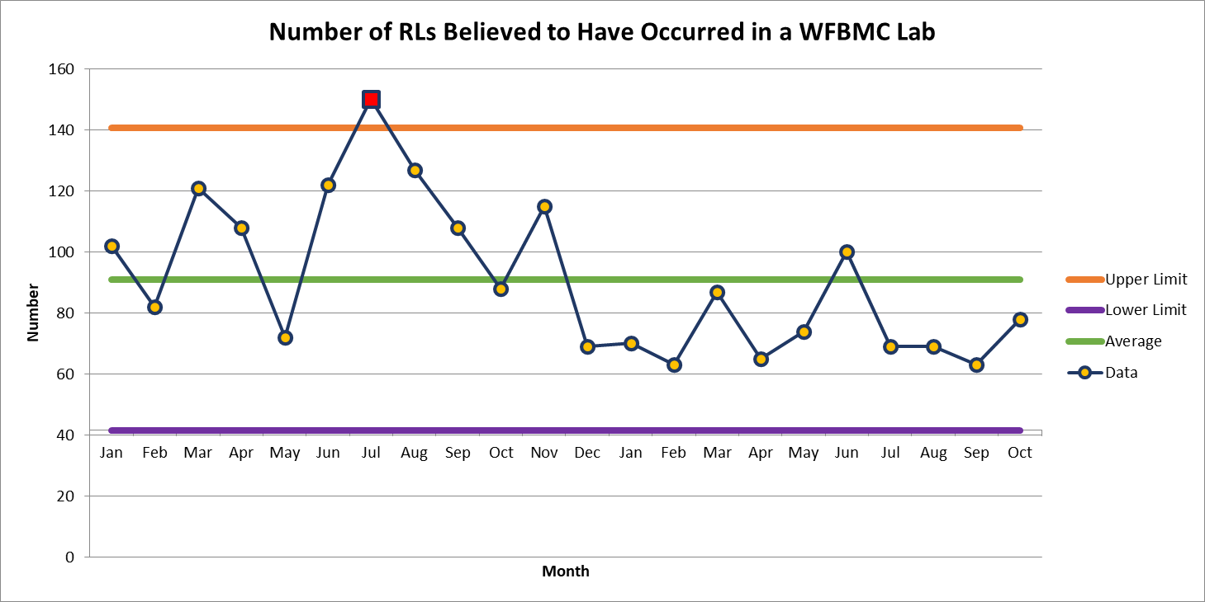
Wake Forest Baptist Hospital 78

Slide 9
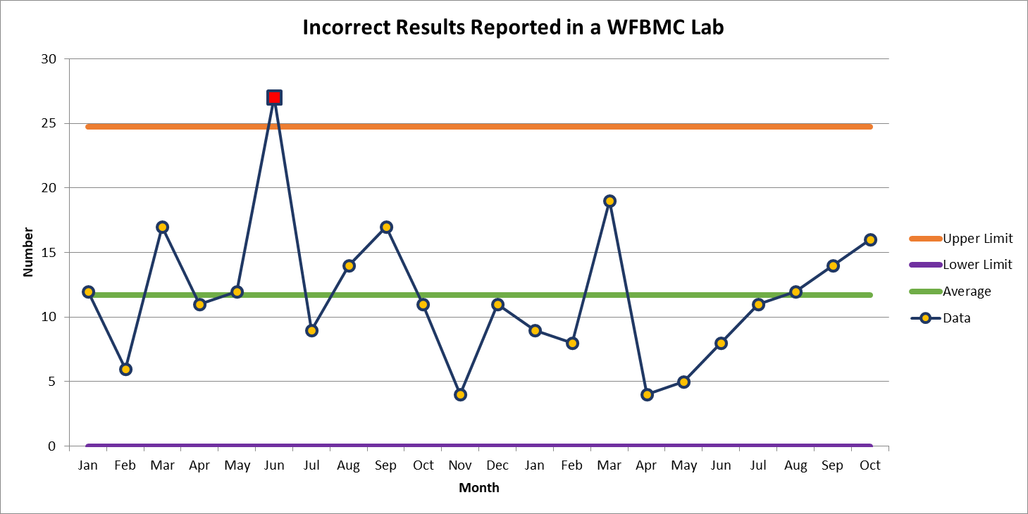
Most Common Deviation WFBMC
October 16

Slide 10
Patient Safety Awareness

Slide 11
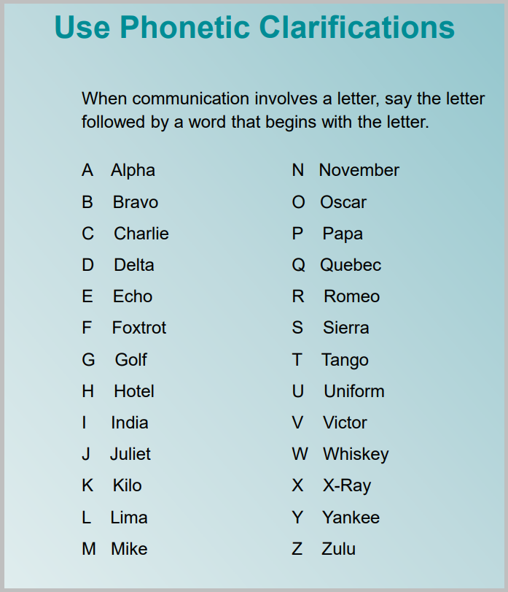
Patient Safety Tool of the Month November 2023

Slide 12
Patient Safety Tool (continued)

Slide 14
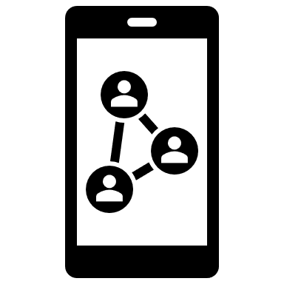
November Safety Focus: Protecting Patient Information
When printing sensitive information be sure to immediately retrieve your documents - others can unintentionally read medical records when documents are left unattended
Never take photos of any patient samples/ equipment
Cell phones should NOT be used in patient testing areas
Social Media
Never expose HIPPA information via Social Media
Limit social media at work
Only access charts of patients to whom you are providing direct care
This Photo by is liUnknown Author censed under CC BY-NC
Special note on social media:
Patient care areas – no social media should be accessed for personal use at any time including unpaid meal breaks in patient care areas.
Patient care areas include non-treatment areas such as nurse’s stations

Slide 15
For more information on social media policies please visit:
Title 21 Document
QUAL-POL-0011 : 1.0
&
Social Media Policy on PolicyTech
https://atrium.policytech.com/dotNet/documents/?docid=78686

Slide 16
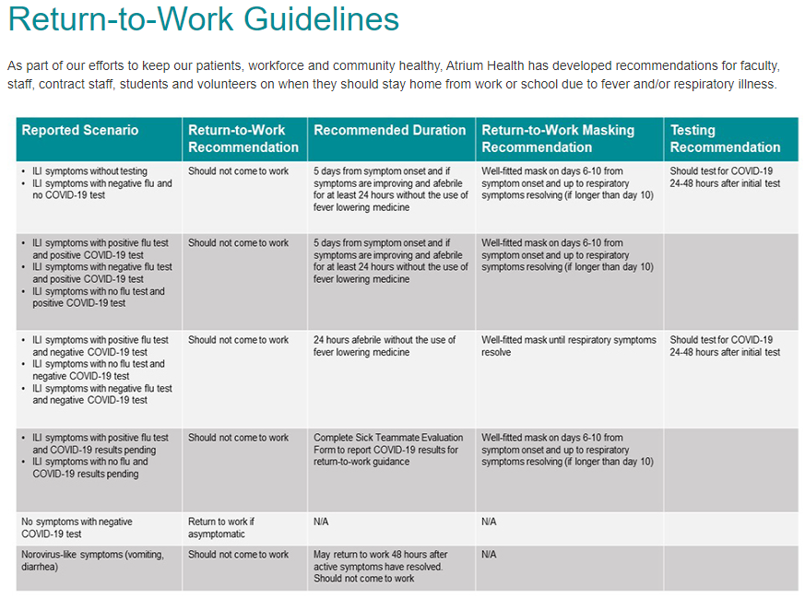
Questions about when to return to work after illness?
https://intranet.wakehealth.edu/departments/employee-health/return-to-work-guidelines

Slide 17
Please contact the Quality, Safety and Accreditation Team if you have any quality or safety concerns.
QS_A@wakehealth.edu

