Slide 1
Blood Bank Tests for Stem Cell Lab and Receiving Products from the National Marrow Donor Program (NMDP)

Slide 2
Sample Types
TSXBM – Performed on a potential donor samples
GTXBM – Taken directly from the stem cell product bag for confirmation of ABO.
XMBM – Crossmatch for Transplant patient
TBMTD – Antibody titer on incompatible transplant donor
TBMTR – Antibody titer on incompatible transplant recipient

Slide 3
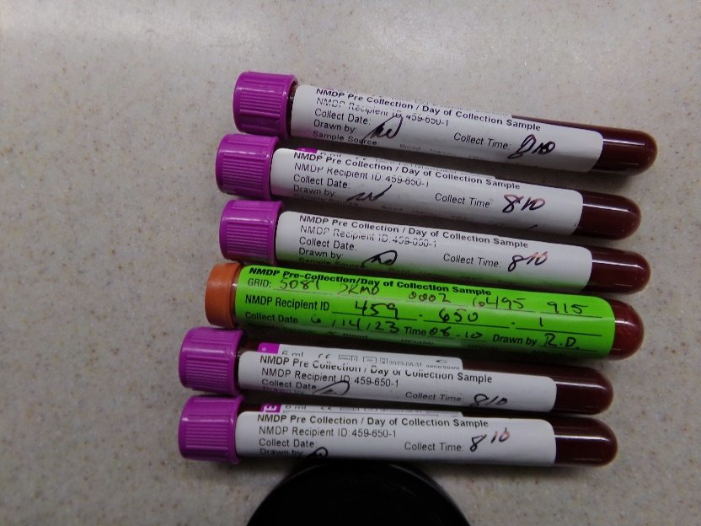
TSXBM
Transplants facilitated through the NMDP are deidentified, so that the donor and recipient cannot identify each other.
The donor tubes will have labels with the NMDP identifiers only; these have green labels, or white labels with green writing, see below:

Slide 4
TSXBM, continued
The Stem Cell Lab will send a Request to Confirm Group and Type
If the tube has an NMDP label only, this is the DONOR tube.
Perform Group/Type and Antibody screen on tube provided.
Return sample and results to SCTCT lab at tube 132.
SCTCT Lab may request a titer based on these results; this will come with a different form.

Slide 5
GTXBM
The sample will come in a 12x75 tube.
This specimen is directly from the product bag.
SCTCT Lab will label this sample; it is donor sample, but will have the recipient name on the label.
There are a large number of white cells in the sample
There are very few red cells in the sample

Slide 6
XMBM
SCTCT Lab will complete the top of the Crossmatch Stem Cell Donor with Recipient Form
When Blood Bank receives the form, one technologist will identify the donor and recipient tubes; place a red Donor sticker on the donor tube and a yellow Recipient sticker on the recipient tube.
A second technologist will check the tube identities
Full crossmatch should be performed manually, not on the Vision
Contact SCTCT Lab with any questions or problems
Put the Crossmatch Form in the Medical Director’s inbox for review

Slide 7
TBMTD/R
Donor or Recipient Titer
SCTCT Lab staff will complete the SCTCT Antibody Titer Form with Donor and Recipient information
Complete titer based on instruction on page 2 of the form
Return SCTCT Antibody Titer Form and samples to SCTCT Lab.

Slide 8
Receipt of Stem Cell Products
Products sometimes arrive outside normal working hours of the SCTCT Lab; Blood Bank receives products from the NMDP in these cases.
SCTCT Lab will send an email with the courier’s name, the recipient name and date of birth, and instructions for product storage
When courier arrives, complete the NMDP Product Receive Log(SCTCT Lab puts this at Front Desk prior to courier arrival) and the Record of Packaging and Receipt(courier will have this form).
SCTCT Lab will send a Crossmatch Bone Marrow Donor with Recipient form for the XMBM
The Recipient will have a current tube in the Blood Bank; SCTCT Lab is responsible for ensuring the recipient tube is available.
The Donor tube will arrive with the product.
Place the completed XMBM Form in the Medical Director’s inbox for review

Slide 9
References in Title21
BB-SOP-0114 BM/HPC Procedures and Protocols
BB-POL-0055 Transplant Testing Protocols

