Slide 1
Lab Safety Team
12.2023 | Department of Lab & Pathology

Slide 2
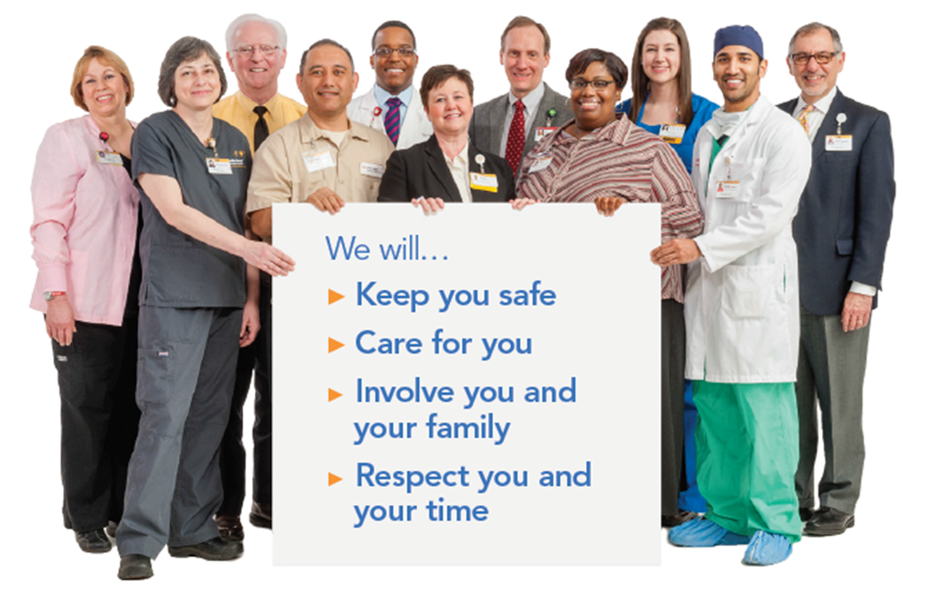
Patient Safety

Slide 3

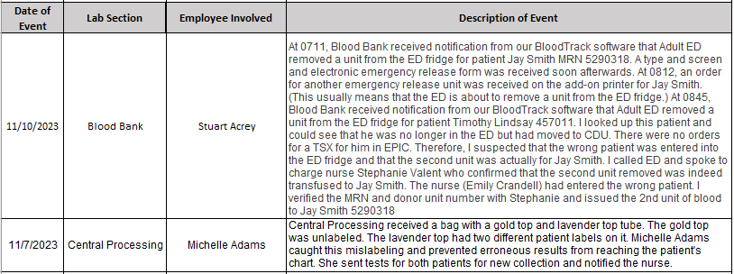
Good Catches
for
November

Slide 4
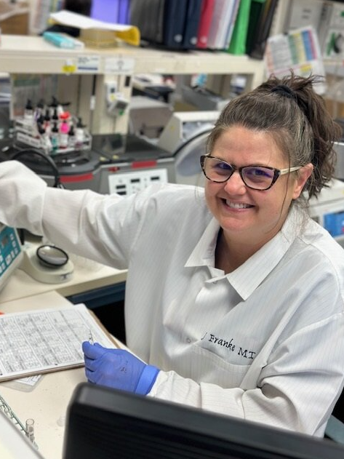
Good Catch Recipient
November 2023
Stuart M. Acrey
Blood Bank

Slide 5
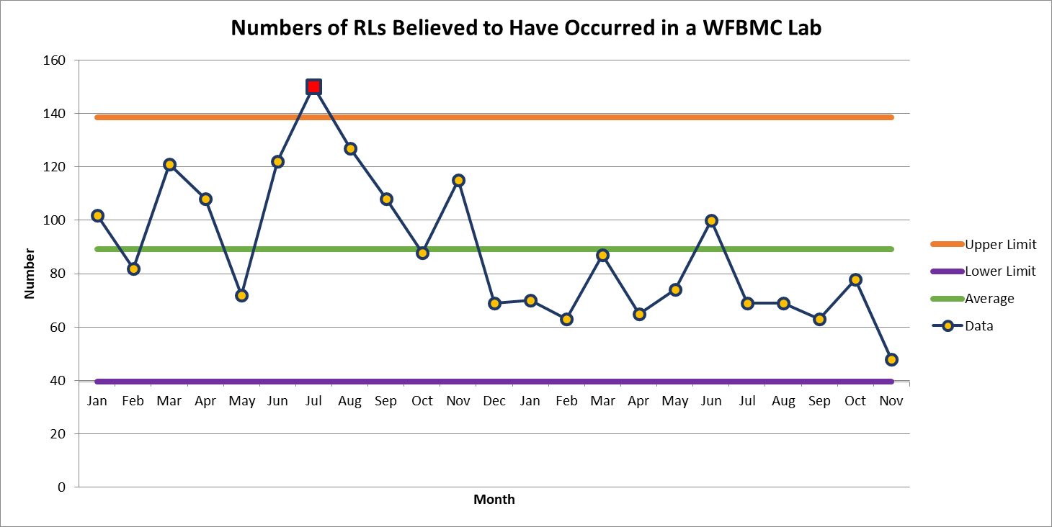
Wake Forest Baptist Hospital 48

Slide 6
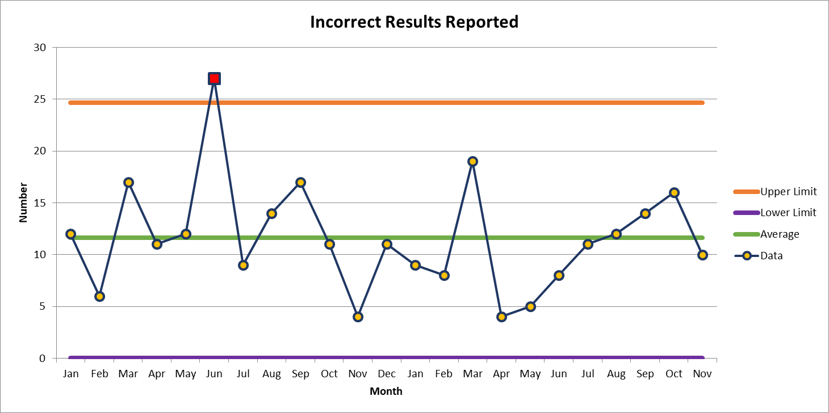
Most Common Deviation in a WFBMC Lab
Tie between Incorrect Results Reported and Incorrect Processing
November 10

Slide 7

Patient Safety Awareness

Slide 8
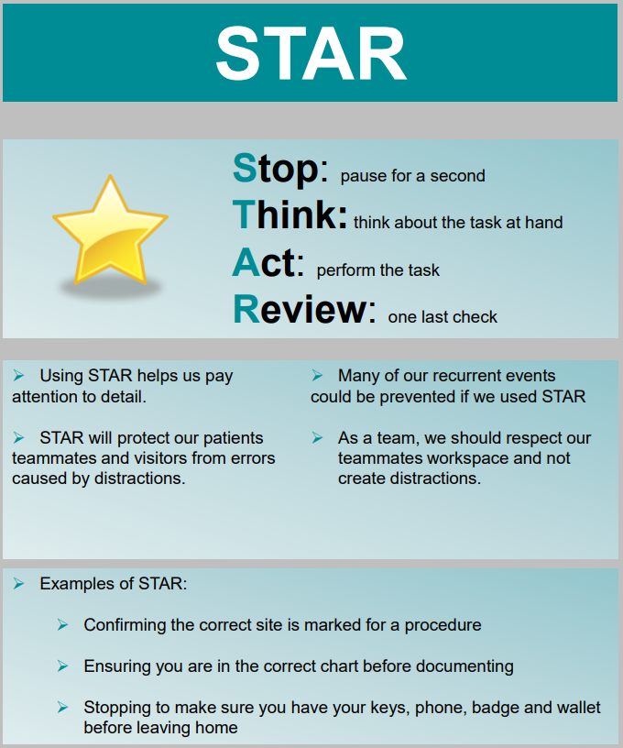

Patient Safety Tool of the Month
November
2023

Slide 9
When to use STAR
When a distraction occurs, and you return to your sample and/or task at hand.
When a problem occurs that you have not encountered before.
When there is time pressure, or a high-risk situation has presented itself.
When coaching others.

Slide 10


Slide 11


December Safety Focus:
Guidelines for Holiday Decorations in the Lab: Overview
Dos
Non-flammable or flame-retardant decorations
Light strands that are UL-approved mini lights with a max of 2 strands attached together
Plug decorations/lights directly into wall (Extension cords are not permitted)
One tree per unit labeled “flame retardant”
Place all decorations below 18 inches from the ceiling
Please see AHWFB Decorations Flyer for additional guidelines
Do nots
No live greenery or preserved organic greenery
No lights on doors, door frames or emergency equipment
Do not obstruct emergency exits or view of emergency exits or safety equipment
Do not penetrate doors with screws/tacks
No open flame candles
This Photo by Unknown Author is licensed under CC BY-NC

Slide 12

High Reliability Organizations
Consider a nuclear power plant, aircraft carrier, or an Atrium Health emergency department…
They all operate under trying conditions with the potential for catastrophic failures.
An airplane has the potential for disaster every time it takes off or lands,
but it does not… Why? Because it is a Highly Reliability Organization.
PREOCCUPATION WITH FAILURE
Every teammate is encouraged to proactively think about how something could go wrong and to remain vigilant for even small problems.
RELUCTANCE TO SIMPLIFY
An HRO digs beyond a simple interpretation to truly uncover and understand the real problem.
SENSITIVITY TO OPERATIONS
Teammates have a keen awareness of the current state of operations and how that state might positively or negatively affect safety.
DEFER TO EXPERTISE
When an issue arises, the expert with the most developed knowledge is consulted, regardless of seniority level.
COMMITMENT TO RESILIENCE
An HRO recognizes that despite best efforts and past safety successes, errors are imminent, and they must be able to rapidly respond to prevent catastrophe. ​​
Notes:
For our Connect to Purpose, I would like to share a story that displays our commitment to being a highly reliable organization. One of the five characteristics of a highly reliable organization is to have a preoccupation with failure. This means that we are always looking at our processes, and ways they could potentially break down before a catastrophic event occurs. As you’ll see, this incident showcases how having a preoccupation with failure can save lives.
A family member rushed into an Urgent Care with an unresponsive patient. In this intense moment, the care team’s ability to communicate and act decisively was crucial. The team immediately called for EMS and determined that the patient was experiencing a drug overdose. The patient’s condition was rapidly deteriorating as they stopped breathing, and their skin began to turn blue. The care team determined that Narcan needed to be administered, and after several doses the patient was responsive, and vital signs were stable. Thankfully, the Urgent Care Service Line saw the importance of adding Narcan to their code carts several years ago, but could this patient have shown up at any of our ambulatory spaces? And would we have been as prepared?
NEXT SLIDE
Having a preoccupation with failure is a mindset that fixates on how things could fail, even if we have not yet experienced the failure. So, despite the rareness of emergent cases like this one in our ambulatory spaces, this event highlights the need for forward thinking and preparedness.
We are also proud to share that the four teammates involved in this emergency situation were recognized with a Good Catch Award. Their exceptional ability to stay focused under pressure, their impressive teamwork sets the standard for our commitment to Zero Harm, for all.

Slide 13

What is Preoccupation with Failure in Lab?
Be inquisitive and curious about everything – this is how we improve and become a more reliable lab
This is YOUR Lab…
Ask clarifying questions when you’re unsure about a process or want to bring awareness to it
Stop for a moment Think about how something could go wrong with your lab processes, Act to make a change, don’t keep it to yourself! and always Review with Managers

Slide 14

Please contact the Quality, Safety and Accreditation Team if you have any quality or safety concerns.
QS_A@wakehealth.edu

