Slide 1
Safety Presentation
1.2024 | Department of Lab & Pathology

Slide 2

Patient Safety

Slide 3

Good Catches
for
December 2023

Slide 4

Good Catch Recipient
December 2023

Slide 5
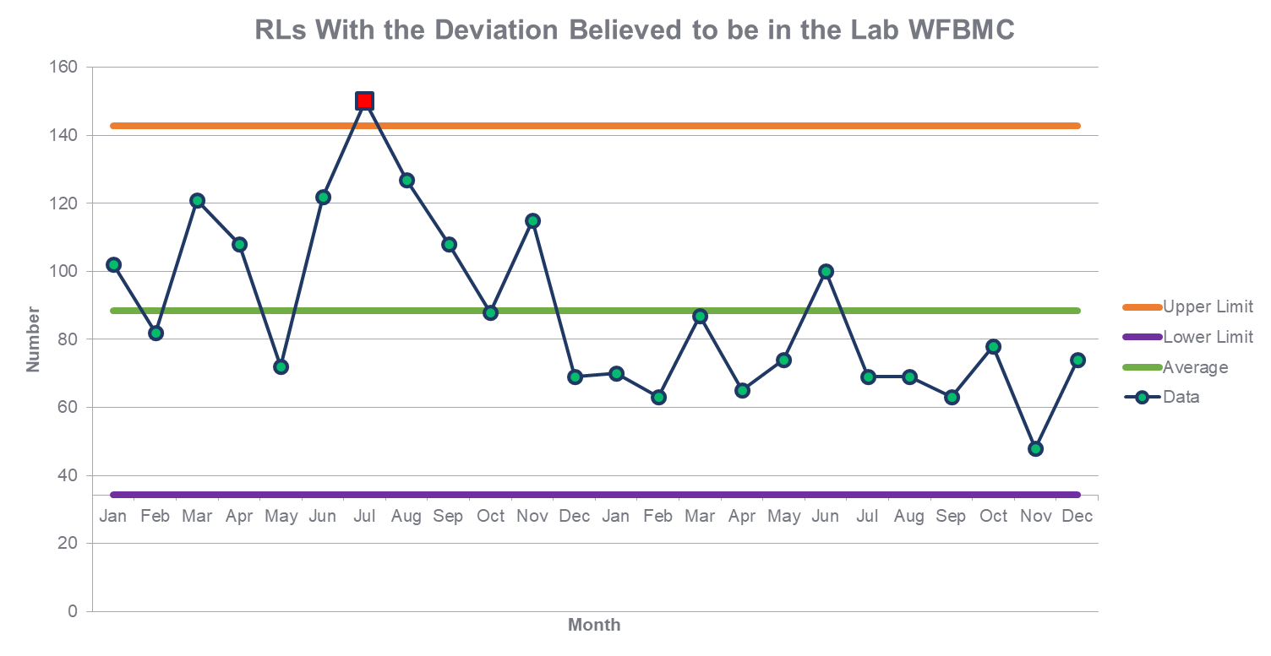

Slide 6
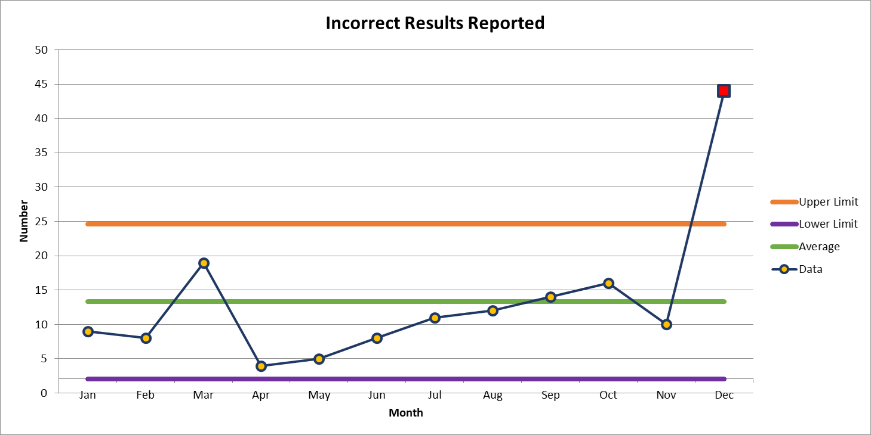
Most Common Deviation in a WFBMC Lab

Slide 7
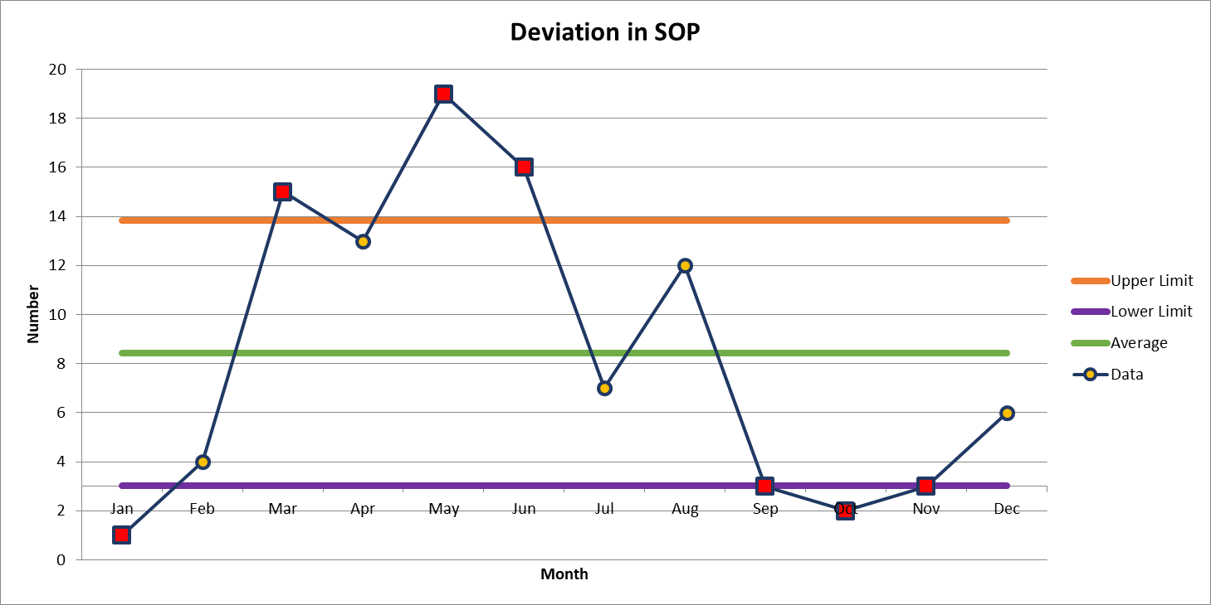
2nd Most Common Deviation in a WFBMC Lab

Slide 8

Patient Safety Awareness

Slide 9
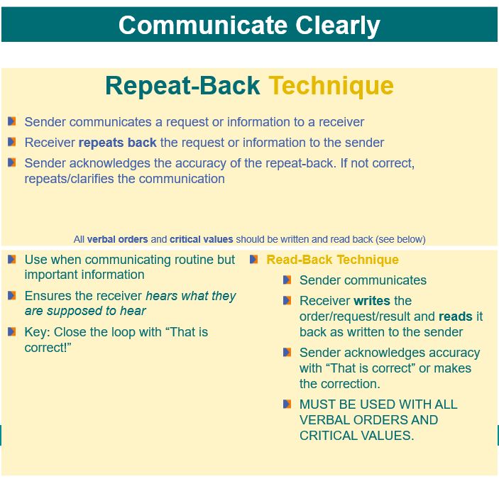

Patient Safety Tool of the Month
January
2024

Slide 10


Slide 11

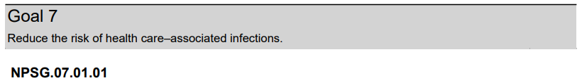
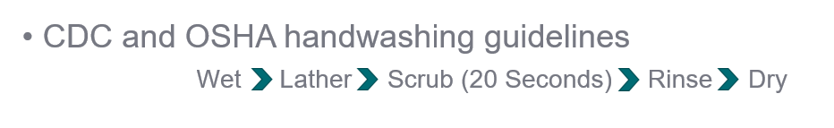

Slide 12
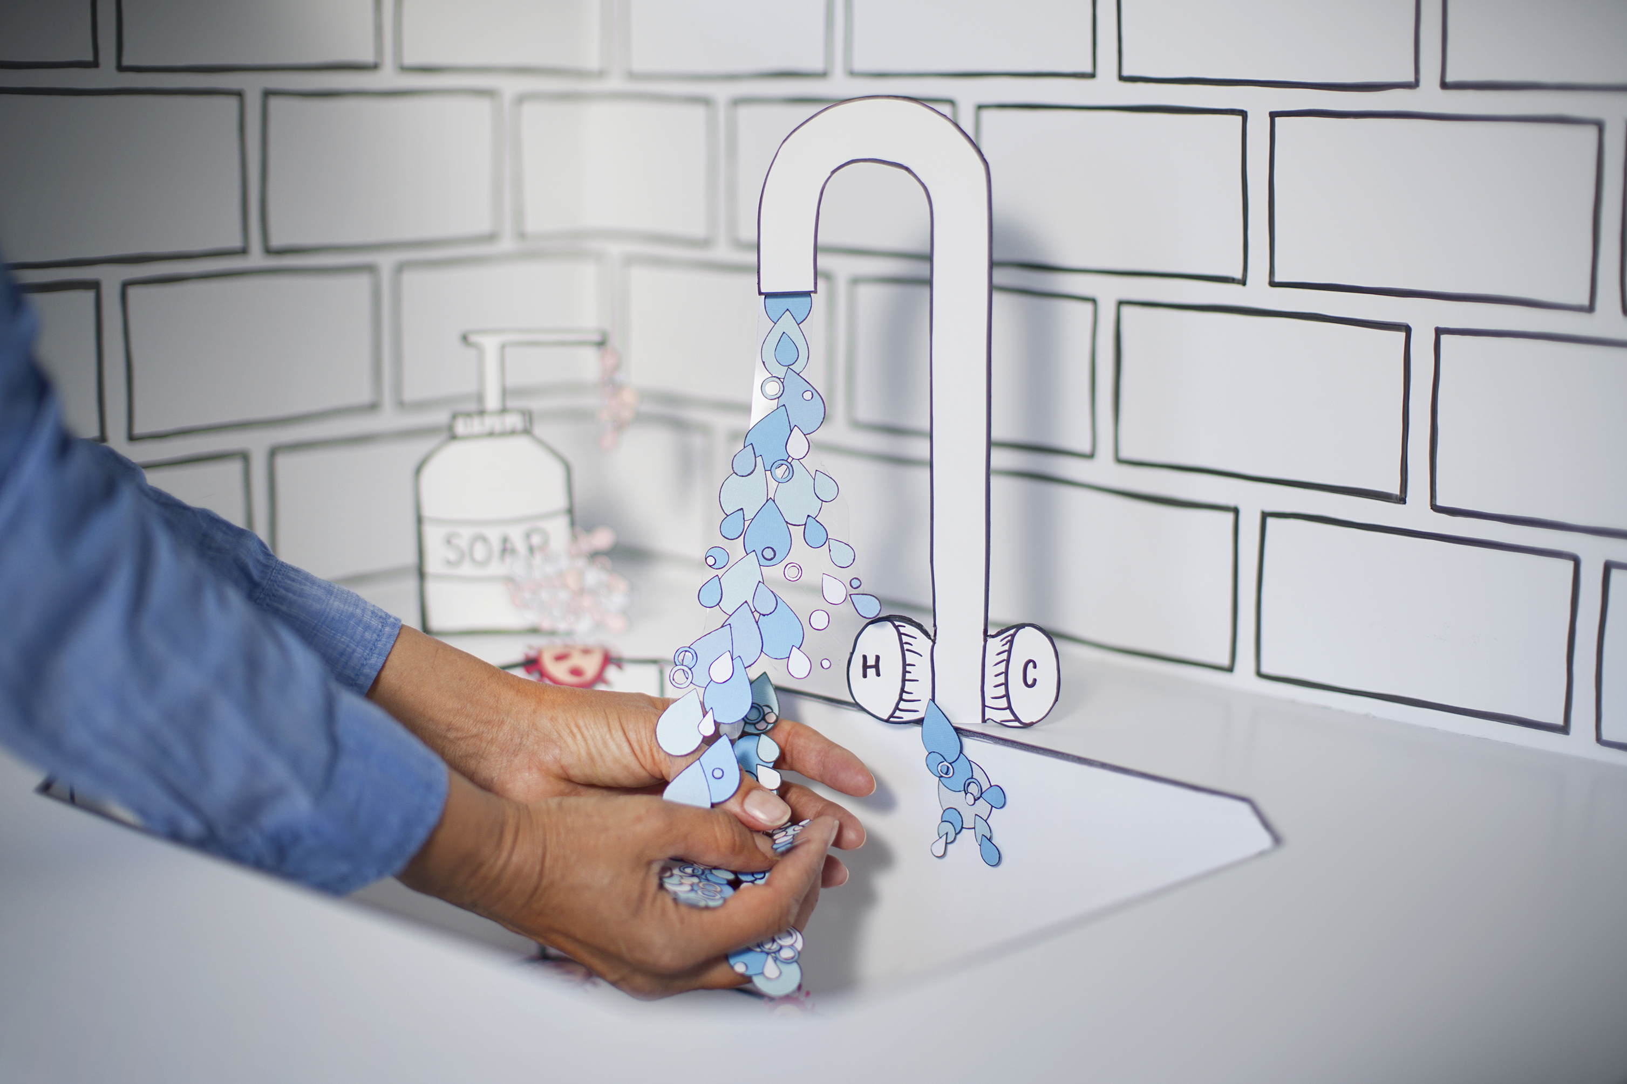
When to wash your hands
After removing your gloves
Before leaving the lab
After patient contact

Slide 13

Please contact the Quality, Safety and Accreditation Team if you have any quality or safety concerns.
QS_A@wakehealth.edu

