Slide 1
Safety Presentation
2.2024 | Department of Lab & Pathology

Slide 2
Patient Safety

Slide 3
Great Catches January 2024
Date Reported | RL# | Good Catch Employee | Description of Event | Site
1/4/2024 | 352031 | Molly Baily | Molly Baily, clinical lab, received a sample in the lab with a Troponin value of 1,056. She recalled that the patient had a previous Troponin value of <3 and reached out to the patient's provider to inquire. The provider questioned that result as well. A recollect was ordered. The recollected sample had a result of <3 as well. Molly's clinical correlation of the discrepant Troponin values with previous values was an essential part of patient care. | HPMC
1/7/2024 | 352043 | Terry Myers | Terry Meyers, clinical lab, received a CBC sample from the ER with a hemoglobin result of 4.3. She noticed that the patient had a previous hemoglobin of 10.8 a few days prior. She called the patient's provider, and both agreed that a recollect was needed. The recollected sample had a value of 10.2, which was align clinically with previous values. Terry's correlation of the discrepant hemoglobin results with previous results was an essential part of patient care! | HPMC

Slide 4
Great Catch Recipient
Terry Myers
AH WFB HPMC
Picture Not Available

Slide 5
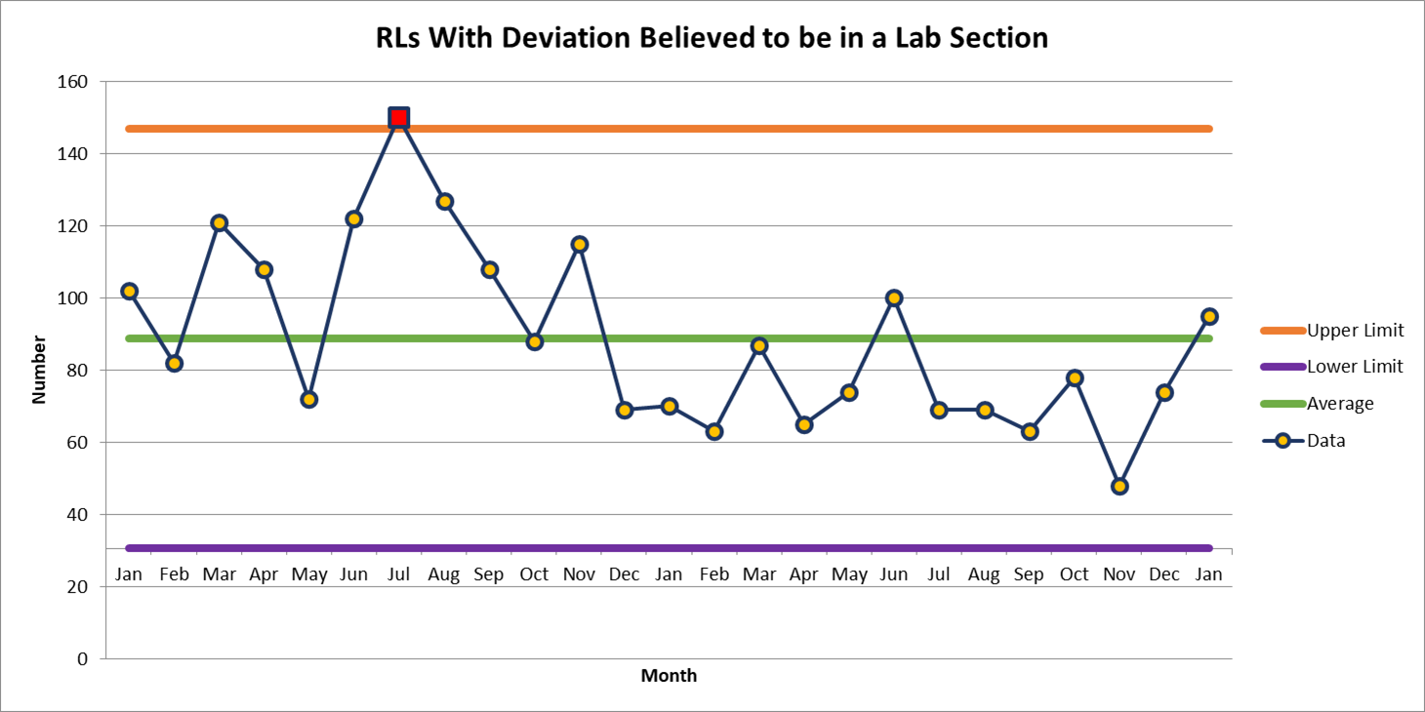
WFBMC

Slide 6
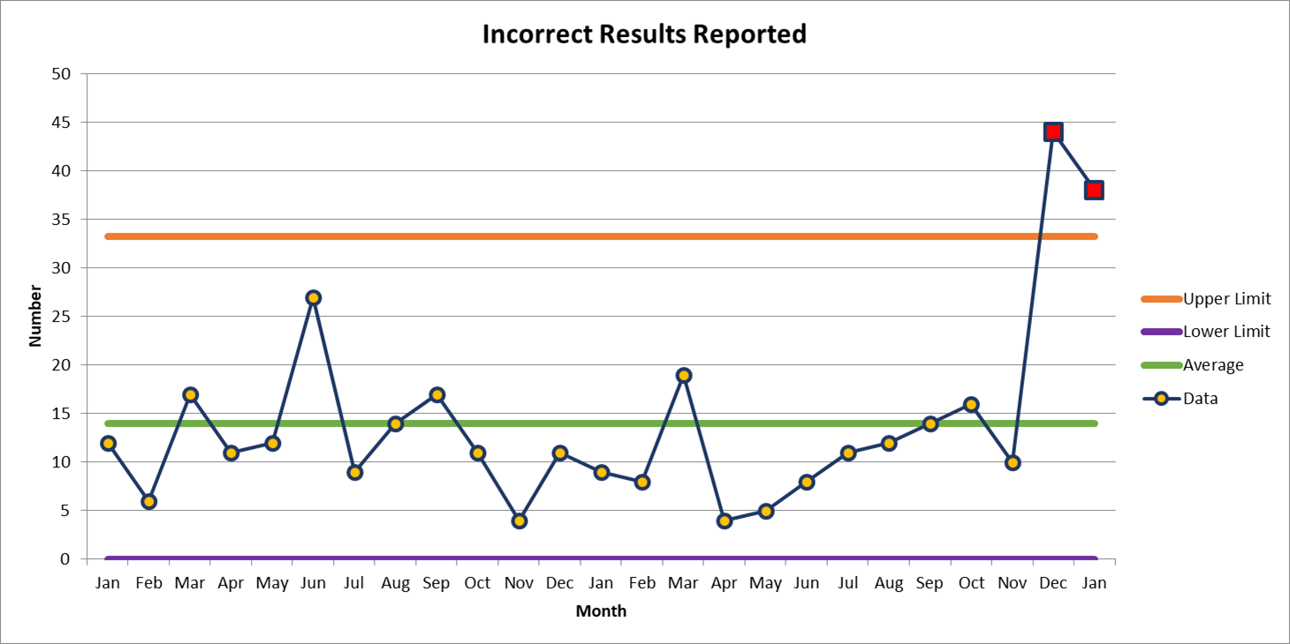
Top Deviation

Slide 7
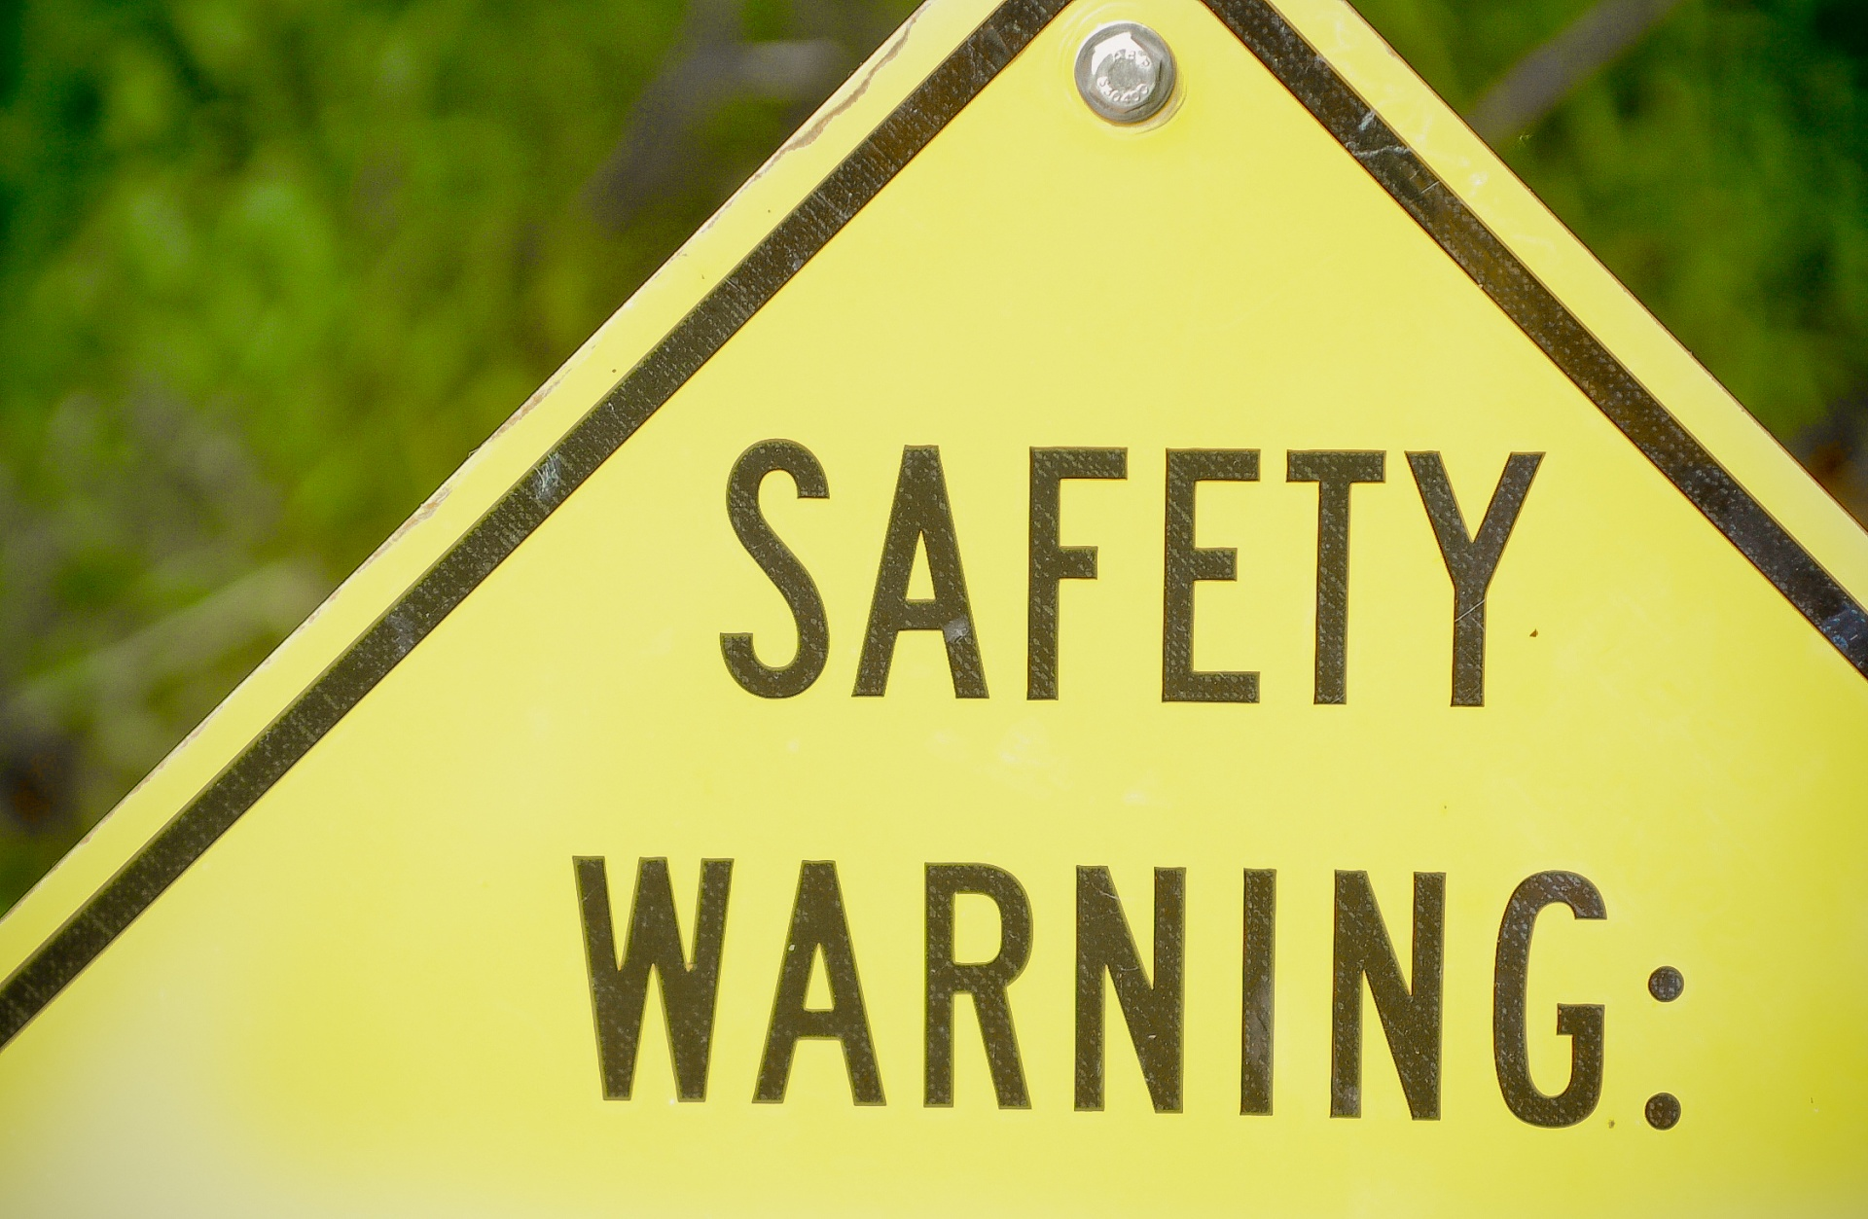

Slide 8
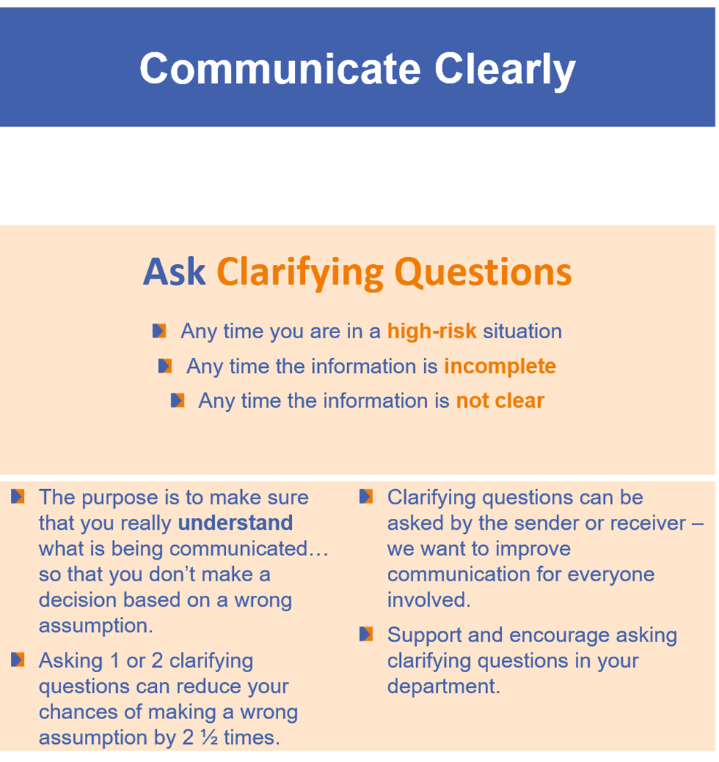
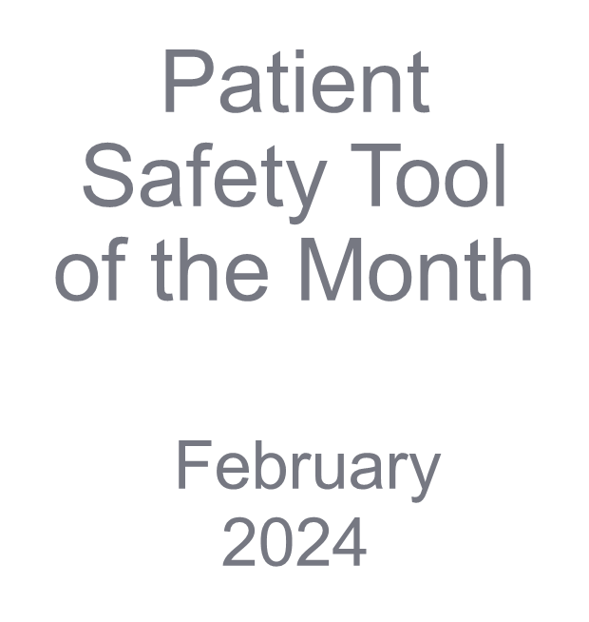

Slide 9
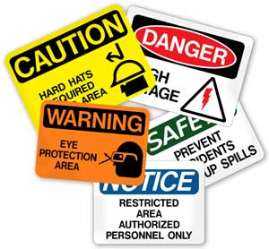
This Photo by Unknown author is licensed under CC BY-ND.

Slide 11
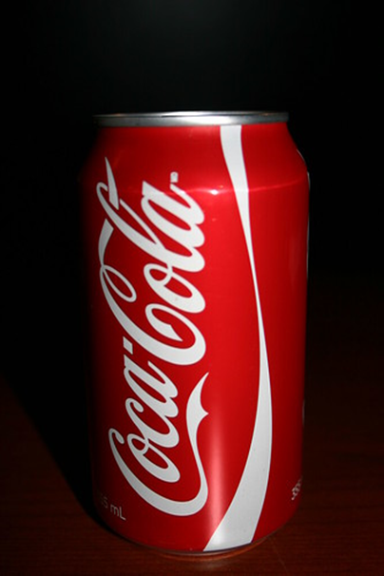
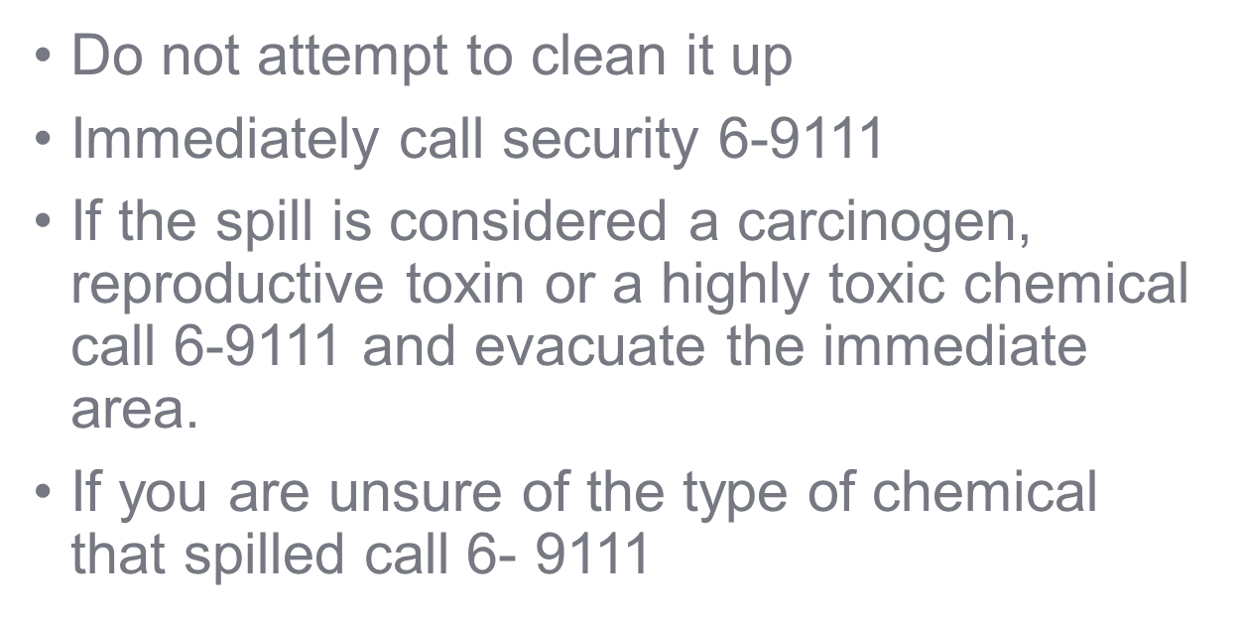
About 300cc

Slide 12
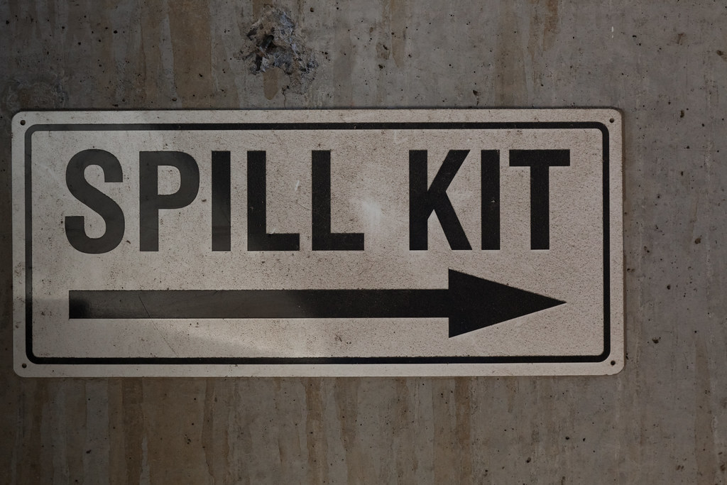

Slide 13
Thank You!

Slide 14
Please contact the Quality, Safety and Accreditation Team if you have any quality or safety concerns.
QS_A@wakehealth.edu

