Slide 1
Safety Presentation
3.2024 | Department of Lab & Pathology

Slide 2

Patient Safety

Slide 3
Great Catches
February 2024

Slide 4
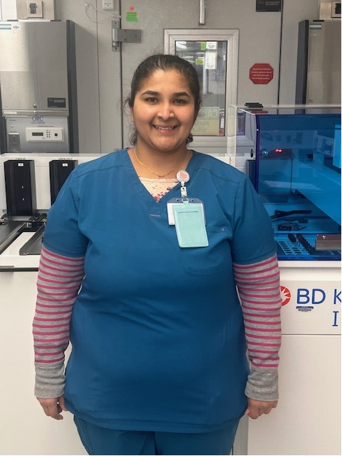
Great Catch Recipient for
February 2024
Pinal Gandhi
Microbiology
WFBMC

Slide 5
WFBMC
Feb 67

Slide 6
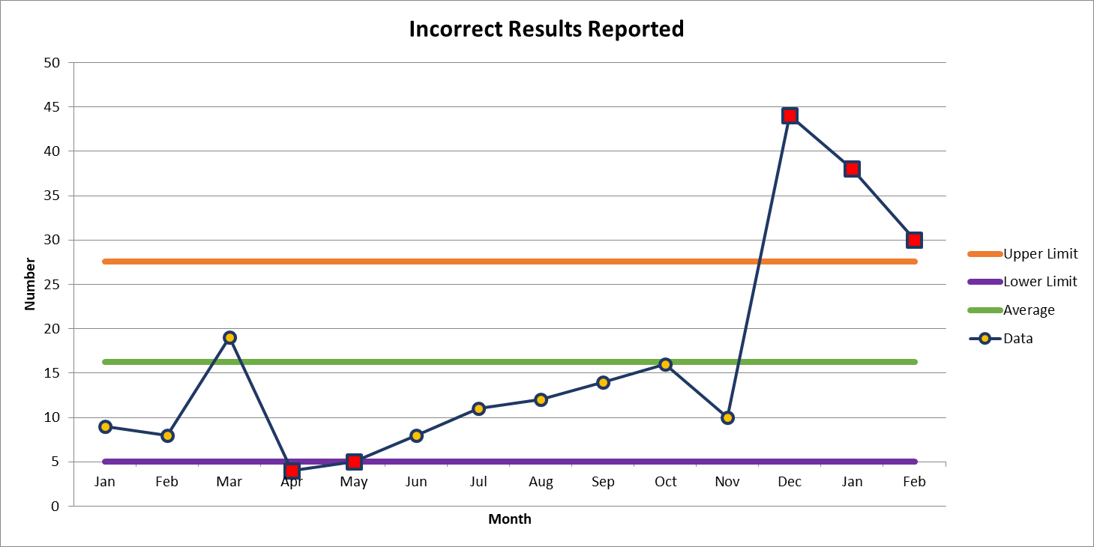
Top Deviation
February 30

Slide 7

Patient Safety Awareness

Slide 8

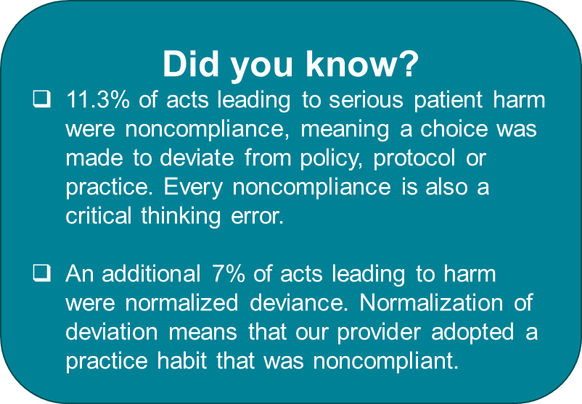

Patient Safety Tool of the Month
Knowing and Complying with Policies
Stop if rules do not make sense
Know Why and Comply
Use know why and comply when making choices based on policy, protocol and professional practice.

Slide 9


Slide 10
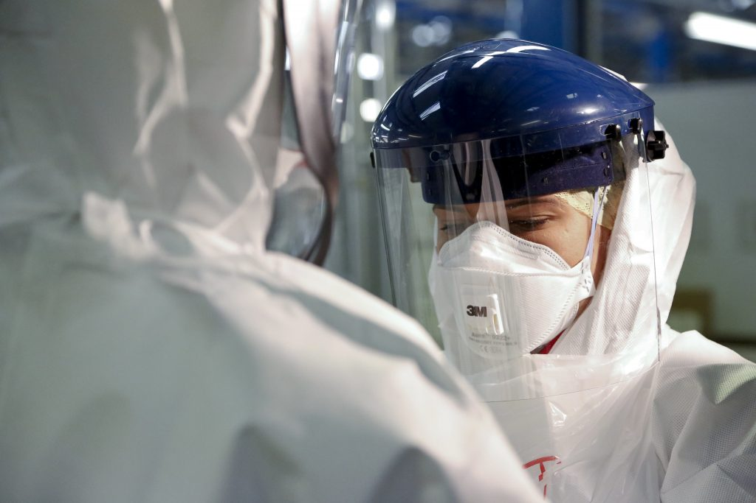
Personal Protective Equipment (PPE)

Slide 11
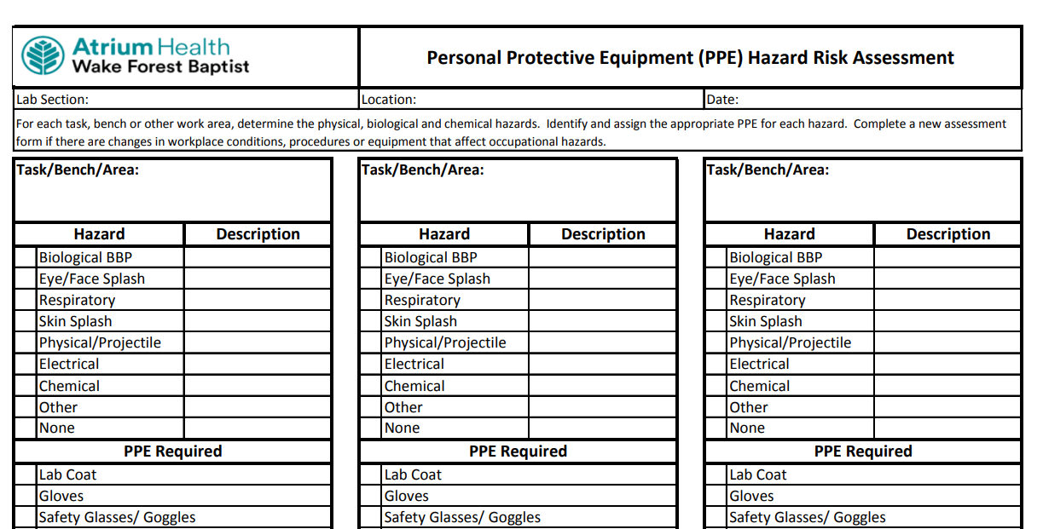
SAFE-POL-0001
PPE/Hazard Assessment Policy
Hazard Assessment Process:
Each lab section manager in collaboration with laboratory employee(s) if needed will complete a hazard assessment annually and when changes in the lab occur, such as new tasks, new equipment, new chemicals.
When performing the hazard assessment, the team will use the hierarchy of control to determine the most effective and applicable protection to the employee.

Slide 12
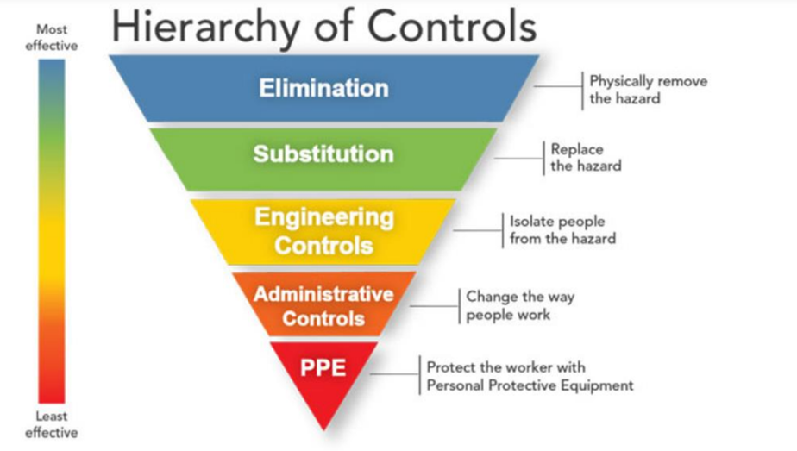

Slide 13
PPE Options
Eye and Face Protection (Goggles/Face Shields/Splash Guards)
  All eye protection equipment must be American National Standards Institute (ANSI) approved and appropriate for the work being done. ANSI A87.1
Foot Protection (Shoes/Footwear)
  If shoe covers are recommended, they must protect the entire foot.
Hand Protection (Gloves)
  All personnel should remove gloves and clean hands using an effective antimicrobial method following contact with blood or other potentially infectious materials or after each patient contact.
Skin (other than hands) and Body Protection (Lab Coats)
  Lab coats must be appropriately sized for the individual and be fastened (snap buttons are recommended) to their full length.
  Lab coat sleeves must be of a sufficient length to prevent skin exposure while wearing gloves.
  Sleeves are never to be worn “pushed up” on the arms.

Slide 14
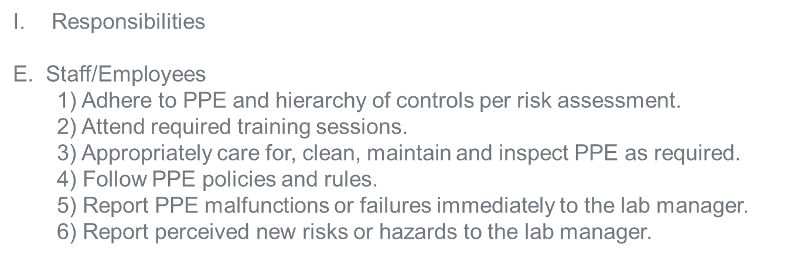
Our Responsibility

Slide 15
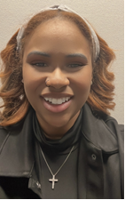
Laboratory Safety Coordinator
Wake Market
Tiffanee James joined the Quality, Safety and Regulatory Affairs Team on March 11th, 2024, as the Safety Coordinator for the Wake Market.
We are excited for the work that she is going to do. Her primary focus will be to work with lab leaders regarding non-conforming events reported via RL reporting and faculty, staff, and patient complaints.
She will also continue some of the other work that previous Safety Coordinators have done such facilitating the Safety Coaches meeting, maintaining the Lab Safety Manual, oversight of vendor alerts, and assisting with keeping the SPOT spreadsheet up to date.
tijames@wakehealth.edu
716-4347

Slide 16

Thank You!

Slide 17

Please contact the Quality, Safety and Accreditation Team if you have any quality or safety concerns.
QS_A@wakehealth.edu

