Slide 1
Safety Presentation
4.2024 | Department of Lab & Pathology

Slide 2
Patient Safety

Slide 3
Great Catches March 2024
Date of Event | Lab Section | Employee Involved | Description of Event
3/1/2024 | HP Laboratory | Delana Spillman | Delana Spillman, clinical laboratory, identified a patient with a critical high White Blood Count that came in through the ER. After noting that there was no pathology evaluation history on file, Delana immediately escalated to a pathologist for evaluation so that the proper Oncology assessment could be initiated by the proper physician.

Slide 4
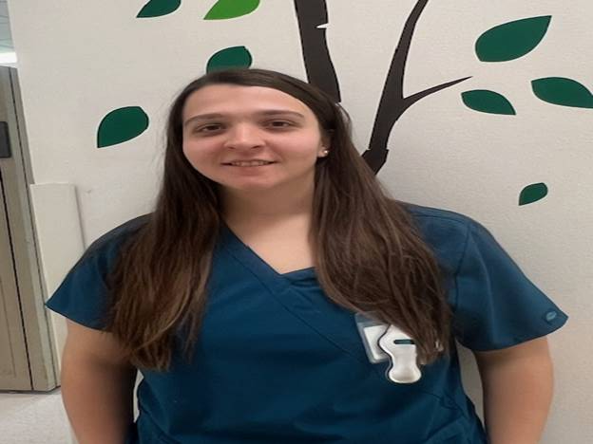
Great Catch Recipient
Delana Spillman
High Point Medical Center

Slide 5
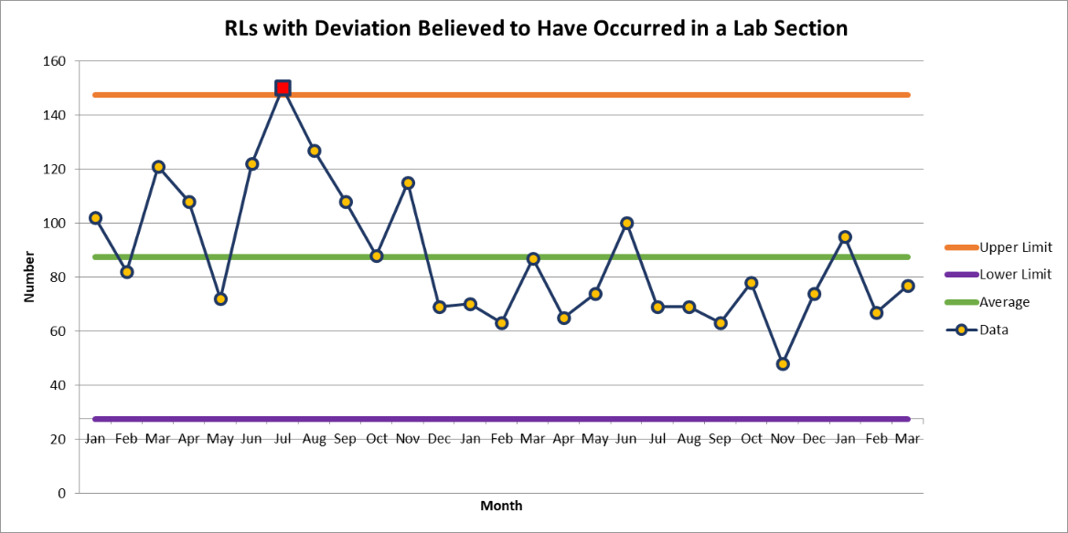
WFBMC
WFBMC 77

Slide 6
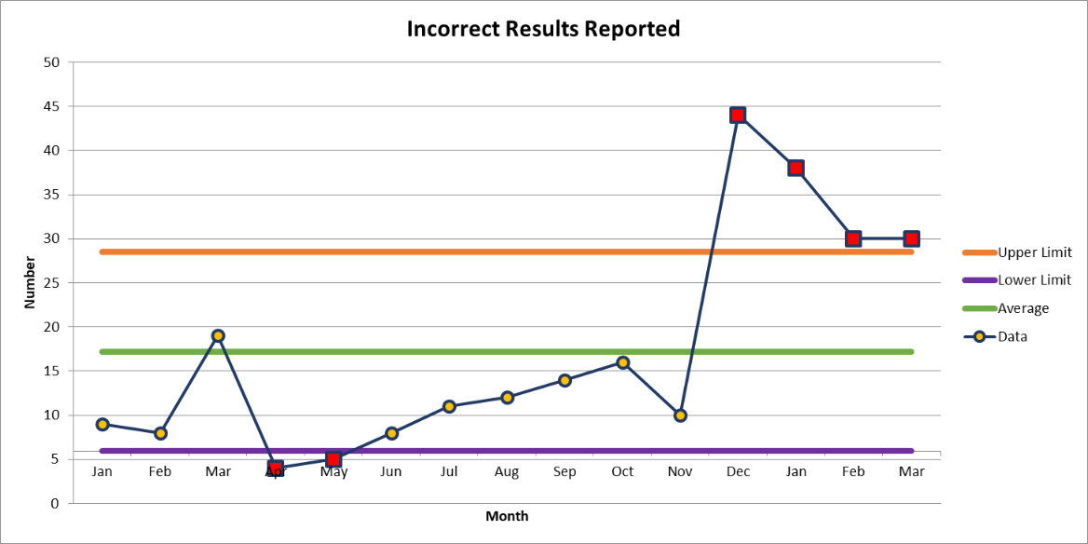
Top Deviation
March 30

Slide 8
Patient Safety Tool of the Month
Practice With & Accept Questioning Attitudes
Q- Qualify (Do I trust this source?) V- Validate (Does it make sense to me?) V- Verify (Check with an expert source)
A questioning attitude is the single most effective Critical Thinking Tool! A quick way to detect incorrect information and assumptions BEFORE you act. Qualify and Validate are quick checks in your head. Verify takes a little more time but addresses that feeling in your gut (your smoke detector). | Always Verify when: Your smoke detector goes off There is a change in plans You are in a high-risk situation You are in a new situation
March ​
2024

Slide 9
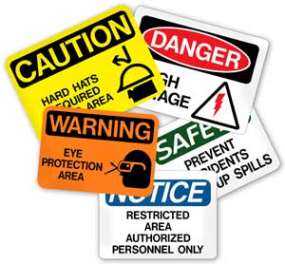
This Photo by Unknown author is licensed under CC BY-ND.

Slide 10
SAFE-POL-0007 Handling Contaminated Requisitions
Step 1:
It is the responsibility of the person first encountering the contaminated requisition to prevent any other person from being exposed.

Slide 11
Handling Contaminated Requisitions
Step 2: ​
Handle contaminated requisitions in one of the following ways: ​
Copy​
Place the contaminated requisition in a plastic sheet cover.​
Make a copy of the contaminated requisition.​
Discard the contaminated requisition.​
Use the requisition copy.

Slide 12
Handling Contaminated Requisitions​
Decontaminate​
Place the contaminated requisition on a dry paper towel.​
Soak the spot on the requisition with a decontaminating solution such as 1:10 Clorox. ​
Allow the requisition to dry. ​
Beside the contaminated spot, write “decontaminated” – date and initial.​

Slide 13
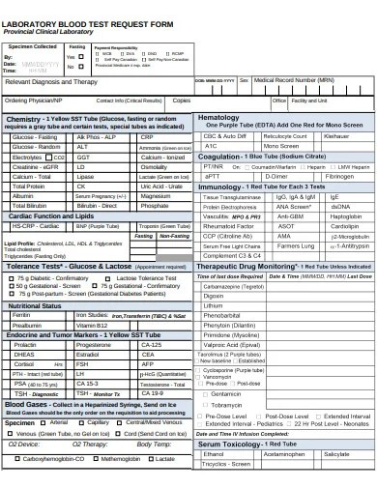
Handling Contaminated Requisitions
Replace
If the requisition is saturated with blood and/or body fluids or so contaminated that it cannot be easily handled, a new requisition should be requested.

Slide 14
Thank You!

Slide 15
Please contact the Quality, Safety and Accreditation Team if you have any quality or safety concerns.
QS_A@wakehealth.edu

