Slide 1
Safety Presentation
5.2024 | Department of Lab & Pathology

Slide 2
Patient Safety

Slide 3
Great Catches April 2024
There were no Great Catches reported for Lab personnel during the month of April.
Enter all Great Catches into the RL reporting system under Good Catch as well as email Tiffanee James @ tijames@wakehealth.edu

Slide 4
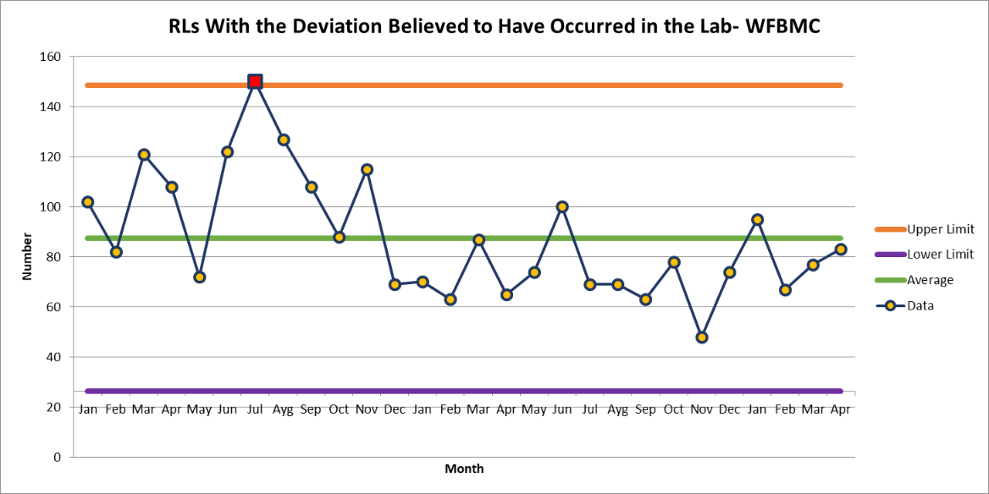
WFBMC
WFBMC 83

Slide 5
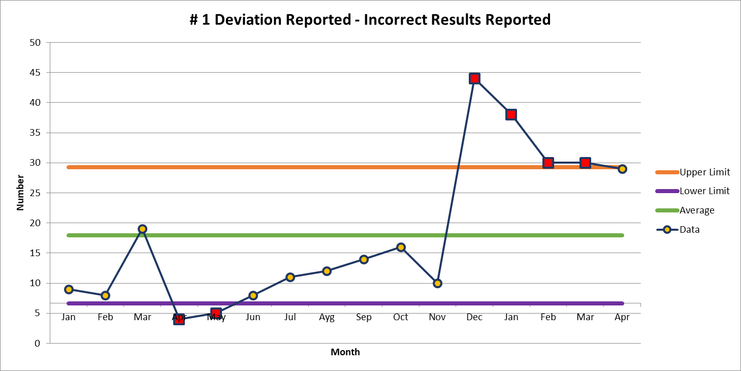
April 29

Slide 6
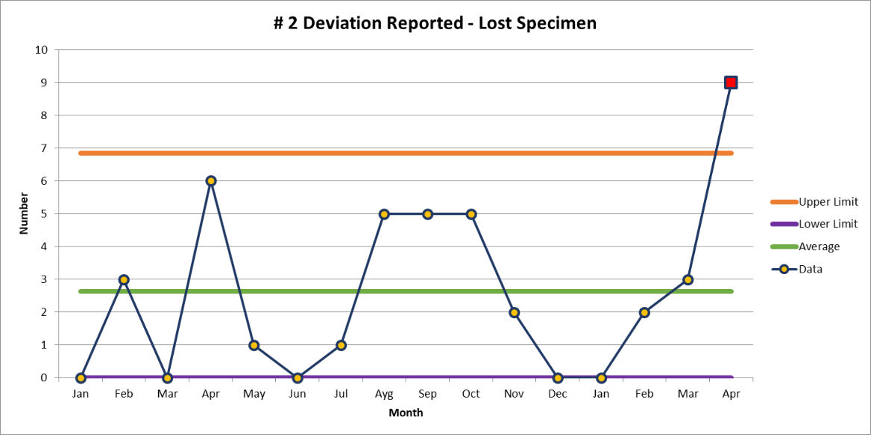
April 9

Slide 8
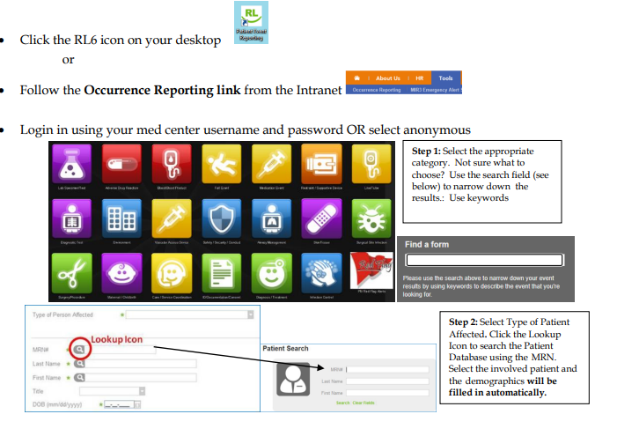
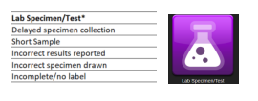
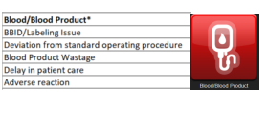
Patient Safety Tool of the Month

Slide 10
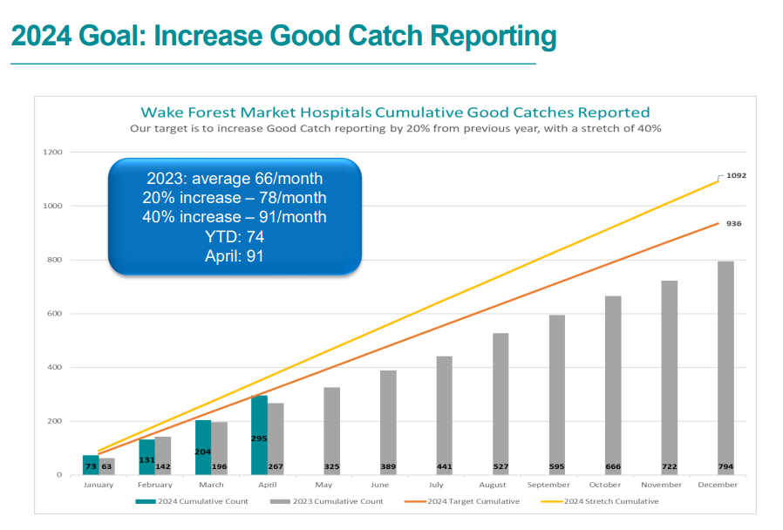

Slide 11
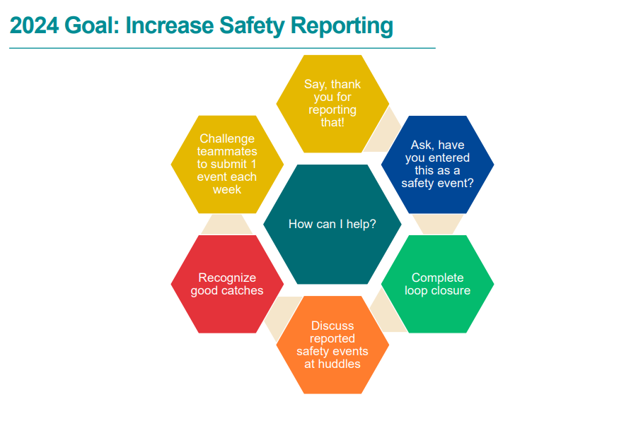

Slide 12
This Photo by Unknown author is licensed under CC BY-ND.

Slide 13
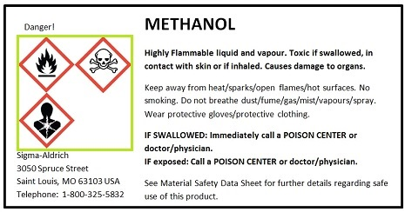
SAFE-POL-0006 Reagent Labeling
Reagent Labeling (COM.30300)
Step 1:
All reagents, calibrators, controls, stains, chemicals, and solutions must be properly labeled as applicable and appropriate with the following elements:

Slide 14
Reagent Labeling
Primary Container:
i. Content and quantity
ii. Concentration or titer
iii. Storage requirements
iv. Date prepared, filtered, aliquoted, or reconstituted.
v. Expiration date
vi. Preparer’s initials
vii. Safety/Hazard information (GHS) (GEN.76200)
Secondary Container:
i. Identity/description of contents
ii. Quantity/concentration or titer if applicable
iii. Storage requirements
iv. Date prepared, filtered, aliquoted, reconstituted, etc.
v. Expiration date
vi. Lot # if applicable
vii. Preparer’s initials
viii. Safety/Hazard information (GHS)

Slide 15
Reagent Labeling
Step 2.
​Information on the label that a user would need to know to properly use a solution should be included.
Examples:
Silver Nitrate Stain: Minimize light exposure may be written on the label in addition to the other information.
Glucose Control: You must change the expiration date once you open the bottle. The new expiration date should be written on the label.

Slide 16
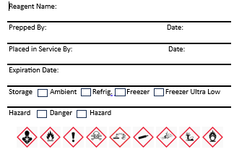
Reagent Labeling
Step 3.
All primary and secondary container labels are neat and legible at all times. Replace labels that are stained, faded or begin to peel. Labels that are not legible are safety issues that could lead to harm to employees and/or patients.

Slide 17
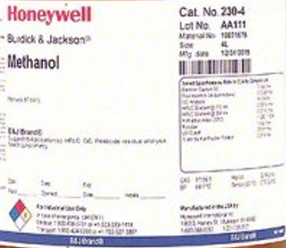
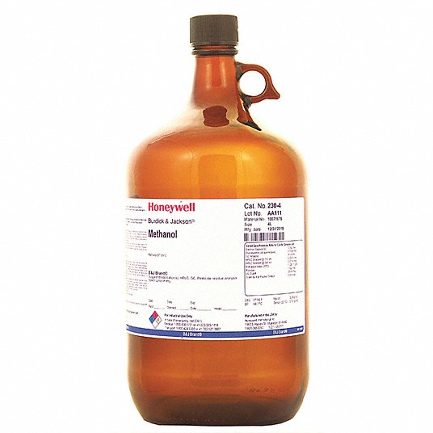
Reagent Labeling
Step 4.
Each lab section will ensure that labels in incoming containers of hazardous chemicals are not removed or defaced.
(OSHA CFR.1910.1200(b)(3)(i))

Slide 18
Thank You!

Slide 19
Please contact the Quality, Safety and Accreditation Team if you have any quality or safety concerns.
QS_A@wakehealth.edu

