Slide 1
Safety Presentation
6.2024 | Department of Lab & Pathology

Slide 2
Patient Safety

Slide 3
Great Catches May 2024
Date Reported | RL# | Good Catch Employee | Description of Event | Site
5/1/2024 | 363088 | Paul Shamel | Paul Shamel was performing a routine lymphocyte subset analysis by flow cytometry when he noticed some odd results from the cytometer. He alerted the specialist technologist to the oddity and through further, more refined testing it was determined that the patient had an undiagnosed lymphocyte neoplasm. | WFBMC
5/2/2024 | 363240 | Lydia DiCandia | Lydia saw that the microbiology sample was collected incorrectly and poured off the Hematology sample before it was run, so that the Micro test could still be run without needing to re-collect. | WFBMC
5/17/2024 | 364736 | Adam Morgan | Exposure labs on the above patient were ordered incorrectly under the patient's account. These labs were reordered to be run under the employee health submitter. However, the labs were incorrectly re-ordered under a completely different patient with very similar demographics : Portillo, Keyla Samantha (MRN 21526323) DOB: 6-22-1999 Compare with actual patient: Portillo, Keylin Mata (MRN 21680668) DOB 6-22-1994 This was caught by myself before samples were run, and the patient was not forced to be re-drawn. | WFBMC

Slide 4
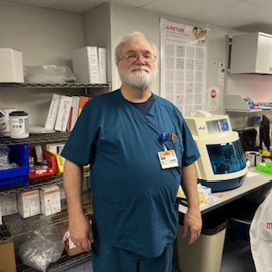
Great Catch Recipient May 2024
Paul Shamel
WFBMC Flow Lab

Slide 5
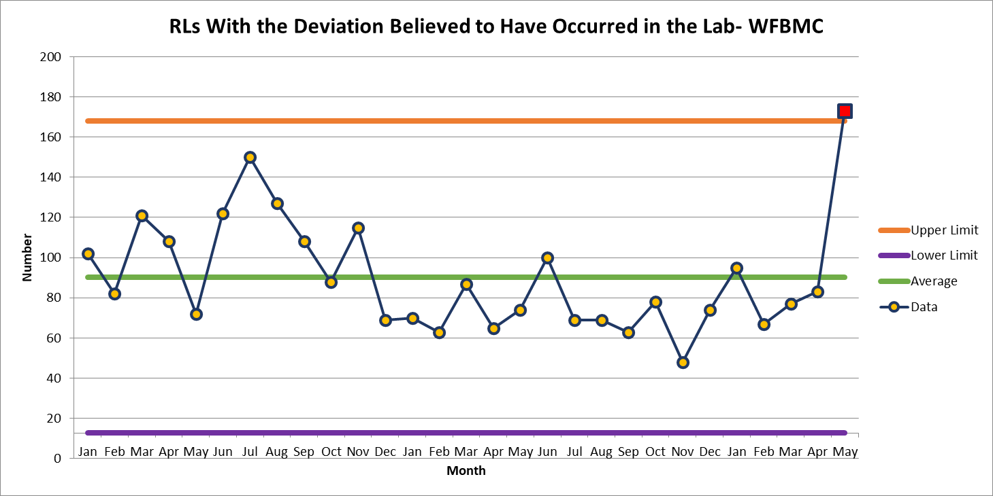
WFBMC 173

Slide 6
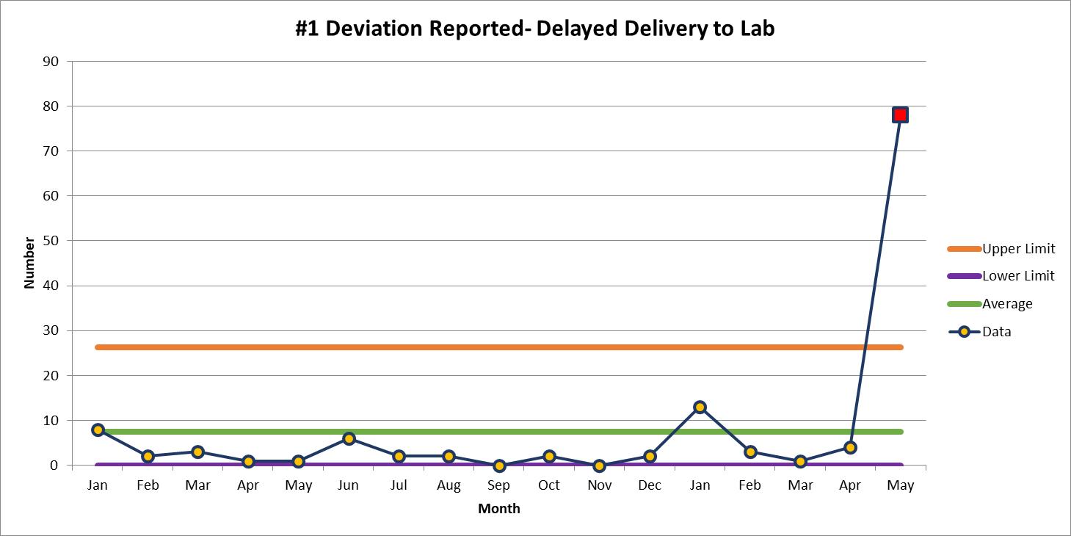
May 78

Slide 7
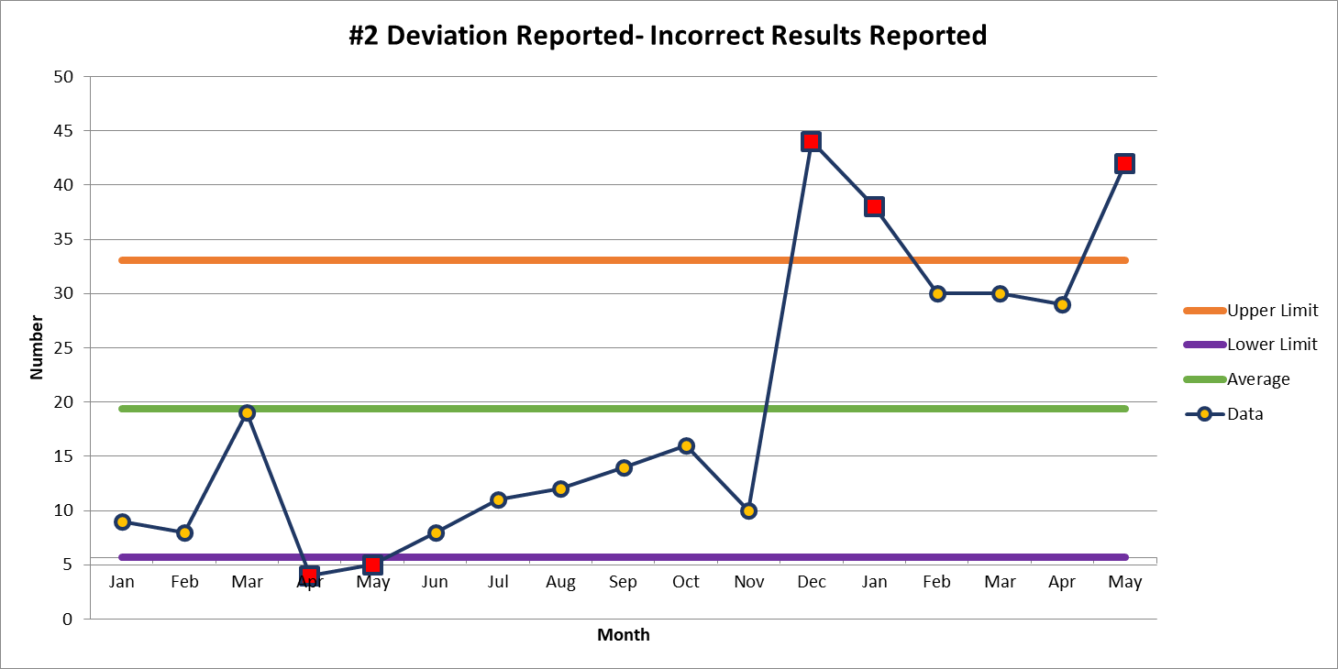
May 42

Slide 9
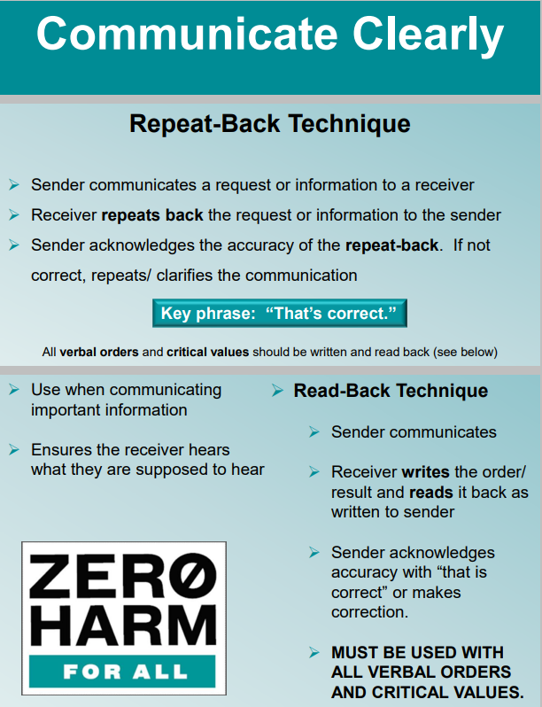
Patient Safety Tool of the Month

Slide 10
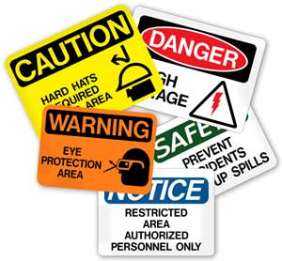
This Photo by Unknown author is licensed under CC BY-ND.

Slide 11
Lab Employee Hazard Awareness
June’s Topic – Sharps Safety
Needles and Scalpels

Slide 12
Needles
Do not recap
Do not bend
Do not remove needles from syringes with your hands
Dispose of immediately after use

Slide 13
Scalpels
When possible….
Use disposable blades
Use a fixed blade with a handle
Do not use excessive force or sawing motions

Slide 14
Things to think about
Check fullness of sharps disposal containers frequently
If container is too full, employees could be punctured or cut by protruding sharps
Keep sharps disposal containers close to areas where sharps are used

Slide 15
What to do if exposure occurs
Let it bleed
Wash it
Cover it
Report it by calling or visiting Employee Health
336-716-4801

Slide 16
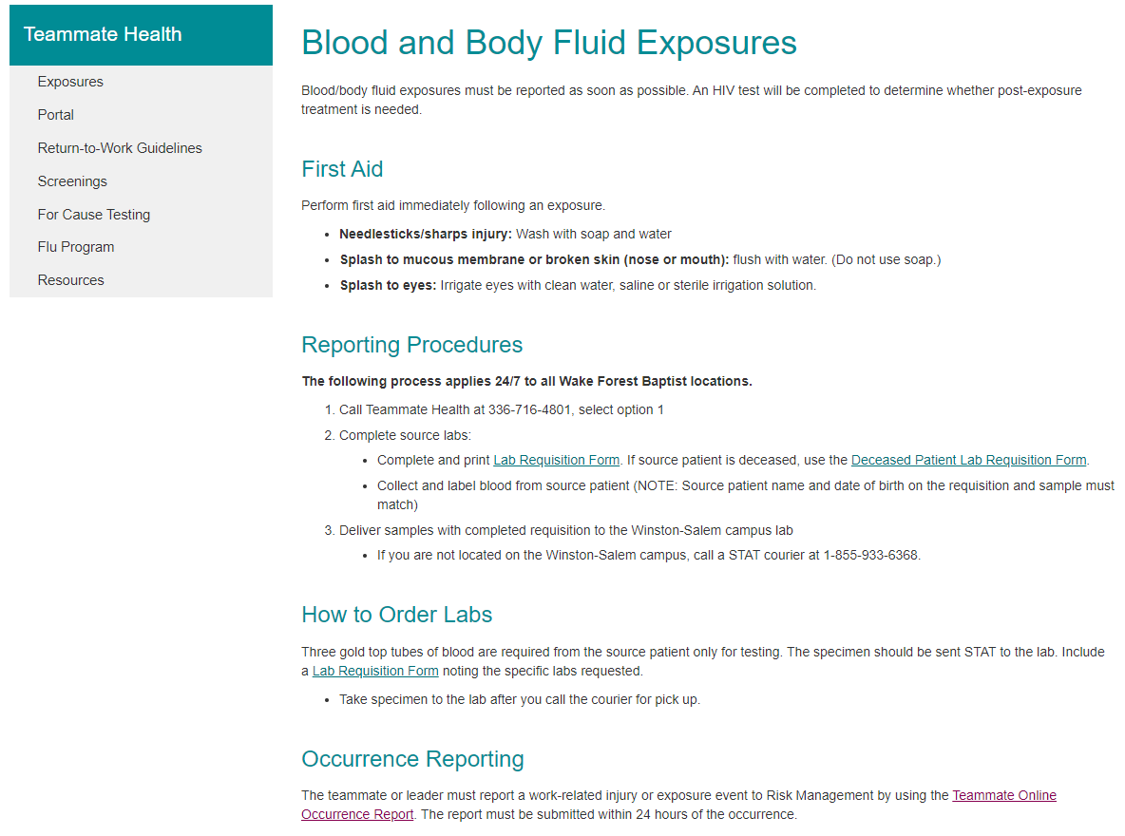

Slide 17
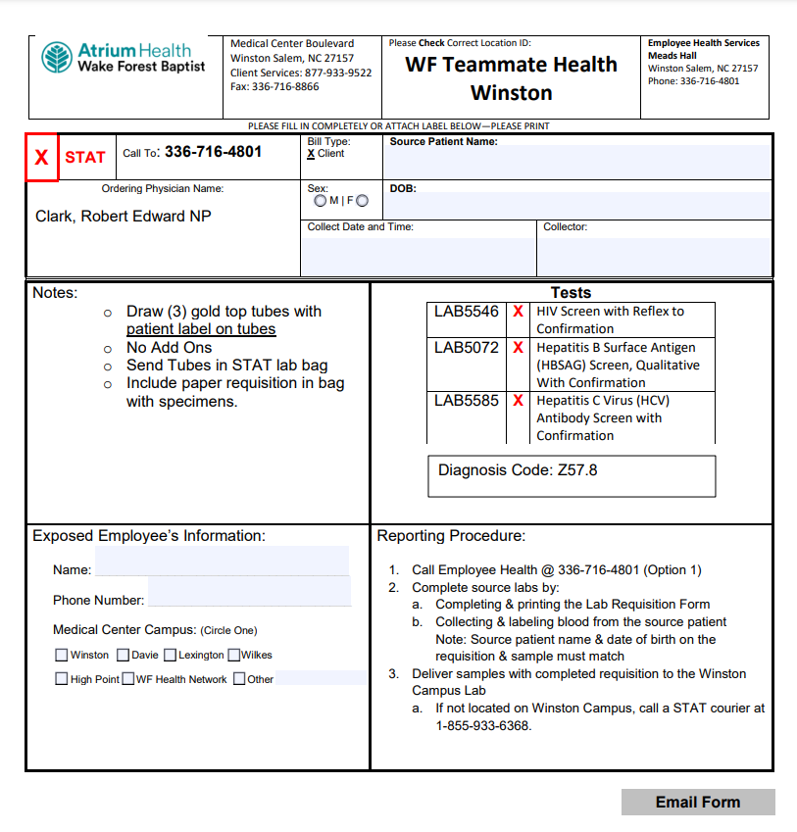

Slide 18
Thank You!

Slide 19
Please contact the Quality, Safety and Accreditation Team if you have any quality or safety concerns.
QS_A@wakehealth.edu

