Slide 1
Safety Presentation
7.2024 | Department of Lab & Pathology

Slide 2
Patient Safety

Slide 3
Good Catches June 2024
There were no Good Catches reported for Lab personnel during the month of June.
Enter all Good Catches into the RL reporting system under Good Catch as well as email Tiffanee James @ tijames@wakehealth.edu

Slide 4
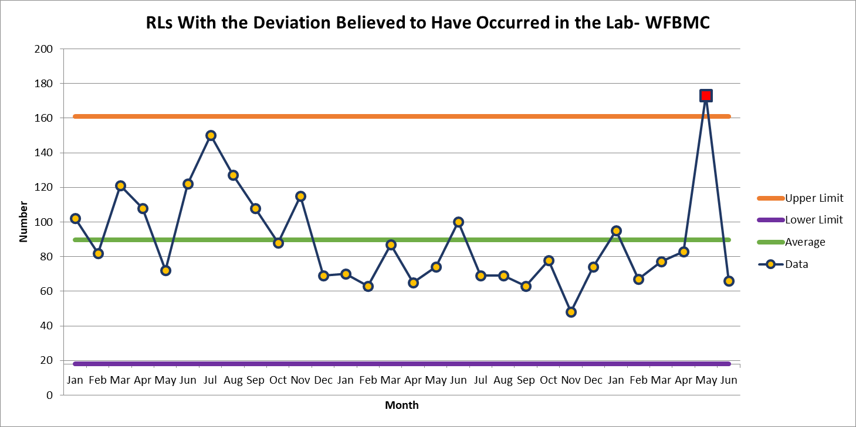
WFBMC 66

Slide 5
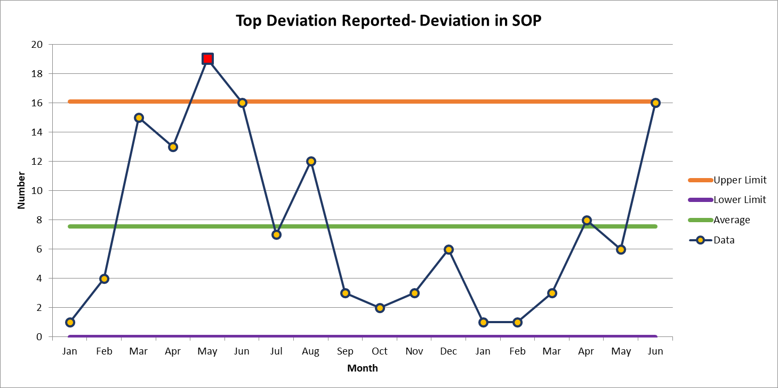
June 16

Slide 6
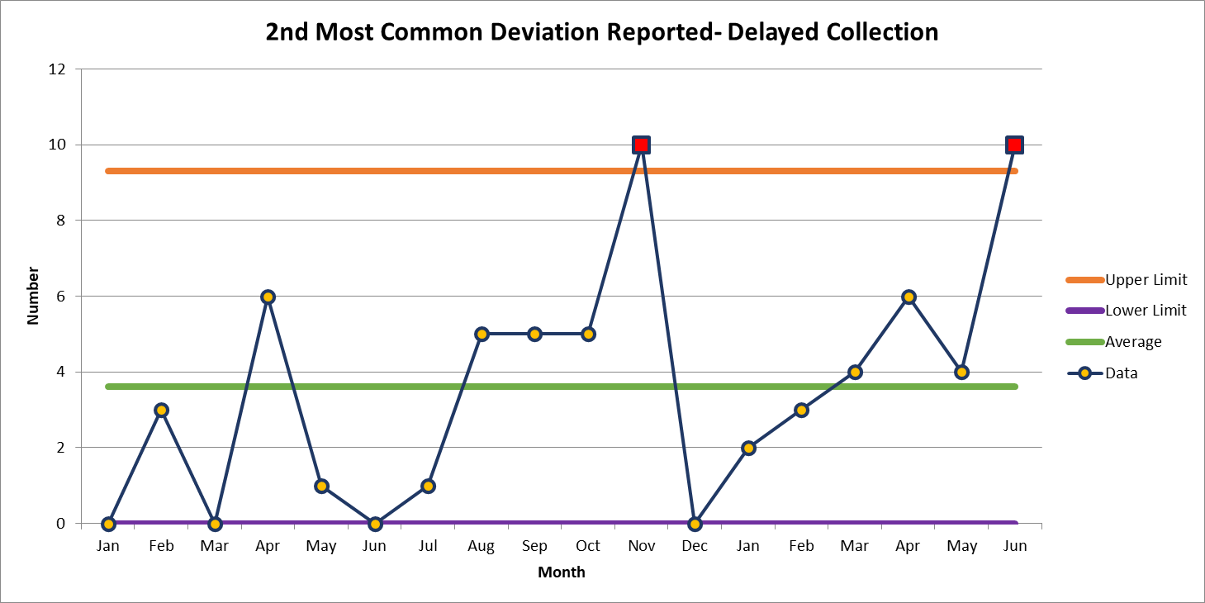
June 10

Slide 7
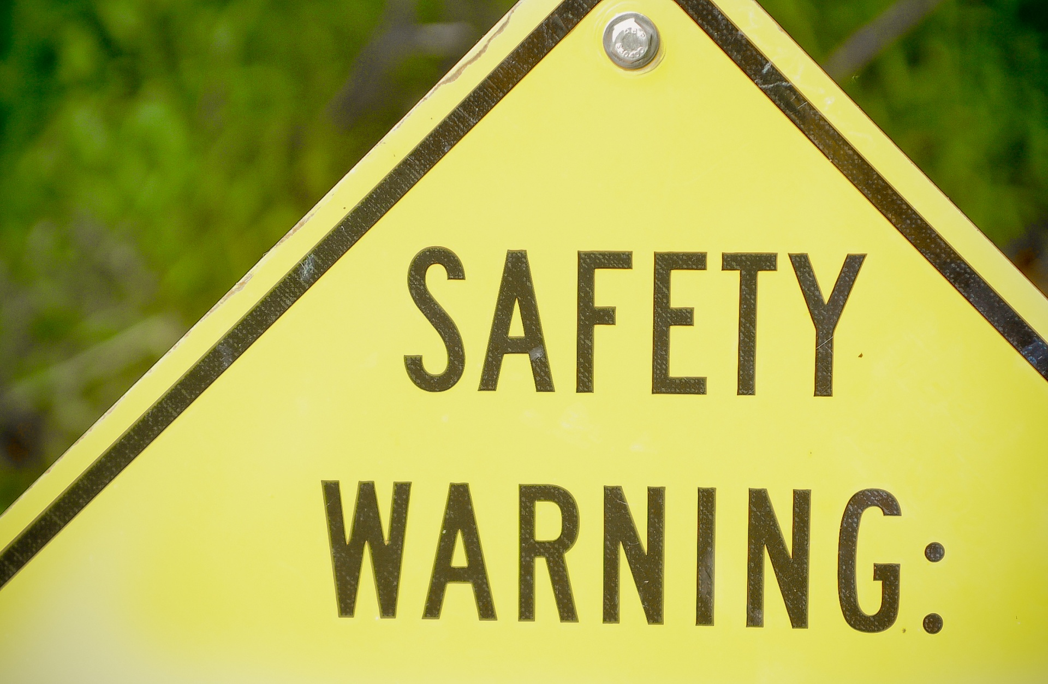

Slide 8
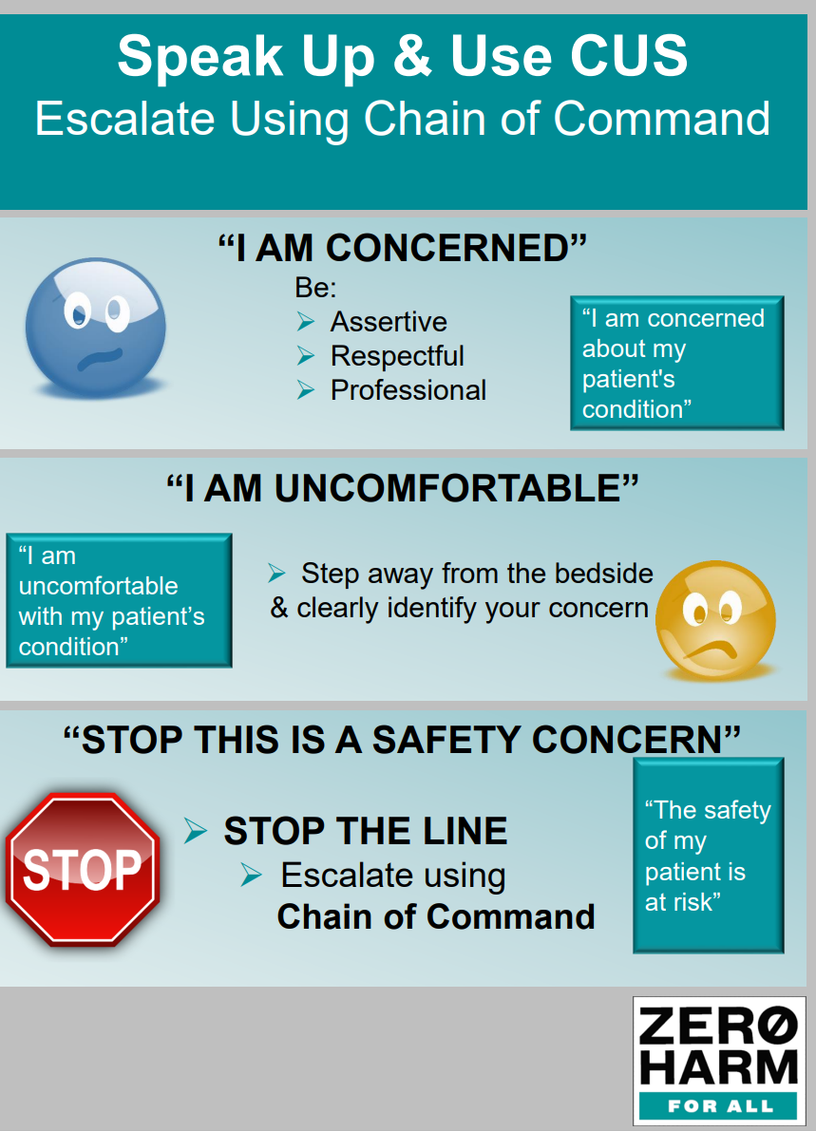

Slide 9
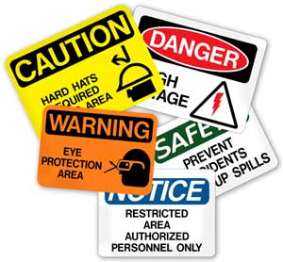
This Photo by Unknown author is licensed under CC BY-ND.

Slide 10
Lab Employee Hazard Awareness
July's Topic – Chemical Fumes
PEL and STEL
Xylene and Formaldehyde
Exposure Monitoring
Liquid Nitrogen

Slide 11
PEL and STEL
PEL
– Permissible Exposure Limit
Maximum chemical concentration in the air that an employee can be exposed to continuously for…
8 hours
STEL
– Short Term Exposure Limit
Maximum chemical concentration in the air that an employee can be exposed to for…
15 minutes

Slide 12
Xylene
PEL - 100 ppm (parts per million of air)
STEL - 150 ppm
Symptoms of exposure
Breathing in small amounts can cause headache, dizziness, drowsiness, and nausea
Breathing in large amounts can cause sleepiness, stumbling, irregular heartbeat, fainting, or even death

Slide 13
Formaldehyde
Formaldehyde is a carcinogen
PEL - 0.75 ppm
STEL - 2 ppm
Symptoms of exposure
Long term overexposure to low levels can cause respiratory difficulty and eczema
Short term overexposure can be fatal
Formaldehyde in the labs
Difference between Formaldehyde and Formalin…
Gas vs. Aqueous
100% Formalin is equivalent to 37-40% Formaldehyde

Slide 14
Exposure Monitoring
EH&S perform exposure monitoring
Ensuring that the PEL or STEL are not being exceeded
If it is discovered that the PEL or STEL is exceeded, or the individual is symptomatic, actions must be taken to decrease exposure
Process changes
Engineering controls
Additional PPE

Slide 15
Liquid Nitrogen (LN2)
When vaporized, LN2 can expand to 695 times in volume
The expansion of the gas can replace the Oxygen in the room, causing Asphyxiation
LN2 gas has no color or odor

Slide 16
Liquid Nitrogen (LN2)
Oxygen Monitoring
Safe Oxygen level in the air
19-25%
An Oxygen monitoring system must be installed in areas where LN2 is stored
The system is to alert you when Oxygen levels in the room are less than the acceptable percentage
If alarm is activated you should…
Evacuate IMEDIATELY

Slide 17
Thank You!

Slide 18
Please contact the Quality, Safety and Accreditation Team if you have any quality or safety concerns.
QS_A@wakehealth.edu

