Slide 1
Safety Presentation
8.2024 | Department of Lab & Pathology

Slide 2
Patient Safety

Slide 3
Good Catches July 2024
Date Reported | RL# | Good Catch Employee | Description of Event | Site
6/24/2024 | 369836 | Monica Rivet | Monica Rivet, clinical lab, applied a Questioning Attitude when she noticed a significant clinical change in test results on a CBC sample when compared to previous results, as these lab results did not correlate with historical data. Monica promptly notified the nurse that collected the sample and requested that all samples associated with this sample in question be recollected. This was to ensure that the patient would not be treated incorrectly if invalid lab results were released to the chart. | HPMC
7/2/2024 | 369483 | Amanda K | Amanda K noticed on delayed type and screen paperwork for day of surgery that the patient had been transfused with in the last 3 months. We were able to complete a day of type and screen on the patient before surgery thanks to Amanda for acting quickly. | DMC
7/14/2024 | 372798 | Terry Meyers | A possible contaminated CBC sample was sent to the lab for testing. Hemoglobin result from this sample was 1.96. Terry Meyers, clinical lab, recognized this as being a clinically absurd value, and immediately requested that another sample be recollected. Chemistry samples were also recollected to ensure that the patient was not treated based on inaccurate lab results. Terry consulted with the patient's nurse regarding the results, and the nurse noted that this sample was not contaminated by fluids. The recollected CBC sample had a hemoglobin of 6.72, which was an extreme difference than the initial sample. | HPMC
7/19/2024 | 372529 | Delana Spillman | Attention to detail! Delana Spillman, clinical lab, was reviewing results that had been manually resulted on a body fluid. This is a process that the clinical lab has in place any time that results are entered manually rather than direct interface resulting. Delana noticed that red blood cells had been reported, rather than total nucleated cells. There was a clinical significance in the results! This was a great catch that involved attention to detail! | HPMC
7/30/2024 | 373366 | James Moreland | PA placed ordered for patient to receive unit of blood and ordered it as irradiated blood. Tech noticed that in the past patient has always received non-irradiated blood, tech called nurse and nurse said she would call PA. The patient is an Oncology patient, in the meantime lab called Oncology to ask if because patient is on chemo if they needed to administer irradiated blood. (this is the reason the PA gave for ordering irradiated blood) Oncology said that the PA needed to call and speak with Dr. Atkins before any blood product was given to patient. The nurse called back and said that the PA did indeed want the patient to receive irradiated blood. The tech asked the nurse to call PA back and have him talk with Dr. Atkins. Lab then received an order to transfuse NON-irradiated blood to patient. | WMC

Slide 4
Good Catch Recipient July 2024
James Moreland
WMC

Slide 5
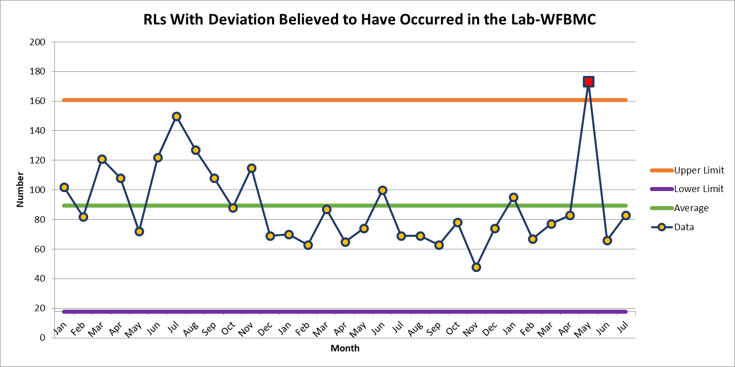
WFBMC 83

Slide 6
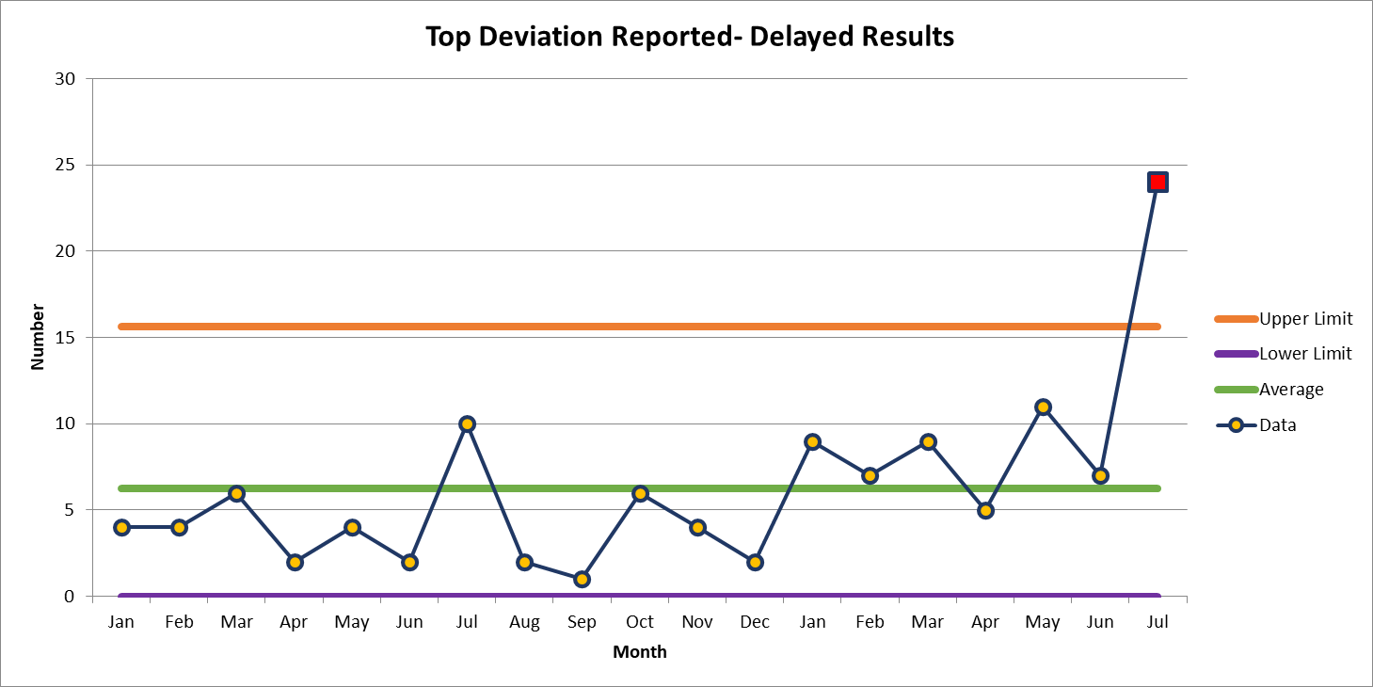
July 24

Slide 7
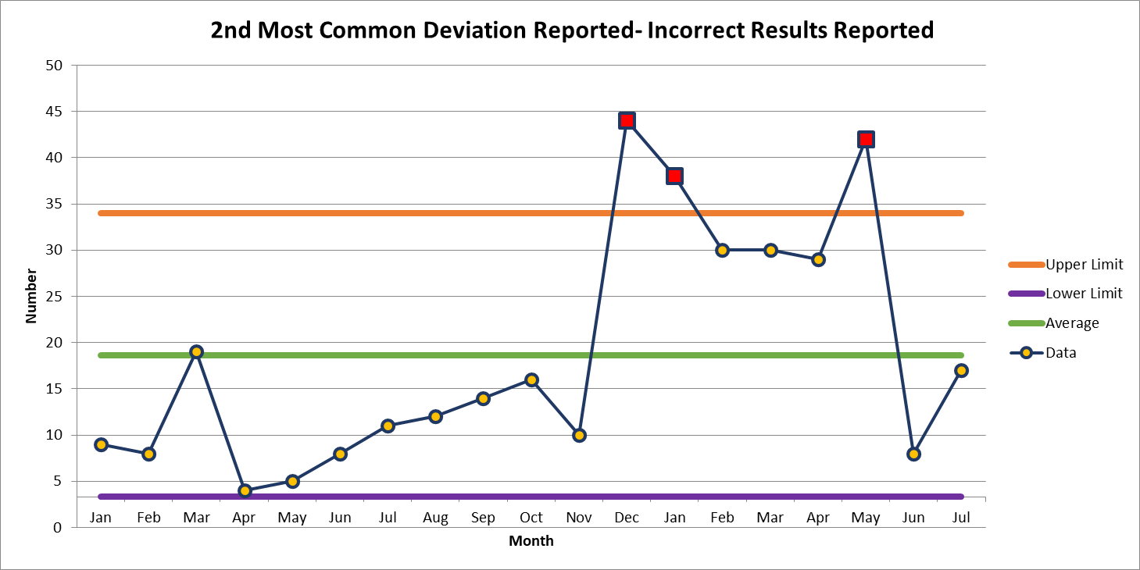
July 17

Slide 8
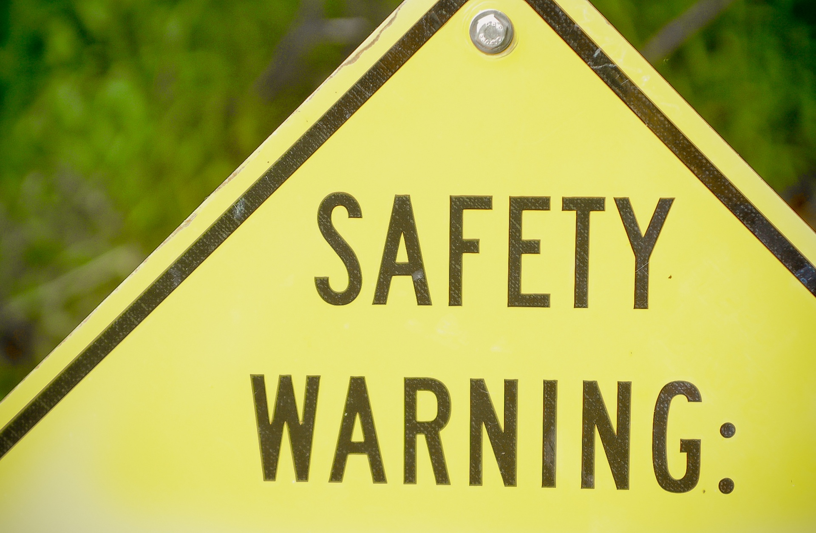

Slide 9
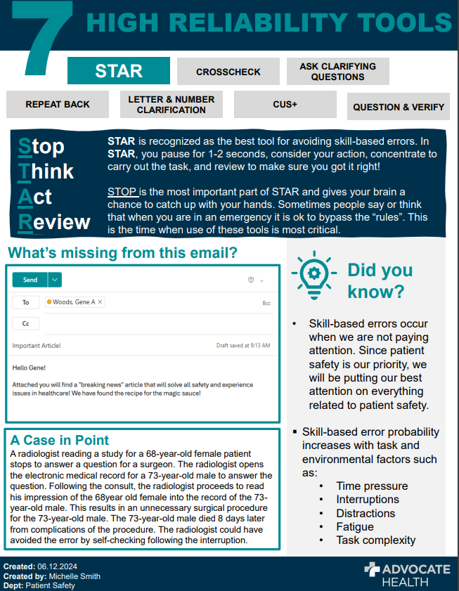

Slide 10
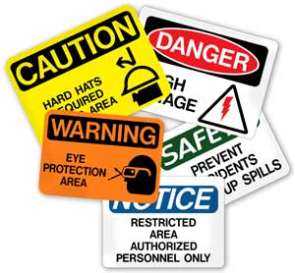
This Photo by Unknown author is licensed under CC BY-ND.

Slide 11
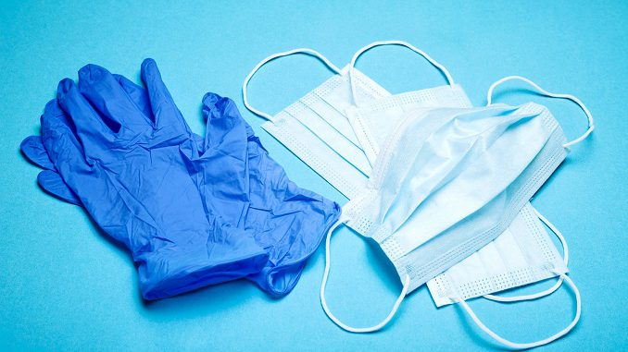
Lab Employee Hazard Awareness
August's Topic – Personal Protective Equipment

Slide 13
What PPE?
Now that we have decided that PPE is going to be our protective method, we need to choose what PPE should be worn for the task
PPE Hazard Risk Assessment

Slide 14
PPE Hazard Risk Assessment

Slide 15
PPE Hazard Risk Assessment
Review annually
Update when a new process is put into place
Help!

Slide 16
Training
All employees should be trained on the PPE required for each task/bench and how to use it

Slide 18
Now that you know why, what and how…..
Make sure to use your PPE

Slide 19
Thank You!

Slide 20
Please contact the Quality, Safety and Accreditation Team if you have any quality or safety concerns.
QS_A@wakehealth.edu

