Slide 1
Safety Presentation
9.2024 | Department of Lab & Pathology

Slide 2
Patient Safety

Slide 3
Good Catches August 2024
Date Reported | RL# | Good Catch Employee | Description of Event | Site
7/30/2024 | 373588 | Maddie Quattlebaum | Maddie Quattlebaum, clinical lab, received synovial body fluid in the lab that had no orders. When Maddie reached out to the Charge Nurse for this patient, and it was learned that this patient had not had any procedures done at the bedside. The Charge Nurse happened to look in the paper chart and noticed that a different patient's chart was below it. The Charge Nurse knew that a patient in a different room had a knee aspiration. She spoke with patient's nurse who informed the Charge Nurse that she was the one to hand deliver the tube specimen, but did not notice that the patient's name was incorrect. This then resulted in a mislabeled sample. Good Catch for both the lab and 7N Charge Nurse! | HPMC
8/1/2024 | 373626 | Leigh Ann Perkins | We received 24hr. urine for testing. Leigh Ann had received call about how to order tests day before. We discussed the urine and realized one of the test they had called about was missing. I called Westgate PSC and the order was missed. The order was placed. | WFBMC
8/5/2024 | 374411 | Gina Anderson | On 8/5/24 our phlebotomist, Gina Anderson notified the coordinator and manager that the Coban wrap that we had ordered came in as having latex in it. When we researched this through our new Henry Schein / Medline crosswalk ordering information we found that the number that we were provided was not the same as our latex free Coban. Gina Immediately pulled them from the shelf and we will return for credit. We now have the correct order number for latex free Coban wrap to utilize with our phlebotomy collections. Her attention to detail may have prevented this being place on any patient that may have latex allergies. | WFBMC
8/28/2024 | 376394 | Alexandra (Alex) Friel | Alexandra (Alex) Friel, clinical lab blood bank, was on her employee break, and had walked outside briefly when she heard a lady's voice crying for help from the Visitor Parking garage. Alex immediately went to find the source of the cry for help and found a female in her car that needed medical attention. The female was trying to get out of her car with the intent of walking to the hospital entrance. She spoke little English, but Alex was able to translate what she was saying in Spanish. Alex helped her back into her car and explained what she was going to do next to help her. Alex then ran and got a wheelchair from the visitor entrance and went back and helped the female into the wheelchair, and then wheeled her to the emergency room. Once inside, she found a provider and shared what she knew about the patient and let them know that she would need an interpreter!! Alex definitely went above and beyond! | HPMC

Slide 4
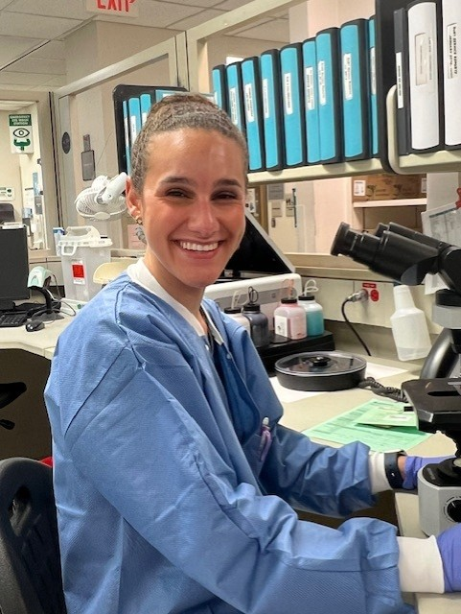
Good Catch Recipient August 2024
Maddie Quattlebaum
HPMC

Slide 5
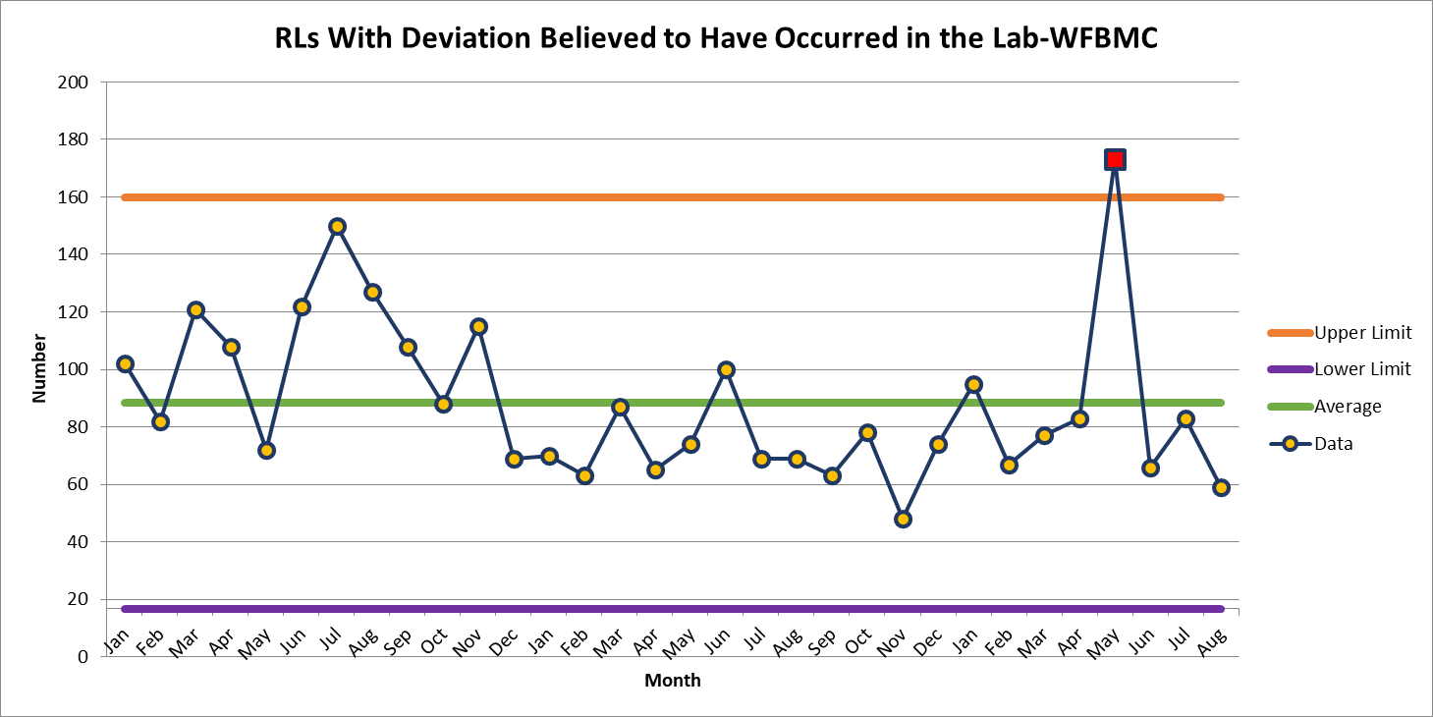
WFBMC 59

Slide 6
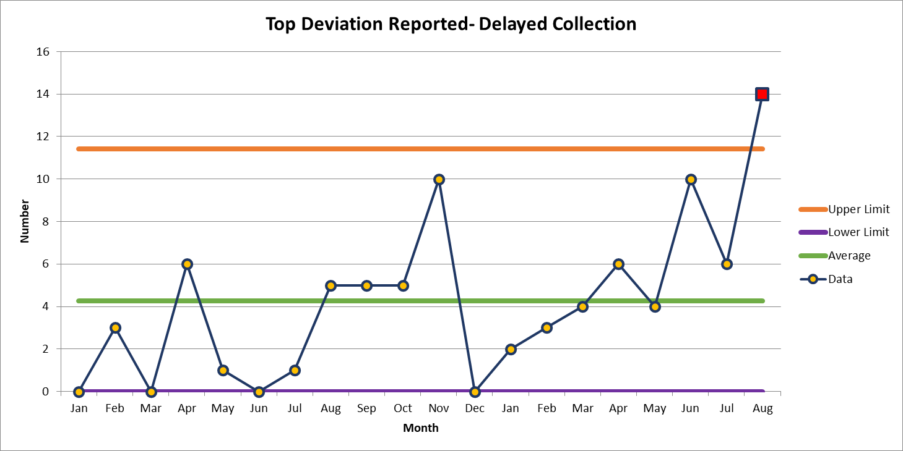
August 14

Slide 7
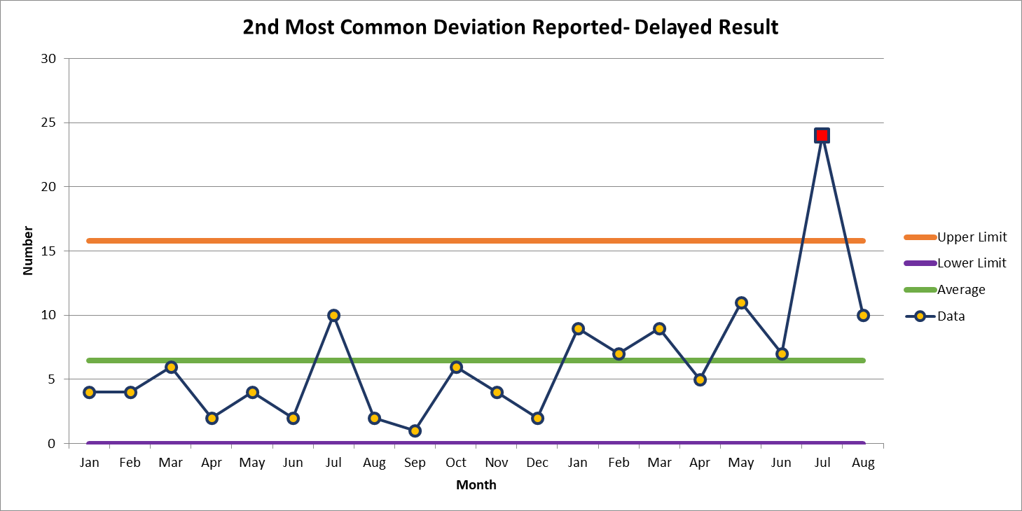
August 10

Slide 8
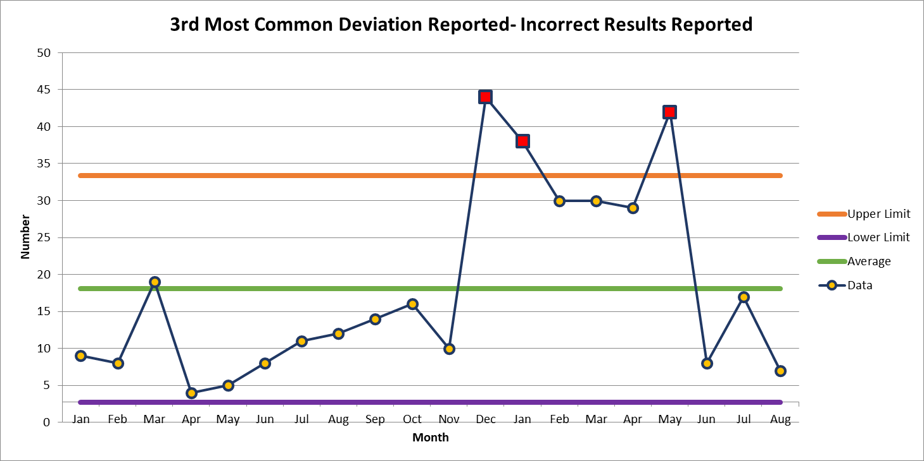
August 7

Slide 10
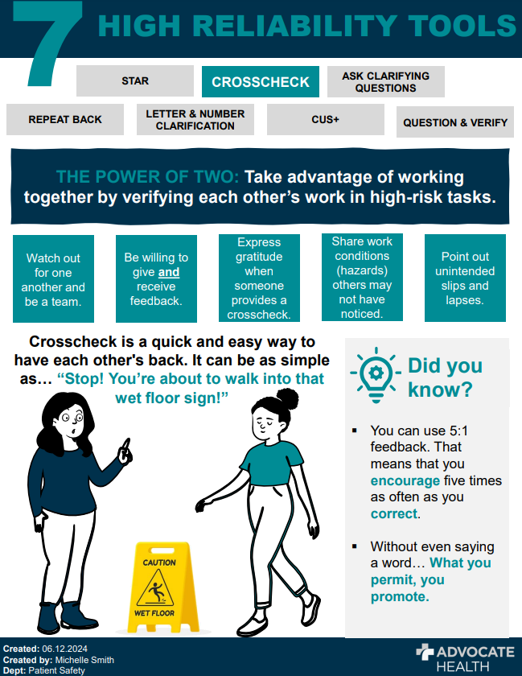

Slide 11
This Photo by Unknown author is licensed under CC BY-ND.

Slide 12
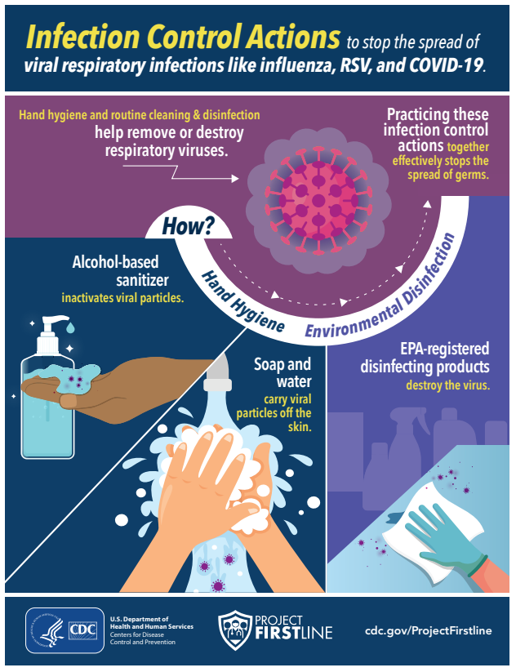
September Safety Focus: Respiratory Season Tips
Prevention Tips:
Practice Physical Distancing
Stay at home when you are sick and report through Teammate Health Portal: https://intranet.wakehealth.edu/departments/employee-health/portal
Clean and Disinfect your environment regularly
Clean your hands often even when not visibly soiled
Avoid touching your eyes, nose or mouth

Slide 13
Thank You!

Slide 14
Please contact the Quality, Safety and Accreditation Team if you have any quality or safety concerns.
QS_A@wakehealth.edu

