Slide 1
Safety Presentation
10.2024 | Department of Lab & Pathology

Slide 2
Patient Safety

Slide 3
Good Catches September 2024
Date Reported | RL# | Good Catch Employee | Description of Event | Site
9/3/2024 | 376933 | Adam Morgan | Adam Morgan from Chemistry caught that the critical blood gasses were being sent to the closed loop critical list. This is something that blood gas does not use or monitor. He called up to blood gas and was concerned that we may need help. He offered to call criticals or give any assistance needed. We did not need anything and the criticals were called it was an IT issue. It was great that he was looking out for his coworkers and the patients! | WFBMC
9/6/2024 | 377171 |  | Patient was leaving the laboratory after having labs collected. She was observed by staff members sitting in the chair leaning back. She was diaphoretic. Code EMS called. Initial BP 78/49. She reports prior vagal episodes with needle sticks. Transported to infusion room for observation in recliner. PO fluids given with snacks. BP improved to 106/73. AAO x4 after 25 min. observation. VSS. Declined further evaluation. Left ambulatory at her request. | Outreach
9/11/2024 | 377556 | Jamie Hunt | Jamie Hunt, clinical lab, recognized that there were several Troponin values that were falsely elevated due to carryover effects from a previously tested patient with an elevated Troponin value, which caused carryover for patient samples tested afterwards. Jamie Hunt applied a questionable attitude, and retested the samples in question. Those results were then amended and called to the proper provider. | HPMC
9/11/2024 | 377582 | Monika Rivet | Applying a questioning attitude: Monika Rivet, clinical lab, recognized a discrepancy in patient results when previous lab values did not correlate. After investigating, it was determined that two separate patients had been collected by phlebotomy, but the patient labels were mixed up. The patients were from two separate rooms in proximity, and the samples were not labeled at the bedside when collected. Great catch! | HPMC
9/17/2024 | 378258 | Lauren McHenry | This patient's sample was repeatedly coming up with an IgE result of >3000 when programmed for an automatic X5 onboard dilution. Chemistry tech Lauren McHenry questioned this, since ">3000" was the result prior to the dilution also, indicating possibly that the automatic dilution was not working properly. The title 21 procedure lists reportable range as "1.5 – 3000 IU/mL," and another reference document clearly lists the full AMR as 15,000 IU/mL. Seeing this possible point of confusion, Lauren sought confirmation of this from her manager to clarify before validating the result, preventing the patient from receiving a less than fully accurate result. | WFBMC
9/27/2024 | 379465 | Kelly Pugh | O negative Emergency Release Blood requested by the physician. Kelly Pugh knew this baby was suffering from HDN due to anti-c antibody with a hemoglobin of 2 and that O negative blood was always c antigen positive. She was able to use her knowledge of blood bank and genetics to have a discussion with the physician and educate them that what they should take was O positive, c negative blood on Emergency Release. She was able to explain the situation and get the best blood possible out quickly for this patient avoiding exacerbating the HDN and hemolysis. | WFBMC

Slide 4
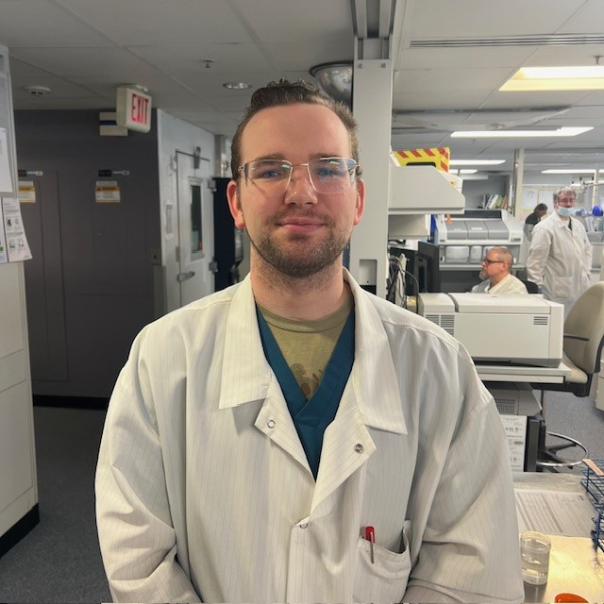
Good Catch Recipient September 2024
Adam Morgan
WFBMC

Slide 5
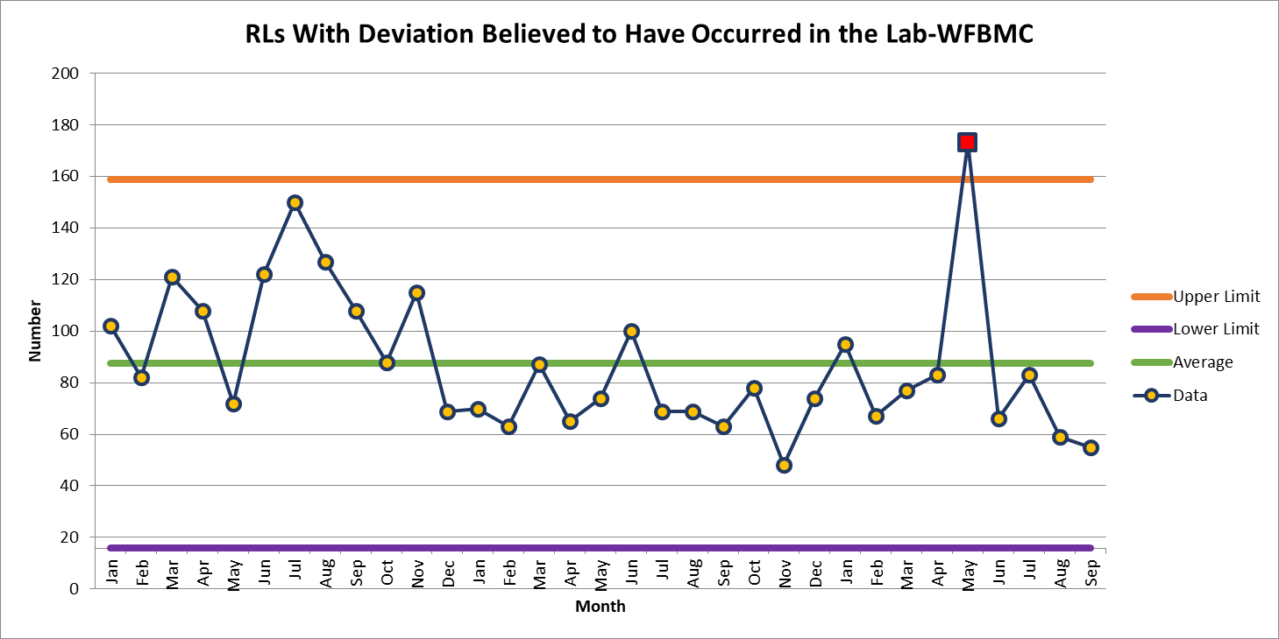
WFBMC 55

Slide 6
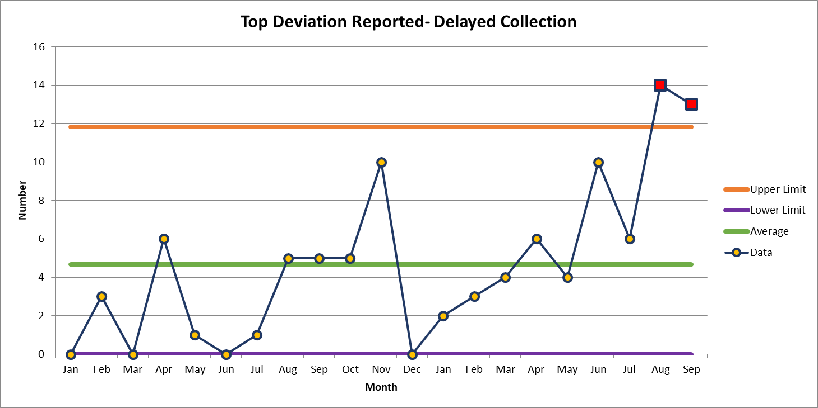
August 13

Slide 7
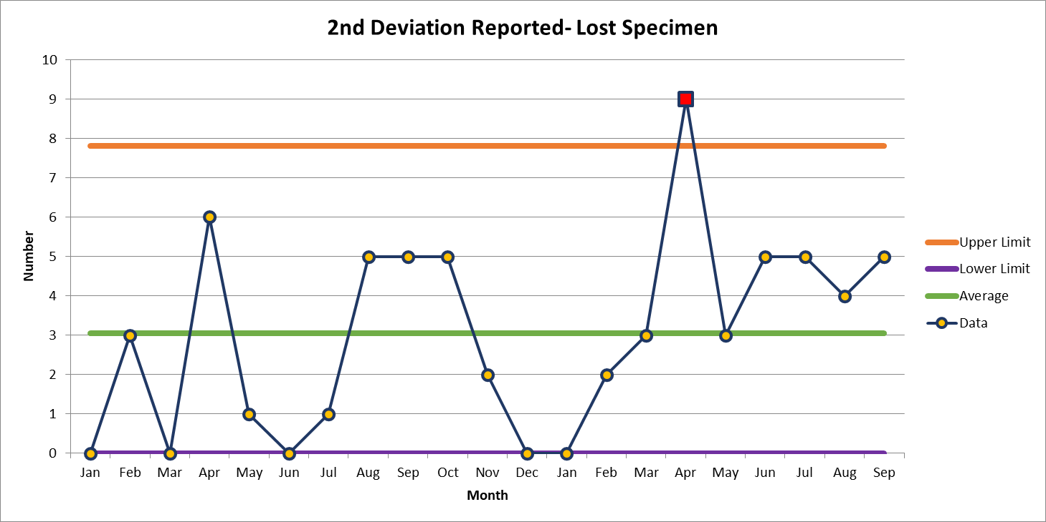
August 5

Slide 8
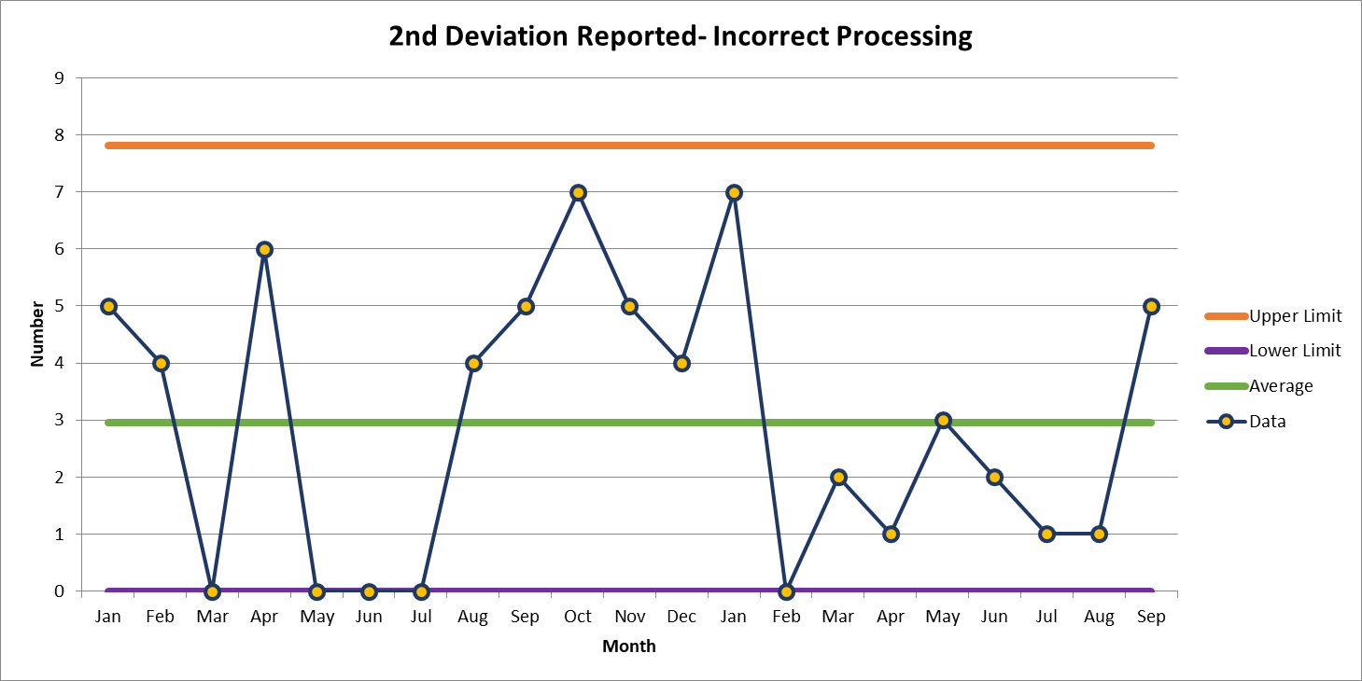
August 5

Slide 10
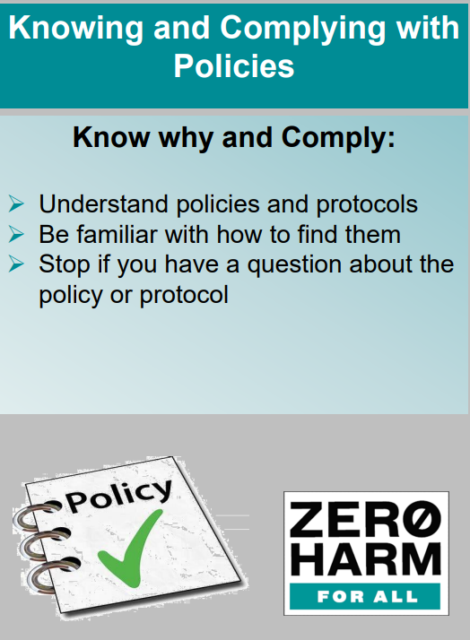

Slide 11
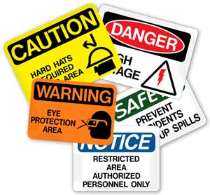
This Photo by Unknown author is licensed under CC BY-ND.

Slide 12
True or False: HIPPA Regulations do not concern me as I do not have direct patient contact.
False!
True/ False: If I am at the nurse’s station with no patients around, I can access my personal social media account.
False!
This is considered a patient care area even if no treatment is taking place

Slide 13
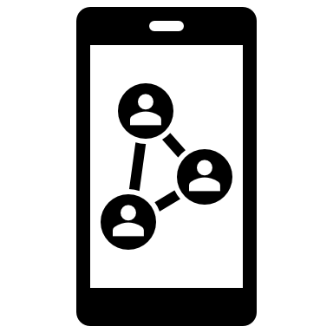
Protecting Patient Information
When printing sensitive information be sure to immediately retrieve your documents - others can unintentionally read medical records when documents are left unattended
Never take photos of any patient samples/ equipment
Cell phones should NOT be used in patient testing areas
Social Media
Never expose HIPPA information via Social Media
Limit social media at work
Only access charts of patients to whom you are providing direct care
This Photo by is liUnknown Author censed under CC BY-NC
Special note on social media:
Patient care areas – no social media should be accessed for personal use at any time including unpaid meal breaks in patient care areas.
Patient care areas include non-treatment areas such as nurse’s stations

Slide 14
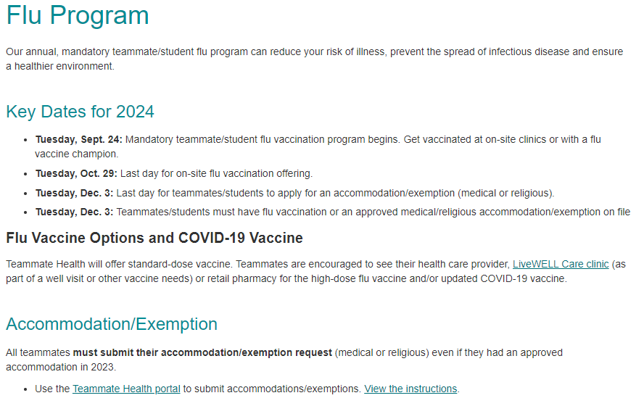
October Safety Focus: Flu Program

Slide 15
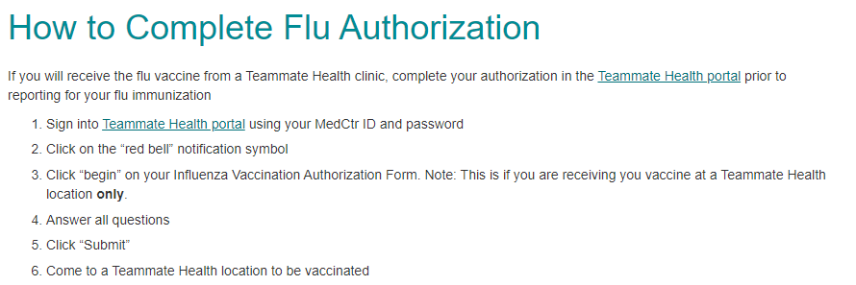
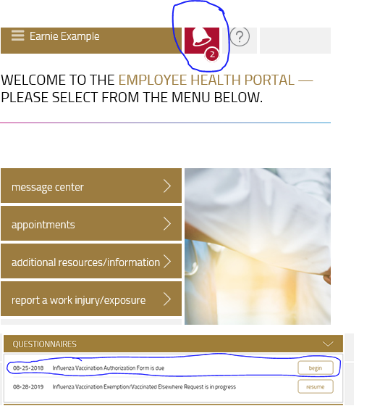

Slide 16
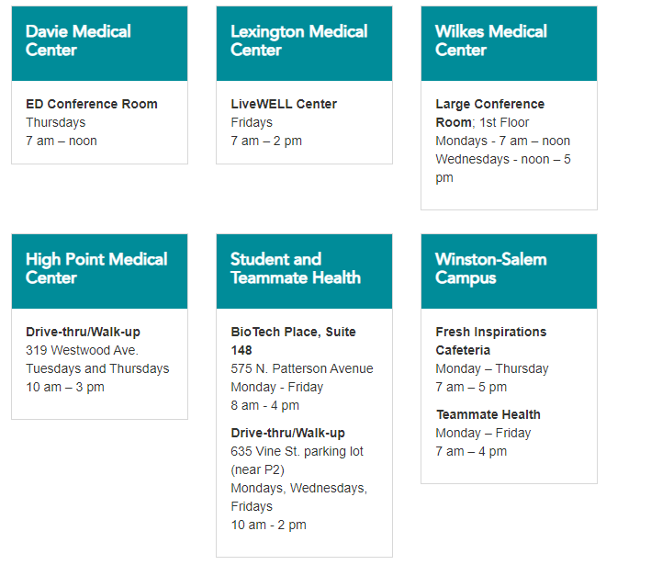
Flu Clinic Locations

Slide 17
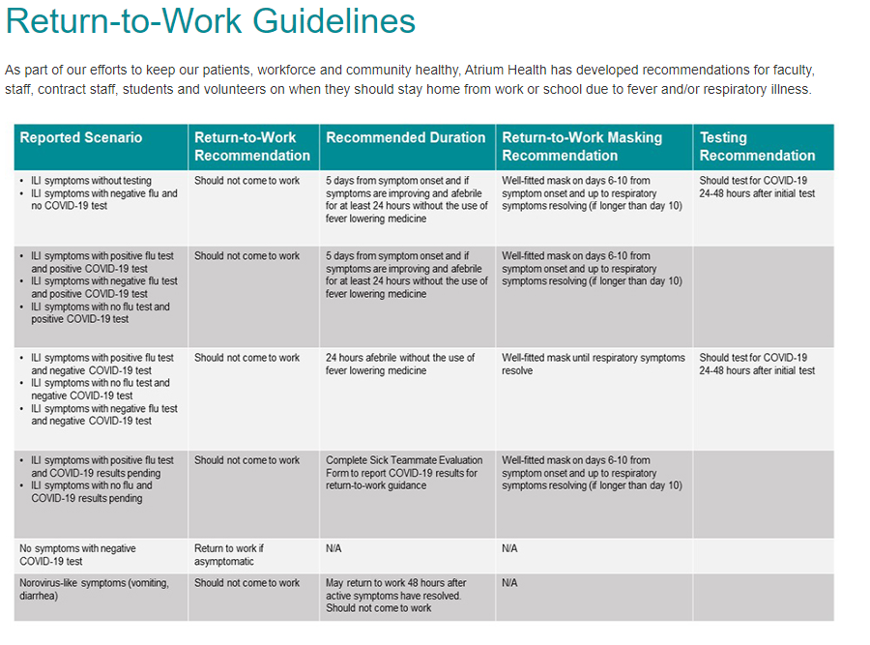

Slide 18
Thank You!

Slide 19
Please contact the Quality, Safety and Accreditation Team if you have any quality or safety concerns.
QS_A@wakehealth.edu

