Slide 1
Dry Shipper Training

Slide 2
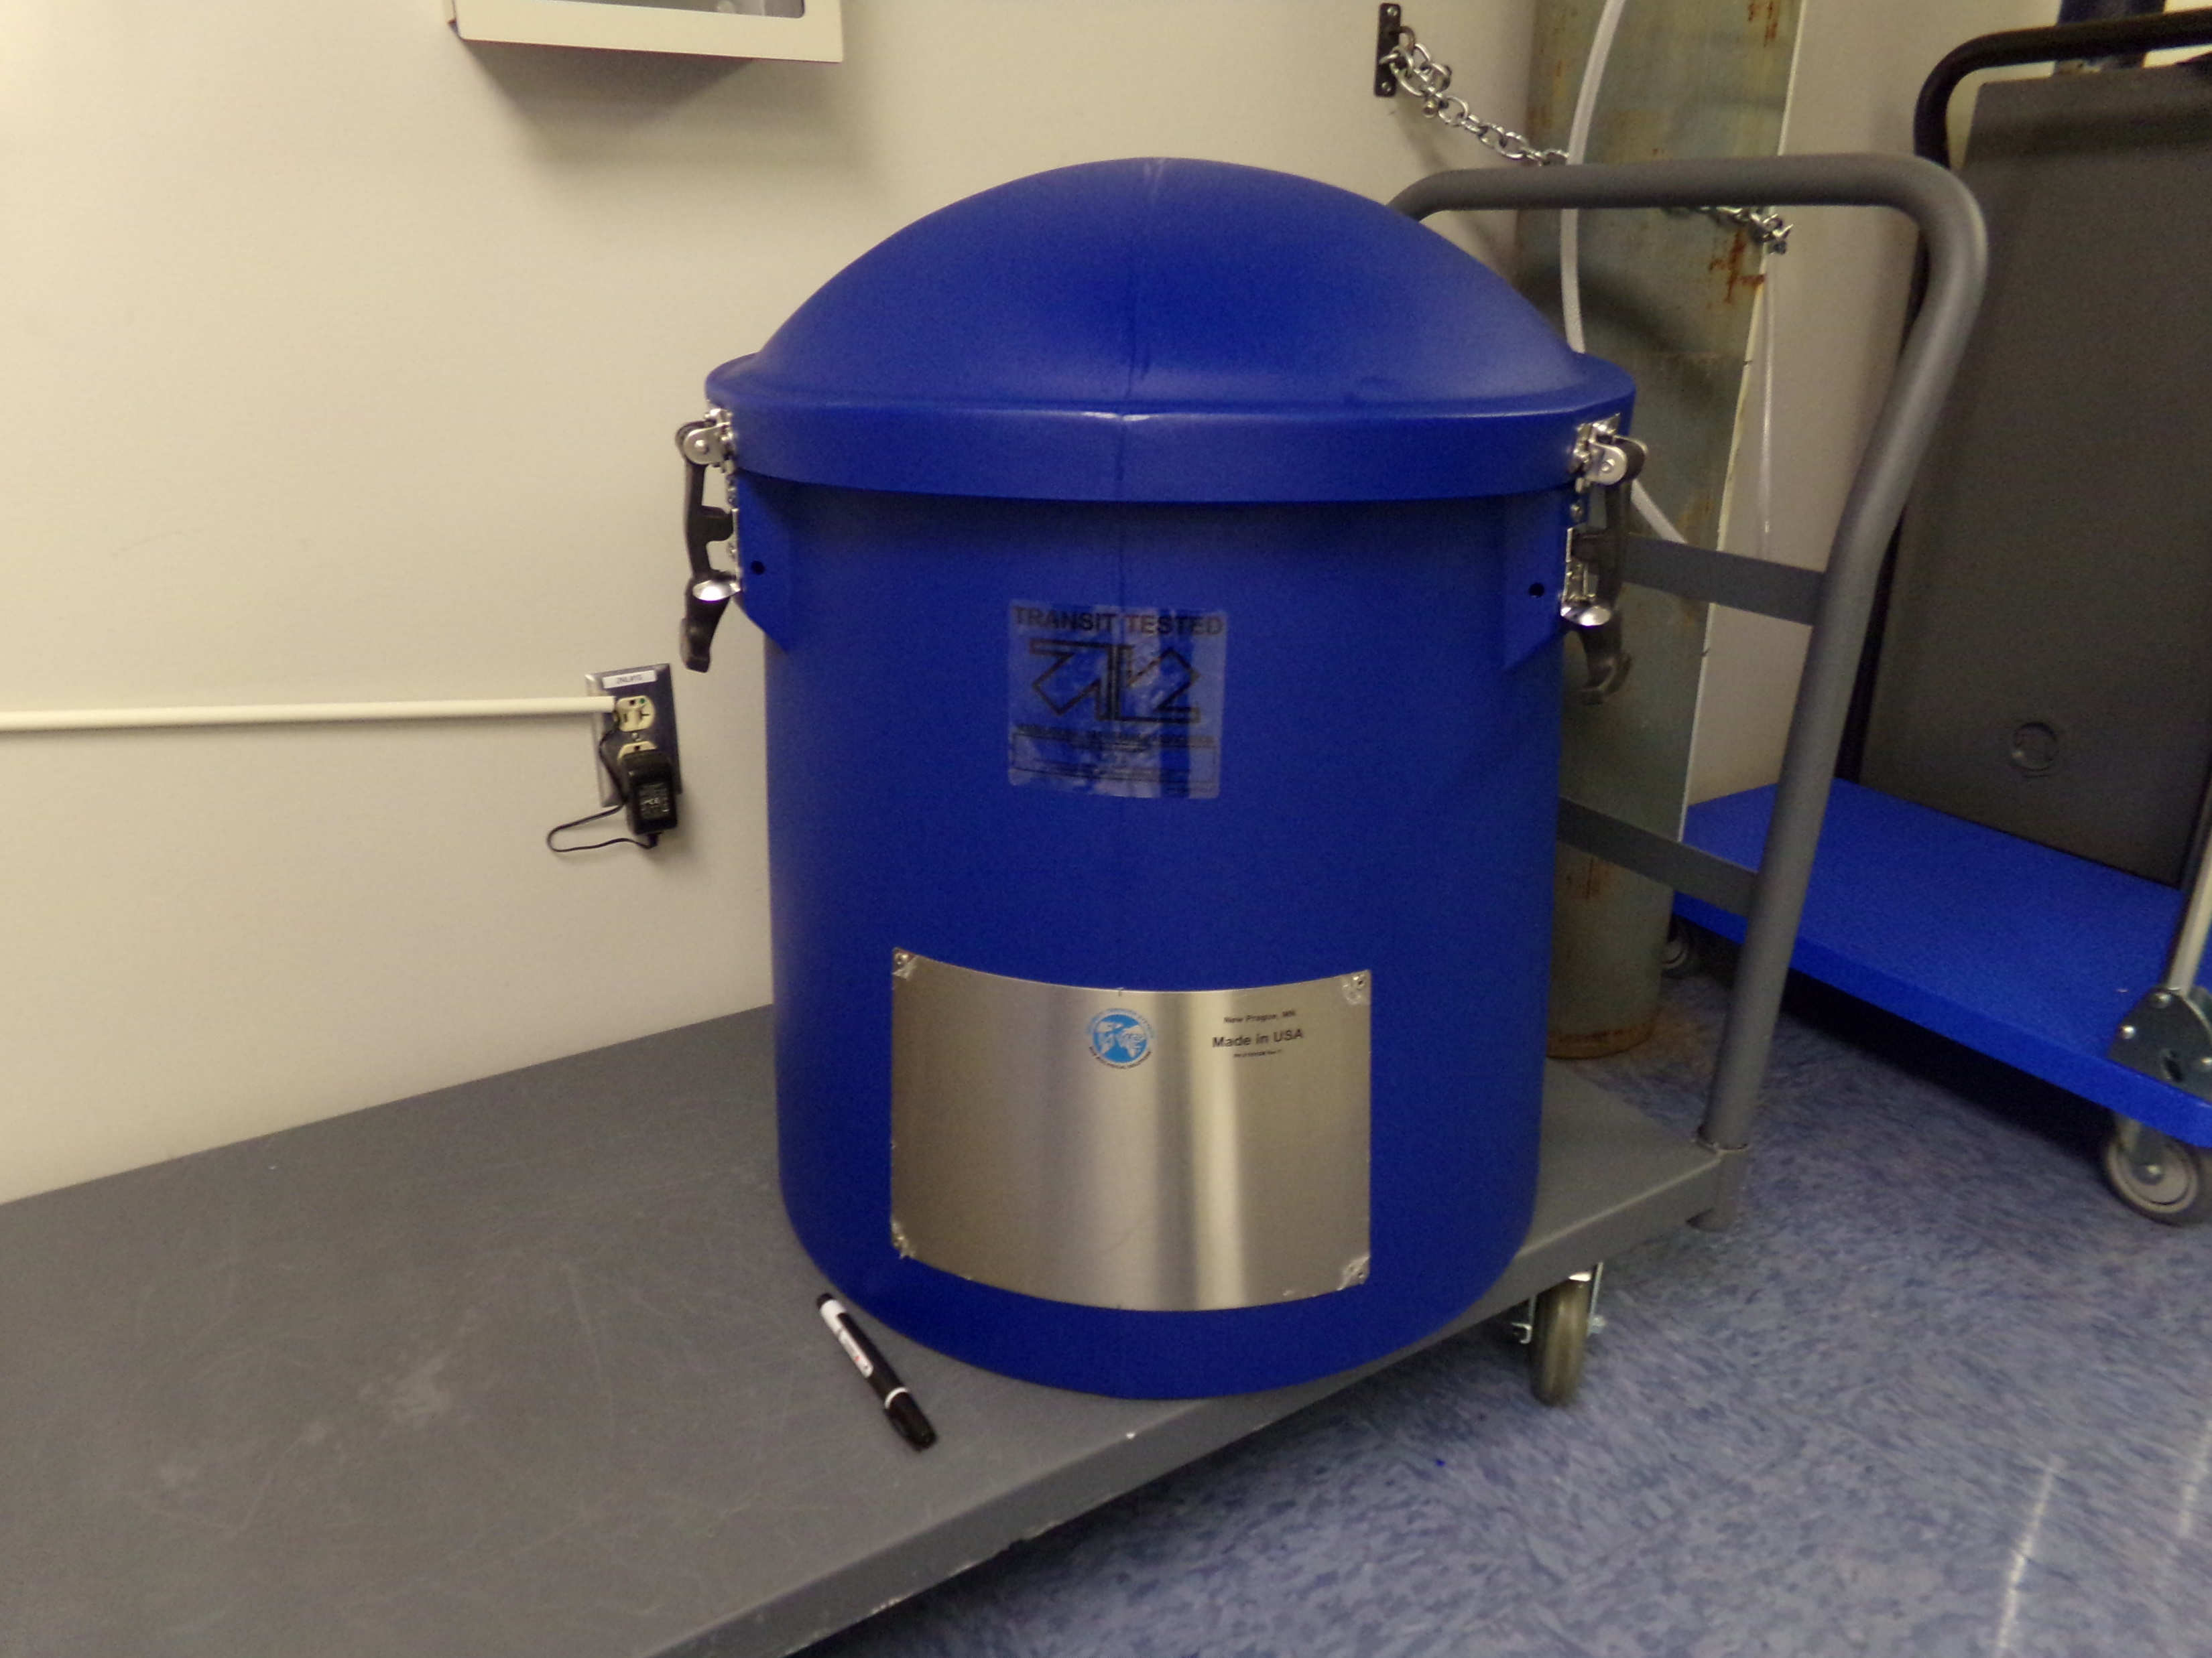
For johnson & Johnson car-t products
The dry shipper is a new piece of equipment in the laboratory.
It has been validated to hold temperature at less than -150°C for 10 hours.
It was purchased for Johnson and Johnson CAR-T products (to meet their requirements), but can be used for in-house transport of any frozen products.

Slide 3
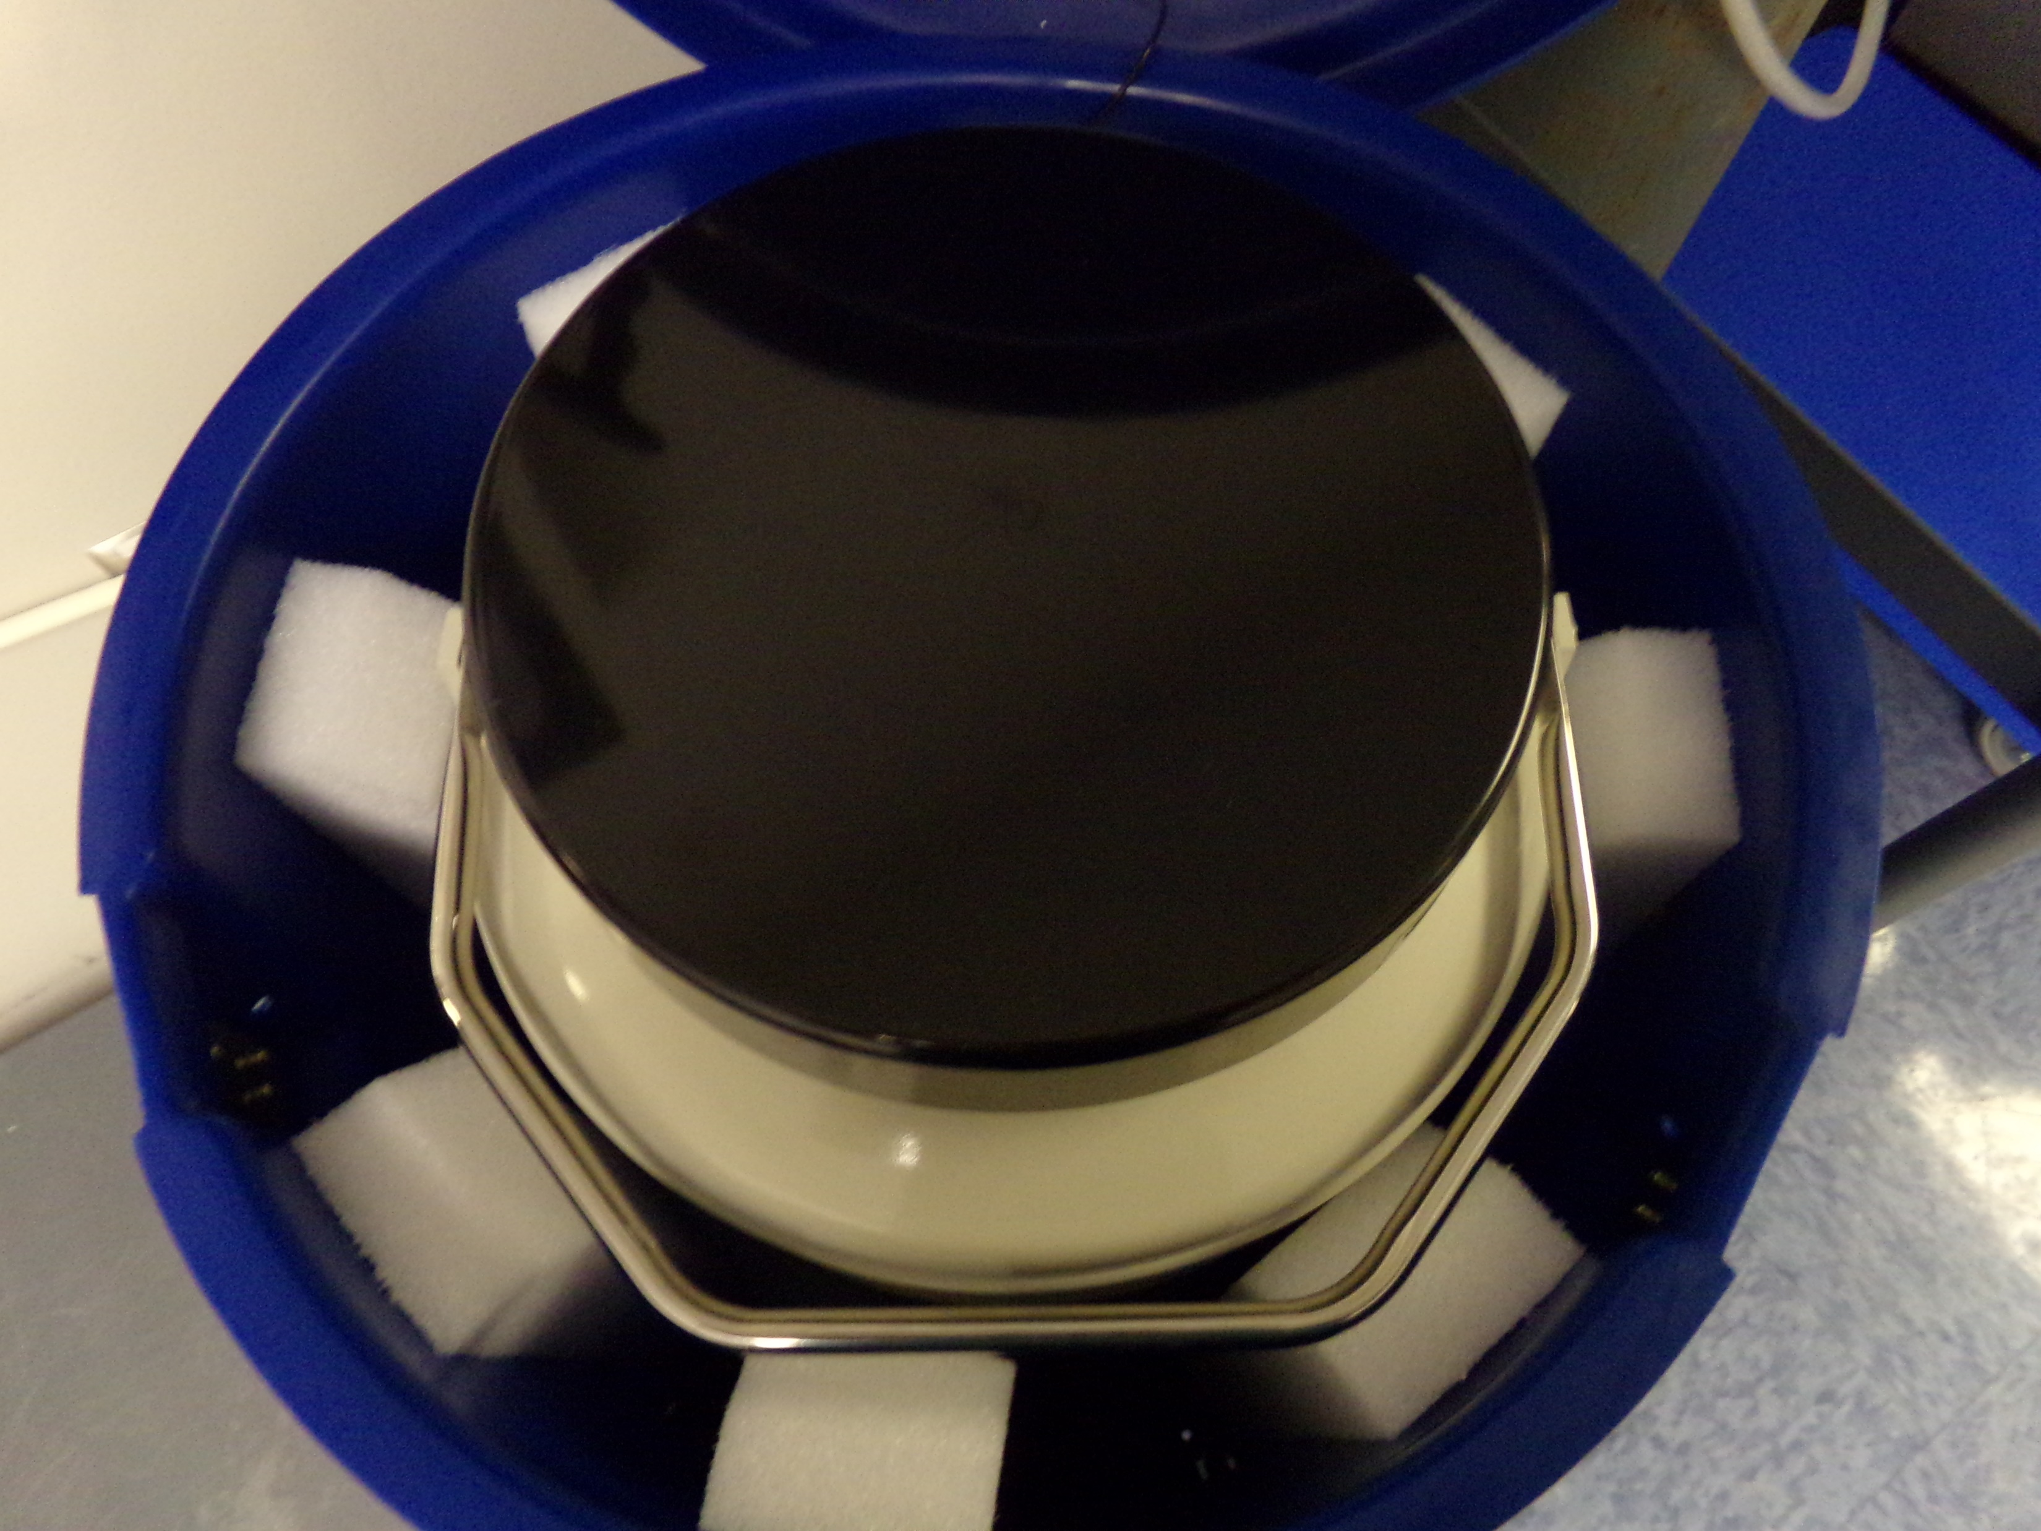
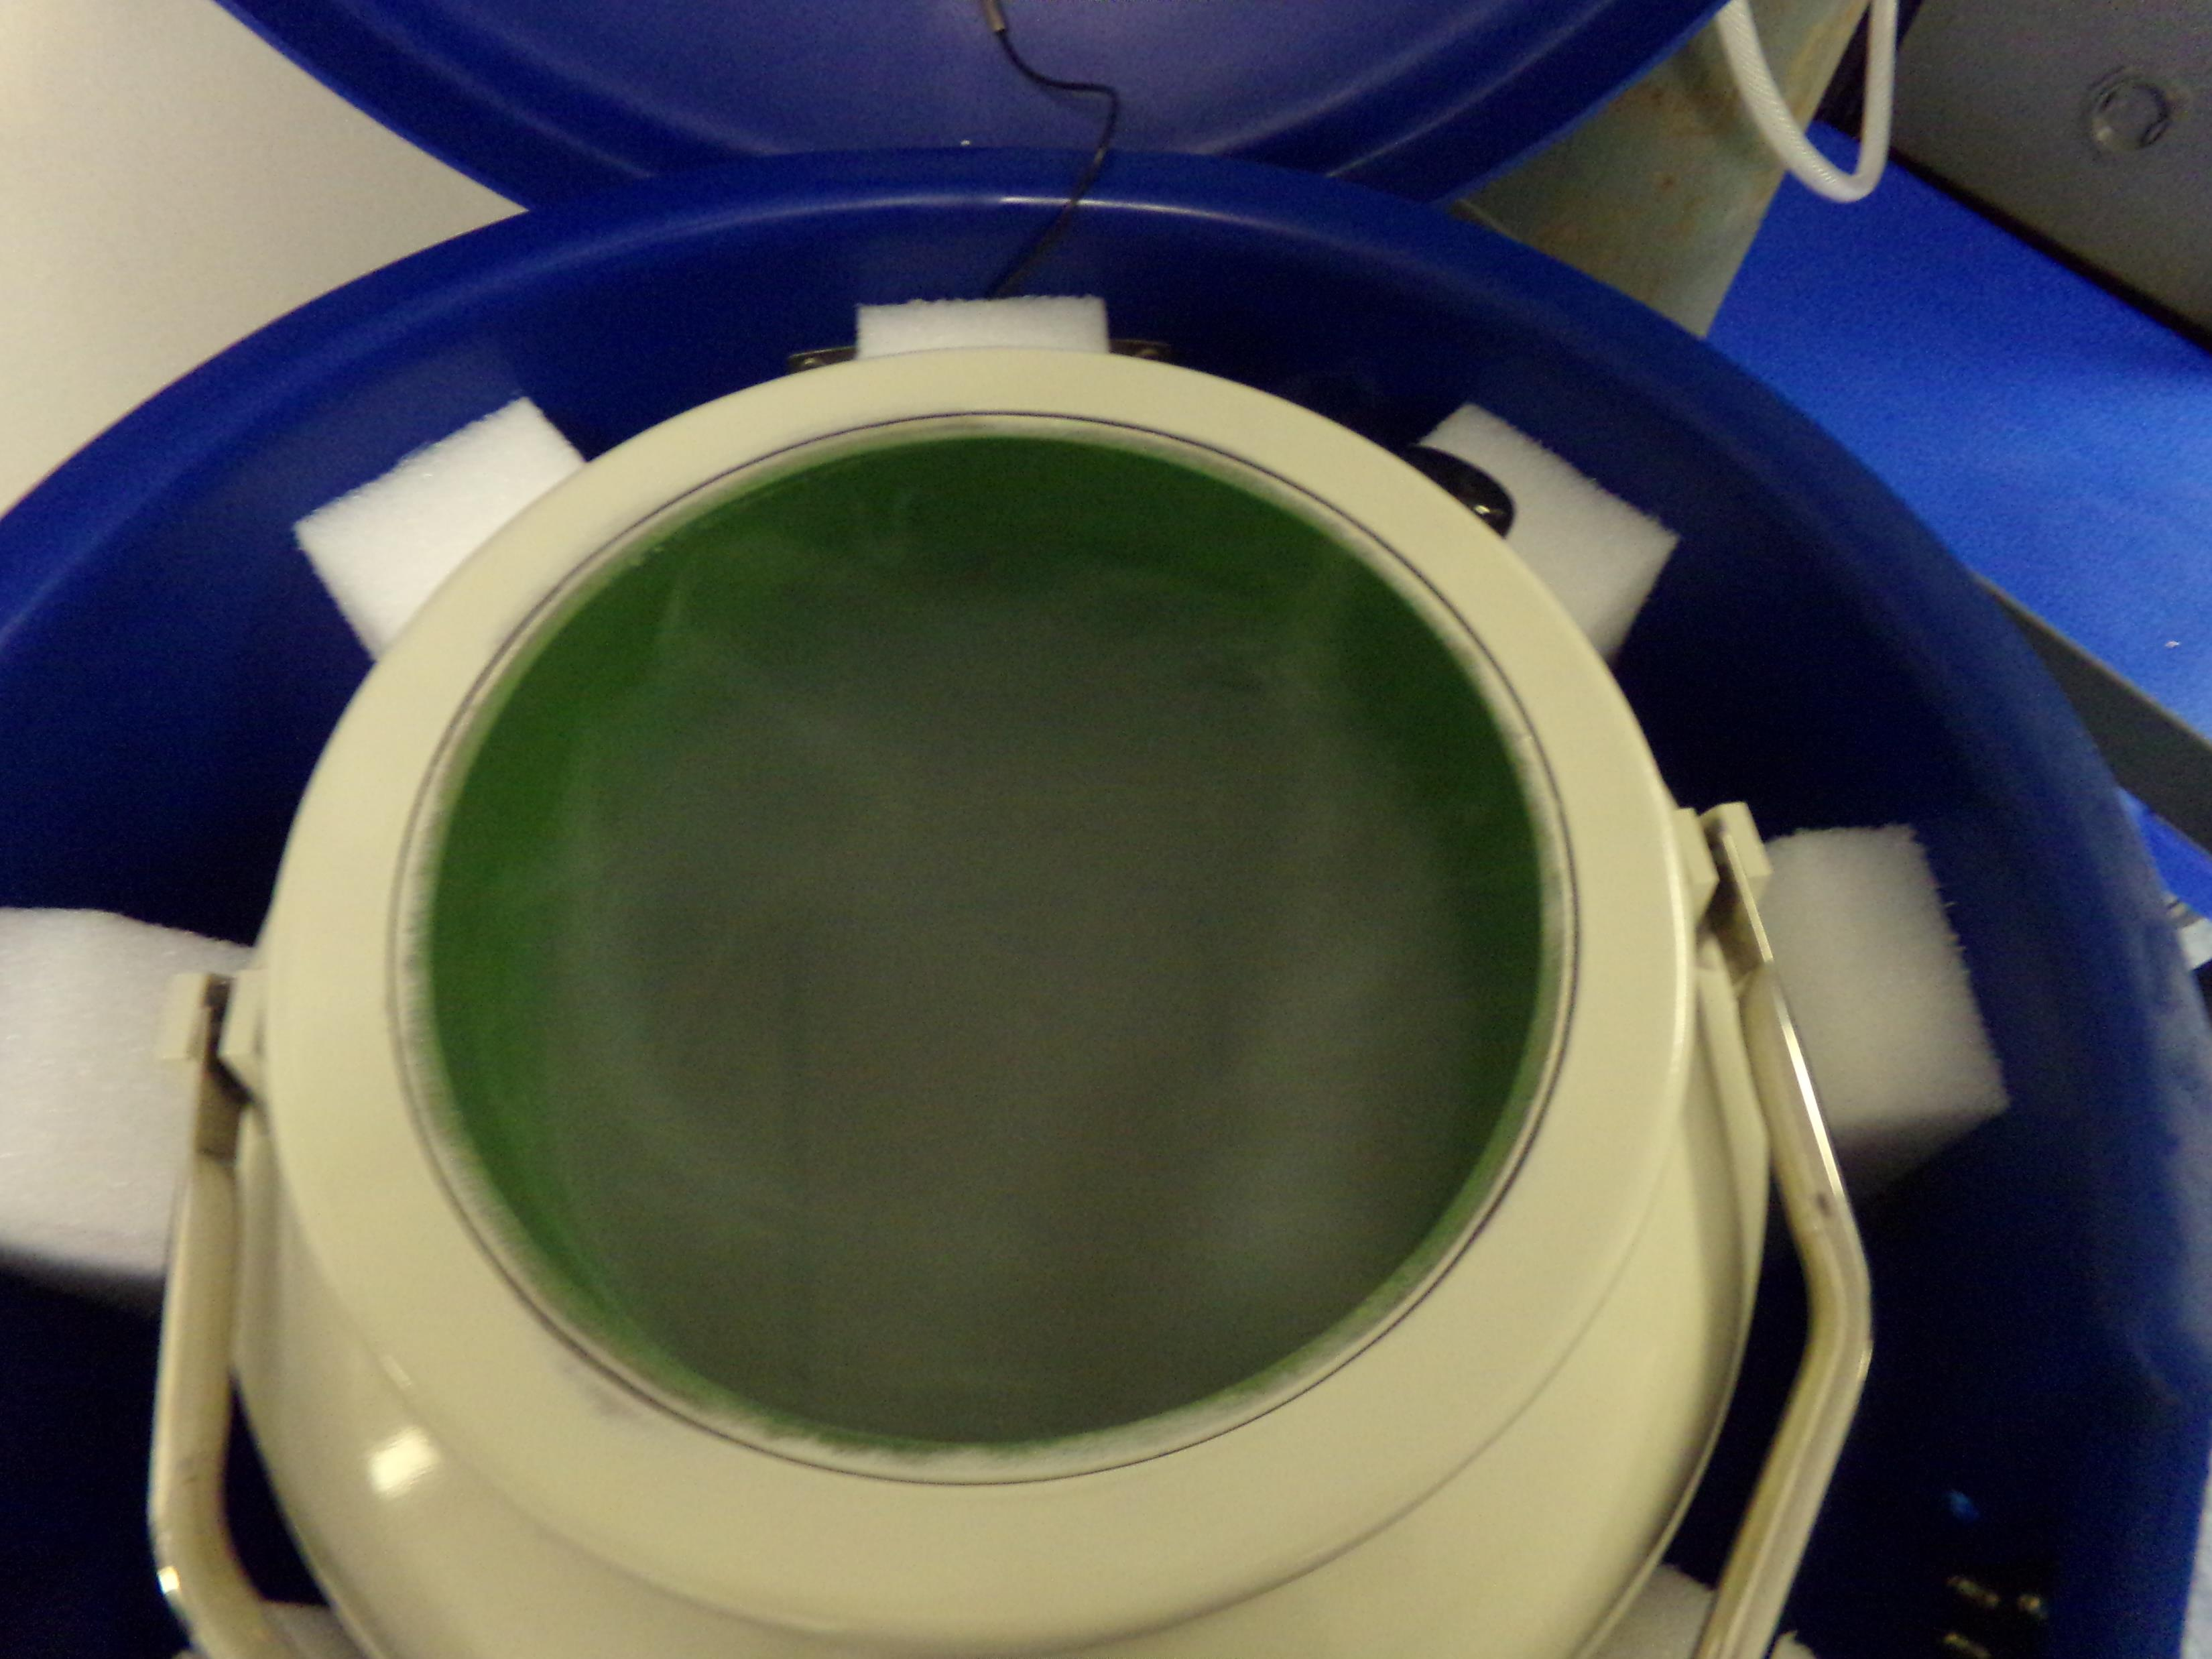
When you open the dry shipper blue lid, there is an inner container that also has a removable Styrofoam cork that is black on top.
Remove cork by pulling straight up, DO NOT TWIST.
Use cart or dolly to move the shipper close to the filling hose (see next slide).

Slide 4
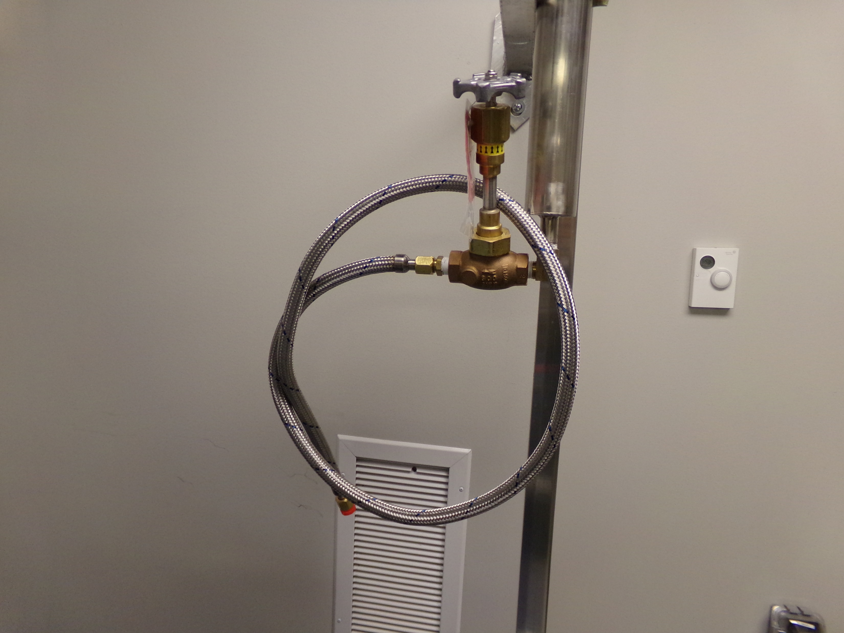
Preparing the shipper for use
There is a filling hose attached to the liquid nitrogen (LN₂) drop closest to CRF #2.
Dry shipper must be filled here, since the drop is close to the return vent to provide adequate ventilation.

Slide 5
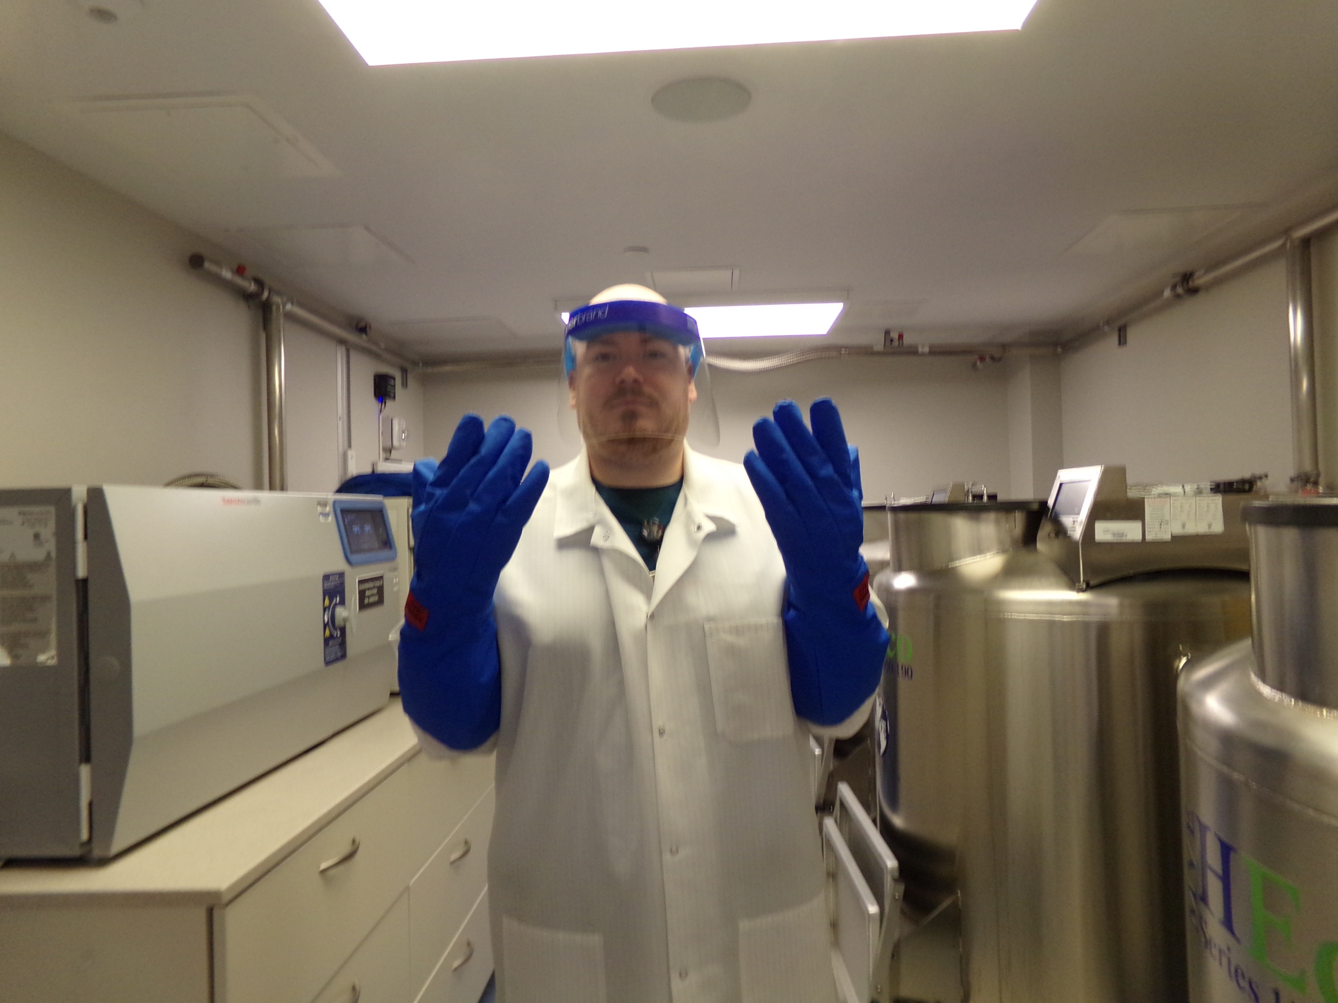
Personal protective equipment (ppe)
Liquid nitrogen can cause bodily harm, and appropriate PPE should always be worn when handling LN₂.
When filling the dry shipper, ALWAYS don the following PPE: Lab Coat, Cryogloves, and Face Shield.

Slide 6
The end of the hose is fitted with a red cap. Remove the cap and place the end of the hose in the inner chamber of the shipper. Open the valve on the LN2 drop and allow the inner chamber to fill up to top of the metal platform.

Slide 7
When the shipper is filled with nitrogen, replace the Styrofoam cork lid and allow to sit for 2 hours.
At the end of 2 hours, don PPE and get another technologist to help you pour the remaining LN2 into reservoir #8.
Two technologists MUST be present to pour off the excess liquid.

Slide 8
Program a data logger and place the probe inside the inner chamber.
Refer to TCTemp 2000 Data Logger Procedure (NCBH) 54953.
Shipper is now charged to hold temperature for 10 hours.

Slide 9
Review and highlights
Always wear proper PPE when filling dry shipper
Two technologists must be available to pour off excess LN₂.
Shipper should be allowed to sit filled for 2 hours to charge.
When charged, shipper is good for 10 hours.
Shipper is only for use in-house, not for shipping to outside institutions.

