Slide 1
Safety Presentation
11.2024 | Department of Lab & Pathology

Slide 2
Patient Safety

Slide 3
Good Catches October 2024
Date Reported | RL# | Good Catch Employee | Description of Event | Site
10-03-2024 | 380059 | Hallee Stanley | My co-worker Hallee Stanley apart of the Chemistry lab went into central processing to look for a sample and came across two tubes (a gold and a lavender) where their labels were switched (the CMP being on the lavender and the CBC being on the gold) which would have ended up resulting in the lavender being spun and unusable and the gold giving EDTA contaminated results. So she got the labels swapped saving the lavender tube from being accidently spun and avoiding contaminated results on the CMP. | WFBMC
10-04-2024 | 380081 | Meredith Bell | Meredith Bell, Laboratory Operations Director, observed a visitor that appeared to be in distress that outside of her office door while waiting for Medical Records assistance. The visitor noted during their conversation that she wasn't feeling well, and that she was trying to get in touch with her husband. Meredith went and got food for the visitor and even used her personal cell phone to try and reach the husband of the visitor. Meredith sat with the visitor and talked to her and waited until the visitor's husband arrived. Meredith also followed up with Medical Records to ensure that the requested documents were being prepared for her. Meredith demonstrated care to this visitor and went above and beyond her scope. | HPMC
10-14-2024 | 381097 | Kathy Dail | This was a great catch by Kathy Dail, one of the Lab Techs that was working this past Saturday. There were a few phone calls inquiring about Labs that had been drawn the prior day. Once Kathy started investigating, she realized that all of the Labs that had went out at the 7:15pm pick up by the courier were not in the processing status. We immediately contacted the courier service and escalated it up to a Manager, who was able to contact the driver and the specimens were found in his vehicle, but luckily, still on ice and able to be processed with minimal delays. This was around 25 specimens. Great job by the Lab Tech! | LMC

Slide 4
Good Catch Recipient October 2024
Kathy Dail
LMC

Slide 5
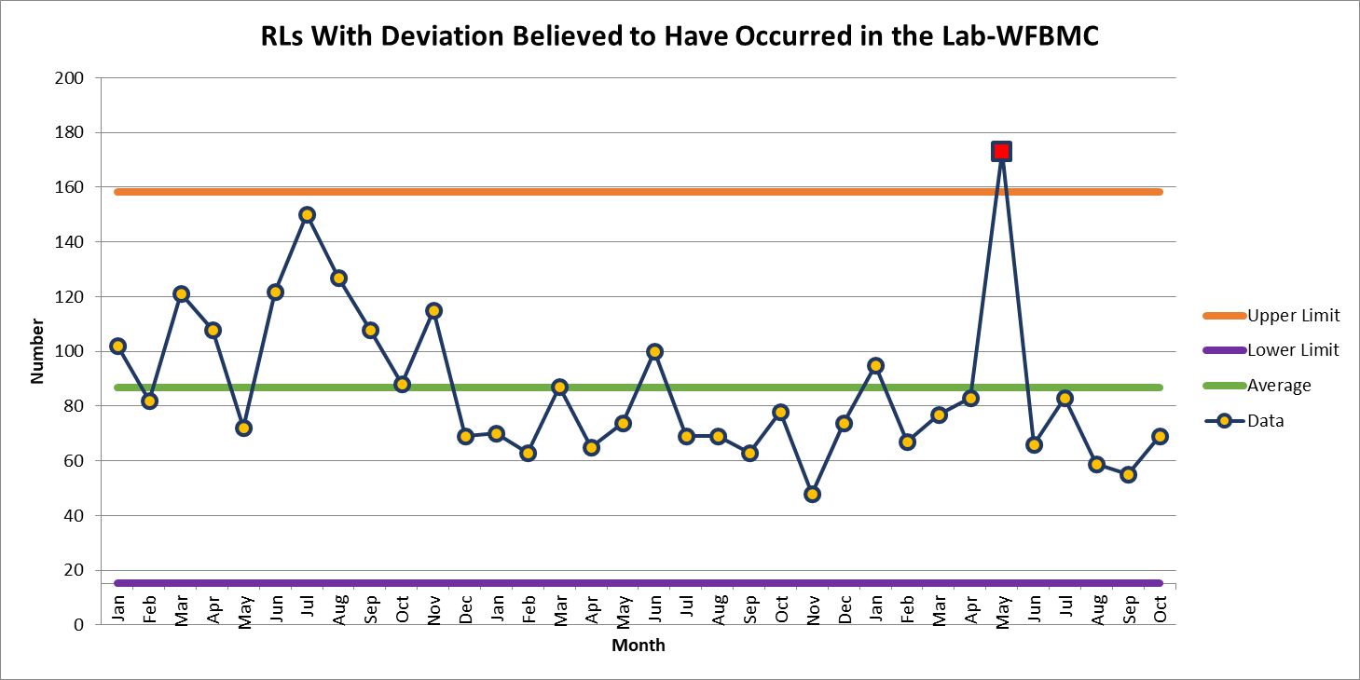
WFBMC 69

Slide 6
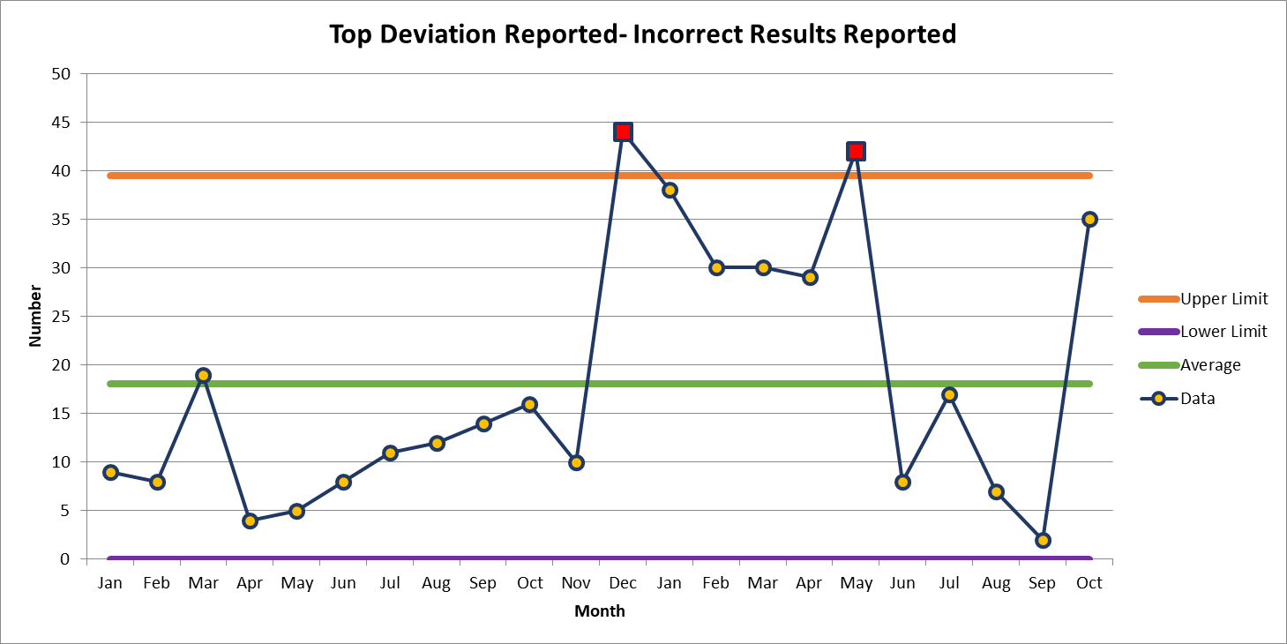
October 35

Slide 7
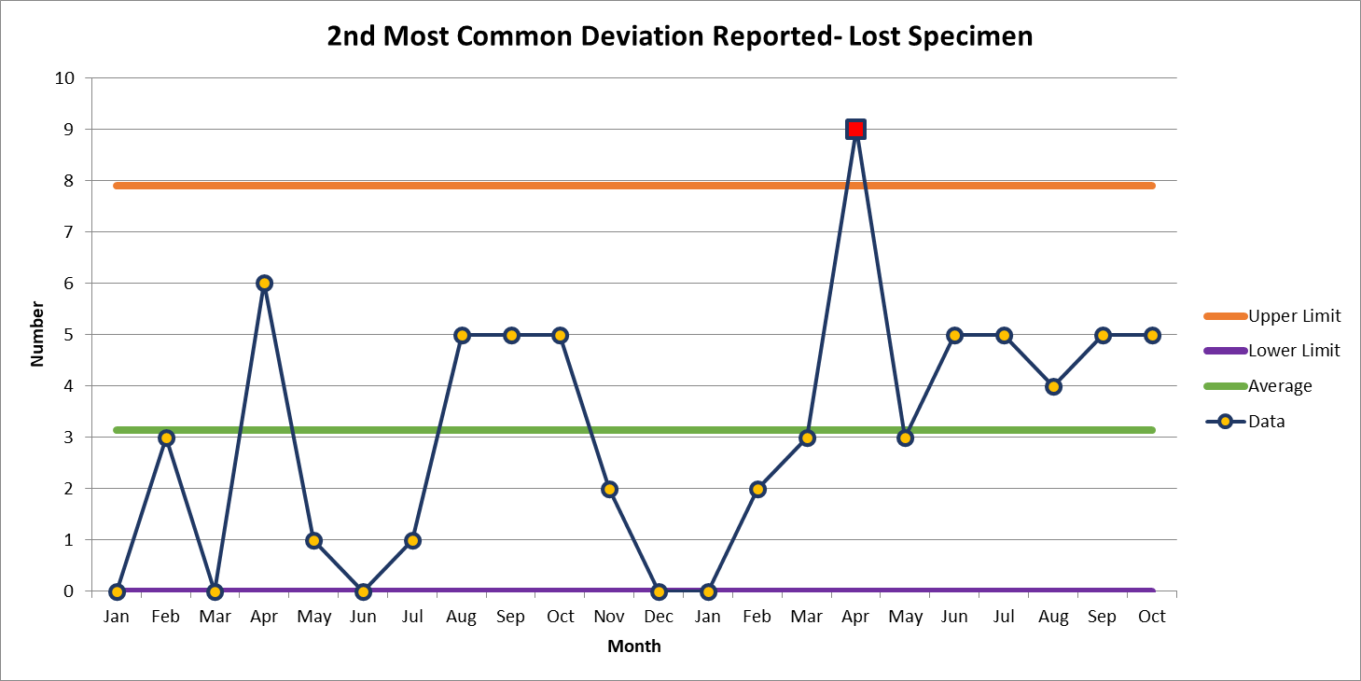
October 7

Slide 8
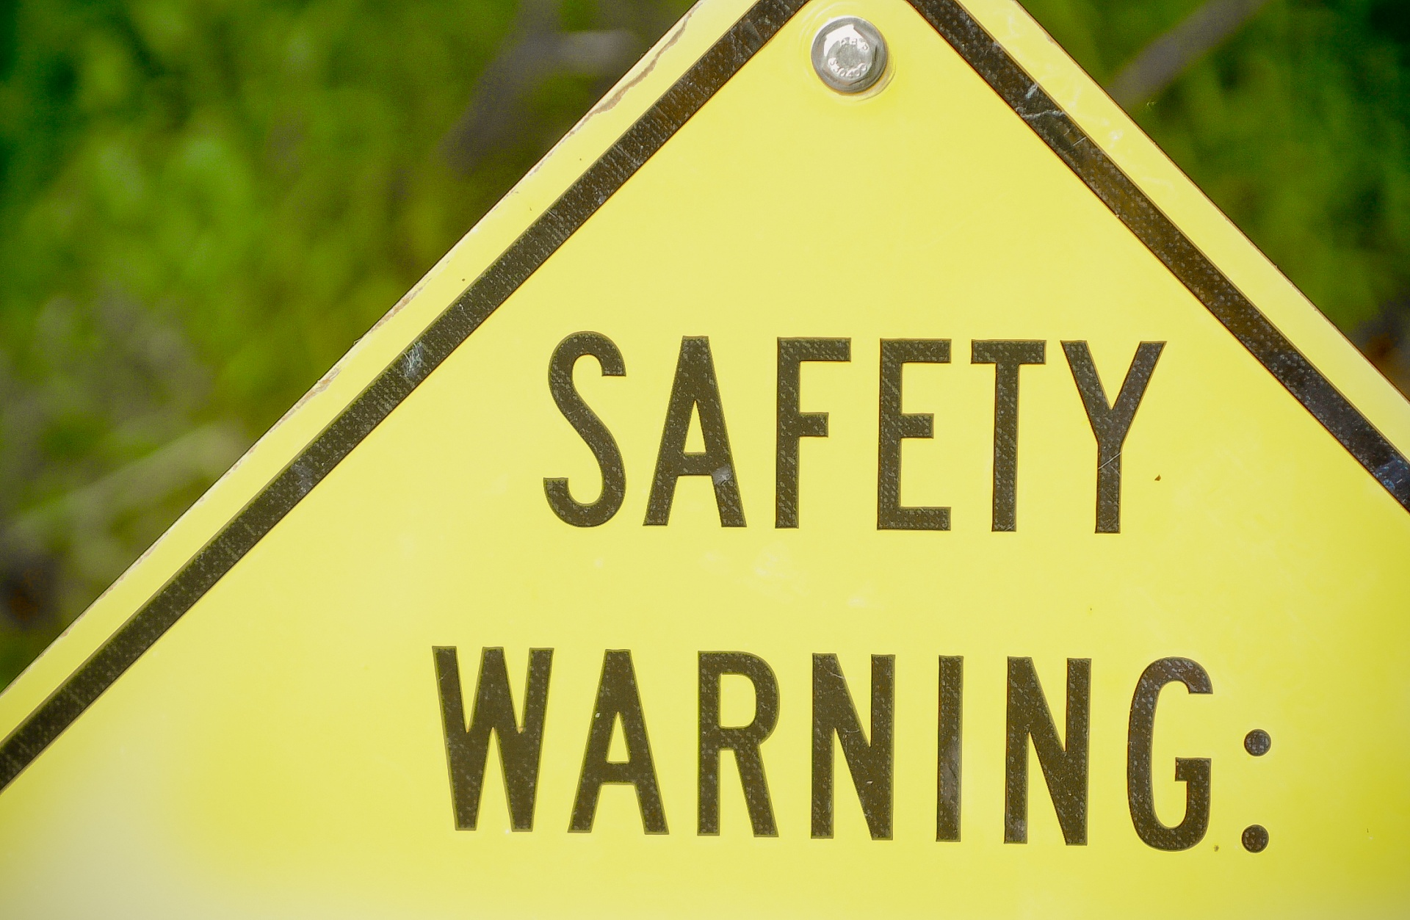

Slide 10
Corrections to Lab Records
GEN.20450
Correction of Laboratory Records
The laboratory makes corrections to laboratory records (eg, quality control data, temperature logs, and intermediate test results or worksheets) using appropriate techniques.
NOTE: The laboratory must have a written procedure that defines how to make corrections to both paper and electronic laboratory records. Laboratory records and changes to such records must be legible and indelible. The techniques used must meet the following criteria:
● Original (erroneous) entries must be visible (ie, erasures and correction fluid or tape are unacceptable) or accessible (eg, audit trail for electronic records).
● Corrected data, including the identity of the person changing the record and when the record was changed, must be accessible to audit.
Evidence of Compliance:
✓ Records of corrections to laboratory records AND
✓ Written procedure for correction of laboratory records

Slide 11
Quality Correction of Laboratory Records Policy (NCBH)
Policy Guidelines:
All changes to laboratory records must be legible and indelible (use of pencils are prohibited).
Original (erroneous) entries must be visible (i.e., erasures, white and correction fluid are unacceptable) or accessible (example: audit trail for electronic records).
Use of a single, horizontal line to strike through the original (erroneous) entry is preferred.
Corrected data, including the identity of the person changing the record and when the record was changed, must be accessible to audit.
Corrections or changes to records should be noted by the Section Manager/Section Medical Director during the monthly QA review process. If reason for correction/change was other than a minor error, implementation of a CAPA review may be necessary.

Slide 12
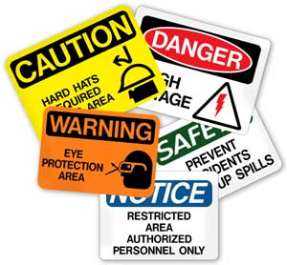
This Photo by Unknown author is licensed under CC BY-ND.

Slide 13
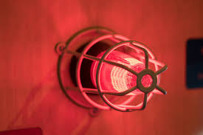
Lab Employee Hazard Awareness
November Topic – Fire Alarm Response

Slide 14
Clinical Labs
Defend in place
The clinical lab is designed for you to continue to provide patient care in the event of a fire

Slide 15
Non-clinical Labs
Evacuate if possible
If leaving could negatively affect patient testing two people can remain in the lab
One person to perform the testing, another person to maintain outside communication and monitor surrounding areas for signs of a fire

Slide 16
Thank You!

Slide 17
Please contact the Quality, Safety and Accreditation Team if you have any quality or safety concerns.
QS_A@wakehealth.edu

