Slide 1
Safety Presentation
01.2025 | Department of Lab & Pathology

Slide 2
Connect to Purpose
Collaboration in the workplace is a work style that helps employees work together to achieve a common goal in ways that benefit a company and its employees. Collaboration is an essential part of teamwork and helps a successful team function most effectively.​
​
The principles are: ​
focus on mission before organization​
manage through trust, not control​
promote others, not yourself​
build constellations, not stars.
Notes:
We as a whole entity want to look the bigger picture
Lab, the work we do along with the results we produce is the driving force behind the patient's diagnosis and the care they receive while frequenting our clinics, PSC's, hospitals

Slide 3
Good Catches December 2024
Date Reported | RL# | Good Catch Employee | Description of Event | Site
12/12/2024 | 387198 | Kimberly Prazak | I was performing a type and screen on this patient and noticed her results looked strange. Kimberly Prazak was able to correctly identify IV contamination as the testing interference. The patient was redrawn and the interference in the results of the type and screen were resolved. | DMC
12/31/2024 | 388711 | Amanda Poteat | Amanda Poteat received a VBG sample in the ICU Blood Gas Lab from 8CCW. Results were suspicious and after comparing with previous results she called the patient's nurse to request a recollect. The redraw was normal. | WFBMC
12/31/2024 | 388703 | Jyneasha Johnson | Jyneasha Johnson received a VBG syringe in the ICU Blood Gas Lab from 7AE with two patient chart labels. After peeling the top label away, she discovered the bottom label was for a different patient. Jyneasha called the patient nurse and requested a redraw for patient safety. | WFBMC

Slide 4
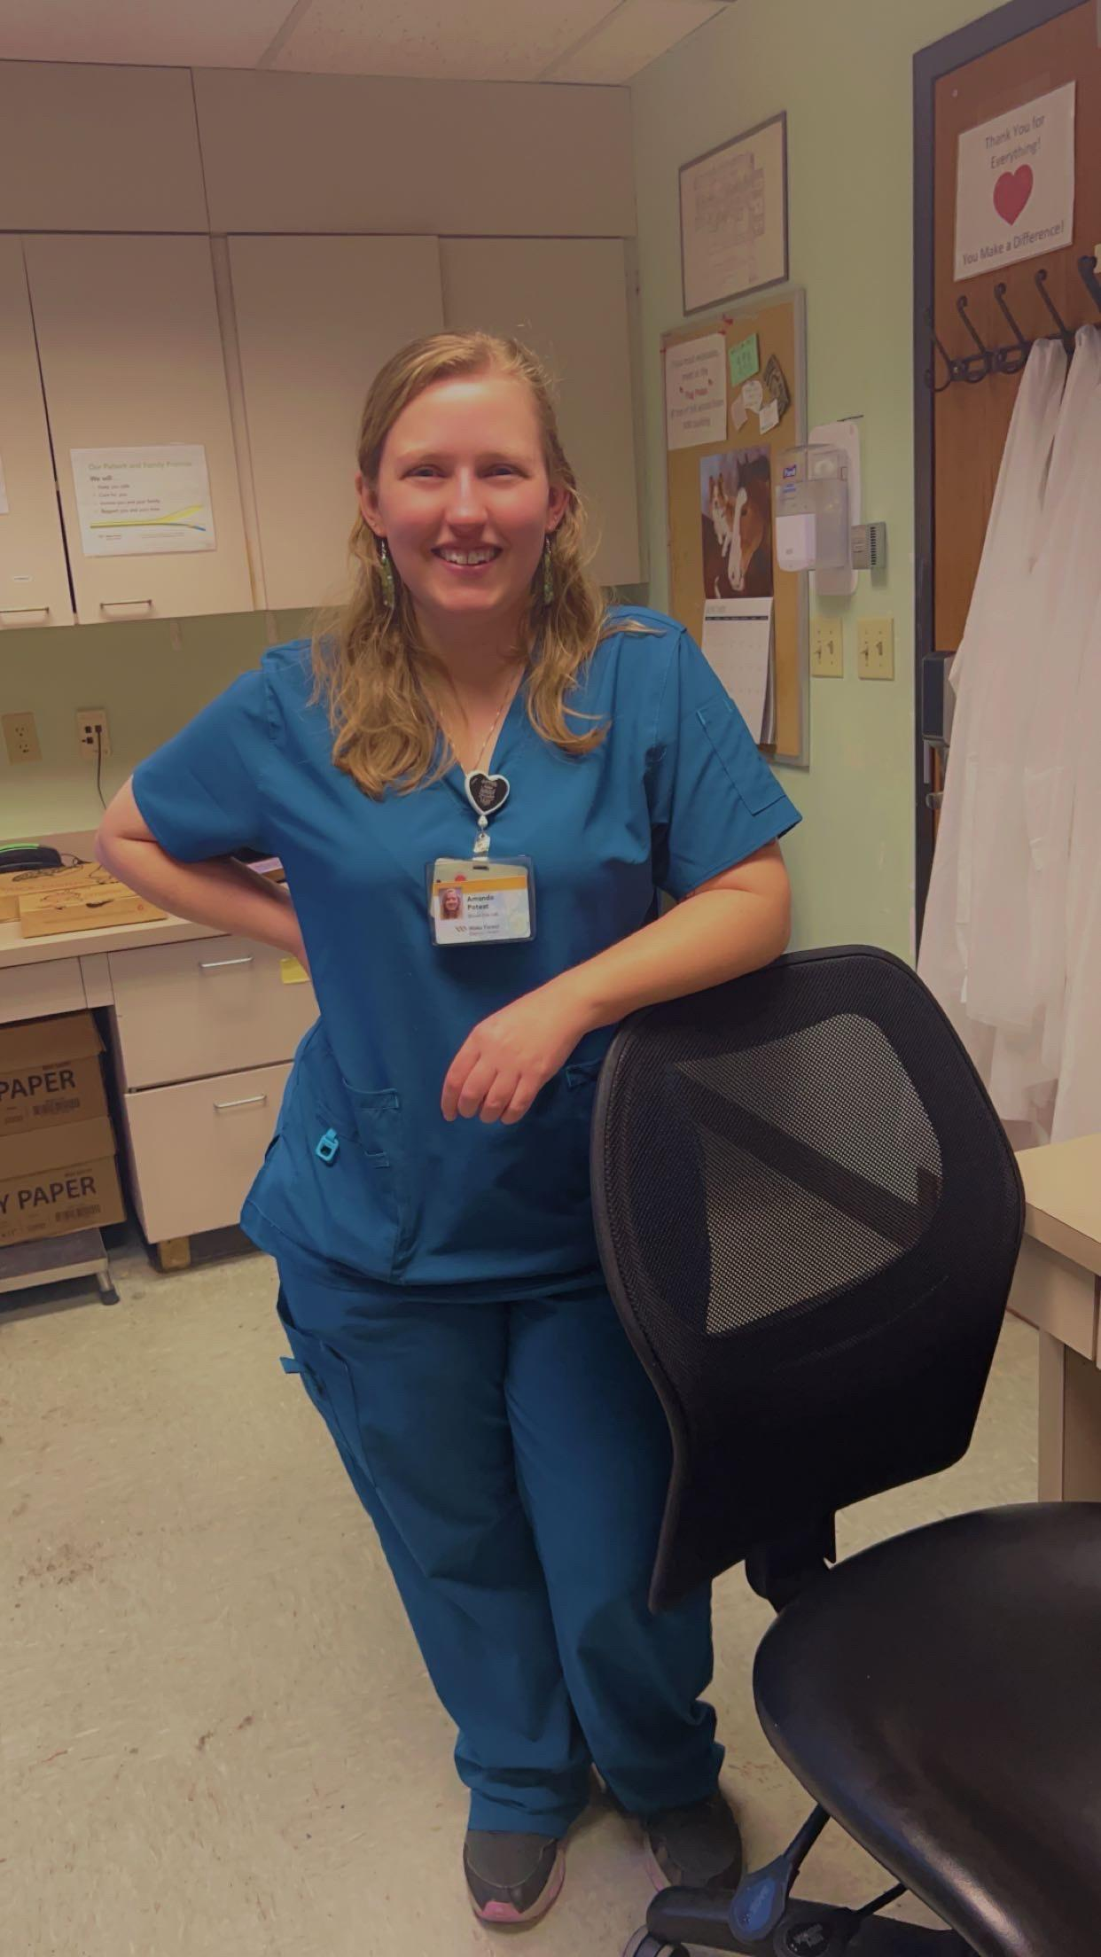
Good Catch Recipient December 2024
Amanda Poteat
Blood Gas Lab
WFBMC

Slide 5
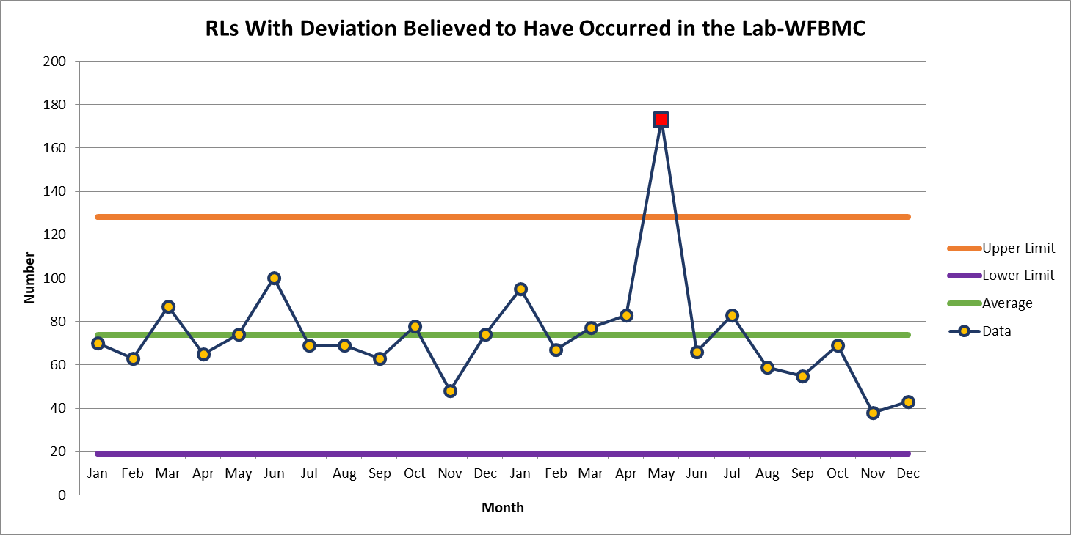
WFBMC 43

Slide 6
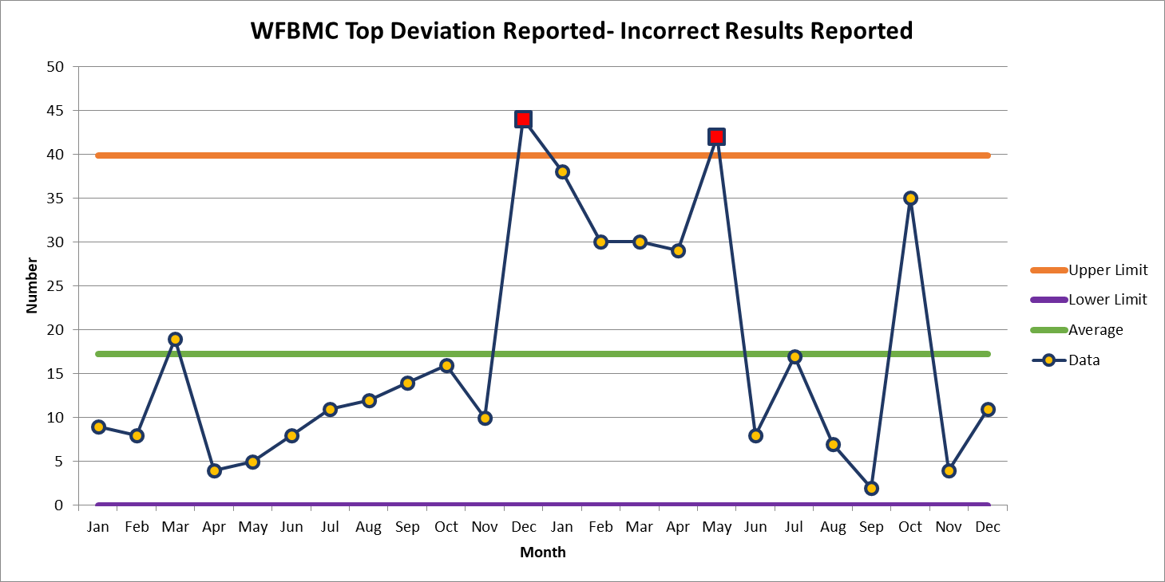
December 11

Slide 7
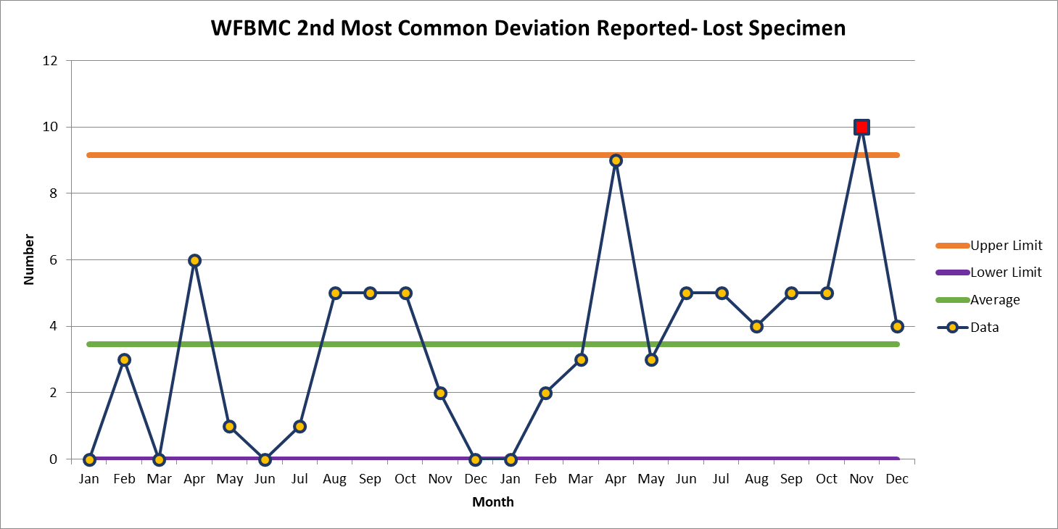
December 4

Slide 8
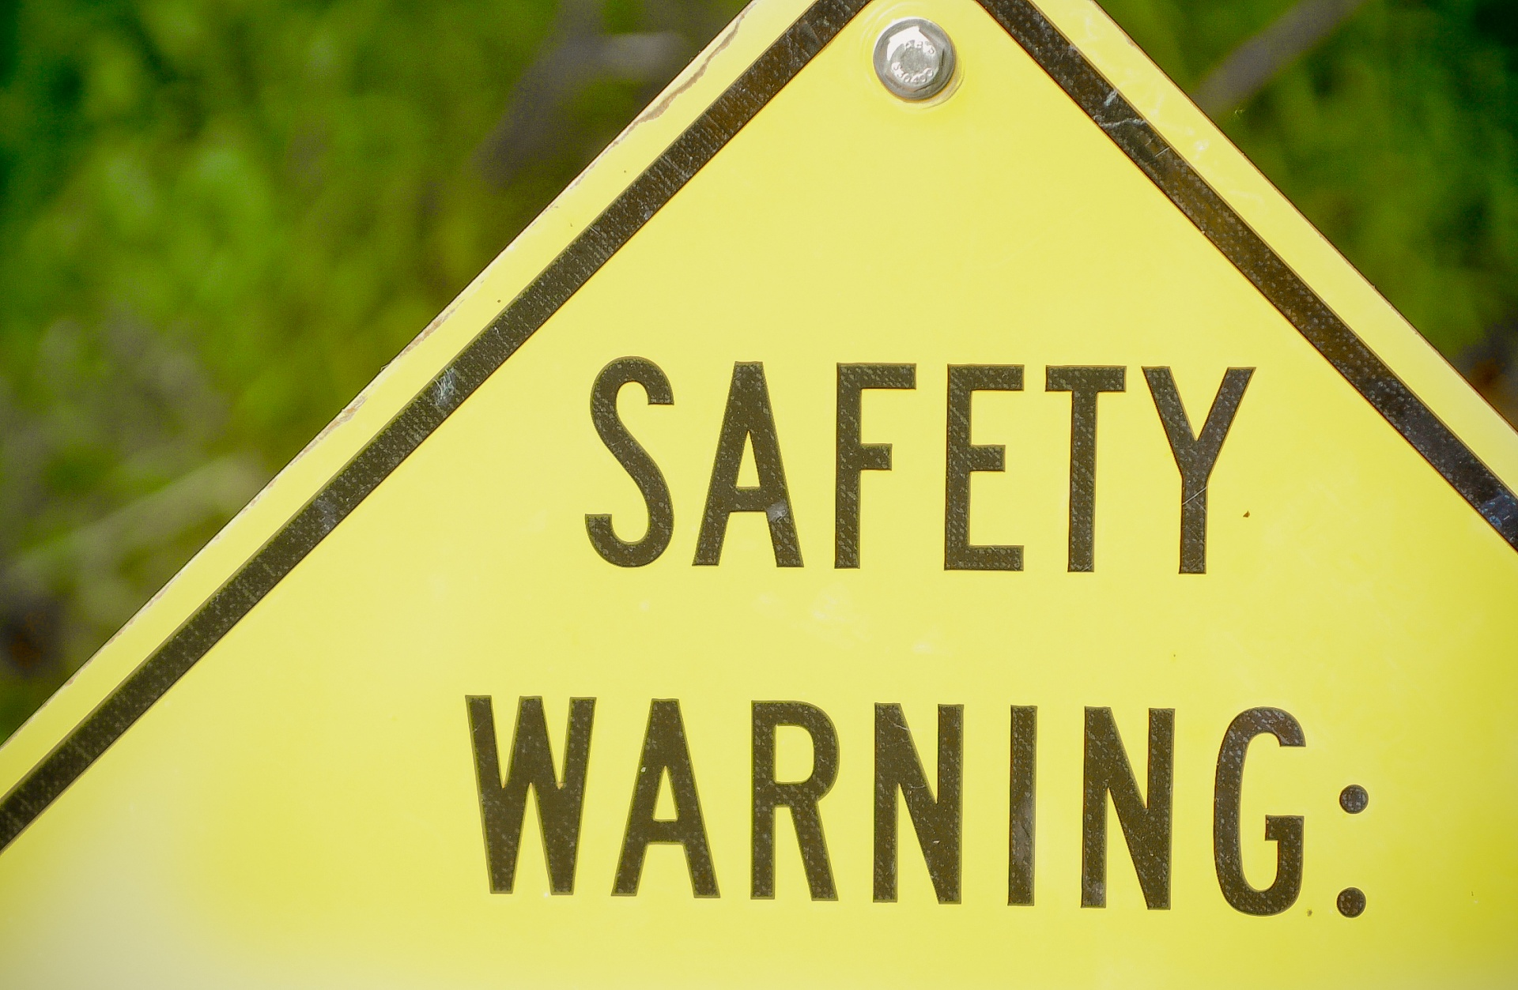

Slide 9
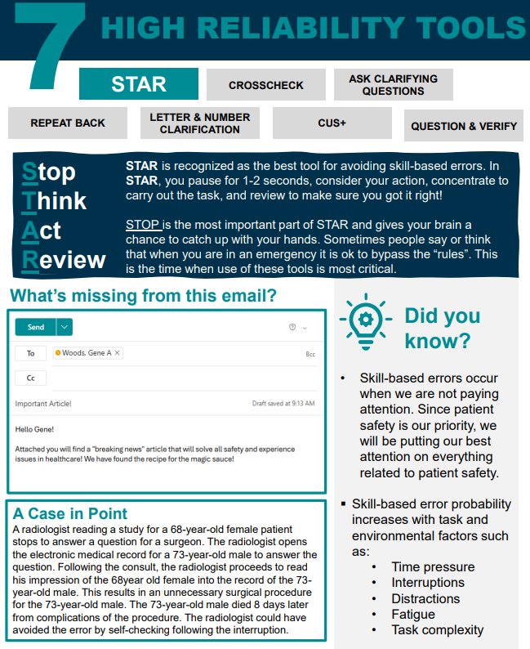

Slide 10
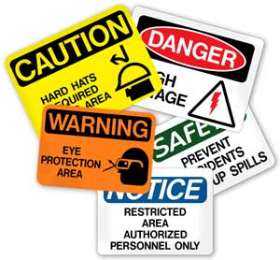
This Photo by Unknown author is licensed under CC BY-ND.

Slide 11
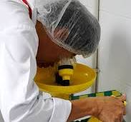
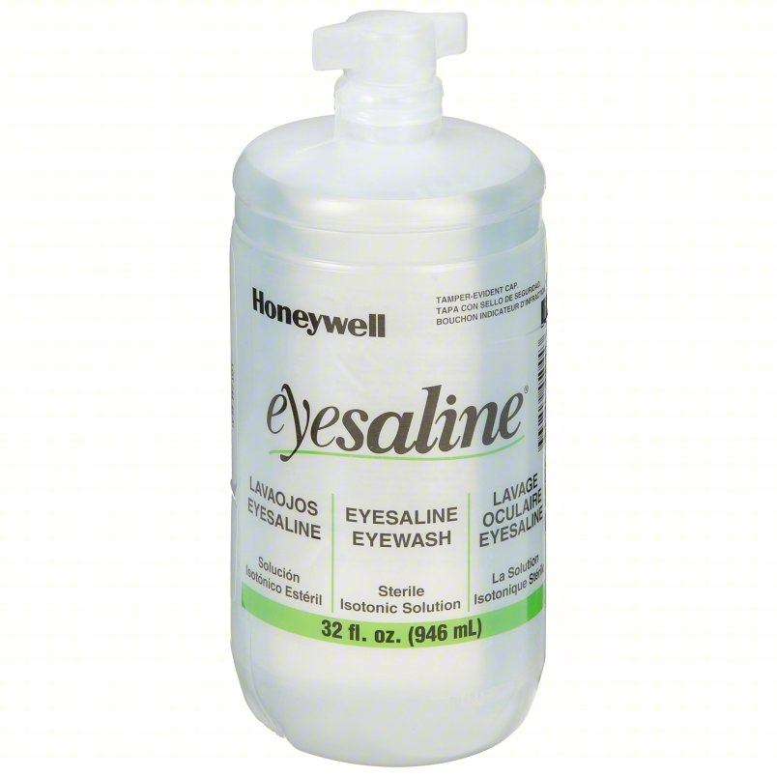
January Employee Hazard Awareness Eyewash Station/Bottles

Slide 12
Emergency Eyewash (GEN.77400)
a. Each lab section has adequate plumbed eyewash.
b. Each lab section is responsible for monitoring the following criteria on each eyewash station in their laboratory section:
i. No greater than 10 seconds travel distance from areas in the laboratory where hazardous chemicals are present to the eyewash stations.
ii. Signage for location of eyewash
iii. Unobstructed path with unlocked doors opening in the direction of the eyewash.
iv. Tepid fluid temperature (between 15 C and 37 C or 60 F and 100 F). Actual recording of the temperature is not required.
v. Plumbed systems are activated weekly.
vi. Capable of delivering 1.5 L per minute for 15 minutes
vii. Flow is provided to both eyes simultaneously.
viii. Nozzles or covers to protect from airborne contaminants.
ix. Hands-free flow once activated.
x. Plumbed systems are protected from unauthorized shut off.
xi. Self-contained or disposable bottled eyewash units are visually examined weekly.
Notes:
In Policy Tech the Eyewash Shower Flush and Maintenace Record Form can be found
This is the recommended form that is used to ensure the form is reviewed and signed off by Lab Manager at the end of each month

Slide 13
Thank You!

Slide 14
Please contact the Quality, Safety and Accreditation Team if you have any quality or safety concerns.
QS_A@wakehealth.edu

