Slide 1
Fire and Code Triage
Quarter 1
Georgia Kontos MS, MLS(ASCP)^{CM}
Blood Bank/SCTCT Safety Representative
3/10/25 | Blood Bank/SCTCT / bt

Slide 2
Fire Alarms
ANY time a fire alarm sounds you should
Look for smoke or fire
Smell for smoke
Listen for announcement over PA system
Share information with management and co-workers

Slide 3
Fire Alarms
If you smell/see smoke or see fire:
DIAL:
Blood Bank location:
BB / 1st Floor NT / Room 1B074A
Stem Cell Transplant and Cellular Therapy location: SCTCT / 2ND Floor NT / Room 2B001A
– OR –
ACTIVATE NEAREST FIRE PULL STATION

Slide 4
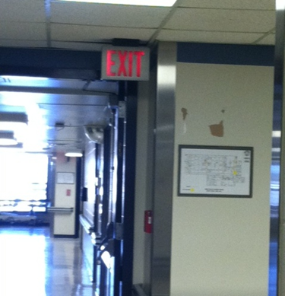
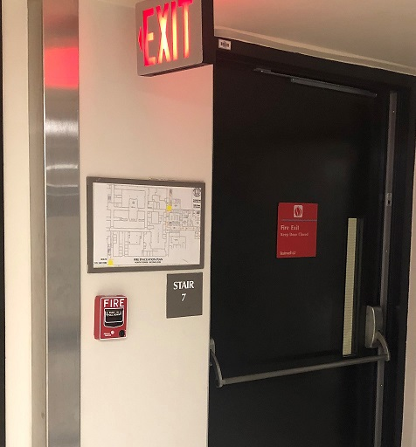
Fire Alarms
Locations of nearest Fire Alarm Pull Station
LOCATION BB:
Out main BB door
Turn right
At elevator well
Fire pull station is on right
directly under red EXIT sign
LOCATION SCTCT:
Out main SCTCT door
Turn Right
Fire pull station is straight ahead
directly under the red EXIT sign, next to the stairwell
Elevators

Slide 5
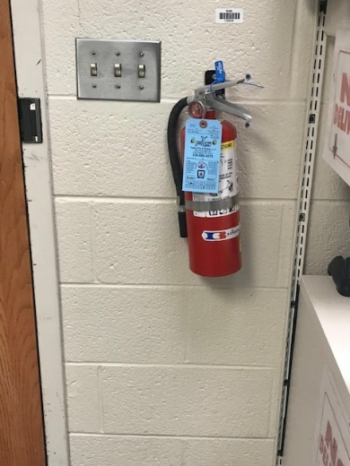
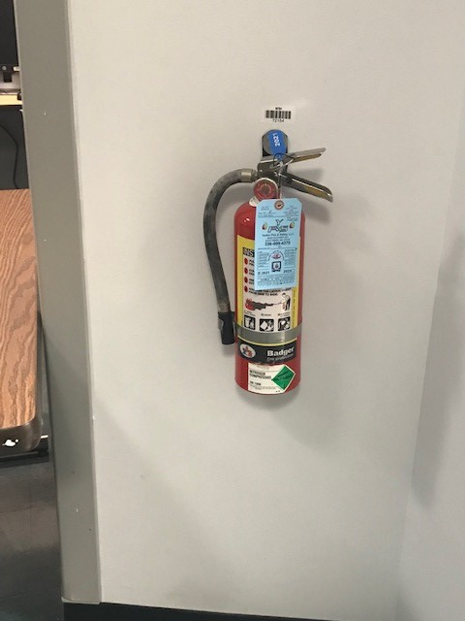
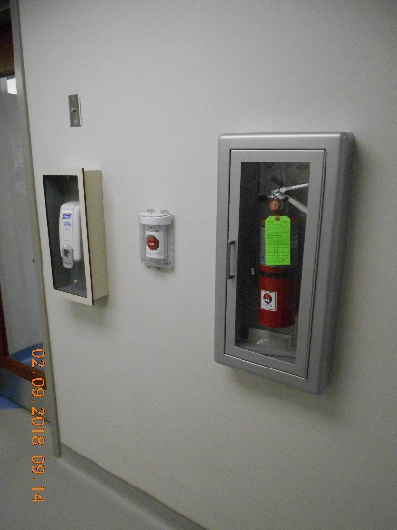
Fire Alarms
Fire Extinguisher Locations
In Blood Bank
On the wall next to the front door, under the outgoing mail basket
In the dance hall, across from the student lockers
In SCTCT Lab
In the processing room,
next to the specimen
receipt door
BB
SCTCT Lab

Slide 6
Fire Alarms
P.A.S.S.
When using a fire extinguisher remember:
Pull extinguisher pin
Aim extinguisher at base of flames
Squeeze extinguisher handle
Sweep extinguisher from side to side until flames are extinguished

Slide 7
Fire Alarm Response Responses can be different depending on the lab you are in
Clinical Labs
Defend in place – Your lab is designed so that in the event of a fire outside the lab, you can continue to provide patient care
Non-clinical Labs
Evacuate!
Exception: If leaving could negatively affect patient testing - 2 people can remain in the lab
One to continue the testing and the other to maintain outside communication and monitor surrounding areas for signs of a fire

Slide 8
Tests and Drills
Tests are performed annually
Advanced notice will be provided
Evacuation is not necessary
Drills are conducted annually
Unannounced
Respond as you would to any other alarm

Slide 9
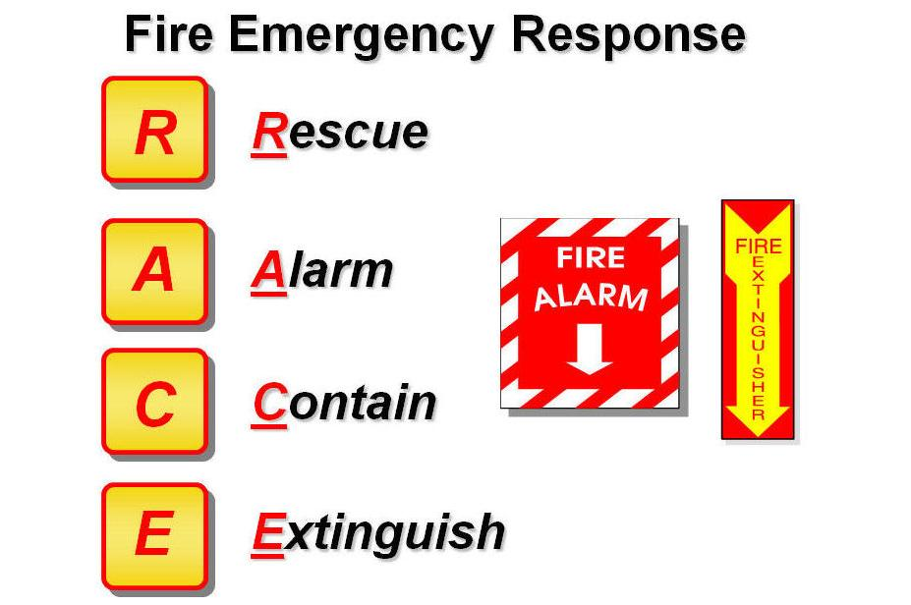
R. A. C. E.
Rescue any persons in immediate fire area without endangering yourself
Alarm: sound the alarm by calling 6-9111 or activating the nearest fire alarm box
Contain the fire by shutting doors and windows, and put wet towels under the door, etc.
Extinguish if the fire is small and localized, and you are familiar with the use of a fire extinguisher, use it to put out the fire – otherwise
Evacuate: use posted evacuation route.
Turn off gas, electrical machinery, close doors, windows as you leave.
Primary Blood Bank Evacuation Route
Turn right out of main BB
door into hallway.
Walk to end of hallway
Take stairs to bottom
Meet in street in front of power
plant

Slide 10
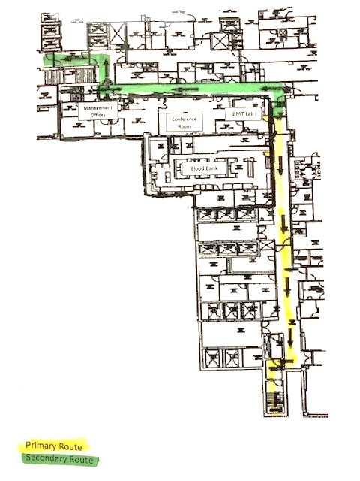
Blood Bank Evacuation Route
Primary
Exit BB through front door. Turn right and proceed to end of hall. Go down North tower stairway to the bottom. Exit to meet in front of the power plant.
Secondary
Exit BB lab through door near bathroom. Proceed forward a few steps then turn Left. Proceed to Watlington Hall and down stairway ahead. Exit building into the courtyard.

Slide 11
SCTCT Evacuation Route
BMT Evacuation Route
Second Floor North Tower
 |  |  |  |  |  |  |  |  |  |  |  | Stair Well
 |  |  |  | North Tower Elevators |  |  |  |  | BMT Office and Specimen Receipt |  |  | Service Elevators
 |  |  |  |  |  |  |  |  | BMT Processing and Cryo Rooms
 |  | Stair Well
Primary
Secondary
Primary
Exit SCTCT through either door. Turn right. Turn right again after the North tower elevators if you exited SCTCT from the cryo room. Go Down North tower stairway at the end of the hall. Exit to meet at the front of the power plant.
Secondary
Exit SCTCT lab through the cryo room. Turn Left. Proceed to Gray building. Turn right down first hallway. Go through double doors. Go down stairway on left and exit building.

Slide 12
Emergency Alert Plain Text Matrix
Facility Alerts
Event | Recommended Plain Language
Evacuation/Relocation | Facility Alert + Relocation/Descriptor + Location
Fire/Alarm | Facility Alert + Fire or type of Alarm + Descriptor/Location
Medical Surge (Phase 1, Phase 2) Mass Casualty (Phase 3) | Facility Alert + Medical Surge Plan Activated + Location
Utility Failure | Facility Alert + Type of Utility Failure / Location
Dangerous Weather (Tornado, etc.) | Facility Alert + Dangerous Weather Alert / Descriptor

Slide 13
Emergency Alert Plain Text Matrix
Security Alerts
Event | Recommended Plain Language
Missing Infant / Child | Security Alert + Missing Person (Infant or Child) + Last Known Location
Missing Person > 18yoa | Security Alert + Missing Person (Adult) + Last Known Location
Armed Intruder / Active Shooter / Hostage Situation | Security Alert + Special Instructions + Descriptor (Type of Threat) + Location

Slide 14
Emergency Alert Plain Text Matrix
Medical Alerts
Event | Approved Code
CPR Involving a Patient | Code Blue + Location

Slide 15
Code Triage
Blood Bank staff will be notified by the Incident Command Center (ICC) when Code Triage Plan is activated
Activate Telephone Call List immediately
Notify management / medical director immediately (24h / 7d)
Staff lab with minimum of 6 employees
Print inventory (RC, PLSMA,PLT) Give to medical director.
Medical Director / Path Resident will report to ICC.
Notify blood supplier of disaster situation

Slide 16
Code Triage
Virtual Personnel Pool
Assess the number and capabilities of the employees present and report personnel available to the Virtual Personnel Pool.
See step by step instructions on how submit a Virtual Personnel Pool
Lab Safety Manual / Code Triage section

Slide 17
Severe Weather
Tornado Approaching
Listen for ECC announcement
Evacuate to areas without exterior windows
Central, new renovated space / storage area
BMT office, conference room, breakroom
Interior stairwell, basement, sub-basement
Hurricane Procedure
Report damages or outage of service immediately to the Service Response Center using 6-9111, option 3.

