Slide 1
BB Blast
4/25/25

Slide 2
Quality
Clocking: Ensure you are clocking in when you are in the lab and not before you get here.
O neg practices: continue to use O negs only as indicated in SOPs. Still 40% of our usage is from short dated products. New inventory levels are 50 O negs and 250 O pos (Original was 100/200). We will continue to drop O neg par levels until we reach better utilization numbers.
Downtime May 4th (Sunday). SQ will be down starting at 8am and lasting about 7 hours. Extra staff will be on hand to assist. After we go back up we will be accessing SQ through Citrix (if they can get it working).
BB blast will now be assigned in medtraining. Everyone is responsible for reading and attesting to have read the information.
Sickle Blood order: starting May 5th the order will be only for 4 O negs. O pos and all other types will be screened in house (first for C,E,K then if negative sent downstairs for HgbS testing). 2nd-3rd will continue to do the bulk of this but will no longer have to wait for the units to arrive to screen and can better work this into the workflow. Bulk order and send segments to heme for hgbs testing.
Document all testing phases, including check cells on antigrams and worksheets as applicable. If you don’t write it down, it has to be retested!!

Slide 3
Quality
Patients TYHD expires when they are discharged. If the patient comes back within the 3 days they need a NEW TYHD!!! Patient from last night came back in via AirCare and was MTP. Sample from a few days ago was used to XM. This is not correct. Sometimes it can be difficult to tell if a patient was discharged and is a readmit but if you KNOW they are a new admission, like this patient arriving from AirCare, they have to have a new TYHD.
Sunquest fix for interface results from Vision is in the works. It needs validating before it can be moved to live. Continue to print worksheets. These can be discarded when the reqs go to be filed. (which for some testing is same day). Your signature on the BB req is an attestation that you checked to ensure the correct results were entered into SQ from the visions.

Slide 4
RFP Overview Pros BioRad Grifols
ABID Software
Allows for other manufacutrers cells
Suggests extra cells to run
Integrated blood antigen facts book
Titers up to 2048 with A2 cells
C3d card
Random access
Zero waste
Onboard stability (IH-500)
7 days red cells
21 days gel cards
30 days LISS packs
20 min weekly maintenance, no monthly or daily
Tube incubators with manual workstations
No Airgap issues
ABID Software
Titers up to 512 with A2 cells
C3d card
Random access
Zero waste
Onboard stability (IH-500)
Till Gel Cards expire
15 min weekly maintenance
20 min monthly maintenance, no daily
Tube incubators with manual workstations

Slide 5
RFP Overview Cons BioRad Grifols
Two analyzers are NOT both validated for the same platforms of testing making the large analyzer not ideal for our lab. We would need 2-3 IH-500 Next
Manual workstations have a larger footprint
ABID software does not allow for third party cells
Titers only up to 512. higher titers would require manual titrations
DG pipettors are terrible (from past experience).
Manual workstations have a larger footprint

Slide 6
RFP Overview Ortho Pro Cons
Analyzers already in use, easy validation to new Swift Analyzers
Smallest footprint for manual workstations
Largest test menu
Fastest TAT
Large selection of panels
We like the MTS pipettors
No ABID software
Under development but no details shared
No C3d card
Under development but no details shared
No ability to titer with A2 cells
Supply issues since COVID
Poor communication about delays in product shipment
Test menu very cumbersome and makes it unusable for things like antigen typing.

Slide 7
RFP Biorad slides

Slide 35
RFP Grifols slides

Slide 51
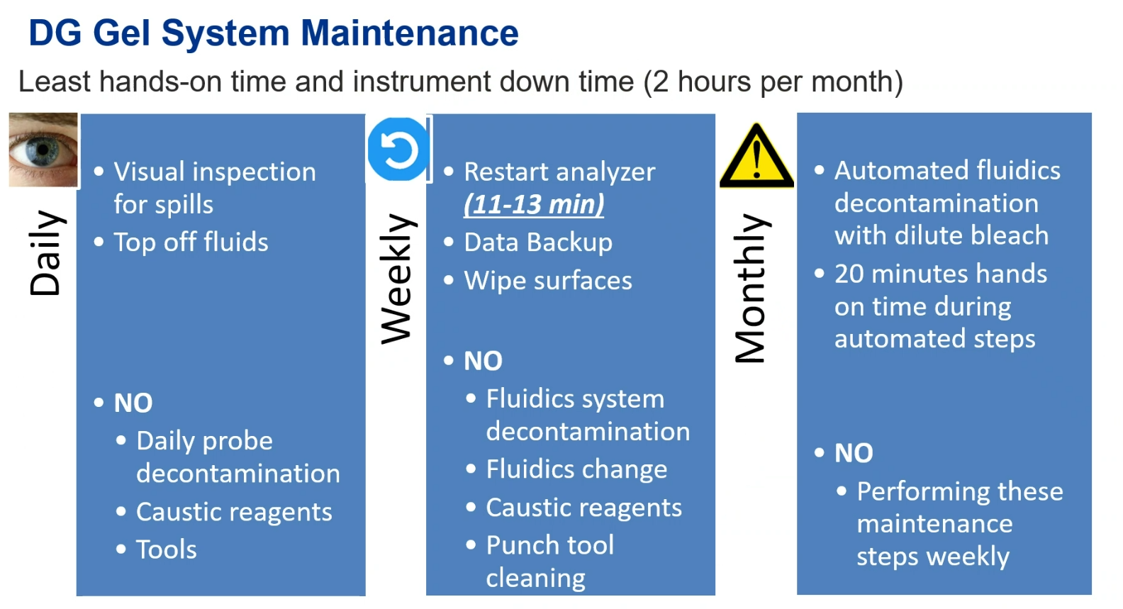

Slide 55
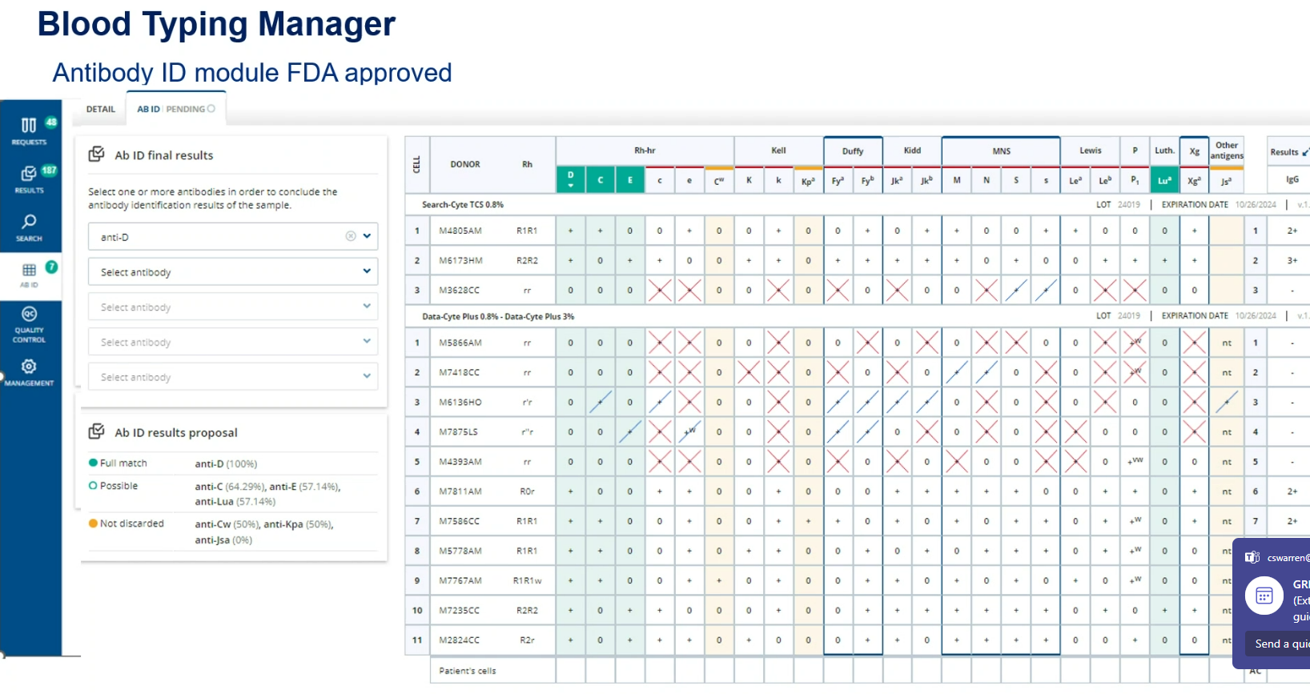

Slide 57
RFP Orthos slides

