Slide 1
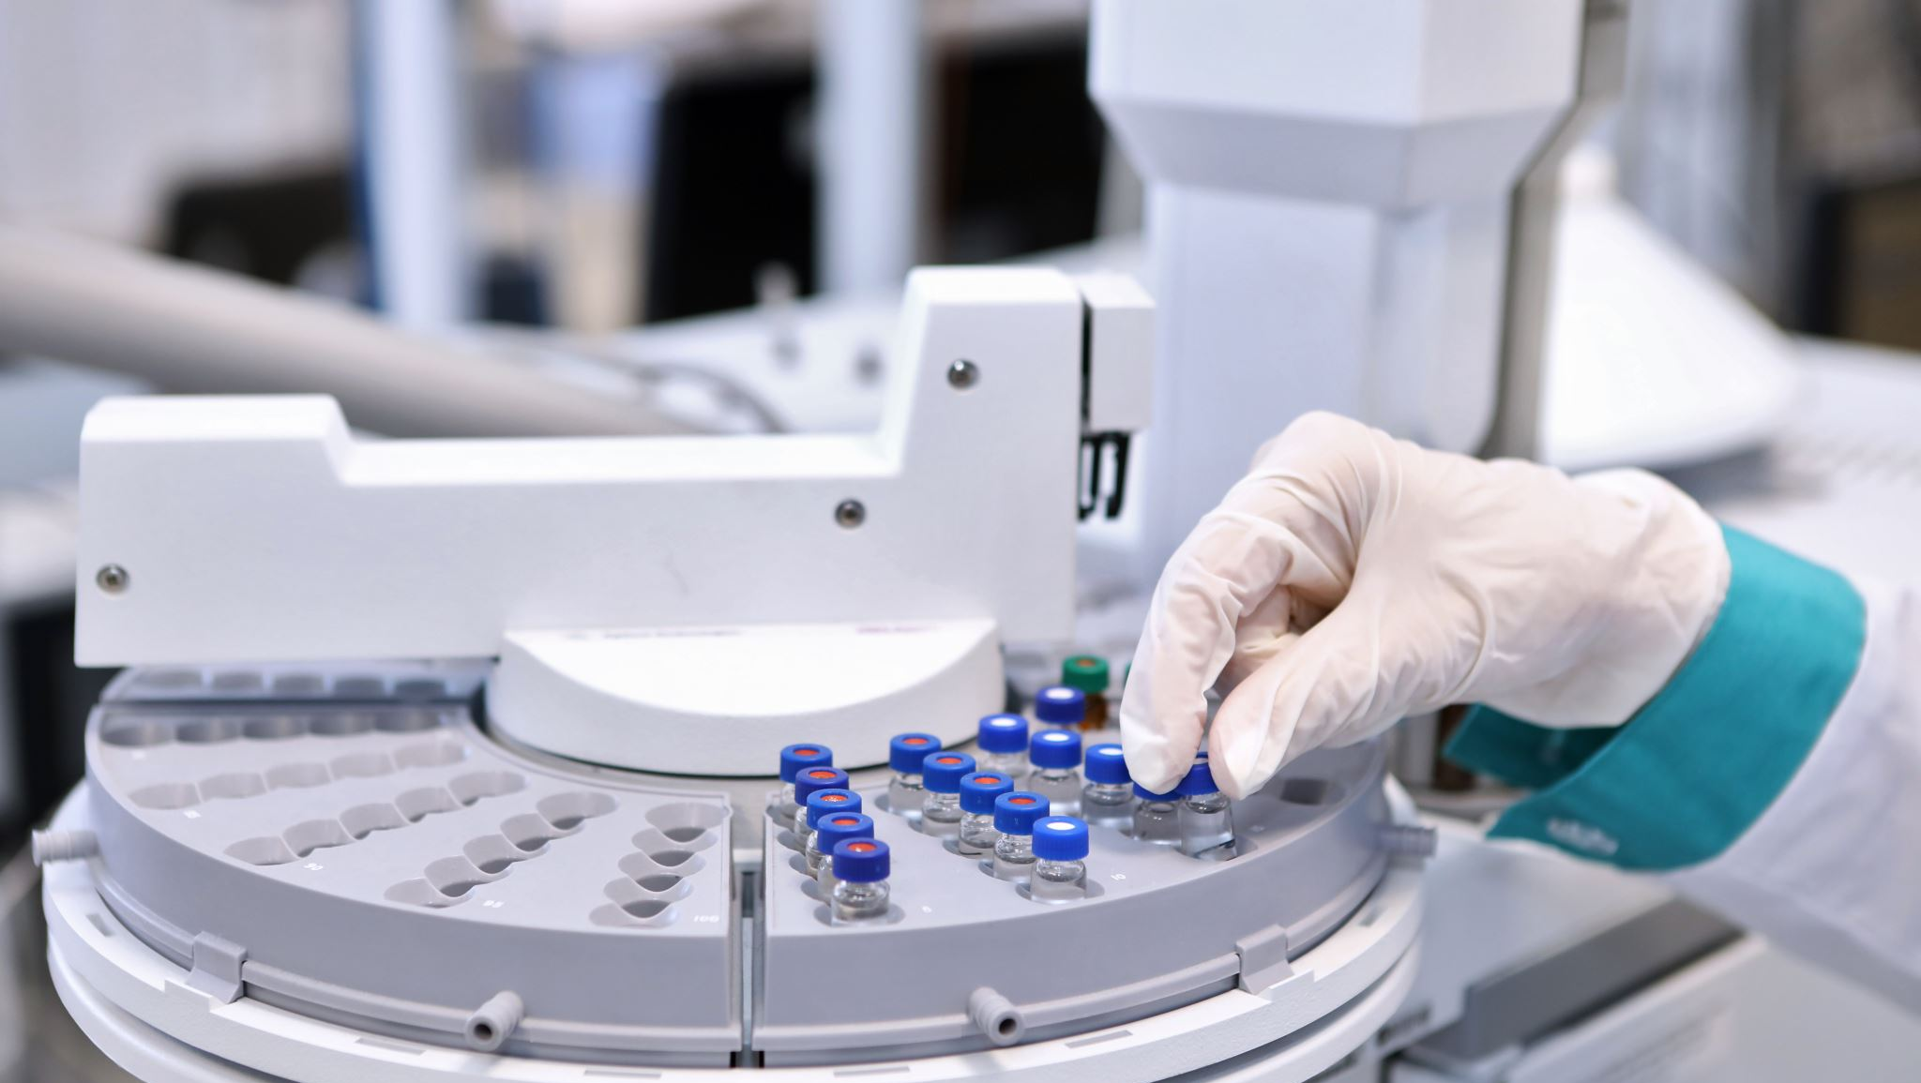
Refrigerated Centrifuge This is a new piece of equipment in the SCTCT Lab. You might use this centrifuge to pack whole blood or other applications as requested. This power point highlights the important things to remember during use.

Slide 2
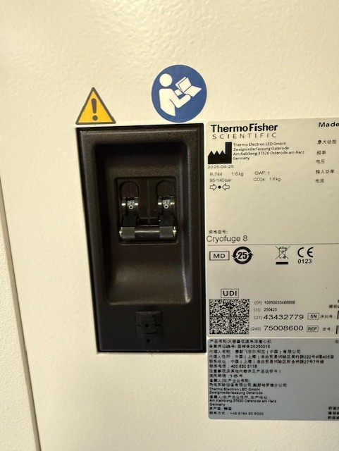
Turn Power to Centrifuge ON
There is a switch on the top right of the centrifuge. Flipping this switch up will turn the centrifuge ON.

Slide 3
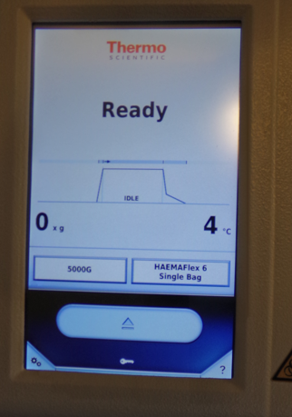
Open/Closing Centrifuge – DIFFERENT FOR NEW CENTRIFUGE
Use the Open or Close Buttons on the Main touch screen to move the centrifuge lid; DO NOT push the lid down or pull it up manually.

Slide 4
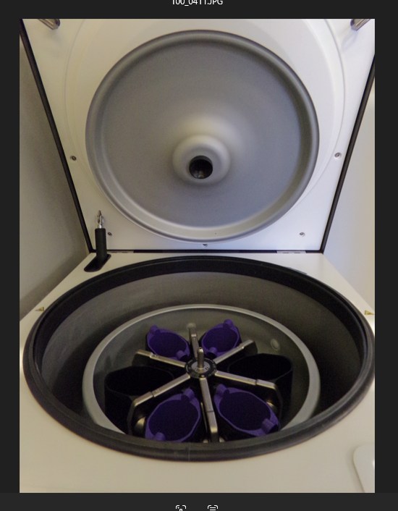
DO NOT TOUCH the inner lid.
The rotor on the inside of the centrifuge has it’s own lid that hangs inside the outer lid when open.
DO NOT touch this lid – there is no reason to move it at all – the centrifuge locks it into place.

Slide 5
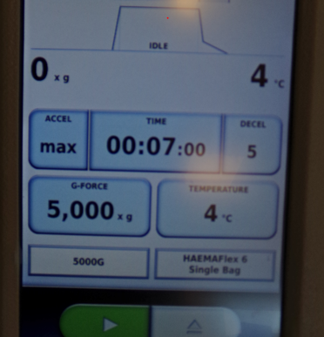
Selecting Program
The Program for packing whole blood is called 5000g.
On the Main screen, press the bottom left button, and the preset programs will display.
Select 5000g.
Ensure the settings are 5000g, 7 minutes, and 4 degrees Celsius.
Press Green Arrow button to start.

Slide 6

Finishing Steps – IMPORTANT!!!!
Do not touch the inner rotor lid
1
Use the Main Screen key pad to close the lid
2
Make sure to turn the power OFF.
3

