Slide 1



DUFFY NULL TESTING
BB 2026 CE #1

Slide 2



What is duffy null?
Duffy null testing identifies a genetic variation of the ACKR1 gene that prevents the expression of the Duffy antigens on RBCs (Fya neg Fyb neg).
Simplest way to determine is Fya/Fyb antigen testing.
While not causing infection, the Duffy-null genotype is the primary cause of lower, yet stable, neutrophil counts (Duffy-Null Associated Neutrophil Count or DANC).
Studies show that this genetic variation causes some healthy neutrophils to route directly to the spleen, never making it into peripheral blood circulation.

Slide 3


Clinical significance
What is ANC? Absolute Neutrophil Count
WBC x (neutrophil %/100)
Normal ANC range in a healthy adult is 1500-8000 cells/µL, with a median of ~5000 cells/µL.
The ANC range of Duffy-null patients is 1210-5390 cells/µL, with a median of 2820 cells/µL. (JAMA)
An ANC of <1500 is considered neutropenic and has increased risk of infection; however 23.8% of healthy Duffy-null individuals have an ANC of <2000 and 10% have one of <1500. By definition this classifies them as neutropenic. (American Society of Hematology)
DANC is a benign, hereditary condition and not a disease. It does not increase the risk of infection, but it can lead to unnecessary, costly, and invasive medical investigations.

Slide 4


Duffy-Null Population percentages
80-100% Western Africans
67% African-Americans
~50% Middle Easterners
<1% European descent

Slide 5
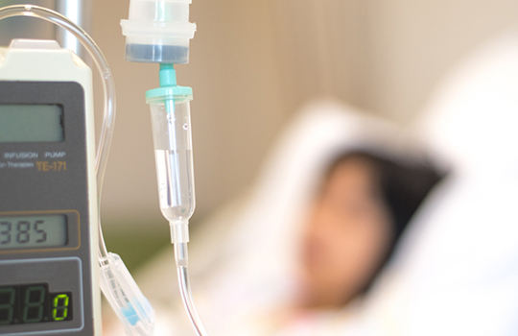
Clinical trial and treatment disparities
Exclusion from Trials: A recent 2024 study showed that 78.8% of clinical trials use neutrophil thresholds (e.g., >1,500/µL) that exclude many Duffy-null individuals, despite them being healthy. (ashpublications.org)
Oncology Outcomes: A recent study found that Duffy-null patients with multiple myeloma may benefit more from triplet therapy (drug regimen) alone than from early stem cell transplants, suggesting the phenotype could serve as a biomarker for personalized treatment. (National Institutes of Health.gov)
Dose Modifications: Research shows that ~53.5% of standard cancer treatment regimens require dose reductions for neutrophil counts that are actually normal for Duffy-null patients. (National Institutes of Health.gov)
This Photo by Unknown Author is licensed under CC BY-NC

Slide 6

Other health considerations
Resistance to Malaria: The Duffy antigen acts as a receptor for Plasmodium vivax. The absence of this antigen (Duffy-null) prevents this parasite from entering red blood cells, providing a significant survival advantage in malaria-endemic regions.
Increased Risk of HIV Infection: The Duffy antigen is a "decoy" receptor that binds and removes proinflammatory chemokines (like CCL5) that suppress HIV replication. Lack of this antigen allows more chemokines to exist, potentially leading to higher HIV acquisition.
Potential for Increased Inflammation: Because the Duffy antigen on red blood cells acts as a sink for inflammatory cytokines and chemokines, its absence may lead to higher levels of circulating inflammatory factors. (Cincinnati Children’s Hospital)

Slide 7


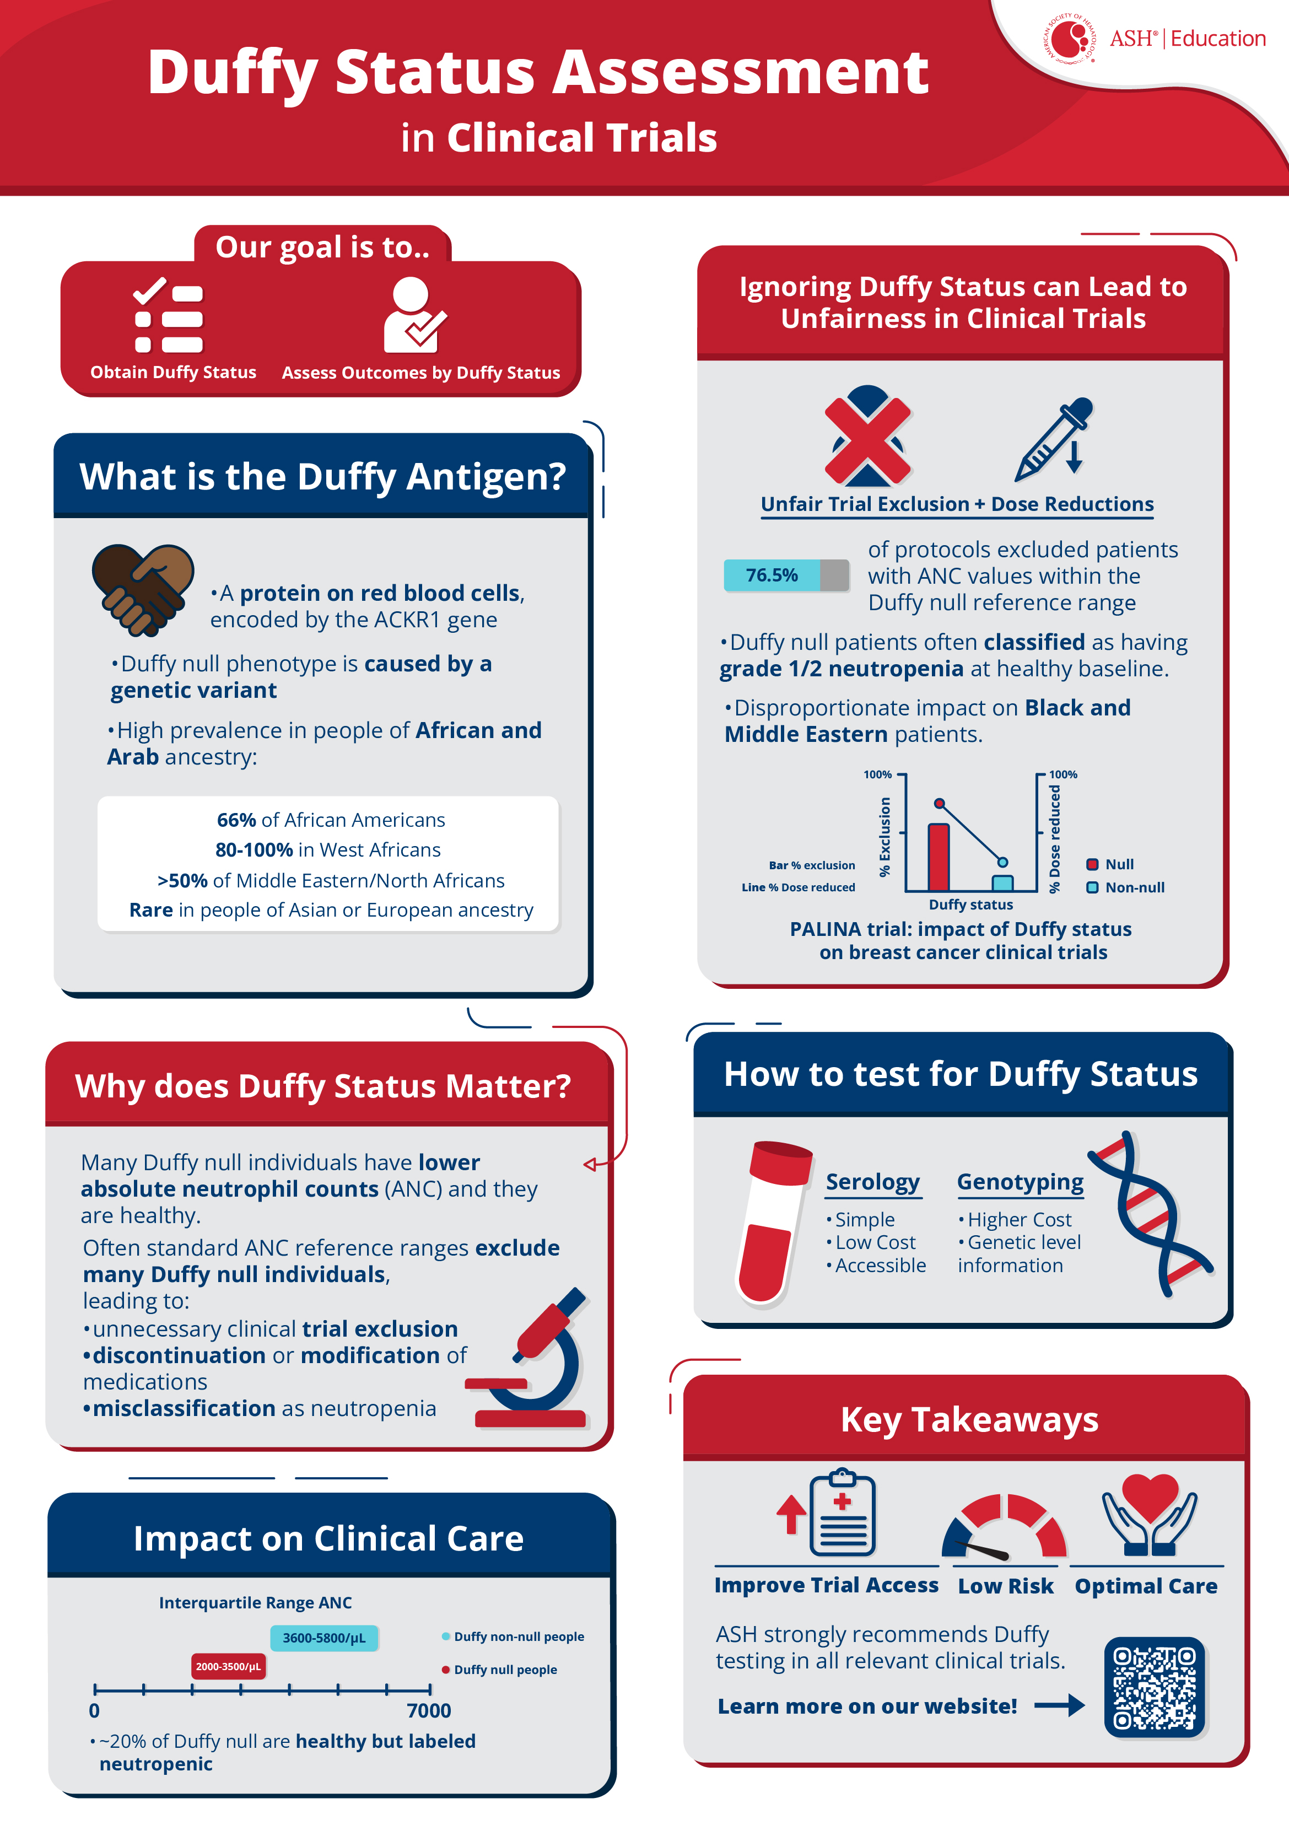
This infographic is from the website of the American Society of hematology.
Our facility, along with the charlotte market, received a grant from the American society of hematology (ash). This was initiated to establish a duffy-null associated neutrophil count (danc) in our health market.

Slide 8
END OF PRESENTATION
PROCEED TO QUIZ. A SCORE OF 100% IS NEEDED FOR CE.

