Slide 1
VPBS-B 2020 Education
A fun review of images with a touch of information!
The following are images from our most recent peripheral blood smear survey. There are some great images to refresh your knowledge. This is a review to meet a requirement, but I also intended for it to be a possible reference for you in the future.

Slide 2
RBC morphology

Slide 3
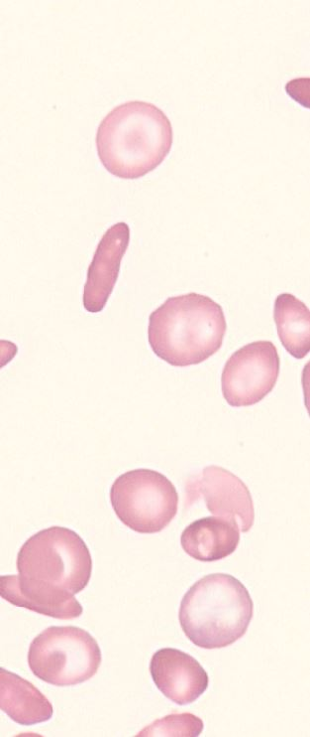
What is in this image? (2 answers)
Burr Cell (Echinocyte)
Sickle Cell
Target Cell (Codocyte)
Acanthocyte
Spherocyte
Elliptocyte
Teardrop cell (Dacrocyte)

Slide 4
There are 2 RBC morphologies of note in this image. There are elliptocytes, called for their elongated shape and a width smaller than that of an ovalocyte. These are often seen in anemias (iron-deficiency, megaloblastic, etc.), thalassemia, myelodysplastic syndrome, and hereditary elliptocytosis. The most prominent morphology are the target cells, also called Codocytes. Target cells are thin rbcs with increased surface to membrane volume ration and decreased hemoglobin content. This causes the cells to flatten out on a smear causing the central darker area surrounded by a ring of pallor, and then a ring of darker hemoglobinized cell surface again. These are usually seen in anemias (iron-deficiency, sickle cell, etc.), thalassemia, post-splenectomy, and chronic liver disease.
What is in this image?
Burr Cell
Sickle Cell
Target Cell
Acanthocyte
Spherocyte
Elliptocyte
Teardrop cell

Slide 5
What is in this image?
Stomatocyte
Target Cell
Teardrop Cell
Helmut Cell (Keratocyte)
Schistocyte

Slide 6
Teardrop Cells (or Dacrocytes) appear in the shape of a teardrop or pear where one end is narrow and the other is enlarged and rounded or blunted. These may be seen with bone marrow fibrosis, and are often associated with abnormal an abnormal spleen or bone marrow. They are also present in many anemias: pernicious anemia, anemia of renal disease, hemolytic anemias, etc. Beware if all of the “tails” or narrow ends are pointed in the same direction on the slide. This is an artifact of slide preparation, and not due to an underlying condition.
What is in this image?
Stomatocyte
Target Cell
Teardrop Cell
Helmut Cell (Keratocyte)
Schistocyte

Slide 7
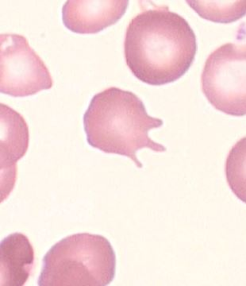
What is the abnormal RBC morph in this image?
Echinocyte (Burr Cell)
Acanthocyte
Schistocyte

Slide 8
What is the abnormal RBC morph in this image?
Echinocyte (Burr Cell)
Acanthocyte
Schistocyte
Acanthocytes have a few elongated projections (spikes) from the RBC surface that are unevenly distributed around the RBC. Echinocytes, in contrast, are typically similarly-sized small projections spread evenly around the surface of the RBC.
Acanthocytes are generally found in individuals with liver disease and hemolytic anemias.
Echinocytes are generally present in patients who have an electrolyte imbalance and patients with liver disease.

Slide 9
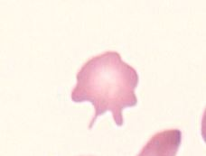
Comparison
Echinocytes (Burr Cells)
Acanthocytes
Schistocytes
This one can also be called a helmet or bite cell.

Slide 10
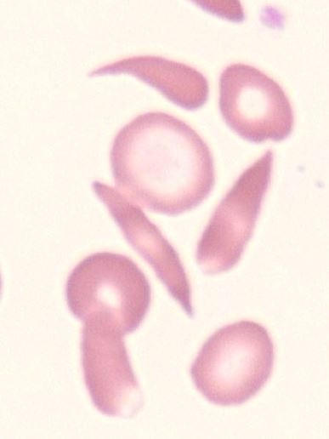
What RBC morph is represented by the cells the arrows are pointing to?
Sickle Cell
Schistocyte
Stomatocyte
Spherocyte
Ovalocyte
Elliptocyte

Slide 11
Sickle cells (Drepanocytes) are long, thin red cells that appear crescentic with two pointed ends. They are formed due to the crystallization of Hemoglobin S upon deoxygenation. They are generally seen when a patient has hemoglobin SS or hemoglobin SC disease and some beta-thalassemias. Colder weather or excess physical activity can bring on a sickle crisis in individuals with these diseases, and often require transfusion for proper oxygenation.
What RBC morph is represented by the cells the arrows are pointing to?
Sickle Cell
Schistocyte
Stomatocyte
Spherocyte
Ovalocyte
Elliptocyte

Slide 12
What is seen in this image?
Some helpful background for this one:
History of Sickle Cell Disease.
HGB = 6.9 | HCT = 19.2 | MCV = 81 | MCHC = 35.9
Teardrop Cell
Sickle Cell
Spherocyte
Schistocyte

Slide 13
The arrow is pointing to a Spherocyte. Notice how it is smaller in diameter and perfectly round, and also how deeply shaded (full of hemoglobin) the cell is. Another hint is in the RBC indices for the sample. The small MCV (normal = 80-100) and high MCHC (normal is 32-36) are clues that spherocytes are possible. The known sickle cell disease is also a clue to look for spherocytes. Spherocytes are most prevalent in hereditary spherocytosis and hemolytic anemias. Spherocytosis is caused by a defect in the RBC membrane that allows increased permeability for sodium and water to enter the cell (plumping it up).
What is seen in this image?
Some helpful background for this one:
History of Sickle Cell Disease.
HGB = 6.9 | HCT = 19.2 | MCV = 81 | MCHC = 35.9
Teardrop Cell
Sickle Cell
Spherocyte
Schistocyte

Slide 14
What RBC inclusion is seen in this image?
(Same patient as previous slide.)
Howell-Jolly bodies
Pappenheimer bodies
Basophilic stippling
Hemoglobin C crystal

Slide 15
The inclusions in the images are Howell-Jolly bodies. H-J bodies are a fragment of nuclear DNA left behind after the nucleus in extruded from the RBC. They are seen often when the spleen is absent or hypofunctional (as occurs with Sickle Cell patients). Usually only 1 H-J body is seen in a cell, but multiple are possible. Note that pappenheimer bodies and basophilic stippling usually comes with multiple inclusions in a cell.
What RBC inclusion is seen in this image?
(Same patient as previous slide.)
Howell-Jolly bodies
Pappenheimer bodies
Basophilic stippling
Hemoglobin C crystal

Slide 16
Same patient as previous slide.
What cell is seen in these images?
Lymphocyte
NRBC
Blast

Slide 17
These Nucleated Red Blood Cells (NRBC’s) are seen often in patients with anemia. The bone marrow attempts to make up for a lower volume of RBC’s in plasma by increasing production, and some cells are released prior to being fully mature. NRBC’s are immature red blood cells whose nucleus has not been removed.
Same patient as previous slide.
What cell is seen in these images?
Lymphocyte
NRBC
Blast

Slide 18
WBC Classification

Slide 19
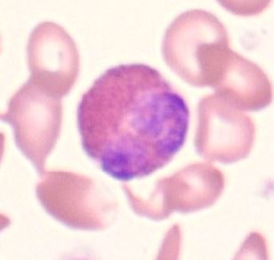
Name the cell in these images.
Segmented Neutrophil
Band Neutrophil
Lymphocyte
Monocyte
Eosinophil
Basophil

Slide 20
Name the cell in these images.
Segmented Neutrophil
Band Neutrophil
Lymphocyte
Monocyte
Eosinophil
Basophil
Starting out easy. Cells filled with red/orange/pink granules can be classified as Eosinophils.

Slide 21
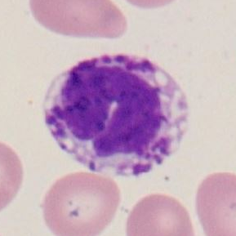
Name the cell in these images.
Segmented Neutrophil
Band Neutrophil
Lymphocyte
Monocyte
Eosinophil
Basophil

Slide 22
Name the cell in these images.
Segmented Neutrophil
Band Neutrophil
Lymphocyte
Monocyte
Eosinophil
Basophil
These are basophils. Note the presence of the large dark blue granules in the cytoplasm.
**Even though the nucleus of these cells look immature, they are classified as basophils because of the granules. They are not classified as band or metamyelocyte.**

Slide 23
Immature Granulocyte Classification
The following several slides are meant to help distinguish neutrophil precursors. Obviously opinions can differ somewhat between techs on how to classify these cells. I will give data based on the results of the CAP survey and reasons why the cells are classified the way they are. I will also say that for cells that you are deciding between 2 categories, CAP (and I) tend to classify them as the more mature of the 2 options. Note also that the maturity of the nucleus lends more weight to the final classification than the cytoplasm.

Slide 24
Patient Data: 65 year old man presenting with shortness of breath, splenomegaly, and bone pain. WBC = 19.9 | RBC = 2.60 | HGB = 7.9 | HCT = 25% | PLT = 46
Immature
Mature
Blast
Promyeloctye
Myeloctye
Metamyeloctye
Band
Segmented Neutrophil

Slide 25
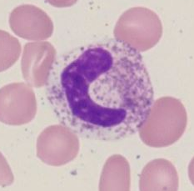
Band vs. Meta
Middle image is a fully mature neutrophil for reference.
Right: Metamyelocytes. The nuclear chromatin is more clumped, and the nucleus has started to “pinch.” A cleft can be seen on the nucleus.
Left: Band neutrophils. Notice that the “pinch” is more than halfway through the nucleus, and all are crescent shaped.

Slide 26
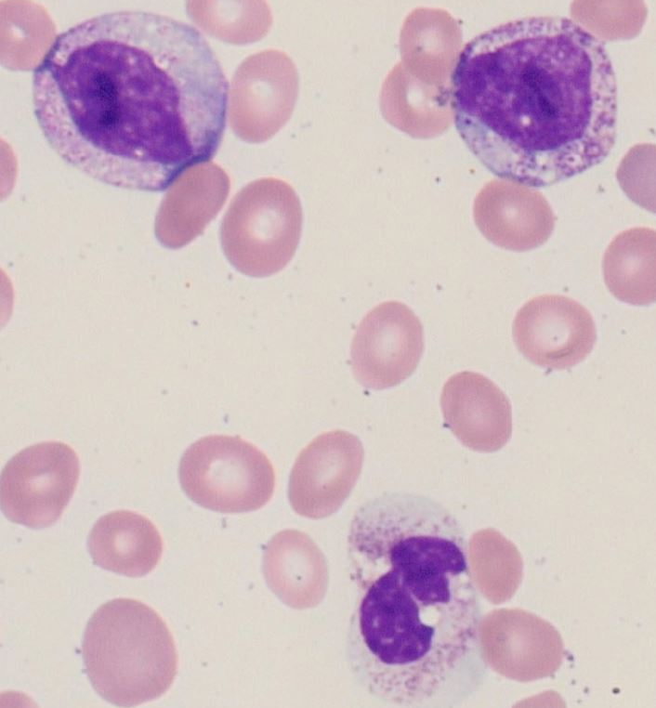
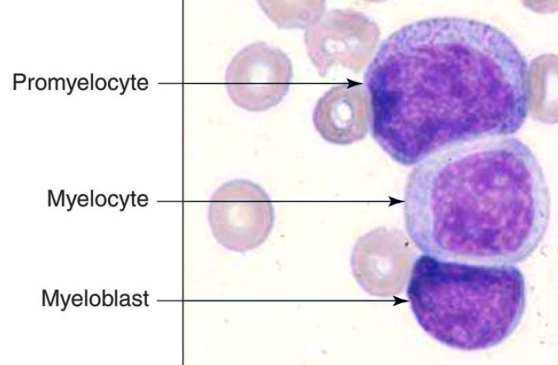
Myelocyte vs. Promyeloctye
Note that this patient also had some toxic granulation, which can complicate differentiating by granules. See next slides for discussion of these images.
Myelo: Smaller, more clumped chromatin, rounding nucleus. Clearing cytoplasm, fewer dark granules.
Promyelo: Larger cell with larger, more diffuse chromatin. Nucleoli may be seen more. Cytoplasm more basophilic (blue) with larger azurophilic (blue) granules.

Slide 27
2 Myelocytes 1 Seg
These two cells on top are easier to classify as Myelocytes. They have clearer cytoplasm with smaller red granules, and the nucleus is clumping and rounding. Note that the cells are approximately the same size as the segmented neutrophil at the bottom of the image.
I wondered if the cell on the upper left might be a monocyte, but settled on myelocyte eventually. There is some toxic vacuolization present as well, so make sure not to mistake that for the vacuoles of a monocyte. Also, the cytoplasm is more red as opposed to the blue/gray cytoplasm of a monocyte.

Slide 28
1 Myelocyte 1 Seg
This cell is more difficult. The reasons I would classify it as a Myeloctye (top cell) are: 1) the cell is the same size as the neutrophil; 2) the nucleus is rounded and darker (meaning more clumped); and 3) the cytoplasm is beginning to clear.
Contrast this cell with the cell in the following slide to try and pick out the differences.

Slide 29
1 Promyelocyte 1 Seg
I would classify the top cell as a Promyelocyte. The cell is slightly larger than the neutrophil below it. The nucleus takes up more space in the cell (cytoplasm:nucleus ratio is smaller). The nucleus has much more diffuse chromatin than the myelo in the previous slide. The granules are darker and more prevalent. The cytoplasm is also more basophilic (darker blue), especially around the RBCs.
If you classified this as a Myelo instead while doing the diff, I could find reasons to agree with you. There are many smaller, more red granules already in the cell, and some of the cytoplasm looks like that of the neutrophil below.
Again, this is more of a discussion than a specific education. I would never fault someone for calling something more mature with good reason.
The other cell is a seg and not a band. The nucleus is clearly creating lobes and pinching off, so we need to go with the mature option of segmented neutrophil.

Slide 30
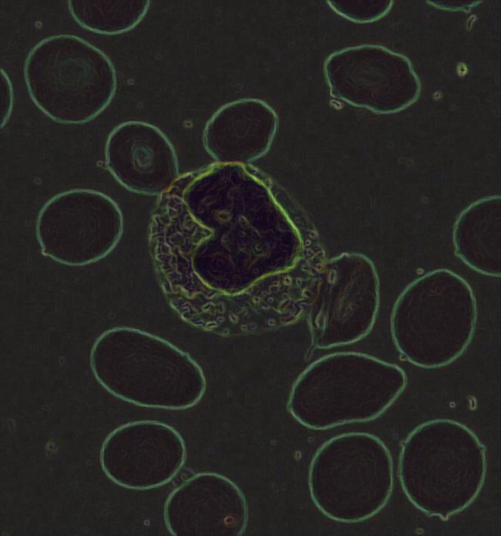
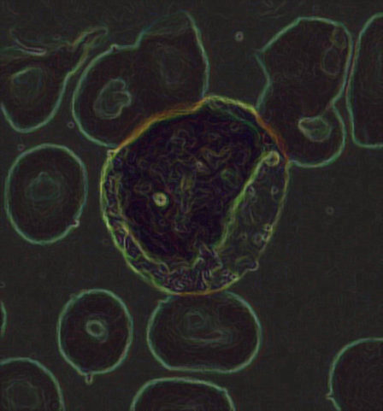
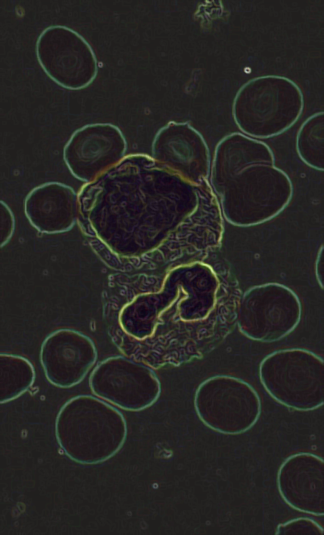
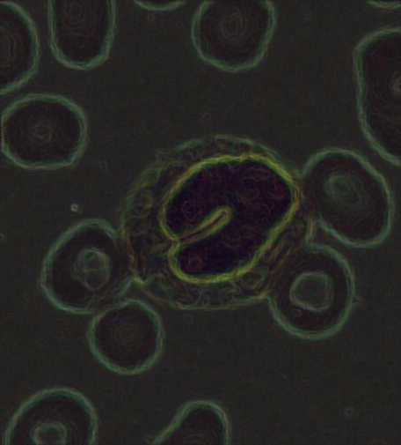
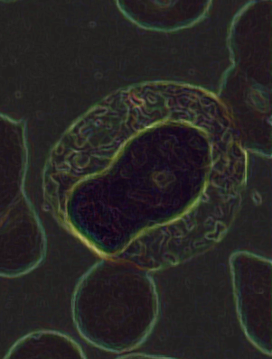
Meta
Possible myelo or promyelo. Need more clues.
Band
Meta
Myelos
I really like this camera effect. Here is just another slide to see 1) the shapes of the nucleus does matter, and 2) the nucleus is very important, but not the only clue when classifying.

Slide 31
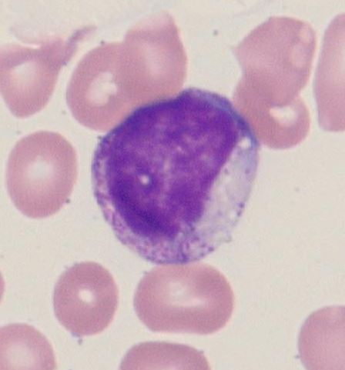
How would you classify the immature cells in these images? (The band is included for reference.)
Band
Meta
Myelo
Promyelo
Blast

Slide 32
Obviously there is one band. The rest fit snugly into the myelocyte category. The three images on bottom are blown up a bit on this slide, but you can see mostly smaller, eosinophilic granules and a nucleus that is rounded and clumped. Cell 1 does have lots of large granules, but they are red. A promyeloctye would be darker burgundy or blueish granules. The cell is overall the same size as the band in the same picture, and the nucleus clearly rounded and clumped. I call this a myelocyte instead of an eosinophil because the nucleus is more prominent than the granules, though this cell will likely become an eosinophil. Cell 4 does have a larger and more diffuse nucleus, but the cytoplasm is very clear. And if not blown up, the cell would be equivalent in size to the band above it. I could understand calling this a PRO, but disagree.
1
Myeloctyes
How would you classify the immature cells in these images? (The band is included for reference.)
Band
Meta
Myelo
Promyelo
Blast
2
3
4

Slide 33
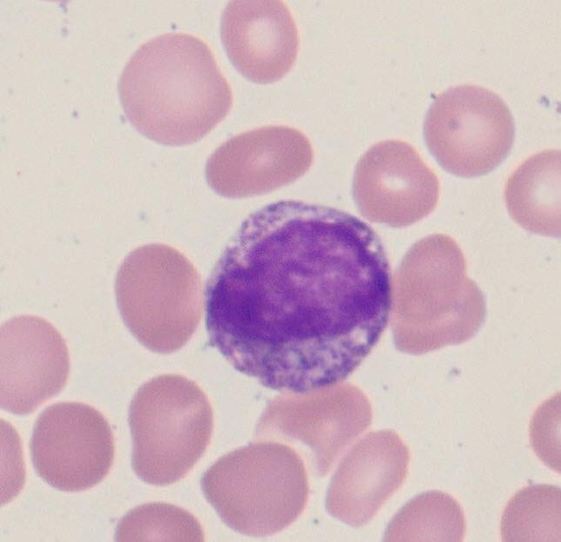
How would you classify the immature cells in these images? (The band is included for reference.)
Band
Meta
Myelo
Promyelo
Blast

Slide 34
Again there is 1 band amidst the images. Cell 2 is a tried-and-true classic promyelocyte. There are large blue granules and very basophilic cytoplasm. The nucleus is eccentric and takes up about 2/3 of the cell. The darker circles in the nucleus are likely nucleoli. Cell 1 also has a large, diffuse nucleus and many dark granules in the cytoplasm. The cytoplasm is also more basophilic. This one is also pretty straight-forward for me. Cell 3 can likely swing 2 ways. I classify as a Pro mostly because of how large and diffuse the nucleus is. The granules and cytoplasm are also pretty dark compared to the band in the same image. This is another cell that could easily be classified more maturely as a Myelocyte based on the whole slide appearance, but I would call it a Promyeloctye.
1
2
How would you classify the immature cells in these images? (The band is included for reference.)
Band
Meta
Myelo
Promyelo
Blast
Promyelocytes
3

Slide 35
Lymphocyte Classification
The following several slides are also images directly from the CAP survey. Again, I will give as much information as possible for why these are classified as they are, but personal interpretation is always present.

Slide 36
Patient Data: 59-year-old woman with persistent cough, fatigue, and fever.
WBC = 25.0 | RBC = 3.84 | HGB = 11.6 | HCT = 35.2% | PLT = 36

Slide 37
The first clue to classifying these cells comes from an overview of the slide. A majority (>50%) of the cells look like the bottom cell of the background image. This tells us that we are more likely to be looking at an ALL, AML, or Lymphoma situation rather than CLL. The other major clue is that we are NOT told of Lymph node involvement (swollen node throat or elsewhere). This would point to ALL or AML rather than Lymphoma. Another clue is the thrombocytopenia that is more common in AML/ALL than Lymphoma, and a slight anemia that is normocytic, normochromic.

Slide 38
All of this information leads to the decision of the cell represented below as being a Blast (Lymphoblast). The cell on top is a normal Lymphocyte for comparison.
Clues in the actual cell: Cell is much larger with a very large and diffuse nucleus. Prominent nucleoli are seen. The chromatin is very lacy and fine. Cytoplasm is scant and dark blue/purple.

Slide 39
Given the information in the previous slides, how would you classify these cells?
1
Cell 1
Lymph
Blast
Cell 2
Lymph
Blast
Cell 3
Lymph
Blast
3
2

Slide 40
Given the information in the previous slides, how would you classify these cells?
1
Cell 1
Lymph
Blast
Cell 2
Lymph
Blast
Cell 3
Lymph
Blast
3
2
Cells 1 and 2 are very similar to the previous slide. 1 is an obvious blast and 2 is an obvious lymph (note small, tight, clumped, and clear blue cytoplasm).
Cell 3 is clearly between these 2 cells in maturity, and it is moving toward being a mature lymph. However, given the size of the nucleus, the laciness of the nucleus, and the presence of the nucleoli, we would classify this cell as a blast on the differential.

Slide 41
How would you classify these cells?
1
Cell 1
Lymph
Blast
Cell 2
Lymph
Blast
2

Slide 42
How would you classify these cells?
1
Cell 1
Lymph
Blast
Cell 2
Lymph
Blast
2
These cells are extremely similar to the cells classified in the previous image. It is easiest to classify them when you can compare the abnormal looking cell to the normal cell.

Slide 43
How would you classify these cells?
1
Cell 1
Lymph
Blast
Cell 2
Lymph
Blast
2

Slide 44
How would you classify these cells?
1
Cell 1
Lymph
Blast
Cell 2
Lymph
Blast
Lymph
Cell 1 is a more obvious blast. It is huge and the lacy nucleus takes up most of the cell.
Cell 2 is difficult to label without a normal lymph in the field to compare. It is slightly bigger than a mature lymph, and multiple nucleoli can be seen. Based on this and the overall slide, we would mark this in the blast category.
2

Slide 45
Lymphocytes
The lymph on top is the cutout from the previous example. I wanted to discuss it for a moment.
You might have said, “I can see nucleoli in it too,” or “It is also dark blue.” Yes, but the nucleus is very clumped/folded on itself and is much darker and “tighter” than the blasts. The cytoplasm is also a clearer blue, whereas the blasts tend to look more purple and less smooth in their cytoplasm.
The lymph on the right could be classified as an atypical lymph based on the abundant pale blue cytoplasm and the way it is wrapping around the RBCs (darker blue in these areas).

Slide 46
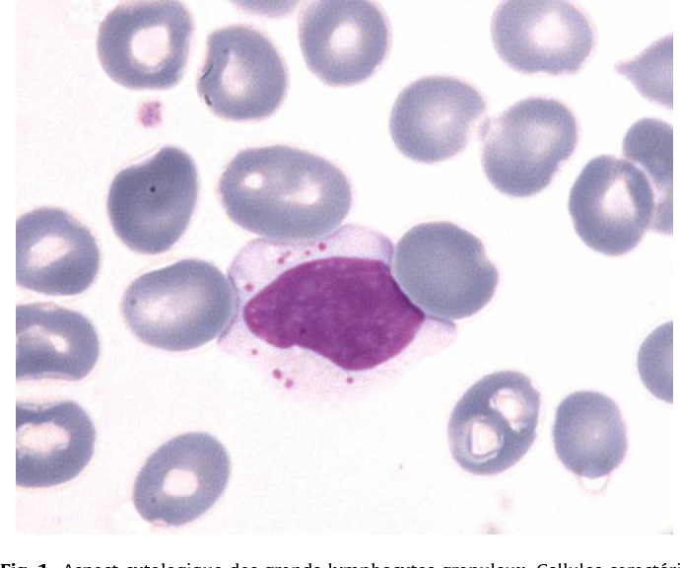
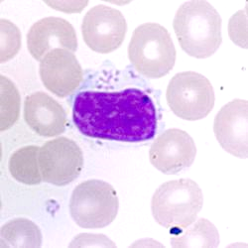
Large Granular Lymphocytes
Sometimes the lymphocytes will have large blue (azurophilic) granules unevenly distributed amid a clear blue cytoplasm. These lymphs are there own category of classification.
If you are performing a differential and see LGL’s, you can mark them as “Abnormal Lymphocytes,” but make sure to put a comment on the line that the abnormal lymphs seen are in fact LGL’s.

Slide 47
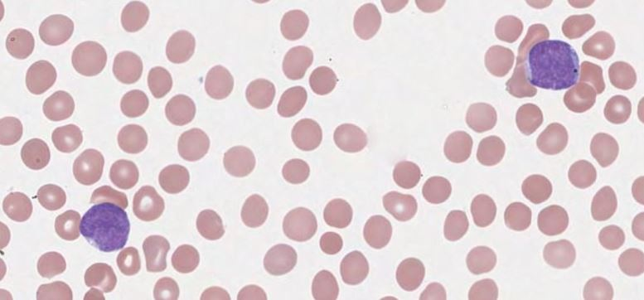
blast
If performing a differential, you would only classify these cells as BLAST. The patient must have a sample sent for flow cytometry for the blasts to receive a classification. This particular patient was diagnoses with AML. Most ALL cases occur in children and is very curable. AML typically occurs in older individuals and has a very low survival rate.

Slide 48
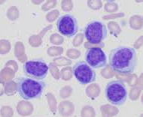
A quick word about Lymphomas. These cells are NOT blasts, but they are malignant lymphocytes. You would classify them as “Abnormal Lymphs” and make sure a path review is ordered. The overall size of these cells is more similar to that of a mature lymphocyte. Note that some of these cells still have visible nucleoli and diffuse nuclear chromatin, but they have an even more lacy or diffuse pattern. The nuclei are often cleft or folded also (big clue it is a lymphoma). The cytoplasm is also typically scant, but closer to the pale blue cytoplasm of a normal or reactive lymph. Most of the time, the actual classification of these cells waits until the patient’s flow cytometry results are returned, but it is important to note their presence.

Slide 49
THANK YOU!!!
I hope this wasn’t too painful. Thank you for taking the time to review this material. If you want to look at the slides from this survey, you can click on the link below and explore for yourself.
https://elss.cap.org/elss/ShowProperty?nodePath=/UCMCON/Contribution%20Folders/WebApplications/digitalscope/vpbs-b-2020.html

