Slide 1
COG B-ALL MRD Gating Primer
Amanda McCaustland, MLS (ASCP)^{CM}
Children’s Minnesota Flow Cytometry Lab

Slide 2
Getting Started
Set FSC threshold to 25,000
Ensure biexponential display is enabled
Collect at least 750,000 events; minimum 500,000 if sample is limited
May adjust percentage of events shown on plots to help with placement of gates (Inspector window > Dot Plot tab > % Events)
As populations of interest vary, worksheets do not have pre-drawn gates for them. Draw the gate manually in the plot that shows the best separation.

Slide 3
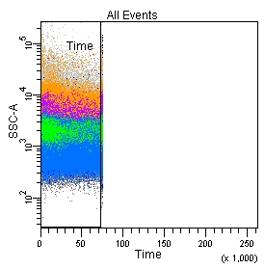
Day 8 (Syto16/20/34/19/10/45)
On the SSC vs Time plot, adjust gate if necessary to exclude any bubbles (such as if tube runs dry)

Slide 4
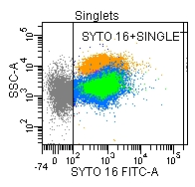
Day 8 (Syto16/20/34/19/10/45)
On the FSC-A vs FSC-H plot, adjust the singlet gate to exclude doublets (should be at approximately 45° angle)
On the SSC vs Syto 16 plot, adjust the gate to exclude Syto 16 negative events
Doublets

Slide 5
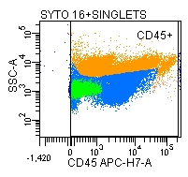
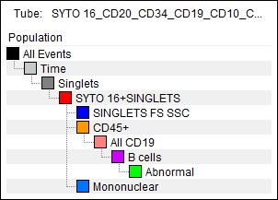
Day 8 (Syto16/20/34/19/10/45)
On the FSC vs SSC plot, adjust the gate if necessary to include all events
On the Syto 16+ Singlets SSC vs CD45 plot, adjust the gate to include all events as blasts may be 45 dim/negative
Pay attention to gating hierarchy!

Slide 6
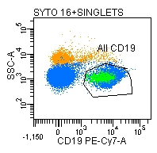
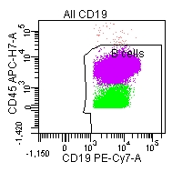
Day 8 (Syto16/20/34/19/10/45)
Adjust the mononuclear gate to exclude PMNs (higher SSC)
Adjust the All CD19 gate to include the 19+ population with low SSC
Adjust the B cells gate to exclude doublets/artefact
Junk

Slide 7
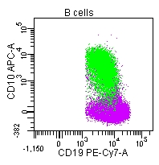
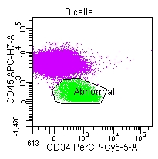
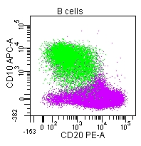
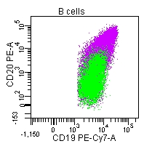
Day 8 (Syto16/20/34/19/10/45)
Evaluate plots for abnormal populations - know what normal looks like and look for populations sitting “outside” of normal
Dim/aberrant expression of CD45, CD19
Expression of CD34, CD10
Dual expression of CD10 and CD20

Slide 8
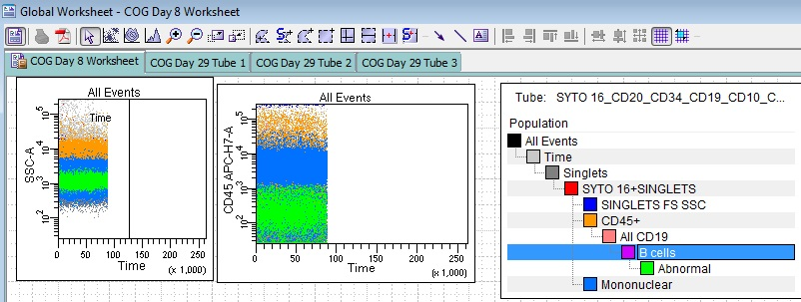
Day 8 (Syto16/20/34/19/10/45)
Make sure “B cells” are highlighted in the population hierarchy (so new populations are “children” of B cells) and use the Polygon Gate tool to draw gates around populations of interest. If a population is small and hard to see, highlight it in the population hierarchy and go to Inspector > Dot Size to increase the size of the dots on the scatterplots.

Slide 9
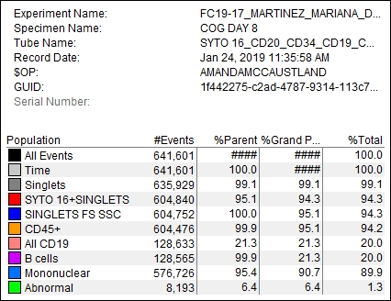
Day 8 Calculation
Day 8 MRD = (Abnormal/Syto16+ Singlets) x 100
Number of events is used to perform calculations.
(8193/604840) x 100 = 1.35% MRD

Slide 10
Day 29
MRD percentage is calculated from abnormal populations gated in tube 1 and 2, using the denominator calculated from tube 3
Reported as the average of tubes 1 and 2
In addition to providing the denominator for calculations, tube 3 is also an indicator of sample quality (peripheral blood contamination)

Slide 11
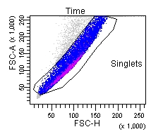
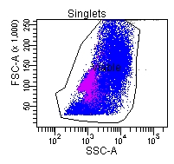
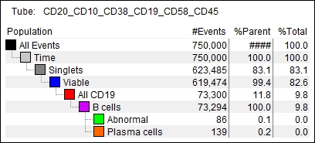
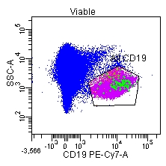
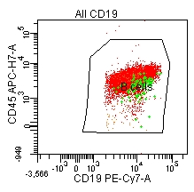
Day 29 - Tubes 1 and 2
Adjust time, singlet and CD19+ gates (similar to Day 8) to zero in on B cells
Select B cells on population hierarchy and use the polygon gate tool to draw gate around population of interest

Slide 12
Tube 1 (20/10/38/19/58/45)
B-ALL
Hematogones
CD38 tends to be dim
Tend to have overexpression of CD58
Over/underexpression of appropriate maturation markers
May be tighter, more homogeneous populations
CD45 variable
CD19 variable: normal/over/underexpression
Bright CD38 (brighter than mature B cells, but dimmer than plasma cells)
CD58 negative
Show a continuous spectrum of losing/gaining markers through the maturation process
Slightly dimmer CD45, increases to normal expression as they mature
Consistently normal CD19 expression

Slide 13
Tube 2 (9/13+33/34/19/10/45)
B-ALL
Hematogones
May be CD13/CD33 positive (aberrant)
May inappropriately over/underexpress CD9
CD34 expression variable
May be tighter, more homogeneous populations
CD45 variable
CD19 variable: normal/over/underexpression
NEVER express CD13 or CD33
CD9 is positive and lost as hematogones mature
Earliest hematogones CD34 positive
Slightly dimmer CD45, increases to normal expression as they mature
Consistently normal CD19 expression

Slide 14
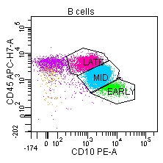
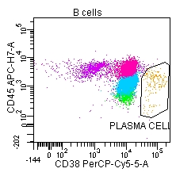
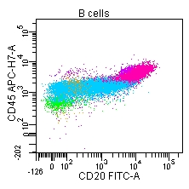
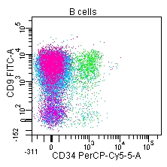
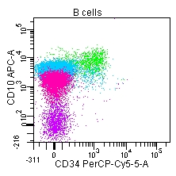
Hematogone Maturation
Early
Positive 34, 10, 19, 9
Negative 20
Bright 38
Dim 45
Mid to Late
Negative 34
Begin to lose 10 and gain 20
Still express 9, bright 38
Brighter 45
Mature B cell
Negative 9, 10
Dimmer 38
Positive 20
Normal 45

Slide 15
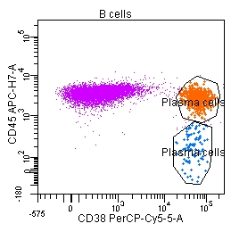
Plasma Cells
CD19 Positive
VERY bright CD38
May be either CD45 positive OR negative in bone marrow (45+ in peripheral blood)
Do not express CD10
May express a small amount of CD20

Slide 16
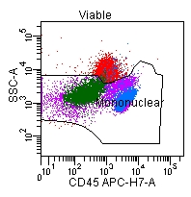
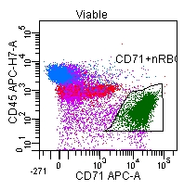
Tube 3 (Syto16/-/3/19/71/45)
Adjust time, singlet, Syto16+, All CD19 and B cell gates as needed
Adjust mononuclear gate to exclude PMNs (higher SSC)
Adjust gates on CD71+ (NRBC) and CD3+ (T lymphs) as necessary
Reducing events shown on plots is helpful in placing these gates
No need to run 750,000 events; 150,000 – 200,000 is OK

Slide 17
Day 29 Calculation
MRD = (Abnormal/B cells) x (Tube 3 B cells/Tube 3 Syto16+ mononuclear cells) x 100
Calculations of tubes 1 and 2 are averaged for reported MRD %
Tube 1: Tube 2: Tube 3:
Tube 1: (86/73294) x (27917/145717) x 100 = 0.022%
Tube 2: (70/77888) x (27917/145717) x 100 = 0.017%
Average = 0.02%

Slide 18
Notes
Phenotypes of abnormal cells may shift as the patient is treated; do not rely exclusively on comparing to diagnostic flow
Though rare, it is possible for abnormal populations to be CD19 negative. If this is suspected, gating strategy will need to be adjusted
“Micro MRD” is when a small abnormal population is observed but the amount falls below our limit of detection (0.01%)

