Slide 1
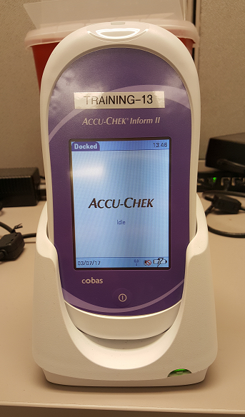
Glucose Meter Unit Expert Training
Developed by POCT Team

Slide 2
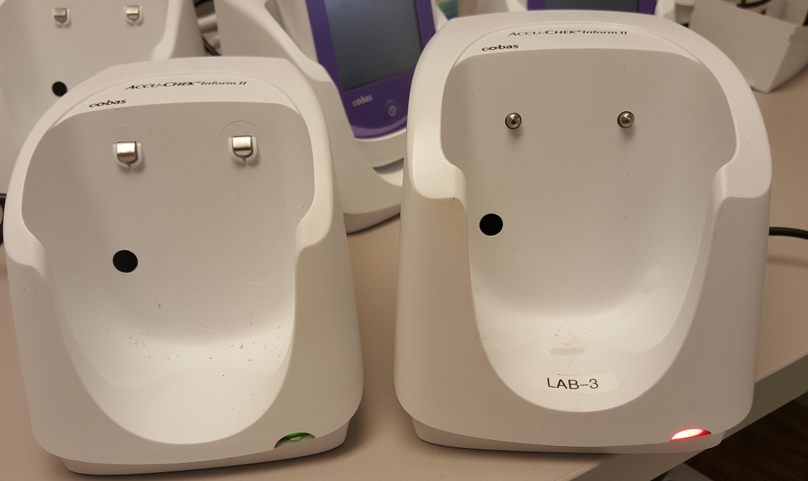
The Glucose Testing Unit
Different Parts:
BASE
- Used to charge the meter
Used to transmit results to Healthlink (must have green light)
Do not remove wiring in assigned ports
Green light means network is up and running, if red- call POCT office x56321
METER:
Needs to be charged and docked after use
Run QC before patient testing (good for 24 hours)
Make sure before docking meter, the meter is charging

Slide 3
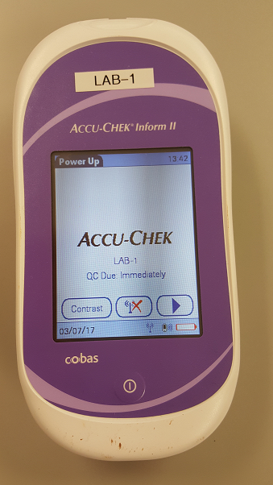
How to use glucose meter:
Please refer to the policy found on HHS connect under Policies titled “Glucose Testing Using Roche Inform II Glucose Meter”
New step added from manufacturer
- After cleaning the meter, if residue is left you can wipe the meter with gauze
* Know patient limitations for testing

Slide 4
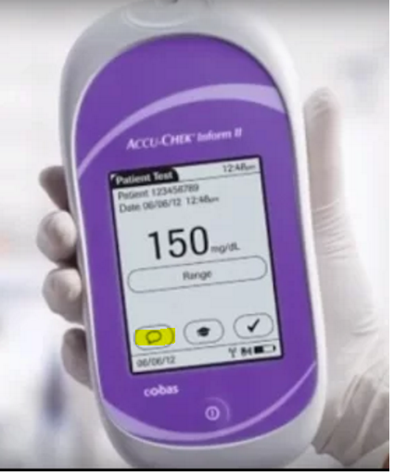
Add Patient & QC Testing Comments when necessary:
QC Comments:
“Need to repeat test”
“Wrong Solution used”
Patient Comments:
Critical High >400 mg/dL
Critical Low <50 mg/dL

Slide 5
IMPORTANT!!!!!
1. SCAN IN THE CORRECT CSN number ex. 301#######
2, DOUBLE CHECK CORRECT PATIENT AND CORRECT CSN#

Slide 6
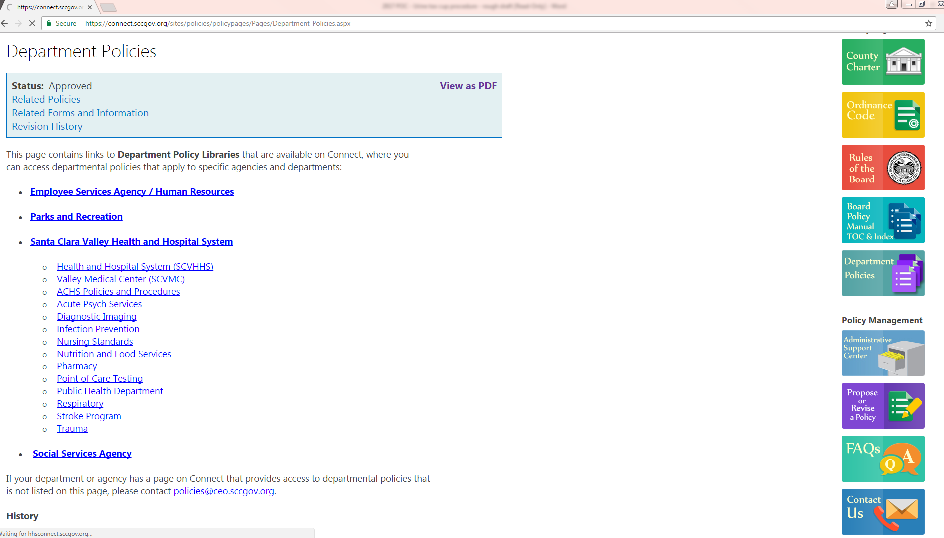
HHS Connect, Point of Care Policies:

Slide 7
As a unit expert, have operators:
Pass the written competency exam:
If they fail it, do not give them the answers, have them reread the procedure, and take the test again.
Please have them sign, date, and write down their employee ID on the front sheet.
Unit Expert should print their name and sign at the back of the test.
The unit expert should observe them performing:
Patient glucose testing or
Quality controls (to include both levels)
It should be under their own employee barcode and not the unit experts
POCT staff checks each and every individual to make sure QC or patient testing has been performed in the middleware.

Slide 8
Emergency Barcodes
Inpatient:
Rapid Response Team must be called. The patient will be transported to ER. ER assigns Emergency barcodes.
Outpatient/Ambulatory:
In cases of emergency, where a patient or visitor needs an immediate glucose test done and there is no time to register patient.
After Medical Alert response is called, a CHARGE RN can use the emergency barcode.
Register the patient after he/she is cared for and within 2 hours of testing fill out the emergency log and send to POCT or LIS. (email address is at the bottom of the log)

Slide 9
Emergency Barcodes
-

Slide 10
Glucose Testing (Downtime)
The EPIC/Healthlink team has formulated special barcodes to be used like emergency barcodes for downtime.
Please have management in your department reach out to them.
Contact information:
408-423-0705

Slide 11
POCT CONTACT
General Line: 885-6321
Office Location: BC055 (in basement next to biomed)

