Slide 1

Carbohydrates

Slide 2
Objectives
Define the following terms: carbohydrates, aldose, ketose, monosaccharide, oligosaccharide, disaccharide, polysaccharide, and glycogen
Describe the carbohydrate metabolic pathways including glycolysis, glycogenesis, glycogenolysis and gluconeogenesis.
Describe the hormonal regulation of glucose metabolism including the origin and effect on glucose following: insulin, glucagon, epinephrine, growth hormone and ACTH.
Differentiate Type I and Type II diabetes, secondary diabetes, glucose intolerance and gestational diabetes including laboratory abnormalities, interpretation of the OGTT and 2 hour post-prandial glucose, treatment and sequelae.
Briefly describe the pathophysiology of diabetes.

Slide 3
Objectives cont…..
Discuss the monitoring of diabetic control including tests used and their interpretation.
Define hypoglycemia and list possible causes
Describe the usefulness of measuring insulin and C-peptide levels
Give the principle, reagents, and interferences for the hexokinase and glucose oxidase methods for glucose determination.
State the relationship between CSF, blood and urine glucose levels.
Describe methods used to measure glycaled hemoglobin.
Describe the methods of detecting ketones in blood and urine.
Describe the relationship between monitoring diabetic therapy and complications.

Slide 4
Carbohydrates
Compounds containing Carbon, hydrogen and oxygen (CHO)
Major food source and energy supply of the body. (fast- simple sugars/over long period of
time-complex CHO)
Primarily stored as liver and muscle glycogen.
Classified based on four properties
  Size of base carbon chain ( triose, tetrose, …..etc)
  Location of the CO (carbonyl group) function group
  Number of sugar units (di, tri, polysaccharide, …etc)
  Stereochemistry ( relative spatial arrangement of atoms within the sugar molecules)

Slide 5
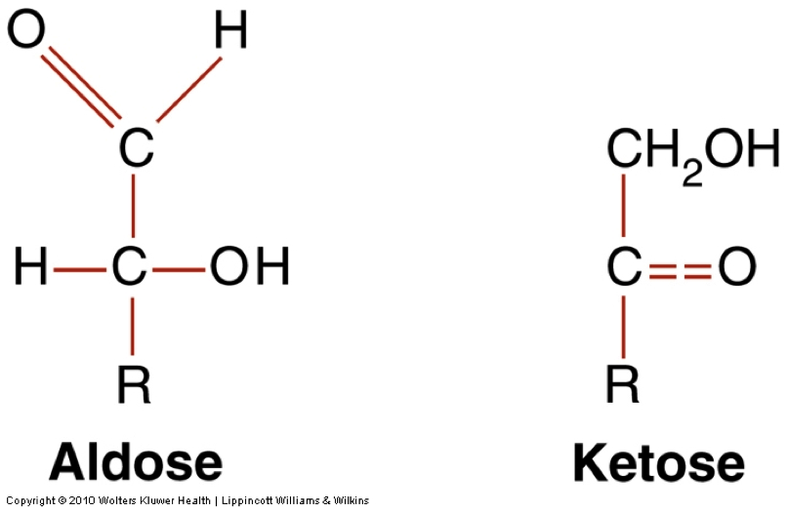
Carbohydrates
Two forms of Carbohydrates
Aldehyde / Ketone
Google Images

Slide 6
Reducing Sugars
Sugar that has an open chain form with an aldehyde group
  Aldehyde is able to be oxidized via a redox reaction, in which another compound is reduced
  Examples: glucose, galactose, lactose, maltose
  Fehling’s test
  2 Cu (OH)₂ + Aldose sugar → Aldonic Acid + Cu₂O Red color + H₂O

Slide 7
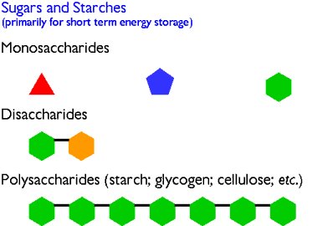
Carbohydrates
Google Images

Slide 8
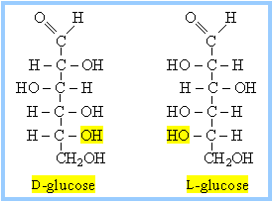
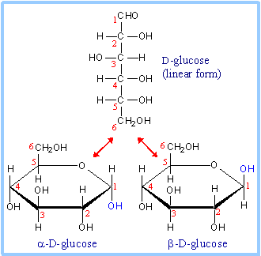

Slide 9
Class Activity
Identify diagrams of carbohydrate molecules
Classify as simple or complex

Slide 10
Glucose Metabolism
Glucose is the primary source of energy for humans.
Nervous system depends on glucose found in extracellular fluid.
Glucose is derived from:
Breakdown of CHO in diet or in body stores(glycogen-in the liver & muscle cells)
Endogenous synthesis from protein or triglycerides

Slide 11
Glucose Metabolism
Fate of Glucose
  Most ingested carbohydrates are polymers (starch, glycogen).
  These are converted to disaccharides, & disaccharides are converted to monosaccharides by enzymes.
  Monosaccharides are absorbed by gut & transported to liver.
  Glucose is only carbohydrate directly used for energy or stored as glycogen; galactose& fructose must be converted to glucose.
  Glycogen is located in cytoplasm of liver and muscle cells.
  Once glucose enters cell, it is rapidly converted to glucose-6-phosphate.
  Ultimate goal of cell is to convert glucose to carbon dioxide and water in the process of cellular respiration to release energy (mitochondria)

Slide 12
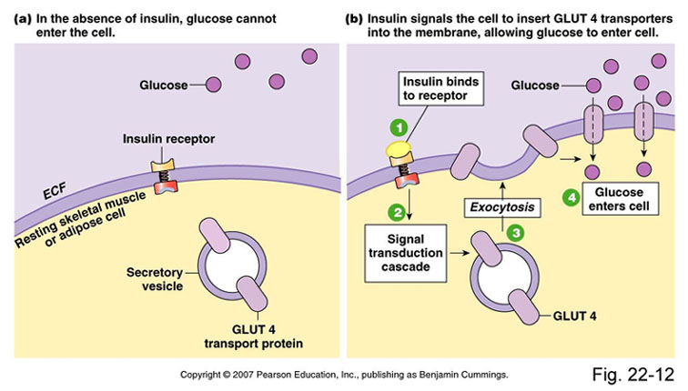
Glucose Metabolism

Slide 13
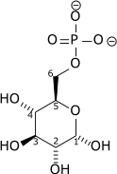
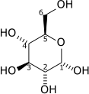

ATP
ADP

Slide 14
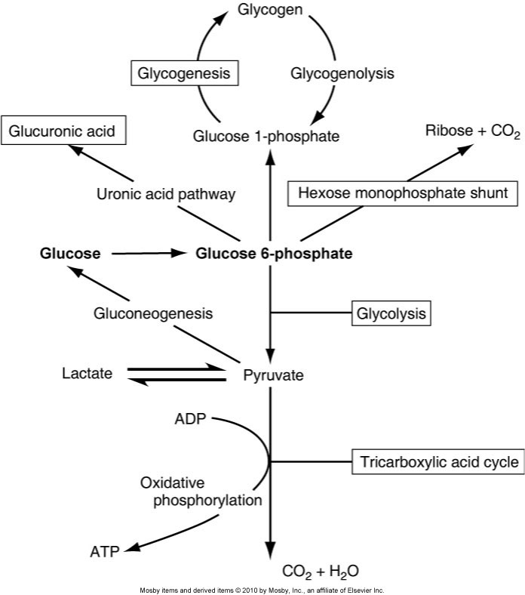

Slide 15
Glucose Metabolism
Pathways of Glucose metabolism
  Glycolysis: breakdown of glucose molecule to CO₂ & H₂O (Aerobic glycolysis=36 ATP/1mole glucose) or lactate (Anaerobic glycolysis=2 ATP/1mole glucose) for production of energy
  Gluconeogenesis: formation of glucose-6-phosphate from non-carbohydrate sources
  Glycogenolysis: breakdown of glycogen to glucose for energy
  Glycogenesis: conversion of glucose to glycogen for storage in liver & muscle tissue

Slide 16
Regulation of Carbohydrate Metabolism
  Liver, pancreas, & other endocrine glands control blood glucose concentrations within a narrow range.
  Hormones that control glucose levels :
    Insulin: from pancreas; ↓
    Glucagon: from pancreas; ↑
    Epinephrine &glucocorticoids(cortisol): from adrenal gland; ↑
    Growth hormone & ACTH: from anterior pituitary; ↑
    Thyroxine (thyroid gland) &somatostatin (pancreas): ↑

Slide 17
Regulation of Glucose Metabolism
 | Effect on Blood Glucose Levels | Method of Action
Insulin | Decreases | Stimulates glucose uptake by cells, promotes storage of glucose as fat or glycogen, inhibits gluconeogenesis, stimulates protein synthesis, inhibits protein breakdown
Glucagon | Increases | Stimulates glycogenolysis and later gluconeogenesis
Epinephrine | Increases | Stimulates glycogenolysis
Growth Hormone | Increases | Stimulates gluconeogenesis and lipolysis
ACTH/Cortisol | Increases | Stimulates gluconeogenesis and inhibits glucose use by tissues
Thyroxine | Increases | Stimulates glycogenolysis and increases intestinal glucose absorption

Slide 18
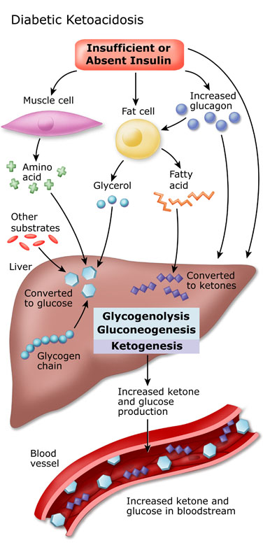

Slide 19
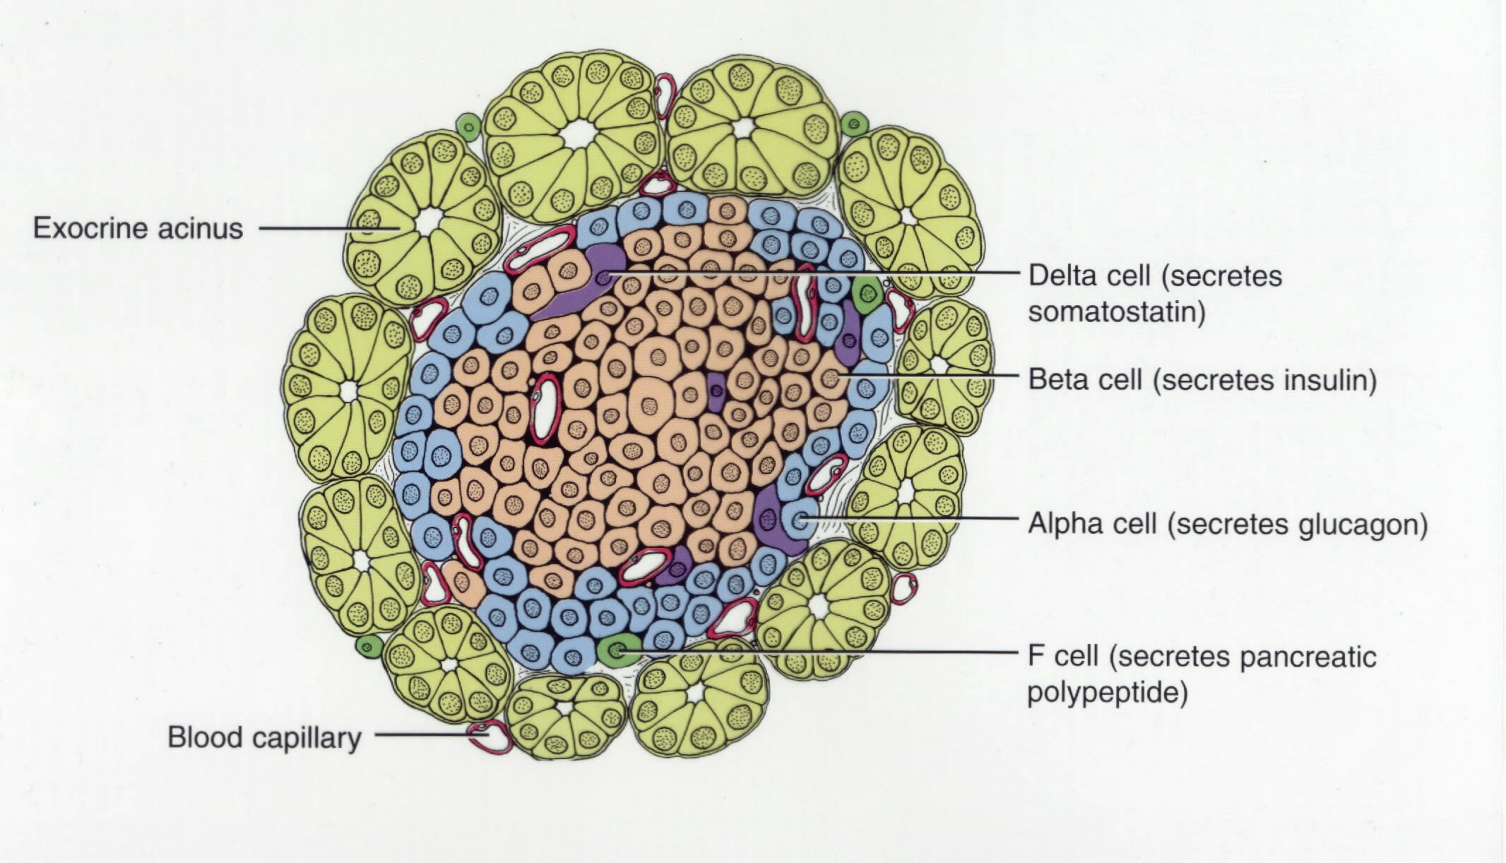
Diagram of Pancreatic Islets and Surrounding Accini

Slide 20
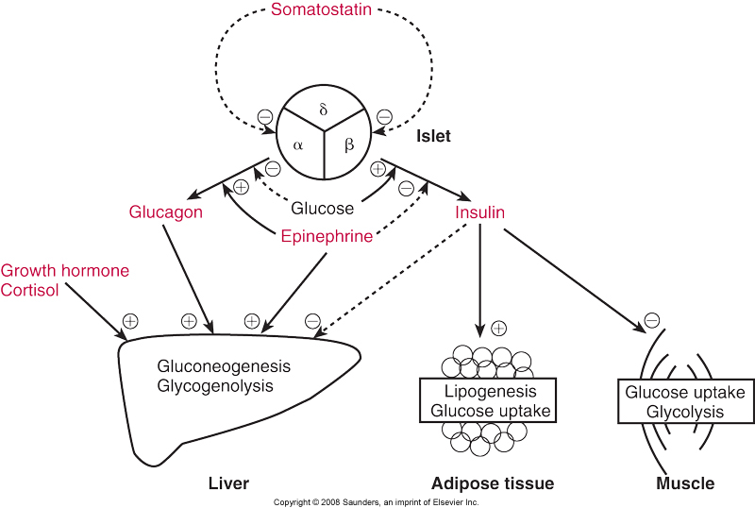
Regulation of Glucose Metabolism

Slide 21
Two groups of diseases involving carbohydrates
  Hyperglycemia: an increase in plasma glucose
  Hypoglycemia: a decrease in plasma glucose

Slide 22
Diabetes Mellitus
Diabetes Mellitus
  A group of metabolic diseases characterized by hyperglycemia resulting from defects in insulin secretion, insulin action, or both
  Type 1
    A) Immune mediated-Results from cellular-mediated autoimmune destruction of β cells of pancreas, causing absolute deficiency of insulin
    B) Idiopathic
    Constitutes 10–20% of all diabetes cases; occurs in childhood & adolescence and is genetic

Slide 23
Diabetes Mellitus
  Type 2
    Characterized by hyperglycemia caused by an individual’s resistance to insulin (decreased biological response to circulating insulin), resulting in a relative insulin deficiency
    Constitutes majority of diabetes cases & is adult onset
    Risk factors include age, obesity, lack of exercise, genetic predisposition.

Slide 24
Diabetes Mellitus
Hyperglycemia, possibly severe
Glucosuria can occur after renal tubular transporter system for glucose becomes saturated
  Type 1
  Absence of insulin with excess of glucagon
  Greater tendency to produce ketones
  Low blood pH (acidosis)
  Complications: cataracts, neuropathy, kidney ,cardiovascular, & blood vessel disease.
Type 2
    Presence of insulin & hyperinsulinemia, attenuated glucagon
    Greater tendency to develop hyper-osmolar-non-ketotic states (hyperglycemia, hyper-osmolarity, and profound dehydration without significant ketoacidosis)

Slide 25
Other Forms of Diabetes
Gestational Diabetes:
  A carbohydrate intolerance occurring for the first time during pregnancy
Secondary Diabetes
  Hyperglycemias due to a specific underlying disease

Slide 26
Secondary Diabetes
Hyperglycemia due to a specific underlying disorder such as:
Genetic defects of B-cell function
Genetic defects in insulin action
Disease of the exocrine pancreas
Endocrinopathies Ex: Cushing disease
Infections
Uncommon forms of immune-mediated diabetes
Other genetic conditions Ex: Down syndrome

Slide 27
Complications of DM
1.Retinopathy | Cataract formation & angiogenesis (proliferation of small blood vessels in the lens)
2.Neuropathy most common 60%-70% | Pain, numbness, tingling sensation in the extremities, dizziness & double vision
3.Angiopathy | Damage to lining of blood vessels which increases the risk of coronary heart disease & stroke
4.Nephropathy | Damage to capillaries associated with the glomerulus which causes reduction in filtering capability of kidneys –leads to end stage kidney disease
5.Infection | Increased susceptibility to infection, ulceration, & gangrene. Skin disorders more common
6.Hyperlipidemia & Atherosclerosis | Abnormal TRG, Chol., and VLDL levels associated with type II diabetes. Low HDL with diabetics in general.
7.Diabetic Ketoacidosis | Fatty acids used for energy producing keto acids( acetone, acetoacetate,β Hydroxybutyrate)
8.Hyperglycemic Hyperosmolar Nonketotic Coma (HHNC) | Glucose >600 mg/dL , Normal or slightly low pH,serum osmolality >350mOsm/Kg, normal keto acid levels ,lethargy or coma

Slide 28
Hyperglycemia (cont’d)
Criteria for Testing for Pre-Diabetes and Diabetes
  All adults >45 years old should have fasting blood glucose measured every 3 years, unless already diagnosed with diabetes.
  Testing should be earlier or more frequent w/ these risk factors:
    Overweight tendencies (BMI ≥25 kg/m²)
    Habitual physical inactivity
    Family history of diabetes in a first-degree relative
    High-risk minority population (African American, Latino)
    History of gestational diabetes or delivering baby >9 lb
    Hypertension (≥140/90)

Slide 29
Hyperglycemia (cont’d)
Criteria for Testing for Pre-Diabetes and Diabetes
  Criteria for type 2 diabetes testing in children, beginning at age 10 or at onset of puberty & with follow-up testing every 2 years
    Family history (first- or second-degree) of type 2 diabetes
    Race/ethnicity (African American, Latino, Native American)
    Signs of insulin resistance
    Maternal history of diabetes or gestational diabetes mellitus

Slide 30
Test for Diabetes Mellitus | Test Requirements | Criteria for Diagnosis
Random Plasma Glucose | None | ≥ 200 mg/dL (plus symptoms of diabetes)
Fasting Plasma Glucose | 8-12 hour fast prior to sampling | ≥ 126 mg/dL Values <100 mg/dL are sufficient to rule out DM
Urine Glucose | None | Positive glucose Urine glucose is a poor marker for DM
Oral Glucose Tolerance Test (OGTT) | Adequate carbohydrate diet at least 3 days prior to testing Fasting sample 75g glucose load followed by serial testing | ≥ 200 mg/dL (testing at 2 hours)
2 Hour Post Prandial Test | Fasting sample Normal meal or standard glucose load (75g) followed by testing at 2 hours | ≥ 200 mg/dL (testing at 2 hours)

Slide 31
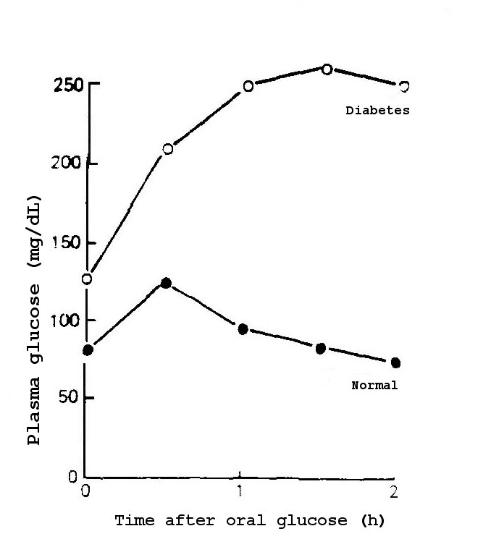

Slide 32
Hyperglycemia (cont’d)
  Patients with following criteria have “pre-diabetes”:
    Fasting glucose of ≥100 mg/dL but <126 mg/dL
    OGTT 2-hour level of ≥140 mg/dL but <200 mg/dL

Slide 33
Hyperglycemia (cont’d)
Criteria for Testing & Diagnosis of Gestational Diabetes
  Age >25 years
  Overweight
  Strong family history of diabetes
  History of abnormal glucose metabolism
  History of poor obstetric outcome
  Presence of glycosuria or glucosuria
  Diagnosis of polycystic ovarian syndrome
  Ethnicity/race (African American, Latino, Native American)

Slide 34
Hypoglycemia
Decreased plasma glucose levels
Can be transient & relatively insignificant or life-threatening
Occurs in healthy-appearing and sick patients, as a result of reaction to medication or of illness (ex: autoantibodies to insulin)
Most often is the result of aggressive use of insulin treatment to maintain normoglycemia.
Symptoms appear at glucose level of about 50–55 mg/dL.
Symptoms: increased hunger, sweating, nausea & vomiting, dizziness, nervousness & shaking, blurred speech & sight, mental confusion
Lab findings:
Blood glucose- low
Insulin- high
C-peptide- low (hypoglycemia caused by over treatment with
commercial insulin)
high (hypoglycemia not caused by over treatment with
commercial insulin)

Slide 35
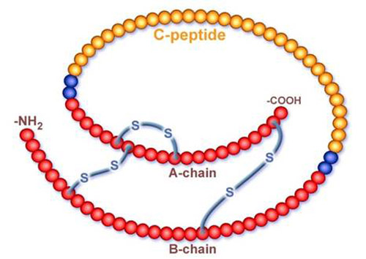
Insulin Structure
Commercial insulin preparations contain no C-peptide.

Slide 36
Role of Laboratory in Differential Diagnosis and Management of Patients
Methods of Glucose Measurement
  Glucose can be measured from serum, plasma, or whole blood.
  Sodium fluoride is the best anticoagulant because it inhibits glycolysis.
  Serum or plasma must be refrigerated & separated from cells within 1 hour to prevent loss of glucose.
  Fasting blood glucose should be obtained in morning after 8- to 10-hour fast.
  Most common methods of glucose analysis use enzymes glucose oxidase or hexokinase.
  Nonspecific methods are used in urinalysis section of lab to detect reducing substances other than glucose.

Slide 37
Hexokinase Methods
Reference Method
Glucose +ATP Glucose-6-phosphate + ADP Hexokinase,Mg²⁺
Glucose-6-phosphate 6-phsphogluconate dehydrogenase
NADP NADPH + H
NADPH is measured by increase in absorbance @ 340 nm
Hemolyzed specimens are unsatisfactory because phosphate esters and enzymes released from RBCs interfere with the assay
Other interferences include: drugs, bilirubin, and lipemia
When used in clinical lab a specimen blank reading is included to correct for interfering substances that absorb at 340nm

Slide 38
Glucose Oxidase Methods
Glucose + 2H₂O + O₂ Gluconic acid + 2H₂O₂
O-Dianisidine + H₂O₂ Oxidized o-Dianisidine + H₂O
(colored)
Glucose oxidase is highly specific for β–D-glucose (treat sample with a mutarotase or extended incubation time allows spontaneous conversion)
The second step, involving peroxidase, is much less specific than the glucose oxidase step.
Various substances compete with the chromogen for H₂O₂ including:
uric acid, ascorbic acid, bilirubin, hemoglobin, tetracycline, and
glutathione.(producing lower values)
This method is suitable for glucose measurement in CSF, but not for urine (false low results in urine specimens-uric acid competes with H₂O₂)

Slide 39
Role of Laboratory (cont’d)
Self-Monitoring of Blood Glucose
  People with diabetes should closely monitor their blood glucose levels to keep them as close to normal as possible.
  Those with type 1 diabetes should check levels 3 or 4 times/day.
2-Hour Postprandial and glucose Tolerance Tests
  2-hour postprandial test
    Patient drinks standardized (75 g) glucose load.
    Glucose measurement is taken 2 hours later.
  Oral glucose tolerance test (not recommended by American Diabetes Association for routine clinical use as the first screening test). The test should begin between 7 Am & 9 Am. Plasma glucose should be measured , fasting, then every 30 minutes for 2 hours after an oral glucose load.

Slide 40
Role of Laboratory (cont’d)
Glycosylated Hemoglobin/Hemoglobin A₁c
  Glycosylated hemoglobin: formation of a hemoglobin compound produced when glucose reacts with amino group of hemoglobin
  Long-term blood glucose regulation can be followed by measurement of glycosylated hemoglobin (covalent bonding of glucose to HGB).
  Provides clinician with time-averaged picture of patient’s blood glucose concentration over past 3 months (RBC life span).
  Hemoglobin A₁c (HbA₁c) is most commonly detected glycosylated hemoglobin.
  Normal ~7% ; > 12% indicates poor glucose control

Slide 41
Glycosylated Hemoglobin/Hemoglobin A₁c
Is a measure of the risk for the development of complications of diabetes.
When levels are kept below 8%, the risk of developing an early sign of diabetes nephropathy, microalbuminuria is greatly reduced.
Measurement of A₁c: expressed as a % of total HGB
Techniques based on:
Charge difference: ex. ion exchange chromatography
Structural difference: ex. immunoassays
Chemical analysis: photometry
Virtually all labs in the USA now use immunoassays or ion-exchange
chromatography

Slide 42
Role of Laboratory (cont’d)
Ketones
  Produced by liver through metabolism of fatty acids
  Provide a ready energy source from stored lipids
  Increase with carbohydrate deprivation or decreased carbohydrate use (diabetes, starvation/fasting, high-fat diets)
  Three ketone bodies
    Acetone
    Acetoacetic acid
    3-β-hydroxybutyric acid
  Specimen requirement is fresh serum or urine.
  Results in diabetic keto acidosis :
Uncompensated | Low pH, normal pCO₂, low HCO₃⁻ , high anion gap, high glucose
Partially compensated | Low pH, low pCO₂, low HCO₃⁻ , high anion gap, high glucose

Slide 43
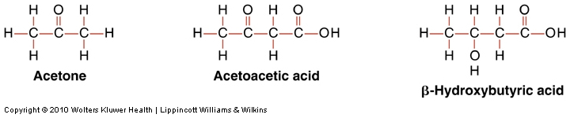
Role of Laboratory (cont’d)
Three ketone bodies

Slide 45
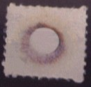
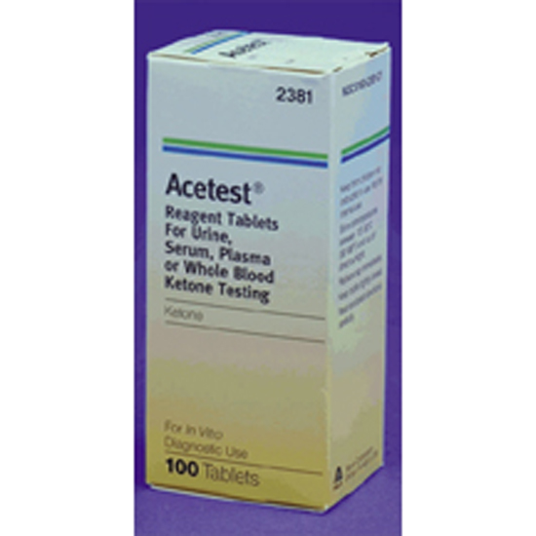
Acetest for Ketones
Acetest tablets contain a mixture of glycine, sodium nitroprusside, disodium phosphate, and lactose
Acetoacetate or acetone + sodium nitroprusside
lavender-purple complex
Acetest was designed for the detection of ketone bodies in
urine, but serum can be used as well.
β-hydroxybutyric acid doesn’t react and hence is not detected.
Negative nitroprusside test result doesn’t rule out ketoacidosis

Slide 46
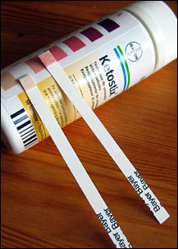
Ketostix
A modification of the nitroprusside
test in which a reagent strip is
used instead of a tablet

Slide 47
Role of Laboratory (cont’d)
Microalbuminuria
  Increase in urinary albumin is early sign of renal nephropathy, a complication of diabetes mellitus.
  Annual assessment of kidney function by determination of urinary albumin excretion is recommended for diabetic patients.
  Defined as persistent albuminuria in range of 30–299 mg/24 hr or albumin- creatinine ratio of 30–300 µg /mg
Islet Autoantibody and Insulin Testing
  Presence of autoantibodies to β-islet cells of pancreas is characteristic of type 1 diabetes.
  Not currently recommended for diabetes diagnosis

Slide 48
Quick monitoring of glucose levels
Whole Blood Glucose
Whole blood glucose is typically performed for screening purposes at the Point of Care
  Accu-Chek glucometer
  i-STAT (Chem 8 panel)
Fasting whole blood glucose levels are usually 5-10 mg/ dL lower than serum levels
Meters can be calibrated to report plasma glucose values, even when the specimen is whole blood.

Slide 49
Measuring Insulin
The primary clinical application of insulin measurement is in the evaluation of hypoglycemia , type II DM optimal initial therapy evaluation and polycystic ovary syndrome.
Measuring insulin along with glucose during an OGTT to diagnose DM is not recommended.
Done by immunoassays
Anti-insulin antibodies cross react with other substances that share the same antigenic epitopes with insulin (ex: proinsulin)
Overestimation of true plasma insulin value results from high levels of proinsulin such as in patients with diabetes or islet cell tumors)
C-peptide doesn’t cross react with anti-insulin Abs.
Fasting insulin values are higher in obese, non-diabetic people & lower in trained athletes.

Slide 50
Measuring Insulin
Type I
Fasting plasma levels are usually low
Glucose loading: no insulin response
Type II
Only low when fasting plasma glucose levels >250mg/dL
Otherwise, normal or high
Glucose loading: delayed often exaggerated response

Slide 51
Measurement of glucose in urine
Rapid , inexpensive , and noninvasive
Used to screen large number of samples
The monitoring of urine glucose lacks sensitivity, and specificity and provides no information about blood glucose concentrations below the renal threshold (usually 180 mg/dL)
Non-specific methods “Clinitest”
1. has a detection limit of 250 mg/dL
2. copper reduction test
3. total reducing substances
4. used to screen neonates & infants for inborn errors of metabolism (looking for reducing sugars other than glucose such as galactose & fructose
Glucose Specific methods
(Clinistix)
1. has a detection limit of 100 mg/dL
2. uses glucose oxidase enzyme
3. Semi-quantitative test strips
4. Procedures that include the H₂O₂-peroxidase reaction are not used for urine

Slide 52
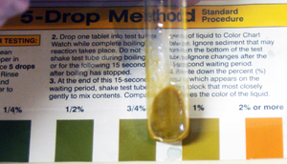
Clinitest
If large quantities (>2 g/dL)of sugar are present in the urine , the solution goes through the range of colors & returns to greenish-brown.

Slide 53
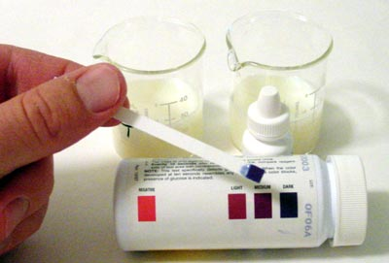
Clinistix
The strips will darken over time. Be sure to read the color at exactly 10 seconds to determine if glucose is present or not.

Slide 54
Glucose in CSF
CSF glucose is normally approximately two-thirds (0.6) of the fasting plasma glucose. The normal range is 50-80 mg/dL
A glucose level below 40 mg/dL is significant and occurs in bacterial and fungal meningitis and in malignancy.

