Slide 1
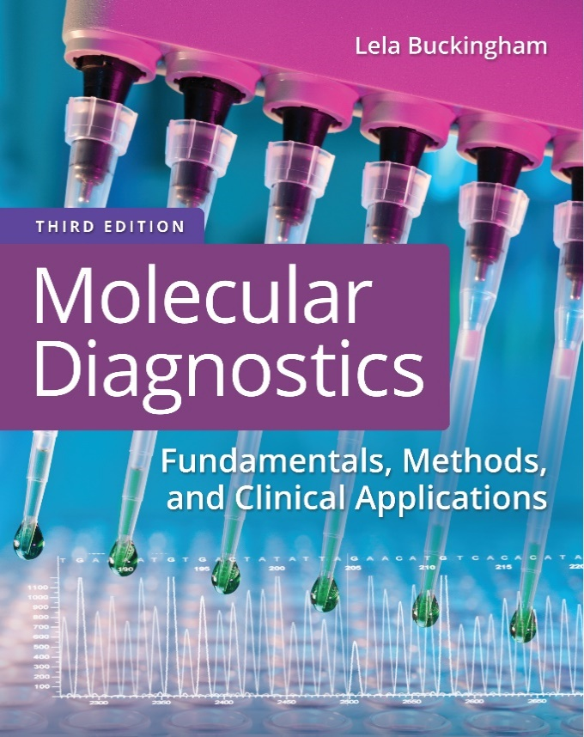
Chapter 1
Nucleic Acids and Proteins

Slide 2
Objectives
Diagram the structure of nitrogen bases, nucleosides, nucleotides, and nucleic acid.
Illustrate three ways in which D N A can be transferred between bacterial cells.
Demonstrate how deoxyribonucleic acid (D N A) is replicated and transcribed into ribonucleic acid (R N A).
Present the genetic code.
Give the definition of a gene.

Slide 3
Objectives (continued)
Describe the structure and chemical nature of the 20 amino acids.
Show how the chemistry of the amino acids affects the chemical characteristics and functions of proteins.
Define primary, secondary, tertiary, and quaternary structure of protein organization.
Describe how amino acids are polymerized into proteins, using R N A as a guide (translation).

Slide 4
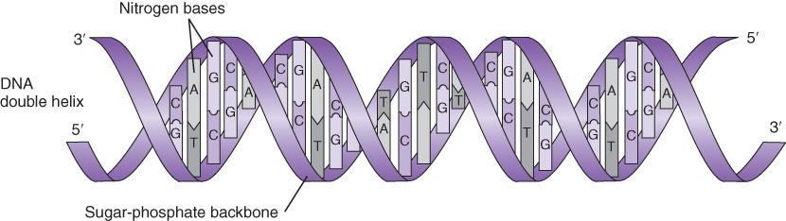
Deoxyribonucleic Acid (D N A)
Deoxyribonucleic acid (D N A) is a genetic information storage system
Notes:
D N A is a polymer of nucleotide bases. Information is stored in the order or sequence of nucleotide bases in the polymer.

Slide 5
History of D N A
Mendel, the father of genetics, described the unit character of genetic traits (1865)
Miescher isolated “nuclein” (1868)
Levene identified the chemical components of D N A
Notes:
D N A and the nature of genetic inheritance have been known since the 1860s; however, the two were not connected at that time.

Slide 6
D N A
D N A is a polymer of nucleotides
Nucleotides are phosphorylated nucleosides
Nucleosides are composed of a ribose sugar and a nitrogen base
There are four common nitrogen bases; two with purine ring structures (adenine and guanine) and two with pyrimidine ring structures (thymine and cytosine)
The order or sequence of nucleotides in the D N A polymer is the code for information storage

Slide 7
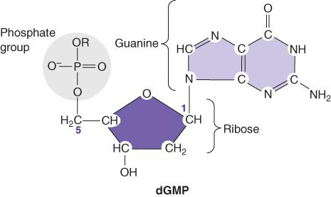
Nucleotide Structure
Notes:
A nucleotide consists of ribose sugar, phosphorylated on carbon 5’, hydroxylated on carbon 3’, carrying a nitrogen base on the 1’ carbon.

Slide 8
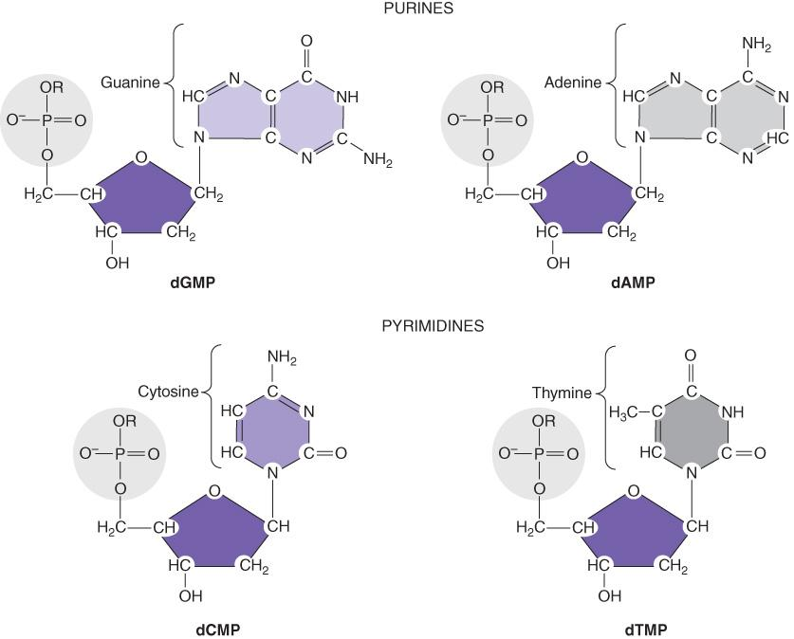
Deoxyribonucleotides
Notes:
The nitrogen bases in purines have a double-ring structure. Those of pyrimidines have a single-ring structure.

Slide 9
D N A Carries Genetic Information
Griffith (1920’s) discovered the “transforming principle”
Avery, MacLeod, and McCarty (1944) showed that the transforming principle is D N A
Hershey and Chase (1952) showed that D N A, not protein, carries genetic information
Chargaff (1950’s): the number of G = C and A = T in all D N A
Notes:
Starting in the 1920s, there were clues that D N A was the carrier of genetic information. This capability of D N A was demonstrated by Griffith’s transforming experiments with virulent bacteria, which, when killed and lysed, were still able to “transform” nonvirulent bacteria. The transforming principle was shown by Avery et al. to be D N A based on its sensitivity to nucleases that degrade D N A. Phage experiments by Hershey and Chase showed that nucleic acid, not protein, was able to produce more phage after introduction to bacteria. Other evidence included the nonrandom nature of D N A base numbers observed by Chargaff.

Slide 10
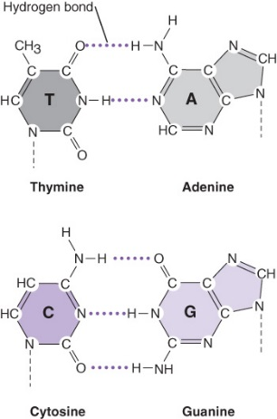
D N A exists as two polymers joined together by hydrogen bonds
Two hydrogen bonds form between A and T
Three hydrogen bonds form between C and G
Notes:
Chargaff’s observations can be explained by the requirements for base pairing of A with T and G with C in D N A.

Slide 11
The two polymers form a double helix
Notes:
Because base pairing requires A:T and C:G, the information on one single strand of the D N A can be inferred from the other single strand.

Slide 12
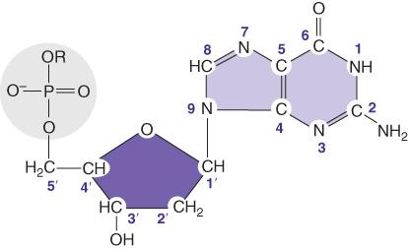
Polarity
D N A strands have polarity based on the phosphodiester bond
D N A strands have 5′ (phosphate) end and a 3′ (hydroxyl) end
Notes:
Nucleotides in D N A are joined by phosphodiester bonds between the phosphate groups on the 5’ ribose carbons and the hydroxyl groups on the 3’ carbons. As a result, the D N A has a 5’ end and a 3’ end.

Slide 13
D N A Replication
Conservative?
Semiconservative?
Dispersive?
Notes:
There were different theories of how D N A could be replicated while still preserving its sequence information.

Slide 14
Meselson and Stahl
Bacteria grown in ¹⁵N and then shifted to ¹⁴N for two generations Predictions:
Conservative: ¼ ¹⁵N: ¾ ¹⁴N
Semiconservative: ½ ¹⁴N/¹⁵N hybrid: ½ ¹⁴N
Dispersive: All hybrid
Notes:
Meselson and Stahl used density gradients to demonstrate that D N A was replicated in a semiconservative manner; that is, one strand of the double helix remains intact to serve as a template for the synthesis of each new strand.

Slide 15
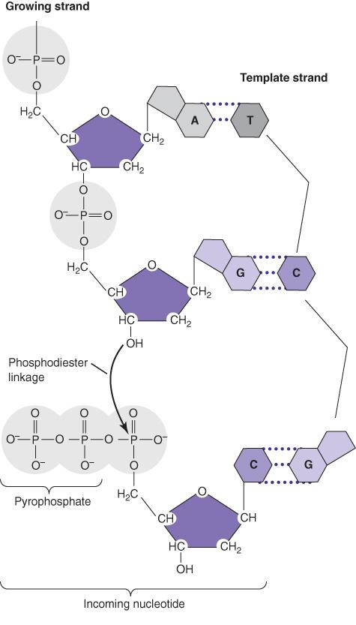
D N A Replication (continued_1)
A new D N A strand is polymerized from the 5′ end to the 3′ end (5′ to 3′), reading the parent strand in the 3′ to 5′ direction
Notes:
The antiparallel nature of D N A results from the direction of synthesis (5’ to 3’) and reading of the template strand (3’ to 5’).

Slide 16
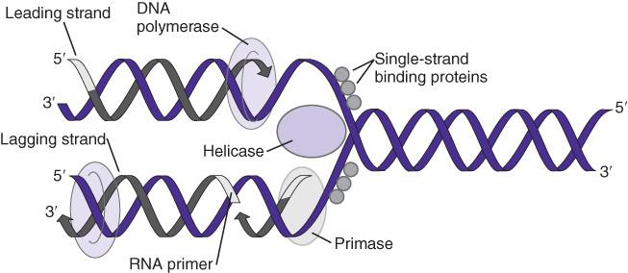
D N A Replication (continued_2)
The replisome is a group of proteins
assembled for D N A replication
Notes:
D N A replication requires a variety of functions, including a helicase to unwind the double helix, single-strand binding proteins to protect the exposed single strands, and multiple D N A polymerases as well as D N A ligase and primase to prime synthesis with R N A. In contrast to R N A, D N A cannot start synthesis without a pre-existing hydroxyl group. This is provided by an R N A primer.

Slide 17
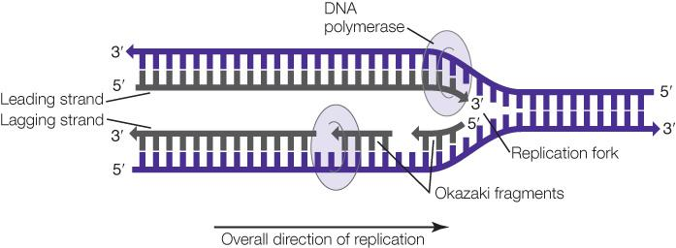
D N A Replication (continued_3)
Despite the antiparallel nature of the two strands, D N A synthesis proceeds along both stands in the same direction
Notes:
One question about D N A replication was as follows: How are both strands of the double helix synthesized in the same direction when one strand is in the wrong orientation to serve as a template? This is accomplished by discontinuous synthesis of one strand (the lagging strand). The strand is copied in short sections moving away from the replication fork, producing Okazaki fragments, named for their discoverers. These fragments are connected after synthesis by D N A ligase. The opposite strand (leading strand) is copied continuously.

Slide 18

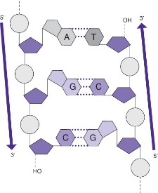
D N A Replication (continued_4)
The two strands of the resulting double helix are antiparallel
Notes:
Complementary sequences are not identical and are anti-parallel.

Slide 19
Recombinant D N A Technology
Three factors were required to perform recombinant D N A technology:
Nucleases—to cut D N A into pieces for recombining
Ligases—to paste the D N A fragments together
Plasmids—to carry the recombined D N A into the cell
Notes:
Recombinant D N A technology provided the basis for current molecular biology methods. Manipulation of D N A in vitro resulted in the ability to produce specifically recombined organisms.

Slide 20
D N A Metabolizing Enzymes
Polymerases—catalyze formation of the phosphodiester bond
Helicases—unwind and untangle
Primase—synthesizes a short R N A to prime D N A synthesis
Methylases—add methyl groups to nitrogen bases
Deaminases—take amino groups from nitrogen bases
Notes:
In addition to the enzymes required for replication, there are many enzyme activities that metabolize or modify D N A. Some are used in the laboratory.

Slide 21
D N A Metabolizing Enzymes (continued)
Nucleases—cut D N A
Ligases—catalyze formation of a single phosphodiester bond
Notes:
In addition to the enzymes required for replication, there are many enzyme activities that metabolize or modify D N A. Some are used in the laboratory.

Slide 22
Nucleases
Exonucleases
  remove bases from the ends of D N A strands
Endonucleases
  cut D N A strands internally
Notes:
Nucleases are used in the laboratory to modify D N A in vitro (Recombinant D N A technology).

Slide 23
Restriction Endonucleases
Enzyme | Isolated From: | Recognition Seq.
Eco R I | E. coli, strain R, 1st enzyme | G v A A T T C
Eco R V | E. coli, strain R, 5th enzyme | G v A T A T C
Hind 3 | H. influenzae, strain d, 3rd enzyme | A v A G C T T
Notes:
Restriction endonucleases are particularly useful because they recognize and cut specific sequences in D N A. There are hundreds of restriction enzymes with many recognition sites. In nature, these enzymes serve as an immune system for bacteria, degrading invading D N A while not cutting their own. The enzymes are named for the bacteria from which they were isolated.

Slide 24
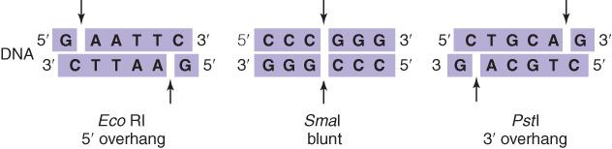
Restriction Endonucleases (continued)
Restriction endonucleases cut double-stranded D N A
Notes:
Type II restriction enzymes cut D N A in different ways. Some make a staggered cut in the double-stranded D N A, leaving a 5’ or 3’ single-strand overhang. Others make a blunt cut, leaving no overhang.

Slide 25
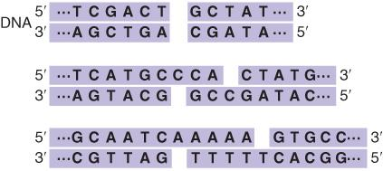
D N A Ligase
D N A ligase “pastes” or ligates cut fragments of D N A together
Notes:
Cut D N A can be pasted together with the formation of a single phosphodiester bond catalyzed by D N A ligase.

Slide 26
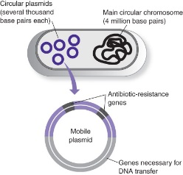
Plasmids
Plasmids can move D N A fragments from cell to cell
Notes:
Plasmids are extra chromosomal D N A, usually in circular form. They can carry genes from cell to cell and are responsible for “horizontal” transfer of phenotype in bacteria.

Slide 27
Central Dogma
CENTRAL DOGMA
of the transfer of biological information
D N A → R N A → protein
Notes:
Biological information in D N A flows through ribonucleic acid (R N A) to protein to produce phenotype.

Slide 28
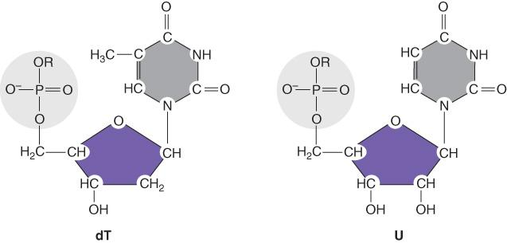
D N A Versus R N A
D N A is double stranded; R N A is “single stranded”
D N A has deoxyribose sugars; R N A has ribose sugars
D N A contains thymine; R N A contains uracil
Notes:
R N A is a nucleic acid without a complementary partner. R N A forms structures through folding and hybridization within the same R N A chain. R N A has an addition hydroxyl group on the 2’ ribose carbon.

Slide 29
R N A Replication Versus D N A Replication
R N A replication:
Requires no priming
Has many more initiation sites
Is slower (50–100 bases per second versus 1000 bases per second)
Has lower fidelity
Is more processive

Slide 30
Amino Acids
Amino acids are classified by the chemical properties of their side chains
Non-polar
Alanine, Ala, A
Isoleucine, Ile, I
Leucine, Leu, L
Methionine, Met, M
Phenylalanine, Phe, F
Proline, Pro, P
Tryptophan, Trp, W
Negatively charged (acidic)
Aspartic acid, Asp, D
Glutamic acid, Glu, E
Polar
Asparagine Asn, N
Cysteine, Cys, C
Glutamine, Gln, Q
Glycine, Gly, G
Serine, Ser, S
Threonine, Thr, T
Tyrosine, Tyr, Y
Positively charged (basic)
Arginine, Arg, R
Histidine, His, H
Lysine, Lys, K

Slide 31

Amino Acids (continued_1)
Amino acids are neutral at a p H that is their isoelectric point (p I)
Notes:
The pH of a solution where the net charge of a protein is zero/neutral

Slide 32
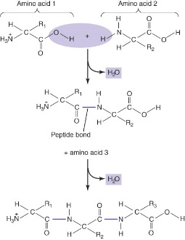
Amino Acids (continued_2)
Amino acids are joined together by -C-C-N- linkages or peptide bonds to make proteins

Slide 33
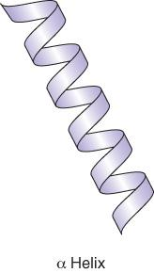
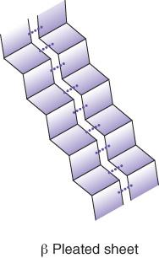
Protein Structure
Primary: Amino acid sequence
Secondary: Intra-chain folding
beta pleated sheets alpha helices

Slide 34
Protein Structure (continued)
Tertiary: Further folding, loss of which denatures protein
Quaternary: Protein–protein interaction for function: Monomers form multimers
  Dimers
  Trimers
  Tetramers
Notes:
Tertiary structure is the interaction of peptides with one another to form multisubunit proteins.

Slide 35
Central Dogma (continued)
CENTRAL DOGMA
of the transfer of biological information
D N A
↓
R N A
↓
Nucleic acid sequence must be translated to amino acid sequence
↓
Protein

Slide 36
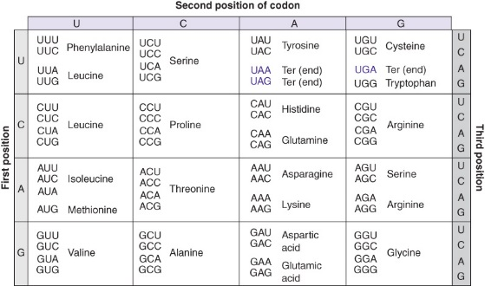
Genetic Code
The genetic code translates a nucleic acid sequence to an amino acid sequence
3 nucleotides =
one codon =
1 amino acid

Slide 37

Gene
A gene is an ordered sequence of nucleotides on a chromosome that encodes a specific functional product
Genes contain nucleotide sequences that will be transcribed and/or translated into protein

Slide 38
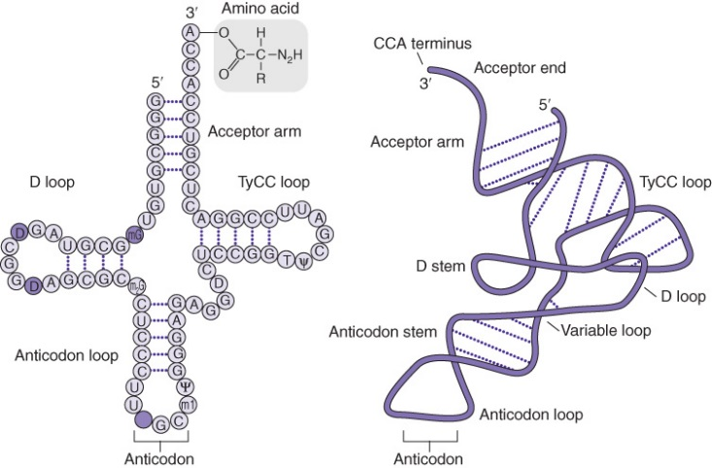
Protein Translation
Messenger R N A—template
Ribosomes—peptidyl transferase
Transfer R N A (t R N A)
  Adaptors
Notes:
Peptidyl transferase: catalyzes the addition of amino acid residues in order to grow polypeptide chain

Slide 39
Charging t R N A
Amino-acyl t R N A synthetases covalently attach amino acids to t R N A’s, matching side chains and anticodons
amino acid + A T P → aminoacyl-A M P + Ppi
aminoacyl-A M P + t R N A → aminoacyl-t R N A + A M P

Slide 40
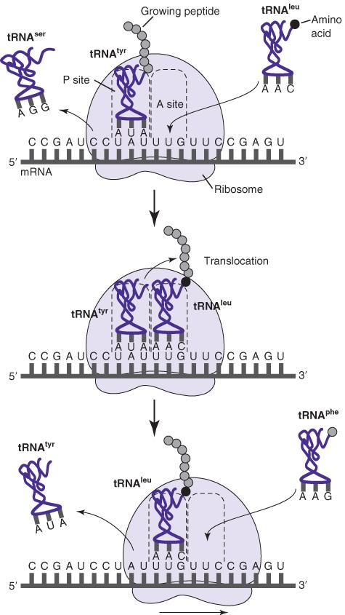
Protein Translation (continued)
Notes:
Protein translation takes place in the ribosomes. Charged tR N As carry in their amino acids and hybridize through their anticodon sequences to mR N A codons, allowing peptidyl transferase enzymatic activity to form a peptide bond between the growing peptide and the incoming amino acid.

Slide 41
Protein Translation: Termination
Termination of the amino acid chain is signaled by one of the three nonsense codons, or termination codons, U A A, U A G, or U G A, which are not charged with an amino acid
Termination or release factors trigger hydrolysis of the finished polypeptide from the final t R N A

Slide 42
Summary
D N A is a polymer of nucleotides, storing genetic information in the order of the nucleotide sequence
D N A replication conserves the D N A sequence
The two strands of double-stranded D N A are antiparallel and complementary
D N A can be manipulated in vitro using D N A metabolizing enzymes

Slide 43
Summary (continued_1)
Restriction endonucleases, ligase, and plasmids are used to make new genetic combinations in vitro
R N A carries genetic information from D N A to ribosomes for protein synthesis
Proteins are made of combinations of 20 amino acids
Protein structure and function depend on the amino acid content and organization

Slide 44
Summary (continued_2)
A gene is defined, in part, by an open reading frame that contains the genetic code
The genetic code translates nucleotide sequence to amino acid sequence (3 nucleotides = 1 codon for 1 amino acid)

