Slide 1
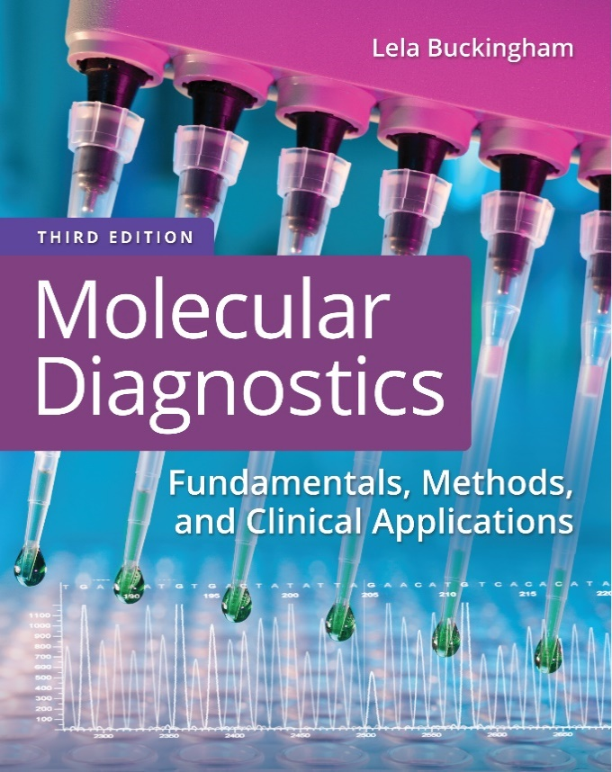
Chapter 2
Gene Expression and Epigenetics

Slide 2
Objectives
Compare and contrast the structure of ribonucleic acid (R N A) with that of D N A.
List and compare the different types of R N A.
Describe how ribonucleotides are polymerized into R N A (transcription) and the relation of the sequence of the R N A transcript to the D N A sequence of its gene.
Describe the cellular processing of messenger R N A.

Slide 3
Objectives (continued)
Describe regulation of transcription using the Lac operon as an example.
Define epigenetics, and list examples of epigenetic phenomena.

Slide 4
Central Dogma
CENTRAL DOGMA
of the transfer of biological information
D N A → R N A → protein

Slide 5
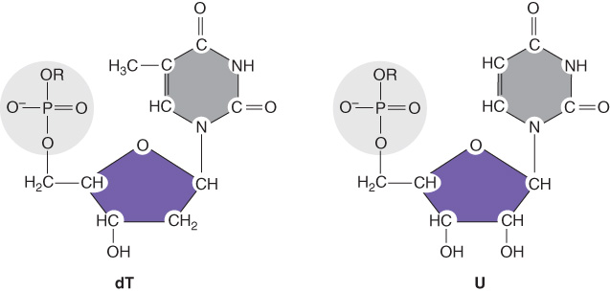
D N A Versus R N A
D N A is double stranded; R N A is “single stranded”
D N A has deoxyribose sugars; R N A has ribose sugars
D N A contains thymine; R N A contains uracil

Slide 6
Types of R N A
Messenger R N A (m R N A)
Ribosomal R N A (r R N A)
Transfer R N A (t R N A)
Heteronuclear R N A (h n R N A)
Small nuclear R N A (s n R N A)
micro R N A (m i R N A)
Short interfering R N A (s i R N A)
Double-stranded R N A (d s R N A)
Many short R N A’s (s n o R N A, t n c R N A, ellipsis)
Notes:
There are many types of R N A, each with different functions. Genetic testing is most concerned with mR N A that carries gene sequences; however, other R N A have roles in disease phenotype. Total R N A isolated from a cell is mostly rR N A.

Slide 7
R N A Replication Versus D N A Replication
R N A replication:
Requires no priming
Has many more initiation sites
Is slower (50–100 bases per second versus 1000 bases per second)
Has lower fidelity
Is more processive

Slide 8
R N A Replication: Initiation
R N A synthesis begins at the promoter
R N A polymerase and accessory proteins assemble on D N A at this site
The first base of the synthesized R N A is +1

Slide 9
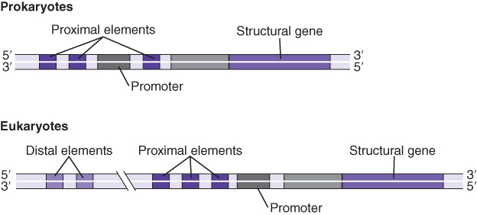
R N A Replication: Promoters
Prokaryotic promoter consensus sequences:
–35 T T G A C A………–10 T A T A A T……+1
Eukaryotic promoter consensus sequences (pol Two):
Enhancer…//…CCAAT…//…–25 TATAAT……+1

Slide 10
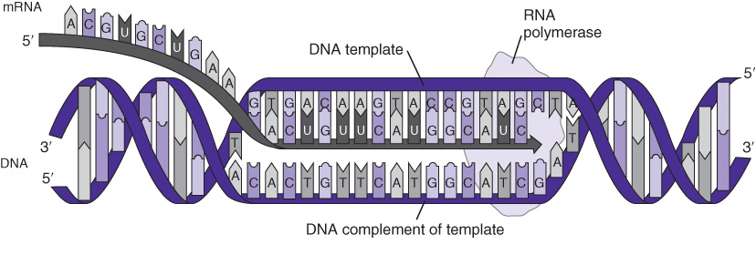
R N A Replication: Elongation
Notes:
R N A polymerase catalyzes the formation of phosphodiester bonds between ribonucleotides to elongate R N A, copying one strand of the gene D N A.

Slide 11
Prokaryotic R N A Polymerase (R N A P)
Core enzyme
α subscript 2 , β, β′
Holoenzyme
α subscript 2 , β, β′σ
Rho factor
rho

Slide 12
Eukaryotic R N A Polymerases
Type | Location | Products | α-amanitin
1 | Nucleolus | 18S, 5.8S, 28S r R N A | Insensitive
2 | Nucleoplasm | m R N A, s n R N A | Inhibited
3 | Nucleoplasm | t R N A, 5S r R N A | Inhibited by high concentration
Mit. | Cytoplasm | M t R N A | Insensitive

Slide 13
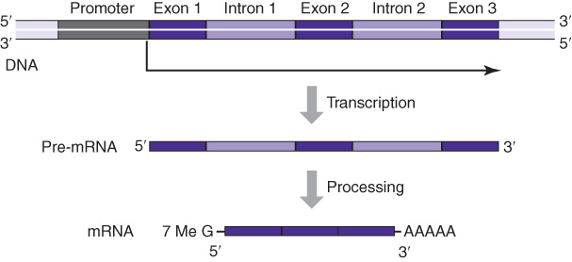
m R N A Processing
Notes:
Introns are removed from mR N A by splicing so that the exons are joined in a continuous protein-coding sequence. Processing also includes covalent attachment of a methylated guanine (cap) at the 5’ end. A run of 20 to 200 adenines is synthesized at the 3’ end of the R N A with termination.

Slide 14
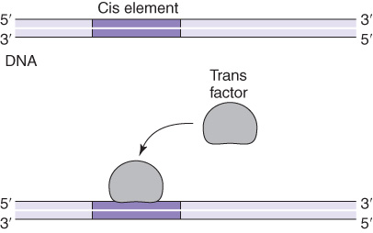
Gene Expression
Factors that control gene expression:
cis elements, which are D N A sequences
trans elements, which are proteins

Slide 15
Gene Expression (continued)
Types of gene expression:
Constitutive
  Genes that are transcribed continuously
  “Housekeeping genes” have products required constantly by the cell
Inducible
  Gene products that are required at specific times during the cell cycle or under certain nutritional/environmental conditions

Slide 16

The Lactose Operon
Jacob and Monod (1960ˈs) discovered the molecular mechanism of inducible gene expression in E. coli
Promoter (P)—site of R N A pol binding
Repressor protein (R)—trans element
Operator (O)—site of R binding
Inducer (I)—binds to repressor protein

Slide 17
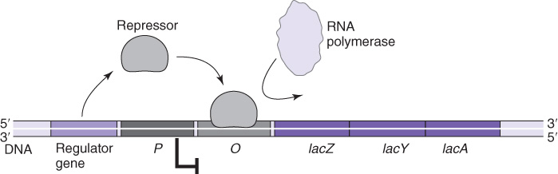
The Lactose Operon (continued)

Slide 18
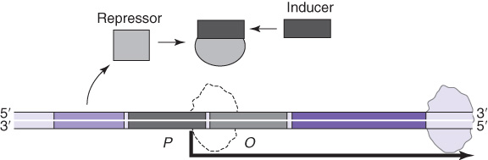
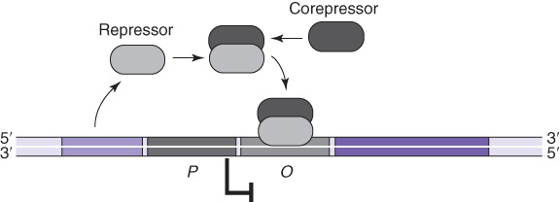
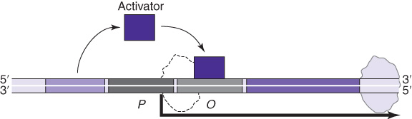
Modes of Gene Regulation in Prokaryotes
Induction
Repression
Activation

Slide 19
Epigenetics
Non–sequence specific, heritable traits
Histone modifications
D N A methylation
Non-coding R N A

Slide 20
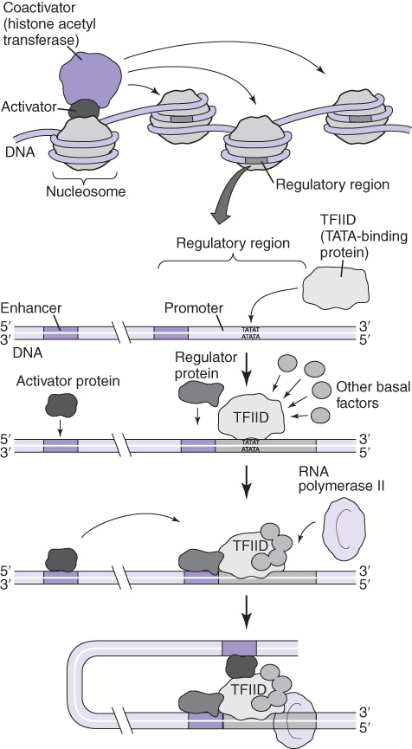
Histones
Histones affect the accessibility of D N A to the binding of R N A polymerase and transcription factors

Slide 21
The Histone Code
Distinct combinations of chemical modifications of histones dictate varying responses
Acetylation
Phosphorylation
Methylation
Ubiquitination
Ribosylation
Glycosylation

Slide 22
D N A Methylation
Methylation of D N A occurs mostly on cytosines or adenines (5-methyl cytosine)
Methylation of cytosines followed by guanine in D N A (C G → C M e G)
  Also called C p G sites
Two major enzymes methylate eukaryotic D N A:
  D N A methyltransferase 1 (D N M T1)—methylates hemimethylated D N A
  D N A methyltransferase 3 (D N M T3)—methylates unmethylated D N A

Slide 23
D N A Methylation (continued)
Restriction/modification enzymes are responsible for methylation of prokaryotic D N A

Slide 24
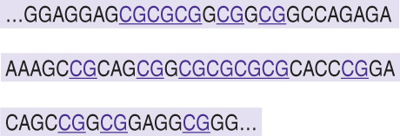
Transcriptional Gene Silencing
Methylation of D N A inhibits transcription of some genes
C p G islands are sites of methylation in human D N A
C p G Island

Slide 25
Non-Coding R N A
Non-coding R N A (n c R N A) are transcribed and processed but not translated
n c R N A are classified by size
  Small n c R N A, including micro R N A (m i R N A) and short interfering R N A (s i R N A)
  Long n c R N A (l n c R N A)
Long n c R N A interact with histones and D N A to affect transcription

Slide 26
Non-Coding R N A (continued)
Small n c R N A interact with m R N A to affect translation
C p G Island

Slide 27
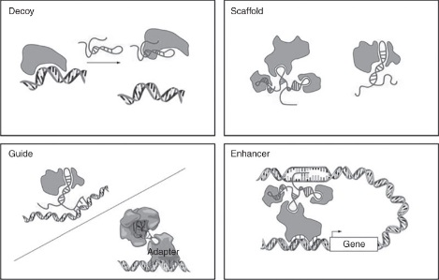
Long Non-Coding R N A
Long non-coding R N A (l n c R N A) interact with D N A and proteins to affect transcription

Slide 28
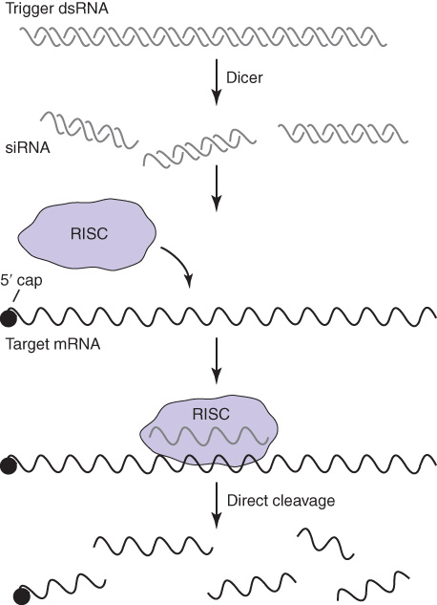
Post-Transcriptional Gene Silencing
micro R N A (m i R N A) silences specific genes by hybridizing to the 3′ end of the m R N A and preventing protein synthesis

Slide 29
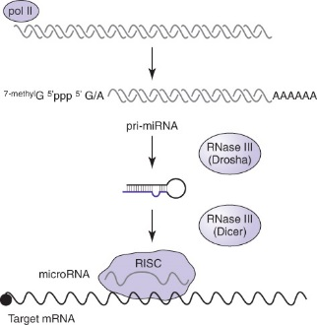
Post-Transcriptional Gene Silencing (continued)
Small interfering R N A (s i R N A) silence specific genes by promoting degradation of the m R N A target

Slide 30
Summary
R N A carries genetic information from D N A to ribosomes for protein synthesis
Different types of R N A have different cellular functions
R N A is synthesized (transcribed) in a process similar to D N A replication
Transcription of R N A is constitutive or inducible

Slide 31
Summary (continued)
Inducible genes are expressed only when required
Epigenetic factors also control expression of genes
  Histone modification
  D N A methylation
  Non-coding R N A

