Slide 1
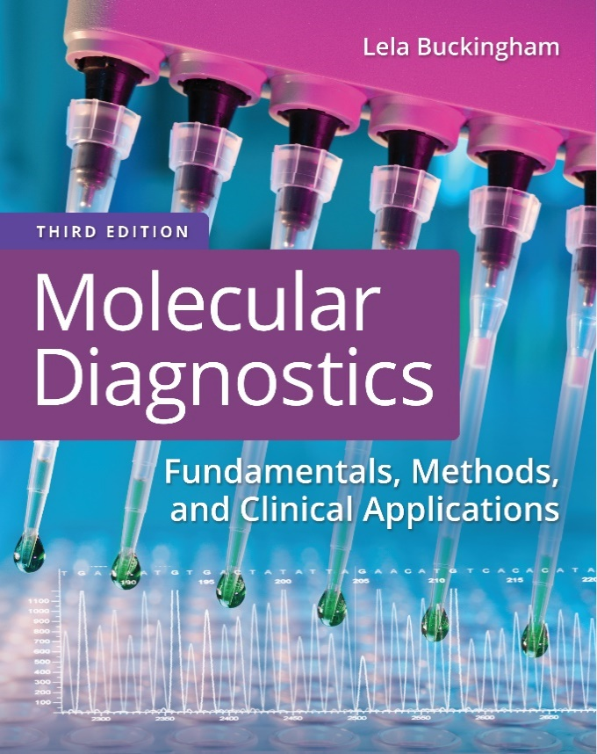
Chapter 3
Nucleic Acid Extraction Methods

Slide 2
Objectives
Compare and contrast organic, inorganic, and solid-phase approaches for D N A isolation.
Compare and contrast organic and solid-phase approaches for isolating total R N A.
Distinguish between the isolation of total R N A with that of messenger R N A.

Slide 3
Objectives (continued)
Describe the gel-based, spectrophotometric, and fluorometric methods used to determine the quantity and quality of D N A and R N A preparations.
Calculate the concentration and yield of D N A and R N A from a given nucleic acid preparation.

Slide 4
Isolation of D N A
Nucleic acids are isolated from a variety of specimens
Blood
Buffy coat
Bone marrow
Solid tissue
Lavage fluids
Bacteria, viruses
Fungi
Organelles, mitochondria

Slide 5
Isolation of D N A (continued_1)
More specimens adequate for amplification by polymerase chain reaction (P C R)
Dried blood, plasma
Saliva, urine
Bone, teeth
Amniotic fluid, >8 weeks
Hair follicles, hair shafts
Buccal cells

Slide 6
Isolation of D N A (continued_2)
Cerebrospinal fluid
Formalin fixed tissue
Feces
Soil

Slide 7
D N A Extraction Methods
Organic—uses organic chemicals, phenol, chloroform
Inorganic—uses inorganic chemicals, detergents, E D T A, acetic acid, salt (salting out, spooling)
Solid phase—D N A is immobilized on a solid support, beads or columns

Slide 8
Specimen Preparation
Bone marrow, peripheral blood
Density-gradient centrifugation
Differential osmolysis
Streptokinase
Tissue
Freeze/crush
Mince
Enzymatic digestion
Plants/fungi
Homogenize
Vortex with glass beads

Slide 9
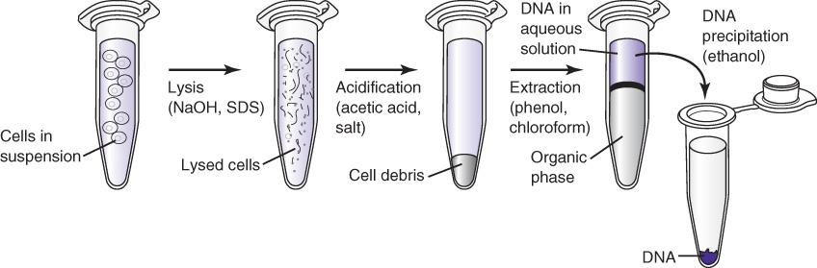
Organic
Notes:
After cell lysis, organic chemicals (phenol + chloroform) strip contaminants away from the nucleic acid. Because these chemicals are hydrophobic, two phases form. The nucleic acid is in the aqueous phase (upper phase under these conditions). Ethanol (or isopropanol) precipitates nucleic acid, which can be collected by centrifugation and resuspended in a smaller volume to increase the concentration of nucleic acid.

Slide 10
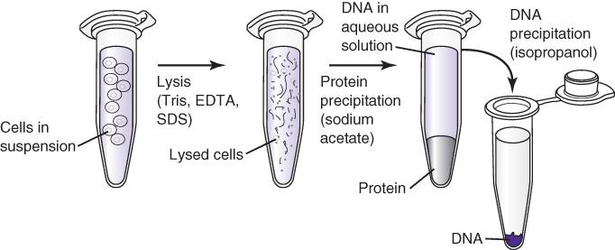
Inorganic
Notes:
Inorganic methods are preferred for routine testing because the chemicals used are less hazardous. In this case, proteins are precipitated and removed by centrifugation. The nucleic acid in the supernatant can then be precipitated and resuspended in a convenient volume and concentration.

Slide 11
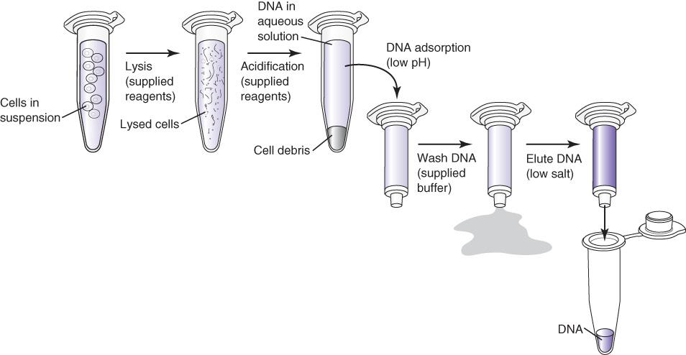
Solid Phase
Notes:
Solid-phase (column) isolation systems are most frequently used. Nucleic acid is collected on the column, washed, and eluted in a convenient volume (about 50 microliters).

Slide 12
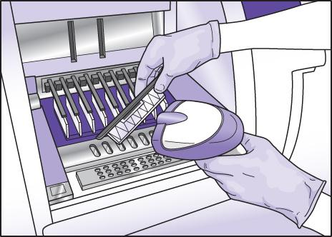
Solid Phase (continued)
Solid-phase isolation media include silica spin columns and beads
Nucleic acid binding to silica beads is the basis for many automated extraction systems

Slide 13
Other D N A Extraction Methods
Limiting specimens (fixed tissue, dried blood, bone)
Rapid extraction for routine testing
Notes:
Rapid extraction from minimal tissues involves removing or inactivating contaminants without trying to further isolate the D N A.

Slide 14
Isolation of D N A from Fixed Tissue
Tissue preserved in fixatives is a valuable source of nucleic acid
Formalin is the most frequently used fixative
Best
Acetone
10% buffered neutral formalin
Not as good
Zamboni’s, Clarke’s
Paraformaldehyde
Formalin–alcohol–acetic acid

Slide 15
Isolation of D N A from Fixed Tissue (continued)
Metharcan
Less desirable
Carnoy’s, Zenker’s, Bouin’s, B-5

Slide 16
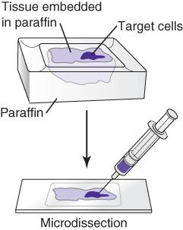
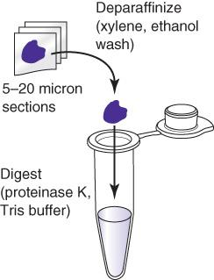
Extraction From Fixed Tissue
Notes:
Crude cell lysates of nucleic acid from fixed tissue are simply made by physically removing tissue from slides (macrodissection) into proteinase K solution. The lysates can be further purified using column (solid-phase) purification.

Slide 17
Isolation of Mitochondrial D N A
Mitochondrial D N A is isolated similar to nuclear D N A
Isolate mitochondria by centrifugation
Isolate total D N A
Notes:
There are two options for the preparation of mitochondrial D N A: Isolate the mitochondria first by differential centrifugation, or just use total D N A, which contains the mitochondrial D N A.

Slide 18
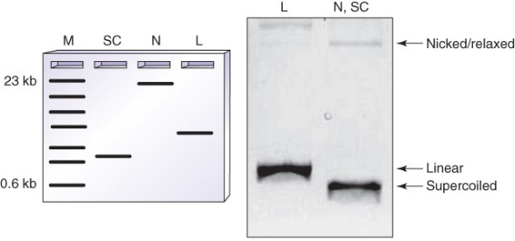
Methods to Assess D N A
Gel electrophoresis with known standards

Slide 19
Methods to Assess D N A (continued)
Spectrophotometry
  1 A₂₆₀ = 50 milligrams per milliliter d s D N A (concentration)
  milligram per milliliter multiplied by milliliter = milligram D N A (yield)
  A₂₆₀ / A₂₈₀ ~ 1.6 to 2.0 (purity)
Fluorometry
Hoechst dye

Slide 20
Nucleic Acid Extraction Methods: R N A

Slide 21
Laboratory Preparation
Bench, equipment
Separate laboratory area designated R Nase-free (R N F)
Wear gloves; wipe with R Nase cleaning agents
Disposables
Certified R Nase-free
Rinsed in 0.1% diethyl pyrocarbonate (D E P C)
Reagents
Certified R Nase-free
Add 0.05% to 0.1% D E P C
Test with R Nase detection agents

Slide 22
Laboratory Preparation (continued)
Reactions
Add R Nase inhibitors

Slide 23
Specimen Collection
Bone marrow, peripheral blood
Acid citrate dextrose (A C D) – yellow cap
Liquid K₃ E D T A - lavender/pink cap
(heparin)
“R N A tubes”
Tissue
Fresh in saline—process immediately
frozen, –70 degrees Centigrade, nitrogen
(fixed, embedded)

Slide 24
Specimen Preparation (continued)
Bone marrow, peripheral blood
Density-gradient centrifugation
Differential osmolysis (remove R B C’s or nuclei)
Tissue
Freeze/grind
Crush in denaturant
Bacteria/fungi/plants
Homogenize
Vortex with glass beads
Enzymatic digestion (zymolyase/lysozyme)

Slide 25
R N A Isolation
Organic
Solid phase
Notes:
There are two approaches to R N A isolation.

Slide 26
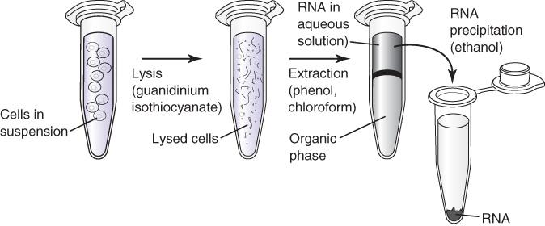
Organic
Notes:
RNF reagents designed for R N A are used. Otherwise, the methods are similar to those of D N A.

Slide 27
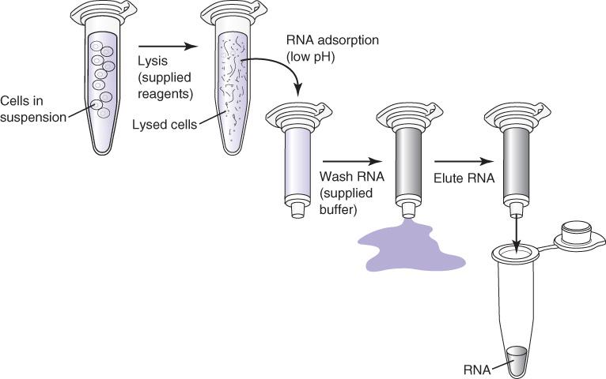
Solid-Phase R N A Isolation
Notes:
RNF reagents designed for R N A are used. Otherwise, the methods are similar to those of D N A.

Slide 28
Types of R N A
Messenger R N A (m R N A)
Ribosomal R N A (r R N A)
Transfer R N A (t R N A)
Heteronuclear R N A (h n R N A)
Small nuclear R N A (s n R N A)
Double-stranded R N A (d s R N A)
Many small/microR N A’s
Notes:
Although there are many types of R N A, messenger R N A is usually the target for genetic testing. Ribosomal R N A makes up most (~80%) of total isolated R N A.

Slide 29
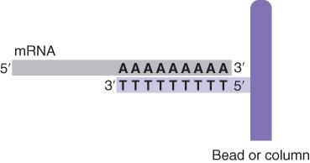
Isolation of m R N A (poly A R N A)
Notes:
Isolation of messenger R N A may be enhanced using columns covalently attached to polyU or polyT oligomers that hydrogen bond specifically to mR N A polyA tails.

Slide 30

Methods to Assess R N A
Gel electrophoresis (total R N A; quality)
Spectrophotometry
1 A₂₆₀ = 40 micrograms/milliliter R N A (concentration)
microgram/milliliter multiplied by milliliter = microgram R N A (yield)
A₂₆₀/ A₂₈₀ >1.6 (purity)

Slide 31
Methods to Assess R N A (continued)
Fluorometry
RiboGreen

Slide 32
Summary
D N A is extracted by organic, inorganic, and solid-phase methods
D N A can also be extracted by more rapid methods or methods designed for challenging specimens
R N A extraction methods include organic and solid-phase methods

Slide 33
Summary (continued)
m R N A can be specifically extracted using immobilized polyT or polyU
D N A and R N A concentration, yield, and purity are assessed using gel analysis, spectrophotometry, or fluorometry

