Slide 1
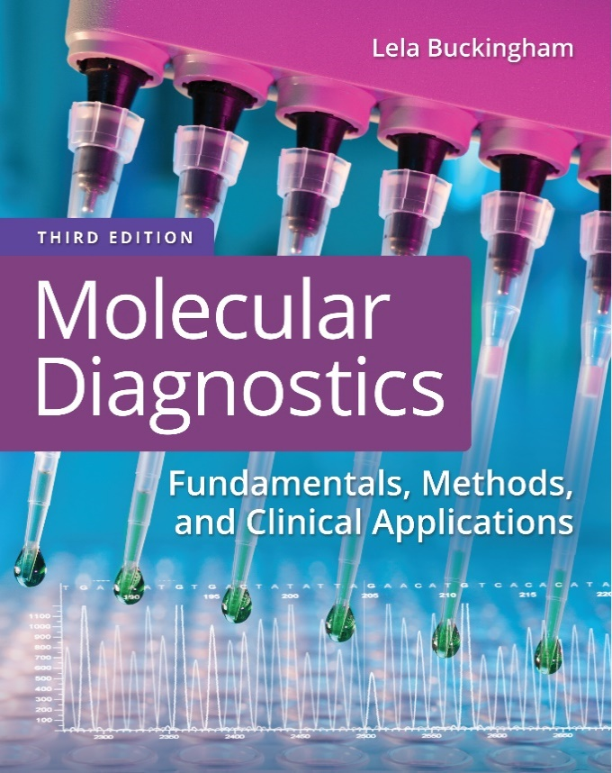
Chapter 4
Resolution and Detection of Nucleic Acids

Slide 2
Objectives
Explain the principle and performance of electrophoresis as it applies to nucleic acids.
Compare and contrast agarose and polyacrylamide gel polymers.
Explain the principle and performance of capillary electrophoresis as it is applied to nucleic acid separation.
Describe the general types of equipment used for electrophoresis.

Slide 3
Objectives (continued)
Discuss methods and applications of pulse-field gel electrophoresis.
Compare and contrast detection systems used in nucleic acid applications.

Slide 4
Electrophoresis
Electrophoresis is the movement of molecules by an electric current
− → +
Nucleic acid moves from the negative to the positive pole

Slide 5
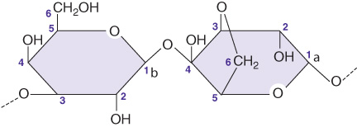
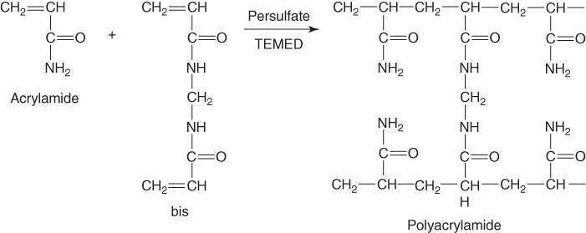
Electrophoresis (continued_1)
When D N A is applied to a macromolecular cage or gel such as agarose or polyacrylamide, its migration under the pull of the current is impeded

Slide 6
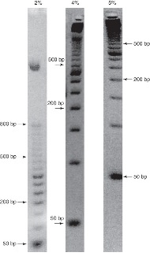
Electrophoresis (continued_2)
The movement of molecules is impeded in the gel such that molecules will collect or form a band according to their speed of migration
The concentration of gel/buffer will affect the resolution (separation by size) of fragments

Slide 7
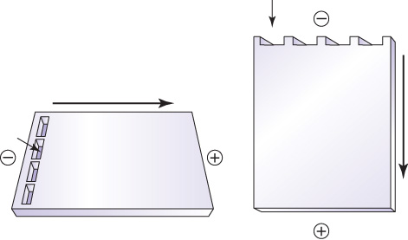
Electrophoresis (continued_3)
Slab gel electrophoresis can have either a horizontal or vertical format
Sample is introduced into wells at the top of the gel

Slide 8
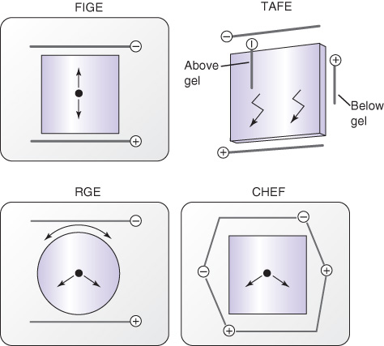
Electrophoresis (continued_4)
Very large D N A molecules are separated by pulsed-field gel electrophoresis (P F G E) systems

Slide 9
Types of P F G E
Field-inversion gel electrophoresis (F I G E)— alternating positive and negative poles
Transverse alternative field electrophoresis (T A F E)—transverse angle reorientation of poles on a vertical gel
Contour-clamped homogenous electric field (C H E F)—alternating polarity in an electrode array
Rotating gel electrophoresis (R G E)—rotating gel with fixed poles

Slide 10
Polyacrylamide Gel Electrophoresis (P A G E)
Acrylamide, in combination with a cross linker, methylene bis-acrylamide
Synthetic, consistent polymer
Polymerization catalysts—ammonium persulfate (A P S) plus N,N,N′,N′-tetramethylethylenediamine (T E M E D), or light activation
Resolves 1-base pair difference in a 1- kilobases molecule (0.1% difference)
Notes:
Agarose gels are cast as a liquid solution prepared from melting agarose powder in running buffer. Polyacrylamide is also prepared in solution but requires a nucleating agent (TEMED) and a catalyst (APS) to start the polymerization process. These chemicals are added before casting the gel.

Slide 11
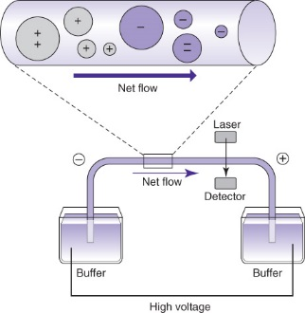
Capillary Electrophoresis (C E)
Separates solutes by charge/mass ratio
Capillary gel electrophoresis is used to separate nucleic acids

Slide 12
Capillary Gel Electrophoresis (C G E)
Thin glass (fused silica) capillary 30- to 100-centimeters multiplied by 25- to 100- micrometers internal diameter
Linear or cross-linked polyacrylamide or other linear polymers are used for sieving
Separation is based on size
C G E is more rapid, automated than slab gels
  Run at higher charge per unit area
  Electrokinetic injection of sample

Slide 13
Electrokinetic Injection
Nucleic acid fragments to be separated are drawn to the mouth of the capillary with a transient positive charge
Once collected, fragments migrate through the capillary to the positive pole

Slide 14
Electrophoresis Buffers
Carry current and protect samples during electrophoresis
Tris-borate E D T A (T B E), Tris-acetate E D T A (T A E), Tris-phosphate E D T A (T P E) used most often for D N A
10-millimolar sodium phosphate or M O P S buffer used for R N A
Buffer additives can be used to modify sample molecules
  Formamide, urea (denaturing agents)

Slide 15
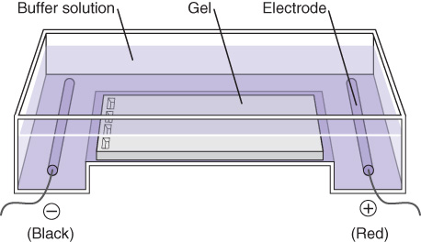
Electrophoresis Equipment
Horizontal or submarine gels are usually (but not always) agarose gels

Slide 16
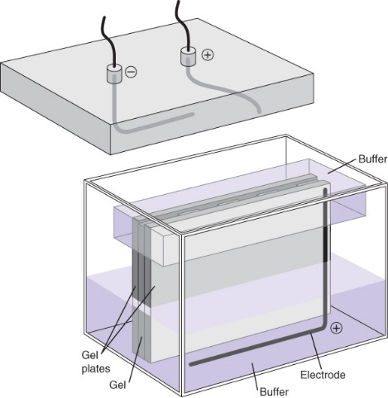
Electrophoresis Equipment (continued_1)
Vertical gels are usually (but not always) polyacrylamide gels

Slide 17
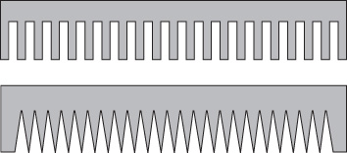
Electrophoresis Equipment (continued_2)
Combs are placed in the gel before polymerization to leave wells in the cast gel for sample loading
Wells are separated by an “ear” of gel

Slide 18
Running a Gel
Use the proper gel concentration for sample size range
0.5% to 5% agarose
3.5% to 20% polyacrylamide
Use the proper comb (well) and gel size to accommodate sample number
Run a molecular-weight marker of known fragment sizes

Slide 19
Running a Gel (continued)
Mix sample with tracking dye (dye + density agent)
Pipet into gel wells
Connect the gel bath to the power supply
Confirm a current (amperage) is passing through the gel

Slide 20
Visualization of Separated Bands
Detect bands by staining during or after electrophoresis
Ethidium bromide—for double-stranded D N A
S Y B R green or S Y B R gold—for single- or double-stranded D N A or for RNA
Silver stain—more sensitive for single- or double-stranded D N A or for RNA and proteins

Slide 21
Summary
Electrophoresis is used to separate molecules by size and/or charge
Nucleic acid fragments can be resolved on agarose of polyacrylamide gels
P F G E is used to resolve very large D N A fragments
C G E is more rapid and automated than slab gel electrophoresis
The choice of electrophoresis method depends on the type and size of sample

