Slide 1

Chapter 5
Analysis and Characterization of Nucleic Acids and Proteins

Slide 2
Objectives
Describe how restriction enzyme sites are mapped on D N A.
Construct a restriction enzyme map of a D N A plasmid or fragment.
Diagram the Southern blot procedure.
Define hybridization, stringency, and melting temperature.
Calculate the melting temperature of a given sequence of d s D N A.

Slide 3
Objectives (continued)
Describe comparative genomic hybridization (C G H).

Slide 4
Restriction Enzymes
Enzyme | Isolated From: | Recognition Seq.
Eco R I | E. coli, strain R, 1st enzyme | Gv A A T TC
Eco R V | E. coli, strain R, 5th enzyme | Gv A T A T C
Hind III | H. influenzae, strain d, 3rd enzyme | Av A G C T T
Notes:
Restriction endonucleases are particularly useful because they recognize and cut specific sequences in D N A. There are hundreds of restriction enzymes with many recognition sites. In nature, these enzymes serve as an immune system for bacteria, degrading invading D N A while not cutting their own. The enzymes are named for the bacteria from which they were isolated.

Slide 5
Restriction Enzymes (continued)
Type 1
Methylation/cleavage (3 subunits) >1000 base pairs from binding site (example, EcoA I G A G N N N N N N N G T C A)
Type 2
Cleavage at specific recognition sites
Type 3
Methylation/cleavage (2 subunits) 24 to 26 base pairs from binding site (example, HinfIII C G A A T)

Slide 6
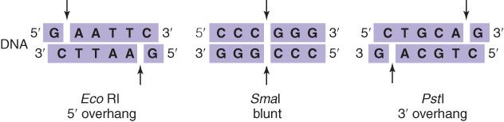
Restriction Enzymes: Type 2
Restriction enzymes cut D N A at specific sites in one of three ways
Notes:
Type II enzyme recognition sites are palindromic; that is, they read the same 5’ to 3’ on both strands of the double helix. The enzymes bind and cut, leaving either a 5’, 3’, or no single-stranded D N A overhang.

Slide 7
Restriction Enzymes: Type 2 (continued)
Sticky ends must match (be complementary)
for optimal re-ligation
Blunt ends can be re-ligated with less efficiency than sticky ends
Sticky ends can be converted to blunt ends with nuclease or polymerase
Blunt ends can be converted to sticky ends by ligating to synthetic adaptors
Notes:
The 3’ or 5’ overhangs are sticky ends; that is, they can hybridize to complementary sticky ends, making the connection of molecules with the same sticky ends more efficient.

Slide 8
Restriction Enzyme Mapping
Digest D N A with a restriction enzyme
Resolve the fragments by gel electrophoresis
The number of bands indicates the number of restriction sites
The size of the bands indicates the distance between restriction sites

Slide 9
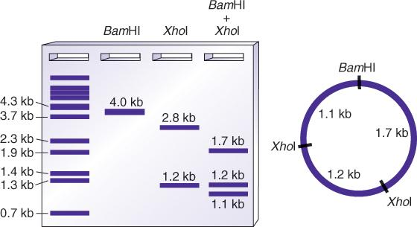
Restriction Enzyme Mapping (continued)
Notes:
This is an example of a restriction map of a 4-kb plasmid. Additional enzymes would increase the resolution of the map. Compare this analysis with that of a linear fragment (Fig. 5.1 in the text).

Slide 10
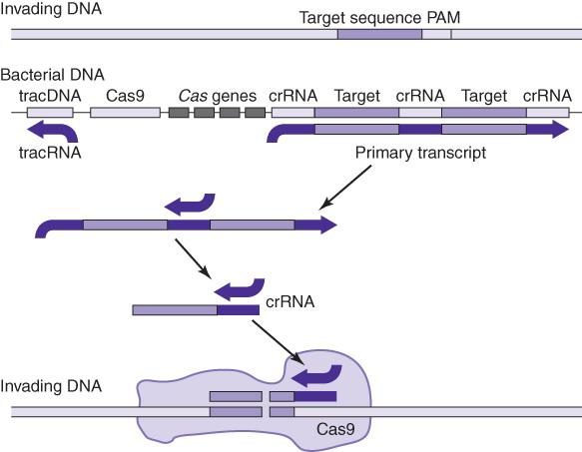
Clustered regularly interspaced short palindromic repeats (C R I S P R)
Restriction enzymes from gram positive bacteria
Notes:
C R I S P R is a system that uses invading D N A as a guide to cutting. So far, it is not used mostly in research applications, where synthetic R N A are designed to guide enzyme cutting (or other activities) to selected sites.

Slide 11
Southern Blot
Developed by Edwin Southern
The Southern blot procedure allows analysis of any specific gene or region without having to clone it from a complex background

Slide 12
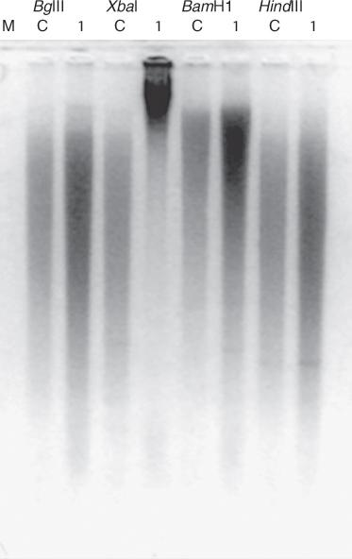
Southern Blot (continued)
Notes:
A Southern blot starts with digestion of genomic D N A with selected restriction enzymes. The cut D N A is separated by agarose gel electrophoresis. This will yield smears of millions of fragments.

Slide 13
D N A-Binding Media
Electrostatic and hydrophobic:
Nitrocellulose
Nylon
Reinforced nitrocellulose
Electrostatic:
Nylon, Nytran
Positively charged nylon
Notes:
The cut D N A from the gel is transferred or blotted to a membrane.

Slide 14
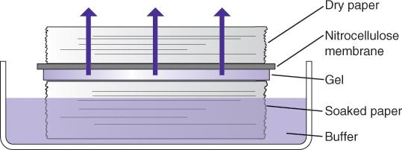
Blotting Transfer
Transfer of cut D N A from the gel to the membrane can be performed in three ways: capillary transfer, electrophoretic transfer and vacuum transfer.
Notes:
Southern first used capillary transfer, as shown, to move the D N A by capillary action from the gel to bind to the membrane.

Slide 15
Probes
Once the D N A is transferred to the membrane, the probe determines what region is seen
Probes can be D N A, R N A, or protein
Probes have covalently attached signal molecules
Radioactive (³²P, ³³P, ³⁵S)
nonradioactive (digoxygenin, biotin, fluorescent)
Notes:
Once on the membrane, the D N A is hybridized to a probe complementary to the region of interest. The probe is labeled with a radioactive or nonradioactive signal.

Slide 16
Probes (continued)
Probes are specific (complementary) to target gene
Notes:
Once on the membrane, the D N A is hybridized to a probe complementary to the region of interest. The probe is labeled with a radioactive or nonradioactive signal.

Slide 17
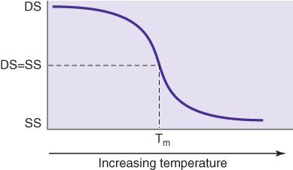
Hybridization Conditions
MELTING TEMPERATURE
(T_{m})
The temperature at which 50% of a
nucleic acid is hybridized to
its complementary strand
Notes:
Probe binding is done under specific conditions for that probe including the optimal temperature based on the melting temperature of the probe sequences.

Slide 18
Hybridization Conditions (continued_1)
T_{m} in solution
is a function of:
Length of D N A
G C content (%G C)
Salt concentration (M)
Formamide concentration
T_{m} = 81.5∫° + 16.6(log M) + 0.41 (%G C) – 0.61 (%formamide) – 500/length
(D N A:D N A)
Notes:
There are slightly different formulae for melting temperature of D N A:R N A and R N A:R N A strands.

Slide 19
Hybridization Conditions (continued_2)
T_{m}
For short (14 to 20 base pairs) oligomers:
T_{m} = 4° (G C) + 2J° (A T)
Notes:
G C content is the dominant factor in melting temperature for short sequences (such as PCR primers). In this case, a simpler formula can be used to estimate the melting temperature based on sequence alone.

Slide 20
Stringency
Stringency describes the conditions under which hybridization takes place
Formamide concentration increases stringency
Low salt increases stringency
Heat increases stringency
Notes:
Stringency can be adjusted by raising or lowering formamide and/or salt concentrations and/or by changing the hybridization temperature. If stringency is too low, the probe will bind at sequences other than the intended target.

Slide 21
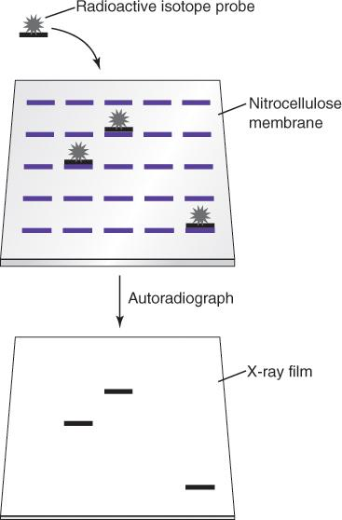
Radioactive Detection
Notes:
After hybridization, radioactive probes are detected by first rinsing off unbound probe and then exposing the membrane to autoradiography film. Probe bound to target will generate a signal on the autoradiogram.

Slide 22
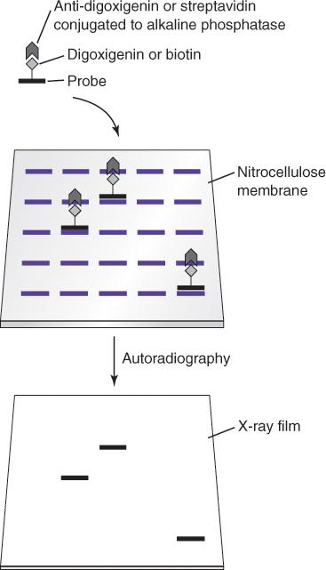
Nonradioactive Detection
Notes:
Nonradioactive probes can produce color or light signals. After hybridization, unbound probe is rinsed from the membrane, and then the membrane is immersed in a solution of conjugated anti-digoxygenin (or streptavidin for biotin). Unbound conjugate is rinsed off, followed by the development of signal by immersion of the membrane into substrate solution.

Slide 23
Detection of Bound Probe
Radioactive or chemiluminescent detection requires exposure of the blot to autoradiography film
Chromogenic detection occurs directly on the blot
Notes:
Color will develop directly on the membrane. To see the chemiluminescent signal, the membrane is exposed to an autoradiography film.

Slide 24
Northern Blot
No restriction digestion required
R N A is blotted to membranes
Probes are labeled antisense R N A or D N A
Internal/loading controls are required
Notes:
Northern blots are similar to Southern blots in methodology, except R N A is the primary target separated on the gel. Because R N A is single stranded, the probe has to be antisense (not identical) to the R N A sequence. When applied to gene expression or other quantification, an internal control, such as a constitutively expressed gene transcript, must be included in the run.

Slide 25
Western Blot
Serum, cell lysate, or protein extract is separated on S D S-polyacrylamide gels (S D S-P A G E) or isoelectric focusing gels (I E F)
Samples are treated with denaturant, such as mixing 1:1 with 0.04 M Tris-H C l, p H 6.8, 0.1% S D S
5% to 20% polyacrylamide gels
Notes:
Western blot uses proteins rather than nucleic acids. Proteins are separated by PAGE and blotted to membranes. Specific antibodies are the probes.

Slide 26
Western Blot (continued)
Proteins may be renatured before blotting to optimize antibody (probe)-epitope binding
Proteins are blotted to membranes by capillary or electrophoretic transfer
Probes are specific binding proteins, polyclonal antibodies, or monoclonal antibodies
Notes:
The primary antibody (one that binds to the target antigen on the blot) may or may not be labeled. For most tests, the primary antibody is not labeled, and a labeled secondary antibody to the primary antibody is used. The label is a visible color or fluorescent molecule.

Slide 27
Filter-Based Hybridization Technologies
 | Target | Probe
Southern blot | D N A | Nucleic acid
northern blot | R N A | Nucleic acid
western blot | Protein | Protein

Slide 28
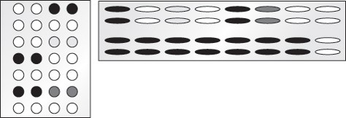
Blotting Formats
Dot blots
Amplification analysis
Expression analysis (R N A)
Mutation analysis
Reverse dot blots
Slot blots
Amplification analysis
Expression analysis

Slide 29
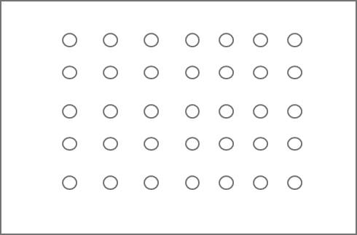
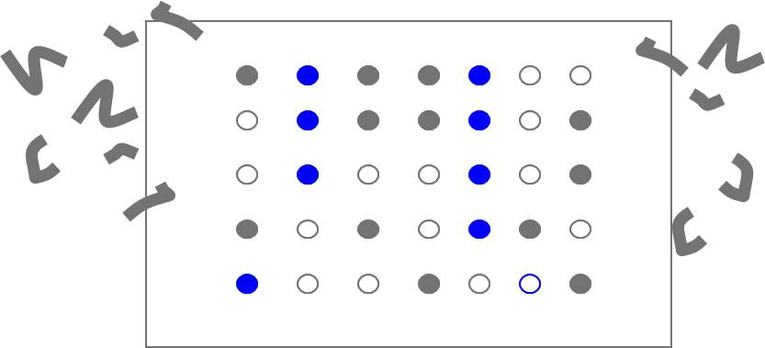
Reverse Dot Blot
Notes:
By spotting many probes onto one membrane instead of the sample (reverse dot blot), one sample can be examined for many different genes. The sample must be labeled to visualize which probes are bound on the membrane.

Slide 30
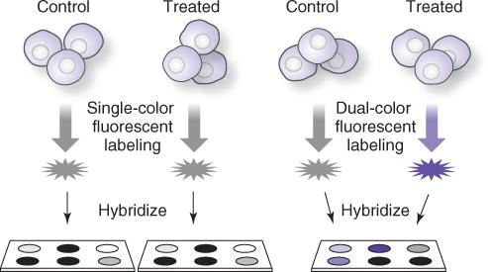
Comparative Genomic Hybridization (C G H)
C G H arrays are reverse dot blots.
Test and reference D N A are labeled by incorporation of nucleotides covalently attached to fluorescent dyes
Test and reference D N A are hybridized to the probes on a chip

Slide 31
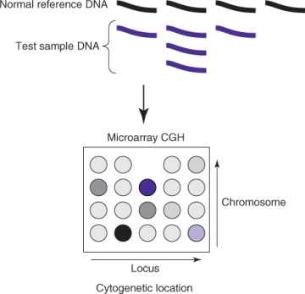
Comparative Genomic Hybridization (C G H) (continued_1)
The labeled D N A is hybridized to D N A fragments immobilized on a glass slide
Notes:
Dominant reference color at a probe location indicates deletion of sample at that gene. Dominant genetics color indicates amplification of the target. A neutral color occurs when there is normal expression or presence in the sample.

Slide 32
Comparative Genomic Hybridization (C G H) (continued_2)
Differences between normal and reference will be revealed:
Amplification—test color dominates
Deletion—reference color dominates
Notes:
Dominant reference color at a probe location indicates deletion of sample at that gene. Dominant genetics color indicates amplification of the target. A neutral color occurs when there is normal expression or presence in the sample.

Slide 33
Summary
Restriction enzymes cut D N A at specific recognition sequences
D N A can be characterized by restriction enzyme mapping
Specific D N A regions in a complex mixture are characterized using Southern blot
Specific proteins in a complex mixture are characterized using Western blot

Slide 34
Summary (continued)
Regions of genomic amplification or deletion are characterized using comparative genomic hybridization

