Slide 1
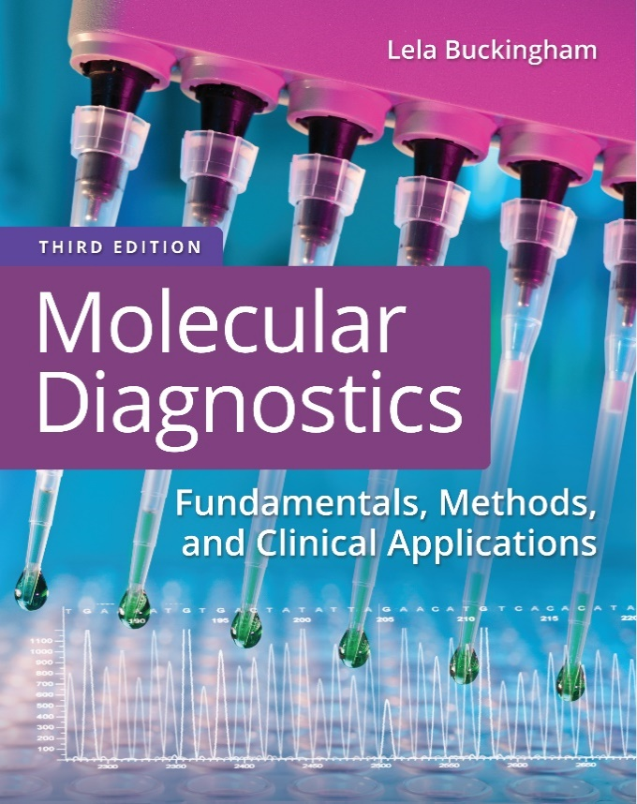
Chapter 6
Nucleic Acid Amplification

Slide 2
Objectives
Describe the principle of amplification by polymerase chain reaction (P C R).
Discuss how products are detected.
Describe examples of modifications that have been developed for P C R.
Differentiate between target amplification and signal amplification.

Slide 3
Objectives (continued)
Compare and contrast between the following in vitro assays for amplifying nucleic acids: P C R, branched D N A, ligase chain reaction, transcription-mediated amplification, and hybrid capture.

Slide 4
Polymerase Chain Reaction
Primer-directed in vitro enzymatic reaction for the production of a specific D N A fragment
Notes:
This is the definition of P C R.

Slide 5
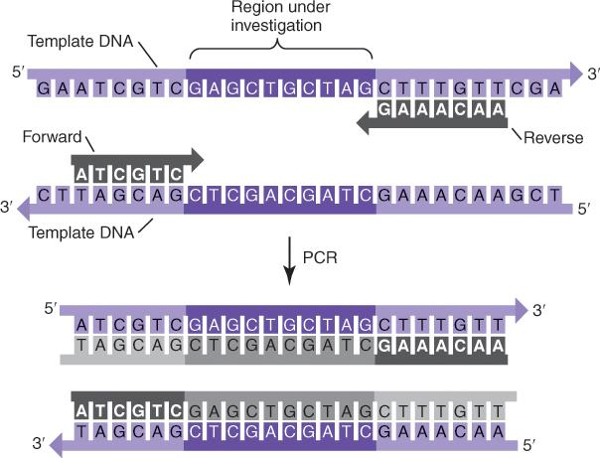
Polymerase Chain Reaction (continued)
Notes:
A diagram of the P C R process shows how primers (forward and reverse) hybridize to sequences flanking the sequence of interest (green). After extension of the primers many times by P C R, the product will be the sequence of interest flanked by the primer sequences.

Slide 6
P C R Primers
Primers are single-stranded 18- to 30-b D N A fragments complementary to sequences flanking the region to be amplified
Primers determine the specificity of the P C R reaction
The distance between the primer-binding sites will determine the size of the P C R product

Slide 7
Performing P C R
Assemble a reaction mix containing all components necessary for D N A synthesis
Subject the reaction mix to an amplification program
Analyze the product of the P C R reaction (the amplicon)

Slide 8
A Standard P C R Reaction Mix
0.25 micromolar each primer
0.2 millimolar each d A T P, d C T P, d G T P, d T TP
50 millimolars K C l
10 millimolars Tris, p H 8.4
1.5 millimolars M g C l₂
2.5 units polymerase
10 superscript 2 to 10 superscript 5 copies of template
50 microliters reaction volume
Notes:
The P C R reaction mix volume can range from 1 to 100 uL.

Slide 9
Amplification Reaction
Amplification takes place as the reaction mix is subjected to an amplification program
The amplification program consists of a series of 20 to 50 P C R cycles
Notes:
The assembled P C R reaction mix is subjected to an amplification program.

Slide 10
Three-Step P C R Cycle
Denaturation
90 degrees to 96 degrees Centigrade, 20 seconds
Annealing
40 degrees to 68 degrees Centigrade, 20 seconds
Extension
70 degrees to 75 degrees Centigrade, 30 seconds

Slide 11
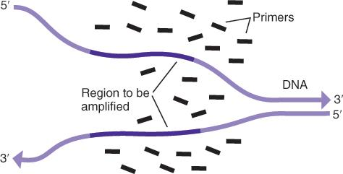
Denaturation
Notes:
The first step of the first cycle of a P C R amplification program is denaturation at high temperature. The template is genomic D N A, with the green area being the region of interest. Primers are depicted in red.

Slide 12
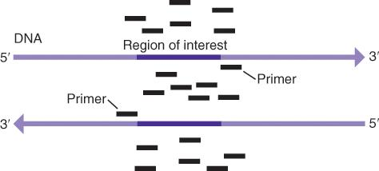
Annealing
Notes:
The second step of the first cycle is annealing, where the primers bind to their targets, flanking the region of interest.

Slide 13
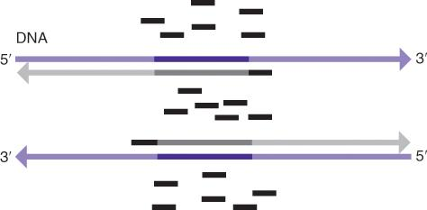
Extension
Notes:
The third step of the first cycle is extension, where D N A polymerase extends the primers, copying the region of interest.

Slide 14
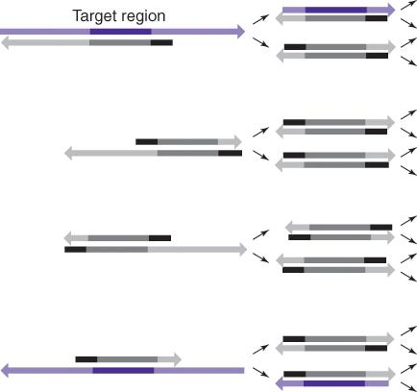
Extension (continued)
Notes:
Denaturation, annealing, and extension in cycle 2 will produce four copies of the target region. After cycle 3, there will be eight copies.

Slide 15
Amplicon
P C R product = amplicon
The number of amplicons = 2^{N}, where N = the number of cycles
Notes:
At the end of 30 cycles, there will be 2³⁰ copies of the target region.

Slide 16
Automation of P C R
P C R requires repeated temperature changes
The thermal cycler changes temperatures in a block or chamber holding the samples
Thermostable polymerases are used to withstand the repeated high denaturation temperatures

Slide 17
Thermostable Polymerases
Taq—Thermus aquaticus (most commonly used)
Sequenase—T. aquaticus Y T-1
Restorase (Taq + repair enzyme)
Tfl—T. flavus
Tth—T. thermophilus H B-8
Tli—Thermococcus litoralis
Carboysothermus hydrenoformans (R T-P C R)
P. kodakaraensis (Thermococcus)
Rapid synthesis
Notes:
Thermally stable enzymes that aren’t deactivated at high temperatures facilitate automation of the P C R process. Enzymes have different properties depending on the application.

Slide 18
Thermostable Polymerases (continued)
P f u—Pyrococcus furiosus (fidelity)
Fused to D N A binding protein for processivity
Notes:
Thermally stable enzymes that aren’t deactivated at high temperatures facilitate automation of the P C R process. Enzymes have different properties depending on the application.

Slide 19
Interpretation of the P C R Results
The P C R product should be of the expected size
No product should be present in the reagent blank
Mis-primes may occur due to nonspecific hybridization of primers
Primer dimers may occur due to hybridization of primers to each other

Slide 20
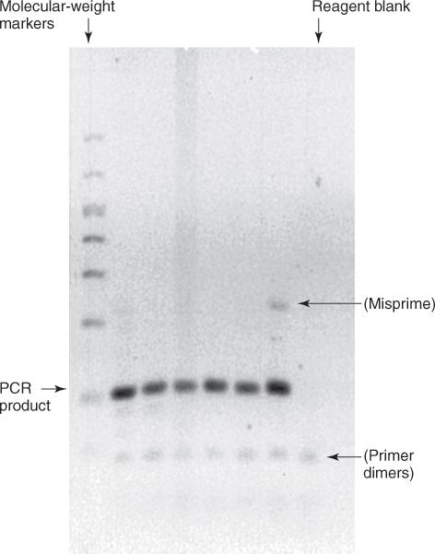
Detection of P C R Product
Notes:
After separation by gel electrophoresis, look for the amplicon (P C R product), which should be of predicted size. No product should be present in the reagent blank lane. Mis-primed and primer dimers are unwanted artifacts.

Slide 21
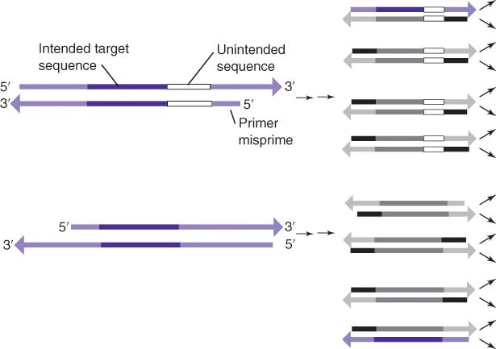
P C R Mis-Primes Produce Unintended Products
Notes:
If one (or more) primer binds to a nonspecific sequence, products are formed that may be larger or smaller than the intended product.

Slide 22
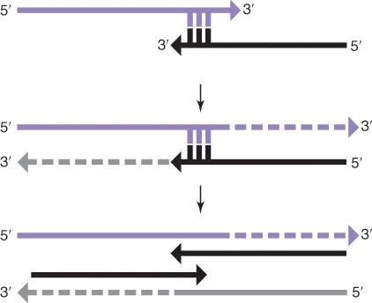
Primer Dimers
Primer dimers can be avoided with proper primer design
Notes:
Primer dimers form from hybridization of primers at their 3’ ends.

Slide 23
Avoiding Mis-Primes and Primer Dimers
Use proper annealing temperature
Design primers carefully
Adjust monovalent cation concentration
Use hot-start method: prepare reaction mixes on ice, place in preheated cycler, or use a sequestered enzyme that requires an initial heat activation

Slide 24
Primer Design
Avoid interstrand homologies
Avoid instrastrand homologies
T subscript m of forward primer = T subscript m of reverse primer
G/C content of 20% to 80%; avoid longer than G G G G
Product size (100 to 700 base pairs)
Target specificity
Notes:
Primers are now designed by software programs that find appropriate primers satisfying the design requirements for input target sequences.

Slide 25
Product Cleaning
Gel elution
Removes all reaction components as well as mis-primes and primer dimers
Solid-phase isolation of P C R product (example, spin columns)
D N A precipitation
Notes:
There are a variety of ways to clean P C R products or remove unwanted reaction components and products. The cleaning approach (or decision to clean at all) will depend on downstream applications.

Slide 26
Contamination Control
Any molecule of D N A containing the intended target sequence is a potential source of contamination
The most dangerous contaminant is P C R product from a previous reaction
Laboratories are designed to prevent exposure of pre-P C R reagents and materials to post-P C R contaminants
Notes:
Contamination control is important for laboratories performing P C R.

Slide 27
Contamination Control (continued)
Physical separation
Air-locks, positive airflow
P C R hoods with U V
d U T P + uracil-N-glycosylase (added to the P C R reaction)
U V (depends on U V wavelength and distance to surface)
10% bleach (most effective for surface decontamination)

Slide 28
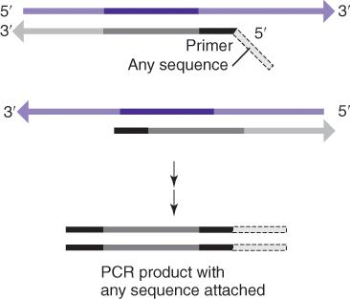
P C R Modifications: Tailed Primers
Notes:
The 3’ end of the P C R primer has to be complementary to the template or else D N A polymerase will not extend it. The 5’ end, however, does not have to be complementary, so unrelated sequences such as promoters, restriction enzyme recognition sites, and fluorescent labels can be attached. These sequences or molecules remain part of the P C R product.

Slide 29
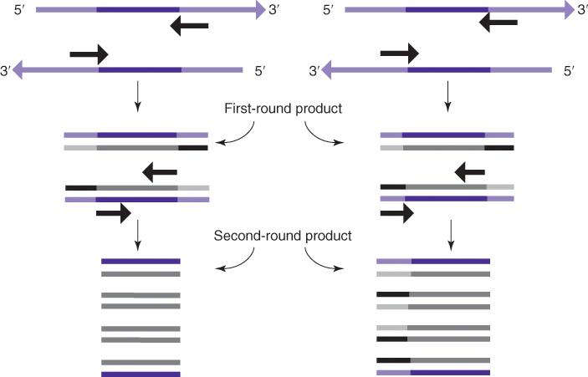
P C R Modifications: Nested P C R
Notes:
There are a growing number of modifications of P C R, some developed specifically for individual applications, including nested P C R. Two rounds of amplification are done to detect rare products or to increase the yield of P C R products. After the first round of P C R, the P C R product is used as a template for a second round with the binding sites from both primers (nested) or one primer (semi-nested) moved inward from the first-round primer-binding sites.

Slide 30
Automated P C R and Detection
P C R with colorimetric detection of product
-Samples are amplified and products detected automatically after the P C R reaction
-Used for infectious disease applications (H I V, H C V, H B V, C M V, Chlamydia, Neisseria, tuberculosis)
Real-time or quantitative P C R (q P C R)
  -Samples are detected by fluorescence during the P C R reaction
Notes:
P C R reactions are increasingly automated. Colorimetric methods are used in some infectious disease and oncology applications, as is quantitative P C R.

Slide 31
Quantitative P C R (q P C R)
Standard P C R with an added probe or dye to generate a fluorescent signal from the product
Detection of signal in real time allows quantification of starting material
Performed in specialized thermal cyclers with fluorescent detection systems
Notes:
Quantitative P C R is also called real-time P C R R T-P C R. The R T-P C R term may be confused with reverse transcriptase P C R so q P C R is the preferred term. Reverse transcriptase quantitative P C R is R T-q P C R.

Slide 32
Quantitative P C R (q P C R) (continued_1)
P C R product grows in an exponential fashion (doubling at each cycle)
P C R signal is observed as an exponential curve with a lag phase, a log phase, a linear phase, and a stationary phase
The length of the lag phase is inversely proportional to the amount of starting material

Slide 33
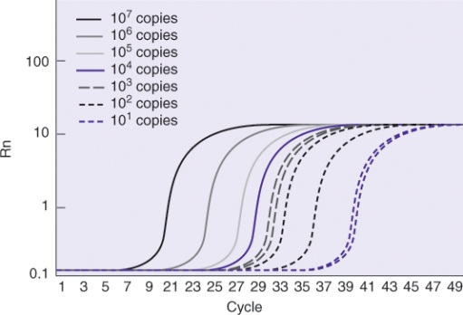
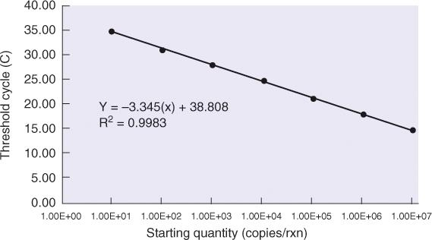
Quantitative P C R (q P C R) (continued_2)
A threshold level of fluorescence is determined based on signal and background
Input is inversely proportional to “threshold” cycle (cycle at which fluorescence crosses the threshold fluorescence level)

Slide 34
q P C R Detection Systems
D N A-specific dyes
Ethidium bromide
S Y B R green
Hybridization probes
Cleavage-based (TaqMan)
Displaceable (molecular beacons, F R E T)
Primer-incorporated probes
Notes:
There are three approaches to real time product detection.

Slide 35
q P C R Detection Systems (continued)
D N A-specific dyes bind and fluoresce double-stranded D N A nonspecifically
Hybridization probes only bind and fluoresce the intended P C R product
Primer-incorporated probes label the P C R product
Notes:
There are advantages and disadvantages to each approach. Unlike hybridization probes, D N A-specific dyes are not sequence specific.

Slide 36
q P C R Detection Instruments
Thermal cyclers with fluorescent detection and specialized software
P C R reaction takes place in optically clear plates, tubes or capillaries
Notes:
As new models are developed, standard P C R tubes are increasingly used.

Slide 37
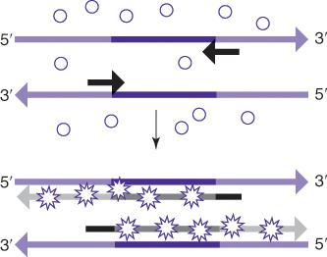
q P C R: S Y B R Green
Binds minor groove of double-stranded D N A
Product can be further tested in a post- amplification melt curve where sequences have characteristic melting temperatures
Notes:
An advantage of D N A-specific dyes is the ability to perform a melt curve after the P C R reaction is complete. The melt curve T_{m} can confirm the product identification and detect any mis-primes or primer dimers.

Slide 38
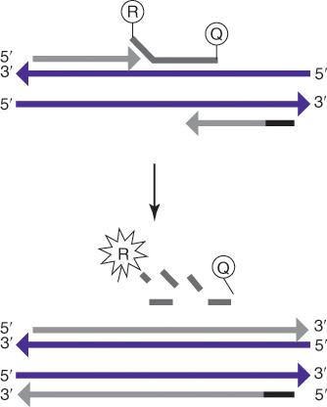
q P C R: TaqMan
Notes:
TaqMan probes hybridize to the target between the primer-binding sites and are digested when the primers are extended. This releases a reporter dye (R) from a quencher (Q). The amount of signal depends on the number of targets amplified.

Slide 39
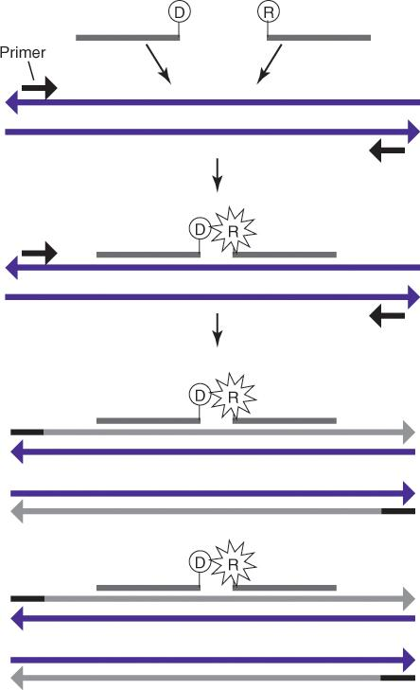
q P C R: Fluorescence Resonance Energy Transfer (F R E T) Probes
R = reporter dye
D = donor
Notes:
F R E T probes are not digested during replication. They bind adjacent to one another on the target, allowing the donor to transfer energy to the reporter dye. The amount of signal depends on the amount of target present.

Slide 40
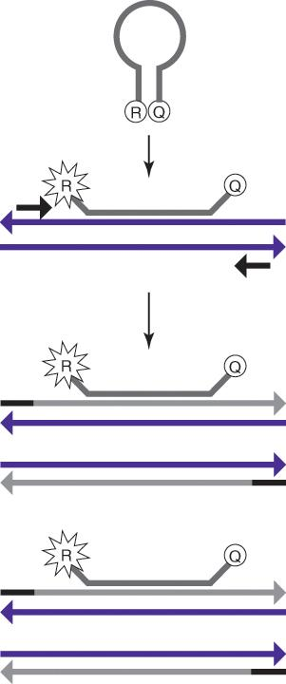
q P C R: Molecular Beacons
Notes:
Molecular beacons also bind target to produce signal. The reporter (R) and quencher (Q) are on opposite ends of the probe and held together by about 5 bp of homology when not bound to the target. In the presence of target sequences, the probe binding overcomes the short-end homology, releasing the reporter from the quencher.

Slide 41
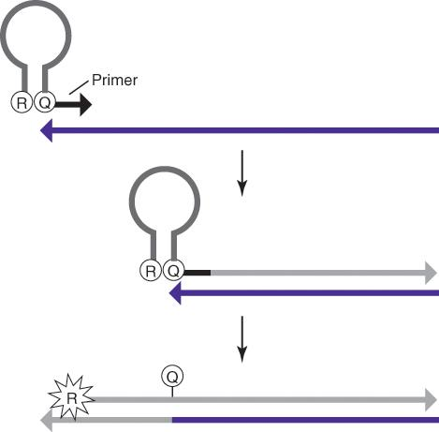
q P C R: Scorpionc Probes
Notes:
Scorpions include a molecule similar to the molecular beacon covalently attached to one primer. Amplification will open the structure and allow for signal. The Scorpion primer-binding site (Z) is added to any target using a 5’ tailed primer in an initial P C R reaction. An advantage of Scorpions is that the fluorescent signal is covalently attached to the P C R product, allowing subsequent analysis, for instance, by capillary electrophoresis.

Slide 42
P C R Advantages
Specific
Simple, rapid, relatively inexpensive
Amplifies from low quantities
Works on damaged D N A
Sensitive
Flexible

Slide 43
P C R Limitations
Contamination risk
Primer complexities
Primer binding-site complexities
Amplifies rare species
Detection methods
Notes:
It is important that P C R primers are specific to the desired target and that the binding sites on the target are unique and accessible. The high sensitivity of P C R may produce technically accurate but clinically false-positive results. In infectious disease applications, the detection of dead organisms may mimic a continuing infection. Overall, the performance of the P C R reaction is only as good as the detection systems used.

Slide 44
Examples of Amplification Methods
Ligase chain reaction (L C R)
Branched D N A (b D N A)
Hybrid capture (H C)
Transcription-mediated amplification, nucleic acid sequence–based amplification (T M A, N A S B A)
L A M P
Notes:
Other amplification methods include product, probe, and signal amplification. (P C R is a product amplification method.)

Slide 45
Ligase Chain Reaction
Isothermal
Probe amplification
Probes bind immediately adjacent to one another on template
The bound probes are ligated and become templates for the binding of more probes
C. trachomatis, N. gonorrhoea, sickle cell mutation
Notes:
Because no thermal cycling is required, LCR is more easily automated.

Slide 46
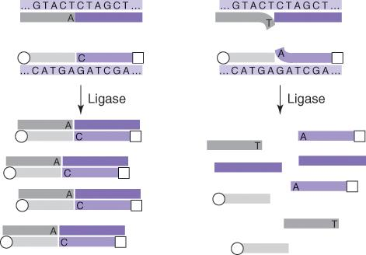
Ligase Chain Reaction (continued)
Notes:
LCR uses probe fragments that are ligated together when bound to target. Ligated products are captured and detected. The product is not amplified. The number of probes ligated depends on the amount of target present.

Slide 47
Branched D N A
Isothermal
Signal amplification
A series of hybridizations attaches multiple signals to each target molecule
H B V, H C V, H I V-1

Slide 48
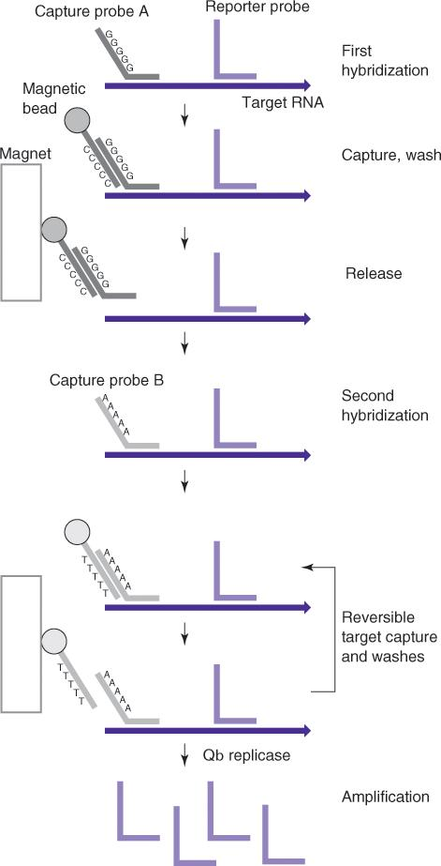
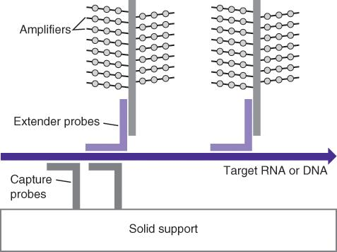
Branched D N A (continued)
Notes:
bD N A relies on a series of hybridizations to capture target and produce multiple signals from a single target. Neither the target nor the probes are amplified. The signal is amplified in proportion to the amount of target present.

Slide 49
Hybrid Capture
Isothermal
Signal amplification
Immobilized D N A probes bind to R N A targets
The R N A:D N A hybrids are bound by labeled monoclonal antibodies
H P V, H B V, C M V

Slide 50
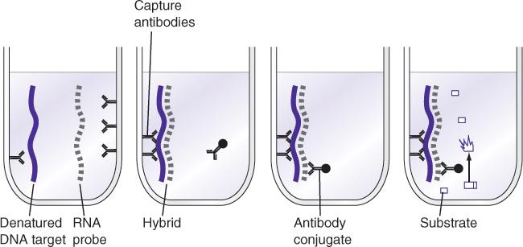
Hybrid Capture (continued)
Notes:
In hybrid capture, antibodies to R N A/D N A hybrids amplify signal from each R N A target. An R N A probe can be used to detect a D N A target.

Slide 51
Transcription-Mediated Amplification
Isothermal
Target amplification as R N A
c D N A is made from R N A target by adding R N A polymerase promoter
R N A is synthesized from the c D N A template and can serve as a source of new c D N A
M. tuberculosis, C. trachomatis, H I V, C M V

Slide 52
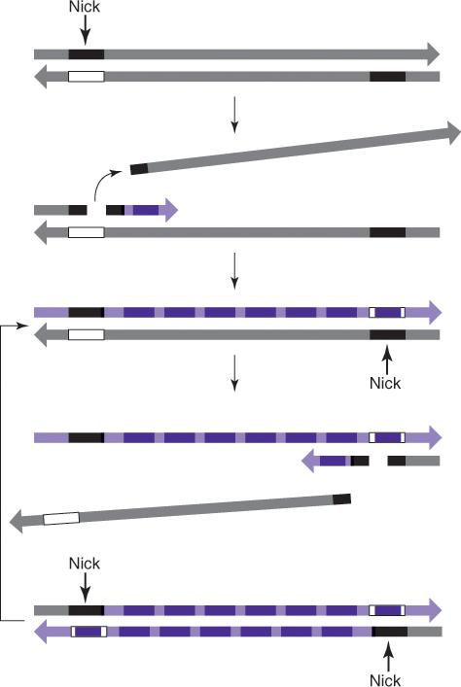
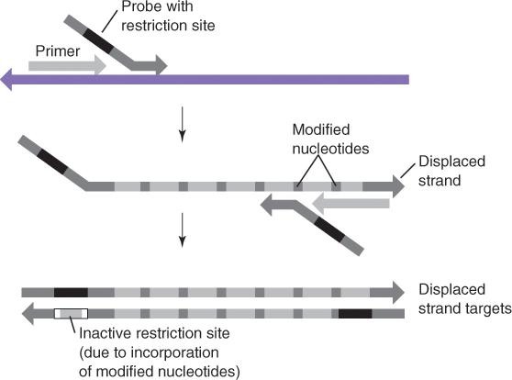
Transcription-Mediated Amplification (continued)
Notes:
T M A starts with R N A, which is converted to c D N A. The c D N A is then transcribed many times. The resulting R N A can be detected with fluorescent probes and can also be used to make more c D N A.

Slide 53
Summary
P C R is a method to specifically amplify target sequences in a complex mixture
The primers determine what sequences are amplified (specificity)
Contamination control is important in laboratories performing P C R
Quantitative P C R (q P C R) offers the advantage of quantifying target

Slide 54
Summary (continued)
In addition to P C R, signal and probe amplification methods are used in the clinical laboratory

