Slide 1

Chapter 7
Chromosomal Structure and Chromosomal Mutations

Slide 2
Objectives
Define mutations and polymorphisms.
Distinguish the three types of D N A mutations: genome, chromosomal, and gene.
Diagram a human chromosome, and label the centromere, q arm, p arm, and telomere.
Illustrate the different types of structural mutations that occur in chromosomes.

Slide 3
Objectives (continued)
Show how karyotypes reveal chromosomal abnormalities.
Describe interphase and metaphase F I S H analyses.

Slide 4
Mutations and Polymorphisms
Mutation—a permanent, transmissible change in the genetic material, usually in a single gene
Polymorphism—two or more genetically determined, proportionally represented phenotypes in the same population
Notes:
Mutations and polymorphisms are both changes in D N A sequence from a reference sequence. They differ by frequency in a given population, with mutations being more rare.

Slide 5
Types of Mutations
Genomic—abnormal chromosome number (monosomy, polysomy, aneuploidy)
Chromosomal—abnormal chromosome structure
Gene—D N A sequence changes in specific genes
Notes:
Mutations can involve a single base or millions of bases, including whole chromosomes.

Slide 6
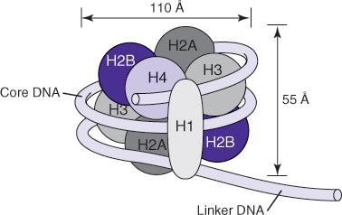
Chromosome Morphology
Telomere—chromosome end
Centromere—site of spindle attachment
Constriction of the metaphase chromosome at the centromere defines two arms
Nucleosome—D N A double helix wrapped around eight histone proteins
Notes:
The nucleosome includes two copies each of histone 2A (H2A), histone 2B (H2B), histone 3 (H3), and histone 4 (H4), wrapped in double-helix core D N A. Linker D N A is double-helix D N A between the nucleosomes. Nucleosomes and D N A are gathered into a tighter structure by interaction with histone H1.

Slide 7
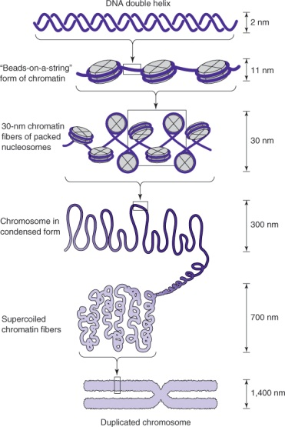
Chromosome Morphology (continued_1)
Chromosome morphology changes during the cell division cycle
Notes:
In interphase cells (G1, S, G2 phases), chromatin, which is D N A and its associated proteins, exists in 11-nm and 30-nm fibers. As cells enter mitosis (M phase), chromatin compacts into the visible chromosomes. Chromosomes visualized in the laboratory are in metaphase and anaphase of mitosis.

Slide 8
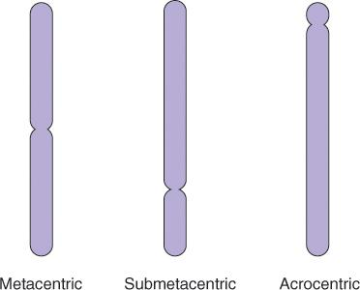
Chromosome Morphology (continued_2)
Notes:
All human chromosomes are submetacentric, with one long arm (q) and one short arm (p) divided by the centromere.

Slide 9
Visualizing Metaphase Chromosomes
Patient cells are incubated and divide in tissue culture
Phytohemagglutinin (P H A)—stimulates cell division
Colcemid—arrests cells in metaphase
3:1 methanol:acetic acid—fixes metaphase chromosomes for staining

Slide 10
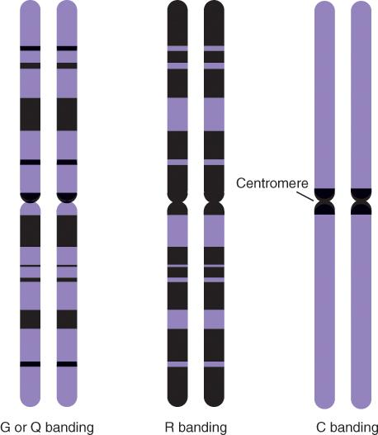
Visualizing Metaphase Chromosomes: Banding
Notes:
Treatment of chromosomes with acid before staining results in reverse staining or R banding. Centromere staining (C banding) aids in analysis of polysomy or monosomy of specific chromosomes.

Slide 11
Karyotype
International System for Human Cytogenetic Nomenclature (I S C N)
46,XX—normal female
46,XY—normal male
G-banded chromosomes are identified by band pattern
Notes:
A karyotype is a set of chromosomes in a cell. The ISCN recommends nomenclature for describing chromosome number as well as naming chromosome locations.

Slide 12
Nomenclature
Number of chromosomes present
Sex chromosome composition
Normal karyotype: 46,XX or 46,XY
Descriptive characters of abnormalities
+ gain of a whole chromosome—47,XY,+21
– loss of a whole chromosome—45,XY,–7
Notes:
There are 46 chromosomes in a normal cell, 22 pairs of autosomes and 1 pair of sex chromosomes. Abnormalities in karyotypes are described by the recommended nomenclature.

Slide 13
Nomenclature (continued)
del deletion — 46,XY,del(7)(q22)
dup duplication — 46,XY,dup(17)(p12p12)
t(n;n) translocations—46,XX,t(2;8)(q21;p13) or t(2;8)
Notes:
There are 46 chromosomes in a normal cell, 22 pairs of autosomes and 1 pair of sex chromosomes. Abnormalities in karyotypes are described by the recommended nomenclature.

Slide 14
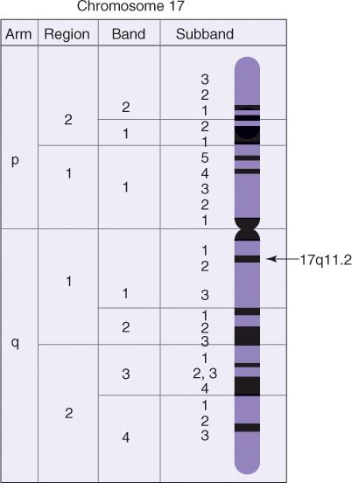
Defining Chromosomal Location
Notes:
The reproducible G bands are used to define chromosomal locations. Chromosome locations are described by the chromosome (17 in the example shown), arm (q), region (1), band (1), and a separator (.), followed by the subband (2).

Slide 15
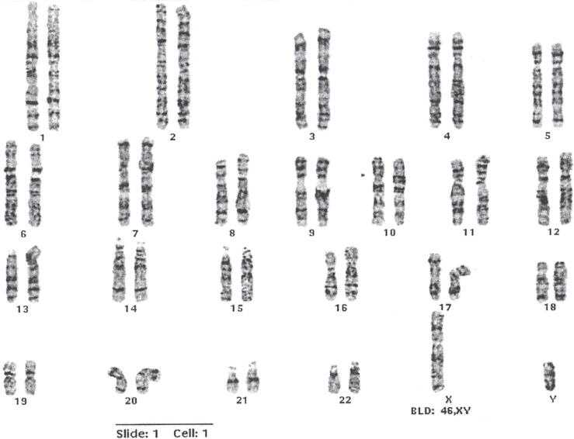
Normal Male Karyotype (46,XY)
(G Banding)
Notes:
A normal karyotype is an image of the 23 pairs of chromosomes in metaphase. Differences in chromosome number and large structural changes are detected by karyotyping.

Slide 16
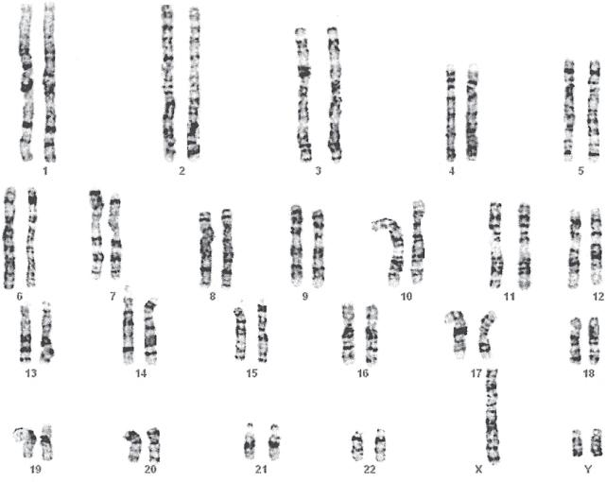
Chromosome Number Abnormality
Aneuploidy (47,XYY)
Notes:
What is the abnormality? This is XYY. (47,XYY)

Slide 17
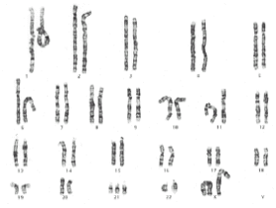
Chromosome Number Abnormality
Trisomy 21 (47,XX,+21)
Notes:
What is the abnormality? This is trisomy 21 (Down syndrome, 47,XX+21). Folded or bent chromosomes do not indicate abnormalities. Chromosomes are arranged as they have emerged from the lysed nuclei.

Slide 18
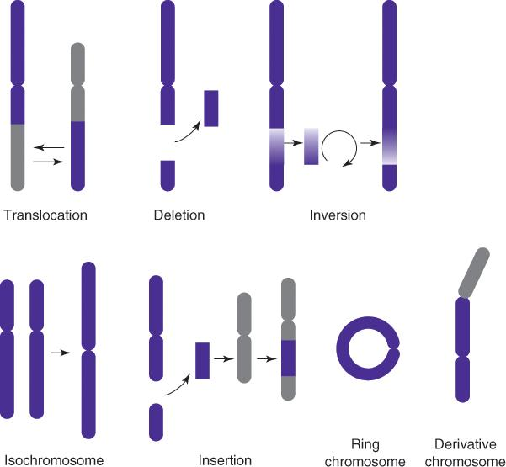
Chromosome Structure Abnormalities
Notes:
Abnormal chromosome number and large structural changes in chromosomes are detectable in the karyotype. Other mutations require more targeted methods, such as fluorescence in situ hybridization (F I S H).

Slide 19
Fluorescence in Situ Hybridization (F I S H)
Hybridization of complementary gene- or region-specific fluorescent probes to chromosomes
Notes:
F I S H is a relatively rapid method to analyze chromosome number and structure in interphase nuclei. The advantage of not having to culture cells is a more rapid turnaround time. Fluorescent probes complementary to the target regions are hybridized in situ on the slide.

Slide 20
Fluorescence in Situ Hybridization
(F I S H) (continued)
Interphase F I S H
Metaphase F I S H
Chromosome painting
Spectral karyotyping
Notes:
Metaphase F I S H allows analysis of larger areas and shows the chromosome location of abnormalities. Interphase F I S H is a more rapid method because cells do not have to be cultured. Chromosome painting and spectral karyotyping provide more comprehensive information for complex rearrangements.

Slide 21
Uses of F I S H
Identification and characterization of numerical and structural chromosome abnormalities
Detection of microscopically invisible deletions
Detection of sub-telomeric aberrations
Prenatal diagnosis of the common aneuploidies (interphase F I S H)

Slide 22
F I S H Probes
Chromosome-specific centromere probes (C E P)
  Hybridize to centromere region
  Detect aneuploidy in interphase and metaphase
Chromosome-painting probes (W C P)
  Hybridize to whole chromosomes or regions
  Characterize chromosomal structural and changes in metaphase cells

Slide 23
F I S H Probes (continued_1)
Unique D N A sequence probes (L S I)
  Hybridize to unique D N A sequences
  Detect gene rearrangements, deletions, and amplifications

Slide 24
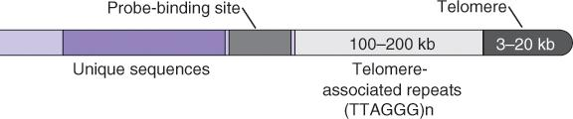
F I S H Probes (continued_2)
Telomere-specific probes (T E L s)
  Hybridize to sub-telomeric regions
  Detect sub-telomeric deletions and rearrangements

Slide 25
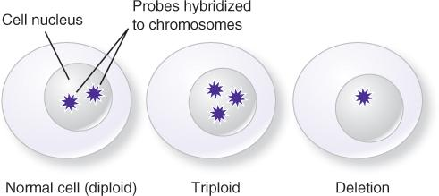
Genetic Abnormalities by Interphase F I S H
L S I Probe
Greater or less than two signals per nucleus is considered abnormal
Normal diploid signal
Trisomy or insertion
Monosomy or deletion

Slide 26
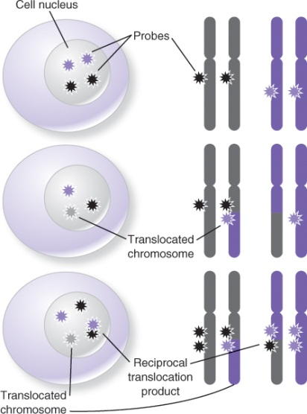
Structural Abnormality by Interphase F I S H
L S I probe (fusion probe)
Notes:
Fusion probes are used to detect translocations, deletions, insertions, or other structural abnormalities that bring together areas that are normally not continuous.

Slide 27
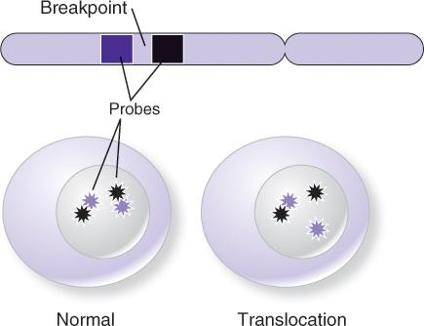
Structural Abnormality by Interphase F I S H
(continued)
L S I probe (break-apart probe)
Notes:
Fusion probes are used to detect translocations, deletions, insertions, or other structural abnormalities that bring together areas that are normally not continuous.

Slide 28
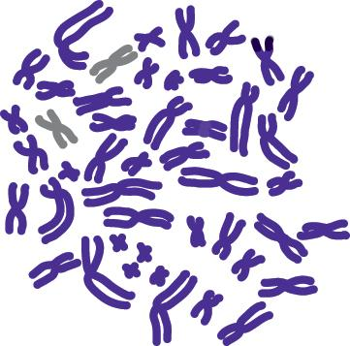
Translocation by Metaphase F I S H
W C P Probe (Whole-Chromosome Painting)
Notes:
Whole-chromosome painting allows detection of cryptic chromosomal changes not obvious from karyotyping. In this illustration, a small piece of chromosome 7 has attached to another chromosome.

Slide 29
Summary
Disease can arise from changes in chromosome number and/or structure
Chromosomes are analyzed by Giemsa staining and karyotyping
Karyotyping detects changes in chromosome number and large structural changes
  Structural changes include translocation, duplication, and deletion of chromosomal regions
More subtle chromosomal changes can be detected by metaphase or interphase F I S H

