Slide 1
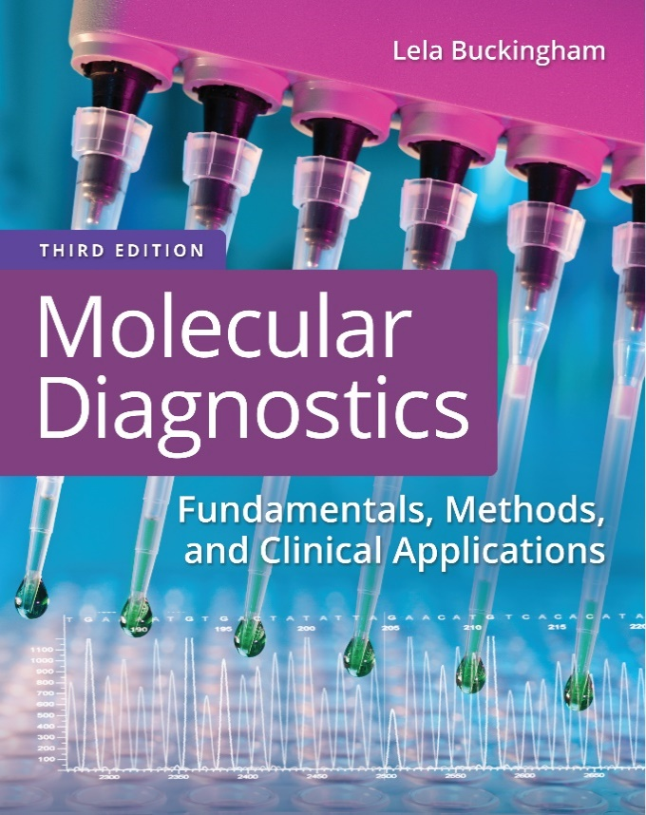
Chapter 8
Gene Mutations

Slide 2
Objectives
Show how immunoassays are used for detecting gene mutations and altered proteins.
List and compare particle separation by high-performance liquid chromatography (H P L C), chromatography, and spectrometry.
Describe hybridization analyses, cleavage methods, and D N A synthesis methods used to detect D N A mutations.

Slide 3
Objectives (continued)
Describe gene mutation nomenclature for expressing sequence changes at the D N A, R N A, and protein levels.
Compare phenotypic consequences of point mutations.

Slide 4
Biochemical Methods
Immunoassays
High-performance liquid chromatography (H P L C)
Mass spectrometry
Notes:
Biochemical methods can detect changes in D N A or R N A sequence as well as changes in protein sequence.

Slide 5
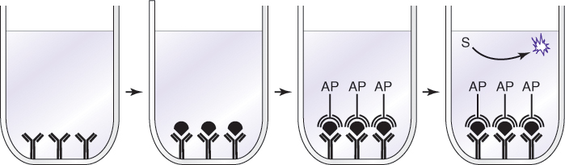
Biochemical Methods (continued_1)
Immunoassays are performed with defined antibodies that detect mutant or wild-type proteins.
Immunohistochemistry is a cytology method to identify normal and mutant proteins in tissue sections
Notes:
Antibodies used for these assays are usually monoclonal, that is, produced from selected and cloned cell lines that produce only that antibody.

Slide 6
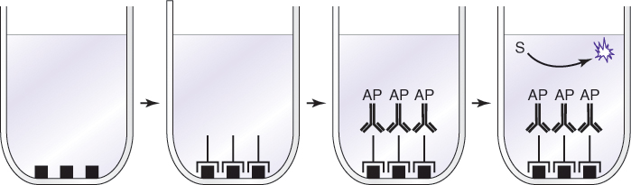
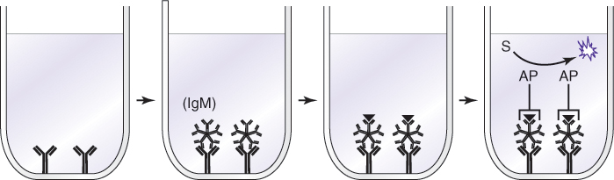
Biochemical Methods (continued_2)
Antigen can be immobilized to detect the presence of antibodies.
Notes:
For antibody detection, antigen is immobilized and bound to specific antibody, if present, which is detected with AP-conjugated secondary antibody (A). Antigen may also be detected with immobilized antibodies to IgM or IgG, which will capture antigen for detection with enzyme conjugate (B).

Slide 7
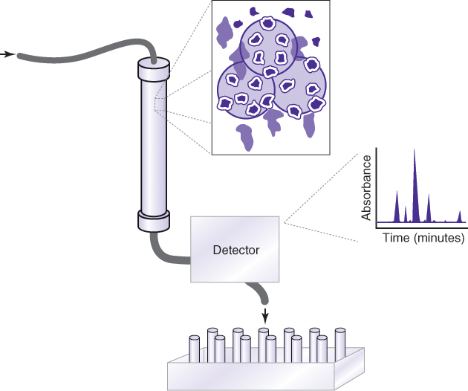
Biochemical Methods (continued_3)
High-performance liquid chromatography (H P L C) uses solid and liquid phases to separate particles by size, charge, or chemical characteristics
Notes:
Particles are separated according to their size by sieving through defined solid and liquid phases. A solid phase may have pores in which small particles collect and separate from large particles that move more quickly around the matrix. Matrices and solvents may exploit charge or hydrophobicity to separate specific molecules. H P L C is the basis for separation/analysis instruments such as amino acid analyzers. It may also be used as a preparatory step for further analysis by mass spectrometry.

Slide 8
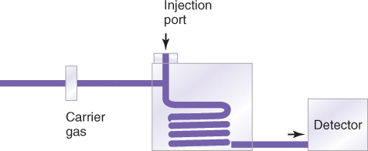
Biochemical Methods (continued_4)
In gas chromatography (G C), samples are vaporized and separated in a gas phase
Notes:
Gas chromatography produces a chromatogram that is specific to each molecule or mixture. G C is used for the detection of drugs and poisons and their metabolites in biological samples.

Slide 9
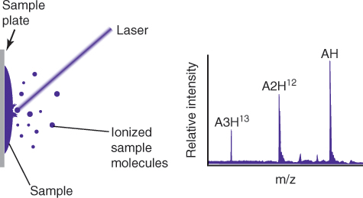
Biochemical Methods (continued_5)
Matrix-assisted laser desorption/ionization (M A L D I) mass spectrometry is used in molecular separations
Notes:
M A L D I time of flight (M A L D I-TOF) separates and identifies peptides and nucleic acids by size and charge. Spectra or peak patterns of particles detected over time are characteristic of the source proteins.

Slide 10
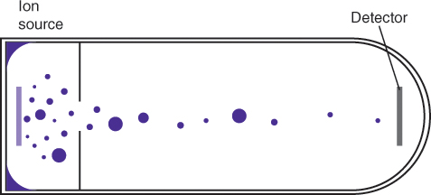
Biochemical Methods (continued_6)
D N A variants can be detected by M A L D I assessment of primer extension
Notes:
Each nucleotide, A, C, G, or T, has its own mass and charge and will alter the primer mass when added according to the template sequence. ddNTPs are used so that only one nucleotide can be added.

Slide 11
Nucleic Acid–Based Detection Methods
Hybridization based
  Single-strand conformational polymorphism (S S C P), melt curves, array technology
Sequencing (polymerization) based
  Sequence-specific polymerase chain reaction (P C R), allelic discrimination
Cleavage based
  Restriction fragment length polymorphism (R F L P), nuclease cleavage

Slide 12
Nucleic Acid–Based Detection Methods (continued_1)
Hybridization based

Slide 13
Single-Strand Conformation Polymorphism (S S C P)
Scans several hundred base pairs
Based on intrastrand folding
  strands will fold based on sequence
  One base difference will affect folding
Folded single strands (conformers) can be resolved by size and shape
Strict temperature requirements
Notes:
S S C P is an example of a hybridization-based method to detect mutations. In this case, D N A sequence is assessed by intrastrand hybridization.

Slide 14
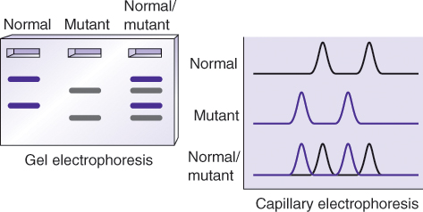
Single Strand Conformation Polymorphism (S S C P) (continued)
Notes:
Gel- or capillary-based S S C P results indicate the presence of a mutation but do not identify the specific nucleotide change.

Slide 15
Melt-Curve Analysis
Based on sequence effect on T_{m}
Can be performed with or without probes
Requires dyes specific to double-stranded D N A
  Ethidium bromide
  S Y B R green
Also performed with fluorescent resonance energy transfer (F R E T) probes

Slide 16
Melt-Curve Analysis (continued_1)
Dye specific to double-stranded D N A (S Y B R green) or F R E T probes will fluoresce when bound to D N A
Denaturation of D N A to single strands will result in loss of fluorescence

Slide 17
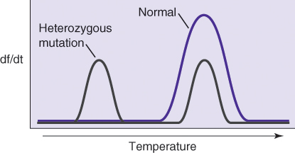
Melt-Curve Analysis (continued_2)
Detection instrument software may convert the melt curve to a derivative of fluorescence (speed of drop versus temperature)
Notes:
The speed of drop of fluorescence (dF) will be maximal at the T_{m.}

Slide 18
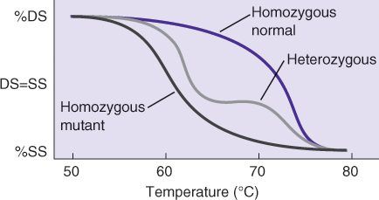
Melt-Curve Analysis (continued_3)
Every sequence has a characteristic T_{m}
Melt-curve T_{m} indicates which sequence is present

Slide 19
Array Technology
Arrays are reverse-dot-blot methods
They are used to investigate multiple genomic sites simultaneously
Unlabeled probes are bound to substrate
Specimen D N A is labeled and hybridized to immobilized probes
Notes:
In arrays, the sample is applied to multiple probes, allowing a more thorough investigation with multiple gene targets in contrast to a single gene target.

Slide 20
Microarray Technologies
Method | Array | Application
Comparative genomic hybridization (C G H) | Microarray, macroarray | Detection of genomic amplifications and deletions
Expression array | Microarray, macroarray | Detection of relative changes in gene expression
Single nucleotide polymorphism (S N P) detection, mutation analysis | Bead array | Detection of single-base differences in D N A

Slide 21
Nucleic Acid–Based Detection Methods (continued_2)
Sequencing (polymerization)-based methods

Slide 22
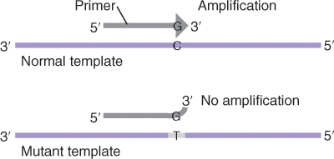
Sequence-Specific Primer P C R (S S P-P C R)
P C R primer extension requires that the 3' base of the primer is complementary to the template
Notes:
The 3’ end of the primer has to be complementary to the template. If not, D N A polymerase will not recognize it as a substrate, and the primer will not be extended.

Slide 23
S S P-P C R
Primer design is used to detect mutations in D N A
Generation of P C R product indicates the presence of a mutation or polymorphism in the template
Notes:
The primer can also be designed with the 3’ base complementary to the normal sequence.

Slide 24
Allelic Discrimination
Uses fluorescently labeled probes
Quantitative P C R (q P C R) technology
Generates “color” signal for mutant or normal sequence
Performed on real-time P C R instruments

Slide 25
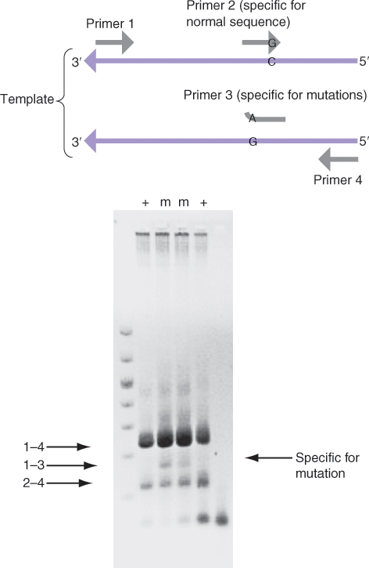
Allelic Discrimination (continued)
Notes:
Standard P C R will reveal a product from primers ending with a complementary base to the mutant base pair if the mutation is present. For qP C R, the Taq exonuclease functions only if the probe is matched to the sequence being tested. Probes, complementary to either the normal sequence (left) or the mutant sequence (right), are labeled with different fluors, for example, FAM and VIC, respectively. High FAM indicates a normal sequence, and high VIC indicates a mutant sequence. If both fluors are detected, the test sample is heterozygous.

Slide 26
Nucleic Acid–Based Detection Methods (continued_3)
Cleavage-based methods

Slide 27
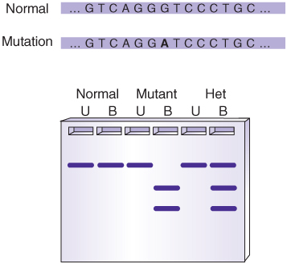
Restriction Fragment Length Polymorphism (RFLP)
Restriction enzyme site recognition detects presence of sequence changes
For example, G → A change creates E c o R1 site:
Notes:
RFLP methods are limited by the recognition sites of restriction enzymes.

Slide 28
Heteroduplex Analysis With Single-Strand-Specific Nucleases
Uses nucleases that cut single-stranded bubbles in heteroduplexes
Region of interest is amplified by P C R or transcribed
The double-stranded (D S) product is denatured and renatured with or without added normal product
Renatured duplexes are digested with nuclease
Products are observed by gel electrophoresis

Slide 29
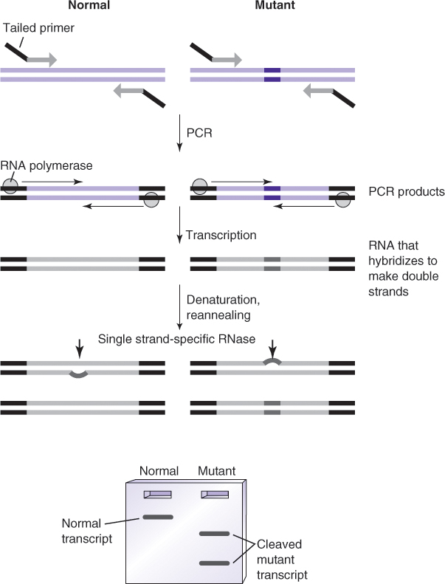
Heteroduplex Analysis With Single-Strand-Specific Nucleases (continued)
Notes:
Normal (left) and mutant (right) transcription templates covering the area to be screened are produced by P C R with tailed primers carrying promoter sequences. R N A polymerase then transcribes the P C R products. The transcripts are denatured and reannealed, forming heteroduplexes between normal and mutant transcripts. R N Ase cleavage products can be resolved on native agarose gels.

Slide 30
Invader Technology
Mutation detection with proprietary enzyme
Sample is mixed with probes and enzyme
Enzyme cleavage of probe-test sample hybrid will yield fluorescent signal
Signal will only occur if probe and test sample sequence are complementary

Slide 31
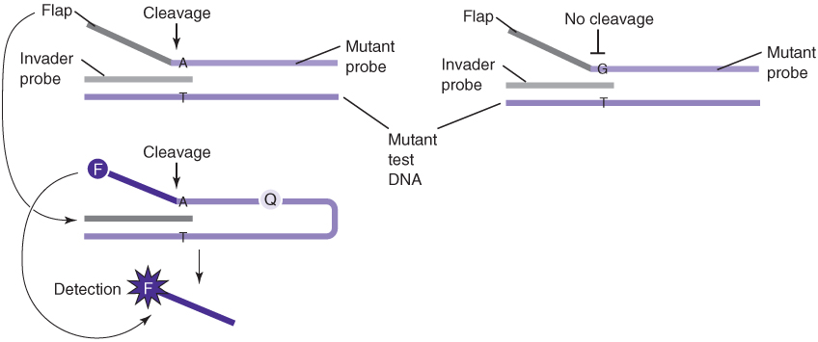
Invader Technology (continued)
Probes and enzyme are provided
96-well plate format
Notes:
Hybridization of supplied probe and anchor sequences to the input template (upper left) forms a structure that is the substrate for the cleavage enzyme. The enzyme removes the flap sequences, which form another hybridization structure with the labeled probe. The second cleavage releases the fluorescent dye from the vicinity of the quencher on the probe, a fluorescent signal. If the template does not match the probe in the first hybridization (upper right), no cleavage occurs.

Slide 32
Point Mutations
Single or a few nucleotide changes

Slide 33
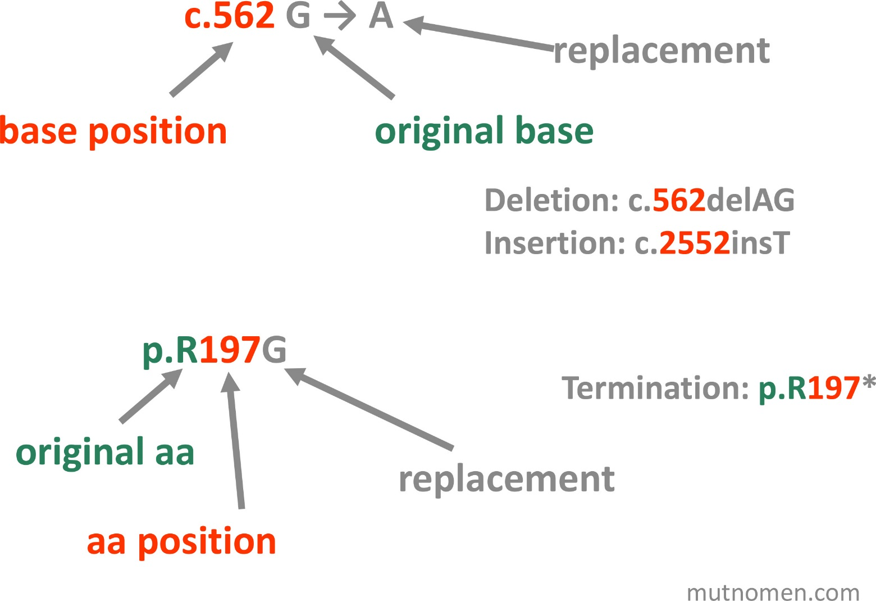
Mutation Nomenclature
Notes:
The use of approved mutation nomenclature is recommended for reporting results. A nucleic acid change is indicated by the location of the original base, an arrow, and the replacement base. An amino acid change is indicated by the original amino acid (single-letter code), location in the protein sequence, and then the replacement amino acid. “c.” indicates complementary D N A, “g.” indicates genomic D N A (with introns), and “p.” indicates protein. Updates and further formatting for deletions, insertions, terminations, frameshifts (fs), and more complex changes can be found at mutnomen.com.

Slide 34
Point Mutations (continued_1)
Gene mutations involving one or a few base pairs
Not detectable by cytogenetic methods
Detected at the D N A-sequence level

Slide 35
Point Mutations (continued_2)
Point mutations do not always have phenotypic effect.
D N A Sequence | Amino Acid Sequence | Type of Mutation
ATG CAG GTG ACC TCA GTG | M Q V T S V | None
ATG CAG GTT ACC TCA GTG | M Q V T S V | Silent, synonymous
ATG CAA GTG ACC TCA GTG | M Q L T S V | Conservative
ATG CCG GTG ACC TCA GTG | M P V T S V | Nonconservative
ATG CAG GTG ACC TGA GTG | M Q V T ter | Nonsense
ATG CAG GTG AAC CTC AGT G | M Q V N L S | Frameshift

Slide 36
Summary
Biochemical methods target mostly protein and amino acid changes but can also detect nucleic acid alterations
  Immunoassays, chromatography, spectrometry
Molecular detection of mutations includes hybridization and sequence- or cleavage-based methods
  S S C P, melt curves, arrays
Changes in nucleic acid sequence can have varying effects on phenotype

