Slide 1
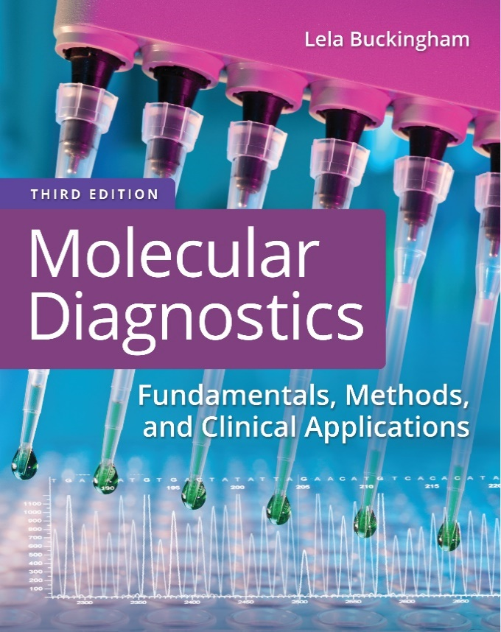
Chapter 9
D N A Sequencing

Slide 2
Objectives
Describe chain termination (Sanger) sequencing methods.
  List the components and the molecular reactions that occur in chain termination sequencing.
  Discuss the advantages of dye primer and dye terminator sequencing.
Describe pyrosequencing
Derive a text D N A sequence from raw sequencing data.

Slide 3
Objectives (continued)
Describe approaches to next-generation sequencing (N G S).
Discuss components of the N G S bioinformatics pipeline.

Slide 4
Sequencing Methods
Maxam–Gilbert chemical sequencing
Sanger chain termination sequencing
Pyrosequencing
Next-generation sequencing
Notes:
Early in the study of molecular biology, the importance of learning the order or sequence of nucleotides in D N A was realized. With this information, genotype in the form of the sequence of nucleotides could predict phenotype, and changes in sequence could explain disease. The Maxam–Gilbert chemical method and the Sanger chain termination method were developed around the same time. The Sanger method became the predominant method because it is less hazardous and easier to interpret than the Maxam–Gilbert method. In the next 10 to 15 years, alternative, less complex approaches, such as pyrosequencing and, soon after that, higher-throughput next-generation methods, were developed.

Slide 5
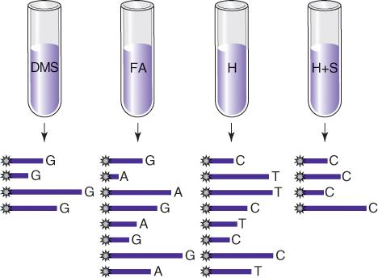
Maxam–Gilbert Sequencing
Maxam–Gilbert sequencing was performed by chain breakage at specific nucleotides

Slide 6
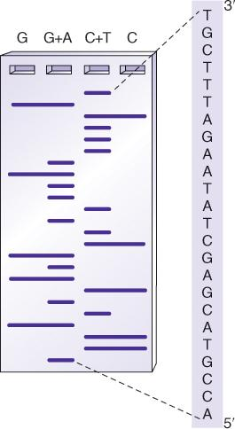
Maxam–Gilbert Sequencing (continued)
Sequencing gels were read from bottom to top (5′ to 3′)

Slide 7
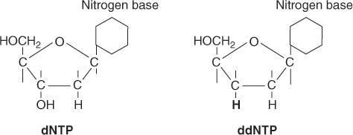
Chain Termination (Sanger) Sequencing
A modified D N A replication reaction
Growing chains are terminated by dideoxynucleotides
Notes:
Chain termination sequencing uses modified nucleotides (dideoxynucleotides or dd N T P) missing the 3’ ribose hydroxyl group required for the formation of the phosphodiester bond in D N A replication.

Slide 8
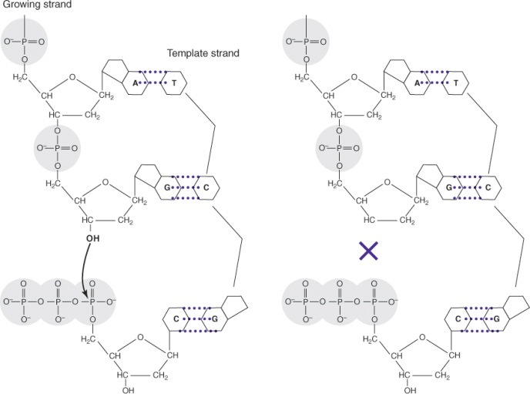
Chain Termination (Sanger) Sequencing (continued_1)
The 3′-OH group necessary for formation of the phosphodiester bond is missing in dd N T P’s and this will terminate extension
Notes:
When a dideoxynucleotide is incorporated into the growing chain, elongation stops with that nucleotide.

Slide 9
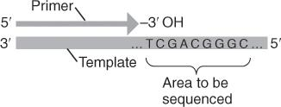
Chain Termination (Sanger) Sequencing (continued_2)
A sequencing reaction mix includes labeled primer and template
Dideoxynucleotides are added separately to each of four tubes
Notes:
Chain termination sequencing is a D N A replication reaction requiring all components for D N A synthesis. In addition, dd N T Ps are added in proportion to the d N T Ps. For manual sequencing, the template has to be single stranded.

Slide 10
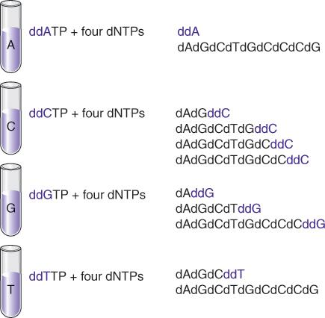
Chain Termination (Sanger) Sequencing (continued_3)
Notes:
With the proper ratio of d N T P:dd N T P, replication will stop at every opportunity to incorporate that base in the growing chain.

Slide 11
Chain Termination (Sanger) Sequencing (continued_4)
With addition of enzyme (D N A polymerase), the primer is extended until a d d N T P is encountered
The chain will end with the incorporation of the d d N T P
With the proper d N T P:d d N T P ratio, the chain will terminate throughout the length of the template
All terminated chains will end in the d d N T P added to that reaction

Slide 12
Chain Termination (Sanger) Sequencing (continued_5)
The collection of fragments is a sequencing ladder
The resulting terminated chains are resolved by electrophoresis
Fragments from each of the four tubes are placed in four separate gel lanes

Slide 13
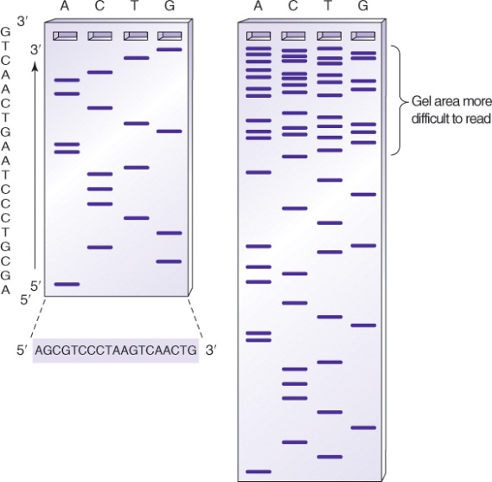
Chain Termination (Sanger) Sequencing (continued_6)
Sequencing gels are read from bottom to top (5′ to 3′)
Notes:
The D N A ladder was resolved using gel electrophoresis. The shortest fragments (terminated close to the primer) are the beginning 5’ end of the sequence. Read lengths were limited by the ability of the gel to resolve large fragments at the top of the gel without losing the small fragments from the bottom of the gel.

Slide 14
Advances in Sequencing Technology:
Cycle Sequencing
Cycle sequencing is chain termination sequencing performed in a thermal cycler
Cycle sequencing requires a heat-stable D N A polymerase
Notes:
With the development of polymerase chain reaction (P C R), Sanger sequencing was automated so that the synthesis reaction was performed on a double-stranded template in the thermal cycler.

Slide 15
Advances in Sequencing Technology:
Fluorescent Dyes
Fluorescent dyes are multicyclic molecules that absorb and emit fluorescent light at specific wavelengths
Examples are fluorescein and rhodamine derivatives
For sequencing applications, these molecules can be covalently attached to nucleotides
Notes:
With advances in fluorescent dye technology, dye “color” could be covalently attached to the dd N T Ps, thereby identifying the terminating bases without having to perform the reaction in separate tubes.

Slide 16
Advances in Sequencing Technology:
Dye Terminators
In dye terminator sequencing, the fluorescent dye molecules are covalently attached to the dideoxynucleotides, labeling the sequencing ladder at the 3′ ends of the chains
A distinct dye or “color” is used for each of the four d d N T P’s
Because the terminating nucleotides can be distinguished by color, all four reactions can be performed in a single tube

Slide 17
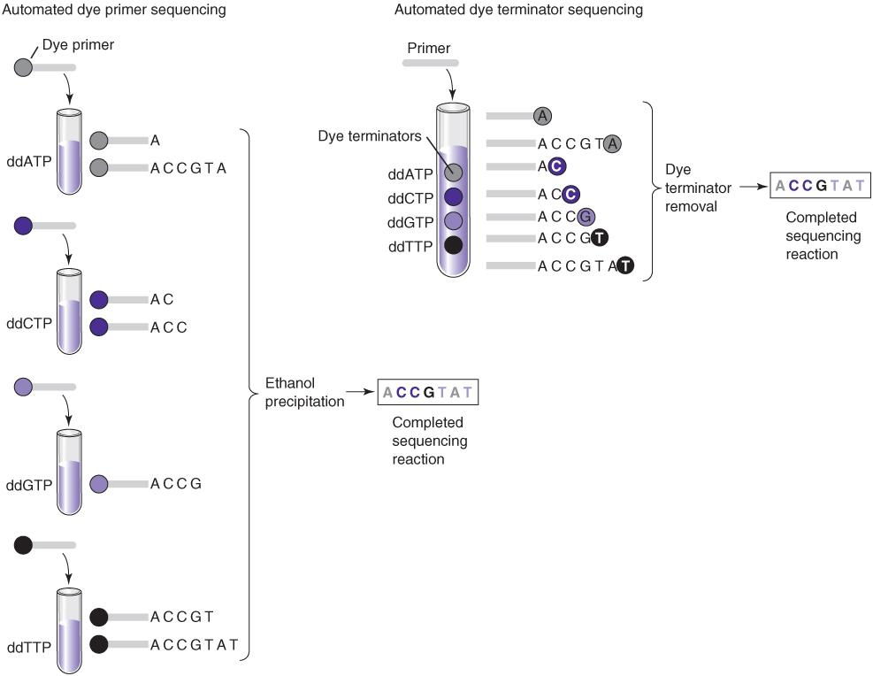
Dye Terminator Sequencing
Notes:
In dye primer sequencing (left), aliquots of the primer are covalently attached at the 5’ end with the four different fluors, each in a separate reaction with a different dd N T P. The resulting ladders can then be combined and resolved based on size and color. Dye terminator sequencing has the advantage of a single reaction with the fluors attached to the dd N T P (right).

Slide 18
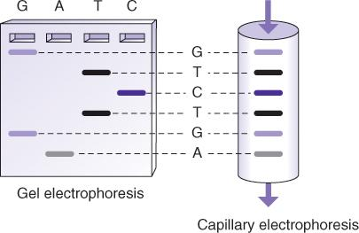
Dye Terminator Sequencing (continued_1)
The D N A ladder can be resolved in one gel lane or in a capillary

Slide 19
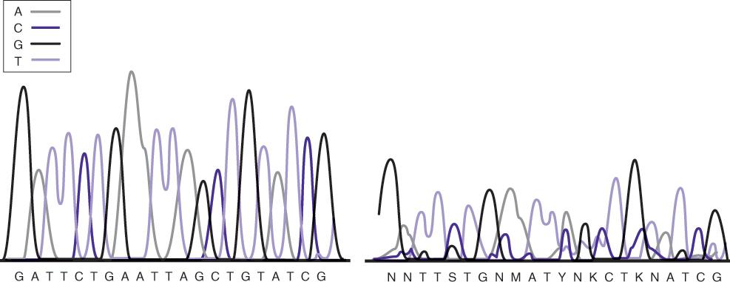
Dye Terminator Sequencing (continued_2)
The D N A ladder is read on an electropherogram
Notes:
The result from capillary gel electrophoresis is a series of peaks representing the size and color of the fragments in the D N A ladder. If the sequence is of good quality (left), sequencing software can convert these peaks into a textual sequence (base calling). Poor sequence quality (right) can result from inadequate template, failure to clean the P C R product to be sequenced, improper reaction conditions, residual ethanol contamination, or a variety of other problems. In this case, the sequencing software cannot call a clear sequence, yielding “N” for any nucleotide and other ambiguities (S, Y, M, K).

Slide 20
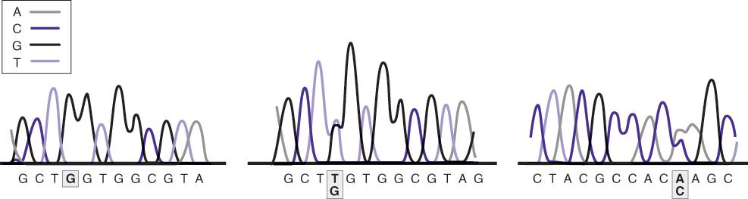
Dye Terminator Sequencing (continued_3)
Dye terminator sequencing on capillary instruments
Sequence analysis software provides analyzed sequence in text and electropherogram form
Peak patterns reflect mutations or sequence changes

Slide 21
Alternative Sequencing Methods:
Pyrosequencing
Pyrosequencing is based on the generation of a light signal through the release of pyrophosphate (P P_{i}) upon nucleotide addition:
D N A_{n} + d N T P → D N A_{n+1} + P P_{i}
P P_{i} is used to generate A T P from adenosine phosphosulfate (A P S)
A P S + P P_{i} → A T P

Slide 22
Alternative Sequencing Methods:
Pyrosequencing (continued_1)
A T P and luciferase generate light by conversion of luciferin to oxyluciferin
Each nucleotide is added in turn
Only one of four will generate a light signal
The remaining nucleotides are removed enzymatically
The light signal is recorded on a pyrogram

Slide 23
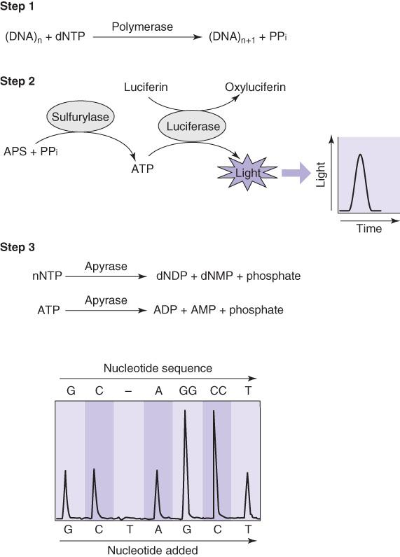
Alternative Sequencing Methods:
Pyrosequencing (continued_2)
Notes:
Pyrosequencing is useful as a resequencing procedure where tests are done to detect known nucleotide changes within a short range of nucleotides. The read length of pyrosequencing is about 100 to 150 bases, compared with up to 1,500 in Sanger sequencing.

Slide 24
The Human Genome Project
The first sequence of the human genome by Sanger sequencing took 10 years and cost $0.5 billion (of a $3 billion project) J. Craig Venter and Francis Collins announced the rough draft in 2000 | Complete sequence and comparative analysis of each chromosome followed Chromosome 22: 1999 Chromosome 21: 2000 Chromosome 20: 2001 Chromosomes 6, 7, 13, 14, Y: 2003 Chromosomes 5, 9, 10, 16, 18, 19: 2004 Chromosomes X, 2, 4: 2005 Chromosomes 1, 3, 8, 11, 12, 15, 17: 2006

Slide 25
The Human D N A Sequence
2.91 giga base pairs
36% to 62% G+C (36% to 44% G+C in genes)
Less than 30,000 genes—n c R N A’s?
Average gene size ~27 kilo base pairs
Less than 2% of genome is open reading frame (O R F)
42% of O R F’s have unknown function
Genes are not evenly distributed within or among chromosomes

Slide 26
The Human D N A Sequence (continued)
Difficult areas to sequence: centromeres, polymorphic regions (major histocompatibility complex [M H C])

Slide 27
The 1000 Genomes Project
The 1000 Genomes Project was founded by the National Human Genome Research Institute (N H G R I), the Wellcome Trust Sanger Institute, and the Beijing Genomics Institute
It was intended to identify variations in the human genome
Genotypes for more than 2,500 individuals have now been made (www.1000genomes.org/)
These databases are now used in bioinformatics to identify polymorphisms

Slide 28
Next-Generation Sequencing (N G S) Technologies
Ion conductance
Reversible dye terminator
Pyrosequencing
Single-molecule long range
Notes:
The completion of the first human D N A sequence led to the realization that the massive information was not completely informative without putting it into context of many other genomes. A burst of technological advances resulted in the design of N G S techniques capable of producing gigabytes of sequencing data, that is, whole genomes, in a single run. Among them, mostly ion conductance and reversible dye terminator technologies have been applied to clinical applications.

Slide 29
Next-Generation Sequencing (N G S)
Generate library
Sequence the library
Analyze the sequence
Notes:
There are three basic steps for both ion conductance and dye terminator sequencing. A library is a collection of D N A fragments to be sequenced.

Slide 30
N G S Library
A sequencing library is the D N A to be sequenced
  Microbial populations
  Whole genomes
  Exomes
  Specific genes or regions
    Standard
    Paired end
  R N A (c D N A)

Slide 31
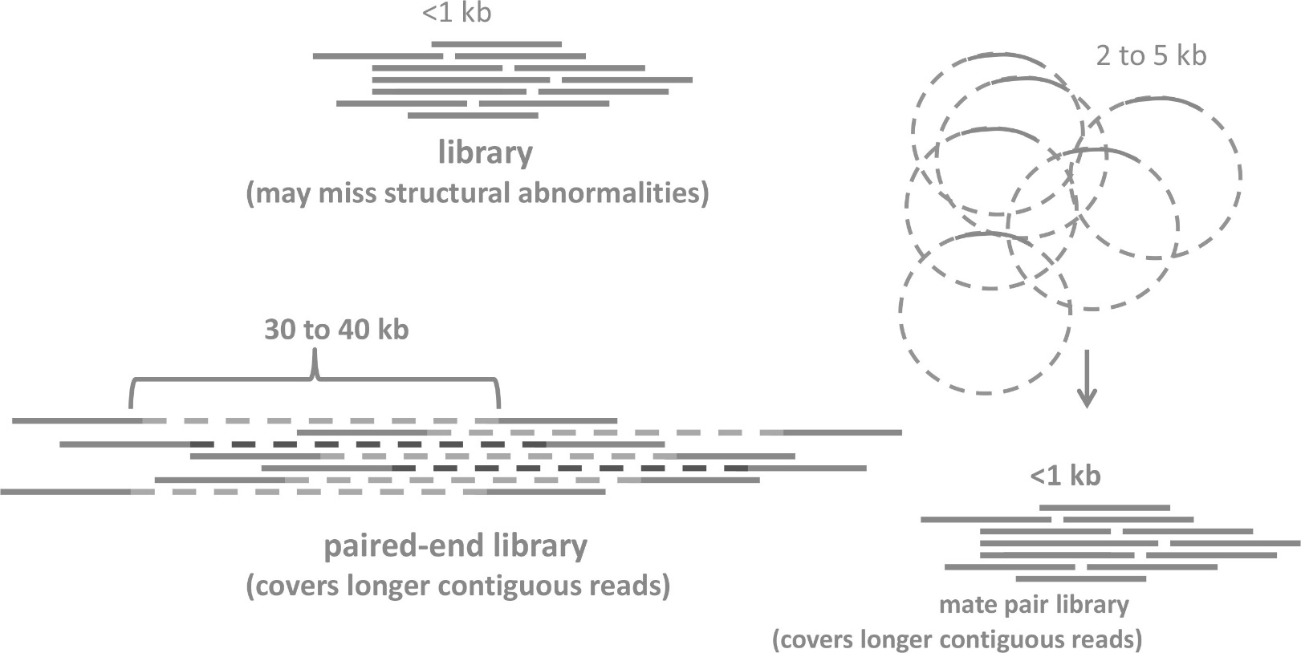
N G S Library (continued)
Fragment D N A to several-hundred-base pair fragments and amplify (or amplify specific regions)

Slide 32

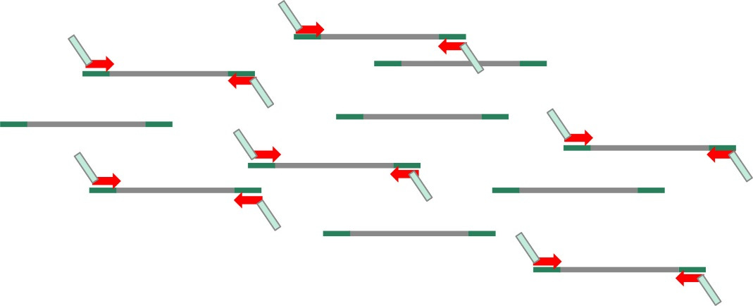
N G S Genome Library
Ligate adaptors on the ends of the fragments
Tailed primers are used to add primer sites or patient-specific sequences to each sample library (index)

Slide 33
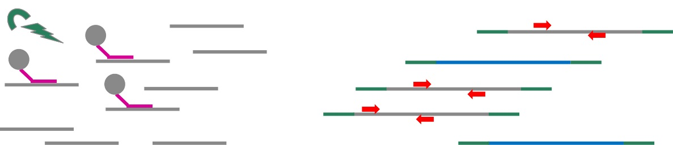
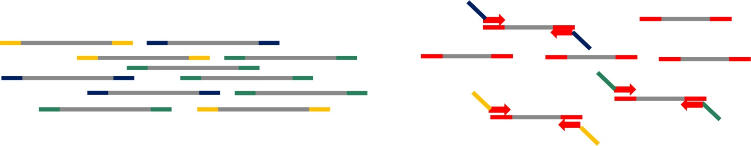
N G S Panel Library
Select specific gene targets with probes or by P C R N G S panel
Add index sequences to the ends of the fragments

Slide 34
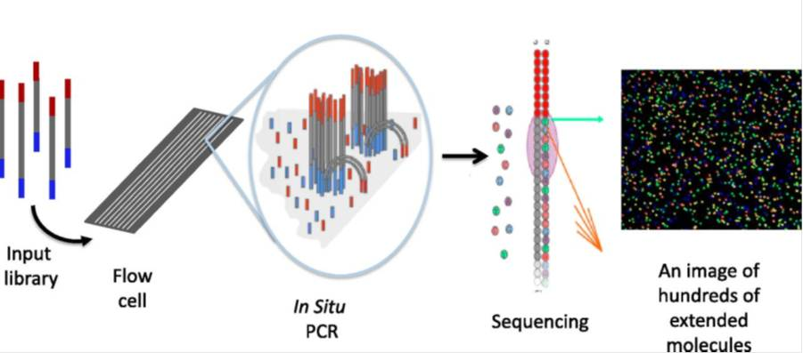
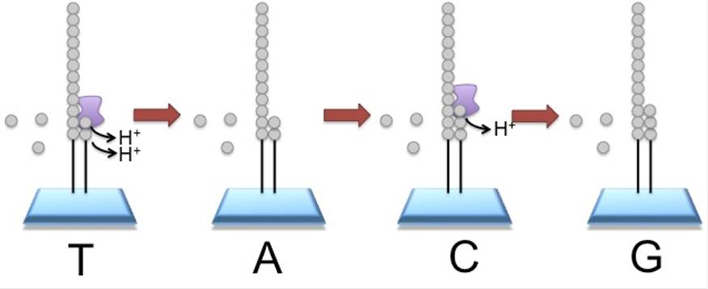
N G S Sequencing Technologies
Reversible dye terminator sequencing
Ion conductance sequencing

Slide 35
Sequence Analysis
Image/data processing
Sequence quality/base calling
  Phred score: Q = –10log E
  where E = probability of error, p(E)
        Q = 10 → 1/10 p(E)
        Q = 20 → 1/100 p(E)
  Clinical Laboratory Standards Institute recommendations:
  Phred = 20 to 30, p(E) = 1/100 to 1/1,000

Slide 36
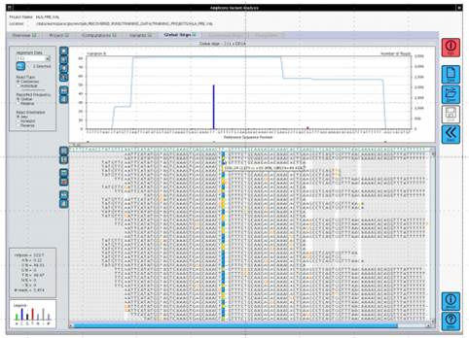
Sequence Analysis: Coverage (Read Depth)
Depends on the amount of template and target size

Slide 37
Sequence Analysis: Coverage (Read Depth) (continued)
Whole genome: 30 to 40× coverage (3 billion base pairs)
Exome: 50 to 100× coverage (30 to 50 million base pairs)
≥500× required for rare variant in mixed population
Cost is limiting factor

Slide 38
Finding Variants
Alignment of data, comparison to reference sequence (for example, N C B I 37)
  Reference sequence may have minor alleles
  Most probable genotype (M P G): theoretical probability of the variant call being correct (properly aligned, nonrepetitive, representative of the sample)
Notes:
Variants by comparison to a reference “normal” sequence are called by most sequencing instrument software. This is reported in a variant call file (vcf). The vcf is filtered for non-critical changes such as polymorphisms, those with low coverage and benign protein effects. Variants surviving filtering may then be annotated, that is searching to see if these variants have previously been associated with disease.

Slide 39
Finding Variants (continued_1)
Filtering Variants
Examine population frequency (ethnic reference genomes)
  Thousand Genomes
  d b S N P
Biological significance (effect on protein)
Notes:
Variants by comparison to a reference “normal” sequence are called by most sequencing instrument software. This is reported in a variant call file (vcf). The vcf is filtered for non-critical changes such as polymorphisms, those with low coverage and benign protein effects. Variants surviving filtering may then be annotated, that is searching to see if these variants have previously been associated with disease.

Slide 40
Finding Variants (continued_2)
Annotating Variants
Clinical significance: variant pathogenicity reference sequences used to refine profiles, for example:
  ClinVar
  Catalogue of Somatic Mutations in Cancer (C O S M I C)
Reference to unaffected family members or nonmalignant tissue
Notes:
Variants by comparison to a reference “normal” sequence are called by most sequencing instrument software. This is reported in a variant call file (vcf). The vcf is filtered for non-critical changes such as polymorphisms, those with low coverage and benign protein effects. Variants surviving filtering may then be annotated, that is searching to see if these variants have previously been associated with disease.

Slide 41
Reporting of Results
Use Human Genome Organization (International) nomenclature
The significance of a variant is affected by:
  Incomplete assessment of structural variants
  Lack of accurate haplotype data
  Variable expressivity
  Penetrance
  Environmental interactions/epigenetics
  Heritability
Notes:
The pathologist must assess the clinical significance of variants for each patient.

Slide 42
Reporting of Results (continued)
  Rare mutations of unknown significance
  Locus and allelic variability
N G S sequences are not always complete
Notes:
The pathologist must assess the clinical significance of variants for each patient.

Slide 43
Archiving
The extent of data to archive has not been established
Average N G S generates terabytes of raw data
Image files require the most storage capacity
Maintain F A S T Q or F A S T A (text) post-alignment files
Notes:
Secure archiving of large amounts of information is a challenge for clinical laboratory sequencing applications.

Slide 44
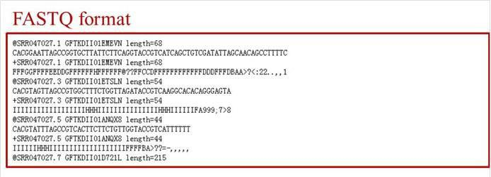
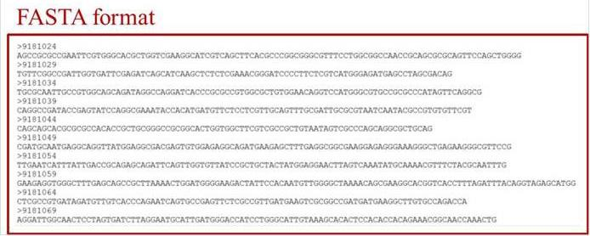
Archiving (continued)
Notes:
Secure archiving of large amounts of information is a challenge for clinical laboratory sequencing applications.

Slide 45
N G S in the Medical Laboratory
Gene panels, targeted gene panels
  10 to 500 genes sequenced
  16s r R N A
  H I V genotypes (R T, pol)
Mitochondrial D N A sequencing (16,500 base pairs)
Whole-exome sequencing
Notes:
Gene panels are sequenced routinely for clinical applications. Smaller libraries are used at reduced cost and do not require extensive bioinformatics analyses.

Slide 46
Summary
Genetic information is stored in the form of the order or sequence of nucleotides in D N A
Chain termination sequencing is the standard method for determination of nucleotide sequence
Dideoxy chain termination sequencing has been facilitated by the development of cycle sequencing and the use of fluorescent dye detection

Slide 47
Summary (continued)
Alternative methods are used for special applications, such as pyrosequencing (for resequencing and polymorphism detection) or bisulfite sequencing (to analyze methylated D N A)

