Slide 1
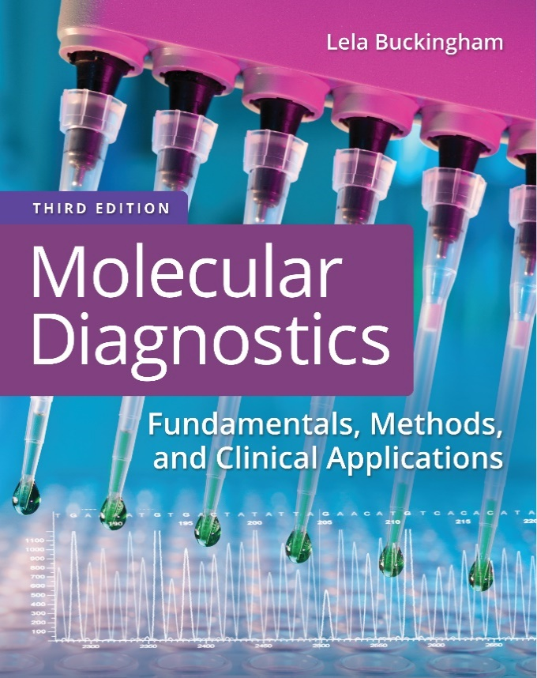
Chapter 10
D N A Polymorphisms and Human Identification

Slide 2
Objectives
Compare and contrast different types of polymorphisms.
Define restriction fragment length polymorphisms.
Describe short tandem repeat structure and nomenclature.
Describe gender identification using the amelogenin locus.

Slide 3
Objectives (continued)
Illustrate the use of short tandem repeats (S T R’s) for bone marrow engraftment monitoring.
Define single-nucleotide polymorphisms.
Discuss mitochondrial D N A typing.

Slide 4
Polymorphism
A D N A polymorphism is a sequence difference compared to a reference standard that is present in at least 1% to 2% of a population
Polymorphisms can be single bases or thousands of bases
Polymorphisms may or may not have phenotypic effects

Slide 5
Polymorphic D N A Sequences
Polymorphisms are found throughout the genome
If the location of a polymorphic sequence is known, it can serve as a landmark or marker for locating other genes or genetics regions
Each polymorphic marker has different versions or alleles

Slide 6
Types of Polymorphic D N A Sequences
R F L P: restriction fragment length polymorphism
V N T R: variable-number tandem repeat (8 to >50 base pairs)
S T R: short tandem repeat (1 to 8 base pairs)
S N P: single-nucleotide polymorphism
Notes:
Polymorphic sequences can take many forms. The types of polymorphisms that have been used in clinical laboratory applications are R F L P s, tandem repeats, and single-nucleotide differences. S T Rs and VNTRs are the same type of polymorphism (repeated sequences in D N A) and differ only in the length of the repeat units.

Slide 7
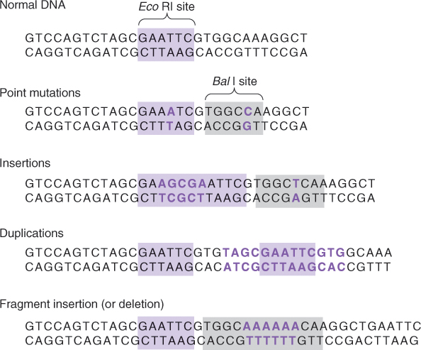
Restriction Fragment Length Polymorphisms
Restriction fragment sizes are altered by changes in or between enzyme recognition sites
Notes:
Application of R F L P to molecular genetic analysis is limited by the location of restriction sites. Still, R F L P analysis is performed with relatively straightforward methods and is versatile.

Slide 8
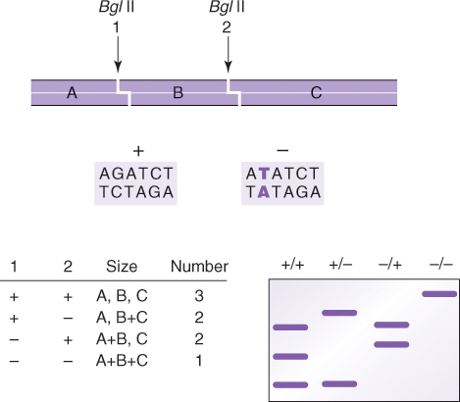
Restriction Fragment Length Polymorphisms (continued_1)
The presence of an R F L P is inferred from changes in fragment sizes
Notes:
D N A is characterized by the pattern of fragments produced by one or more restriction enzymes. The bands are resolved by gel or capillary electrophoresis.

Slide 9
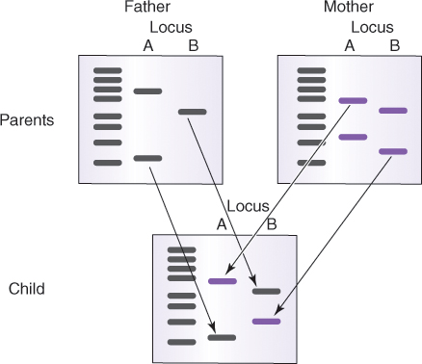
Restriction Fragment Length Polymorphisms (continued_2)
R F L P genotypes are inherited
For each locus, one allele is inherited from each parent
Notes:
R F L P alleles in specified regions of human D N A were originally analyzed using Southern blot.

Slide 10
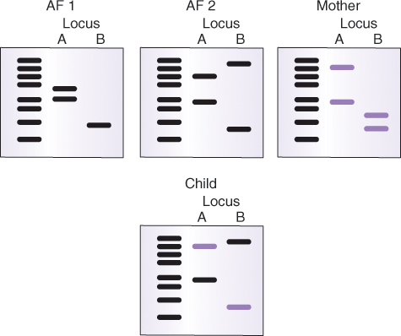
Parentage Testing by R F L P
Which alleged father’s (A F) genotype has the paternal alleles?
Notes:
Only AF 2 can supply the nonmaternal alleles in the child’s D N A.

Slide 11
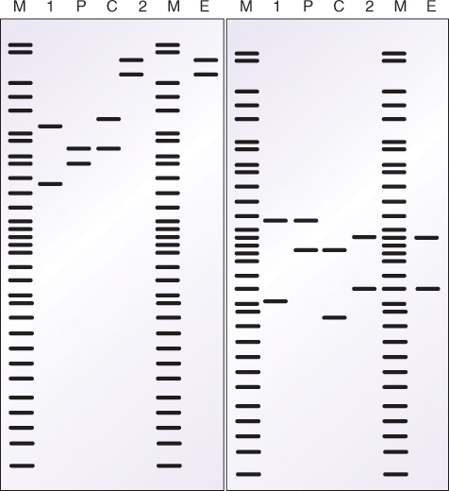
Evidence Testing by R F L P
Which suspect—1 or 2—was at the crime scene?
(V = child victim, P= parent of child victim, E = crime scene evidence, M = molecular-weight standard)
Notes:
This is an example of R F L P crime evidence using two single-locus probes. For both loci probed, suspect 2 “matches” the R F L P alleles found at the crime scene. Positive identification of suspect 2 requires further determination of the frequencies of these specific alleles in the population and the probability of matching them by chance.
The first D N A fingerprinting for human identification was done with R F L P and Southern blot. Using probes to selected genomic regions, Alec Jeffreys was able to demonstrate unique fragment patterns for every individual tested. The main limitation to this method is the amount and quality of D N A demanded by the Southern blot procedure.

Slide 12
Short Tandem Repeat (S T R) Polymorphisms
S T R’s are repeats of nucleotide sequences
  A A A A A A…: mononucleotide
  A T A T A T…: dinucleotide
  T A G T A G T A G…: trinucleotide
  T A G T T A G T T A G T…: tetranucleotide
  T A G G C T A G G C T A G G C…: pentanucleotide
Different alleles contain different numbers of repeats
  T T C T T C T T C T T C: four repeat alleles
  T T C T T C T T C T T C T T C: five repeat alleles
Notes:
S T Rs are equally informative as R F L P s. Alleles differ by the number of repeat units in each locus.

Slide 13
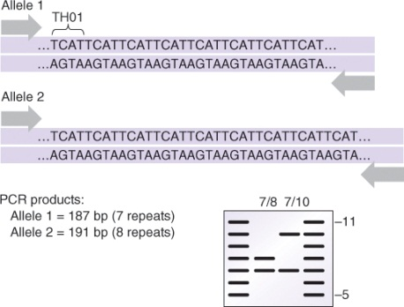
Short Tandem Repeat (S T R) Polymorphisms (continued)
S T R alleles can be analyzed by amplicon size (polymerase chain reaction [P C R])
Allelic ladders are standards representing all alleles observed in a population
Notes:
An advantage of S T Rs is that they can be analyzed by P C R. Primers are designed so that the number of repeats in an allele is reflected in the size of the P C R product.

Slide 14
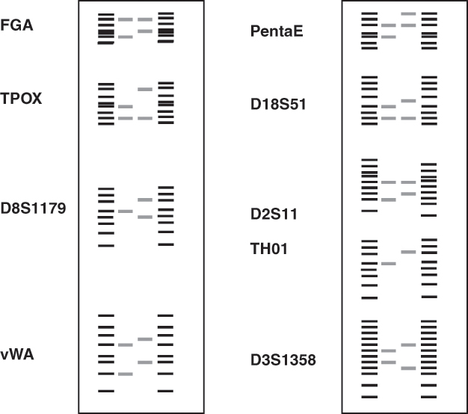
S T R by Multiplex P C R
Multiple loci are genotyped in the same reaction using multiplex P C R
Allelic ladders must not overlap in the same reaction

Slide 15
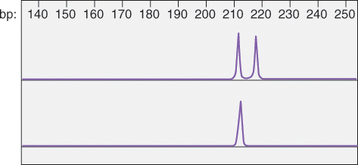
Amelogenin Locus, HUMAMEL
The amelogenin locus is not an S T R
The HUMAMEL gene codes for amelogenin-like protein
The gene is located at Xp22.1-22.3 and Y
X allele = 212 base pairs
Y allele = 218 base pairs
Notes:
The Y allele of amelogenin is slightly larger in males than in females. Amplification of amelogenin will produce a male-specific 218-bp product (Y allele) in addition to the 212-bp product found on the X chromosome (X allele). Males are heterozygous for the amelogenin locus (XY, top), and females are homozygous for this locus (XX, bottom).

Slide 16
Amelogenin Locus, HUMAMEL (continued)
Females (X, X): homozygous
Males (X, Y): heterozygous
Notes:
The Y allele of amelogenin is slightly larger in males than in females. Amplification of amelogenin will produce a male-specific 218-bp product (Y allele) in addition to the 212-bp product found on the X chromosome (X allele). Males are heterozygous for the amelogenin locus (XY, top), and females are homozygous for this locus (XX, bottom).

Slide 17
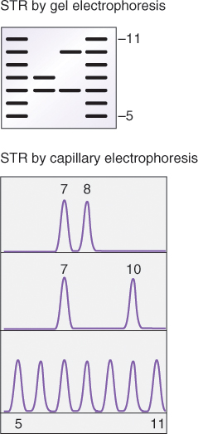
Analysis of S T R by P C R-C G E
S T R genotypes are analyzed using gel or capillary gel electrophoresis
Notes:
Instead of bands on a gel (top), peaks of fluorescence on an electropherogram reveal the P C R product sizes (bottom). Alleles (7, 8, or 10) are determined by comparison with allelic ladders run through the capillary simultaneously with the sample amplicons.

Slide 18
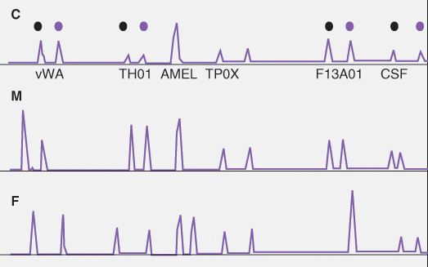
S T R and Parentage Testing
S T R genotypes are inherited
One allele is inherited from each parent
Notes:
Five S T R loci and the amelogenin locus for a child (C), mother (M), and father (F) are shown. Note how the child has inherited one of each allele from the mother (black dots) and one from the father.

Slide 19
Parentage Testing by S T R-P C R
Which alleged father (1 or 2) has the child’s paternal alleles?
Locus | Child | Mother | 1 | 2
D3S1358 | 16/17 | 16 | 17 | 17
vWA | 14/18 | 16/18 | 14/15 | 16/17
FGA | 21/24 | 20/21 | 24 | 24
TH01 | 6 | 6/9.3 | 6/9 | 6/7
TPOX | 10/11 | 10/11 | 8/11 | 8/9
CSF1PO | 11/12 | 12 | 11 | 11/13
D5S818 | 11/13 | 10/11 | 13 | 9/13
D13S317 | 9/12 | 9 | 12/13 | 11/12

Slide 20
Forensic Testing by S T R-P C R
In 1997 the Federal Bureau of Investigation adopted 13 “core” loci as the Combined D N A Indexing System (C O D I S)
The genotype, or profile, of a sample is the collection of alleles in all the loci tested
Genetic concordance: all locus genotypes (alleles) from two sources (for example, suspect and crime evidence) are the same
  Concordance is interpreted as inclusion of a single individual as the donor of both genotypes

Slide 21
Matching Probability of S T R Genotypes in Subpopulations
 | African American | White American | Hispanic American
8 loci | 1/274,000,000 | 1/114,000,000 | 1/145,000,000
9 loci | 1/5.18 × 10⁹ | 1/1.03 × 10⁹ | 1/1.84 × 10⁹
14 loci | 1/6.11 × 10¹⁷ | 1/9.96 × 10¹⁷ | 1/1.31 × 10¹⁷
16 loci | 1/7.64 × 10¹⁷ | 1/9.96 × 10¹⁷ | 1/1.31 × 10¹⁷
1/n = likelihood of two unrelated individuals sharing the same genotype

Slide 22
S T R Polymorphisms: Y-S T R
The Y chromosome is inherited from father to son without recombination
S T R’s on the Y chromosome are therefore inherited paternally as a haplotype
Y haplotypes are used for exclusion and paternal lineage analysis
Notes:
All paternally related males will have the same Y-S T R profile. Y-S T R can be used for relatedness or exclusion but not for positive identity.

Slide 23
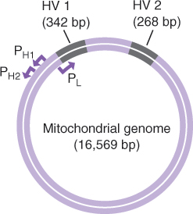
Mitochondrial D N A Polymorphisms
Sequence differences in the hypervariable regions (H V) of the mitochondrial genome

Slide 24
Mitochondrial D N A Polymorphisms (continued)
Mitochondria are maternally inherited
There are an average of 8.5 base differences in the mitochondrial H V sequences of unrelated individuals
All maternal relatives will have the same mitochondrial sequences
Mitochondrial typing can be used for legal exclusion of individuals or confirmation of maternal lineage

Slide 25
Single-Nucleotide Polymorphisms (S N P’s)
Single-nucleotide differences among D N A sequences
One S N P occurs every ~1,000 base pairs in human D N A
S N P’s are detected by sequencing, melt-curve analysis, or other methods
99% have no biological effect; 60,000 are within genes

Slide 26
S N P Haplotypes
S N P’s are inherited in blocks or haplotypes
S N P’s can be used for gene mapping, human identification, chimerism analysis, and many other applications
The Human Haplotype Mapping (HapMap) Project identified S N P haplotypes throughout the human genome

Slide 27
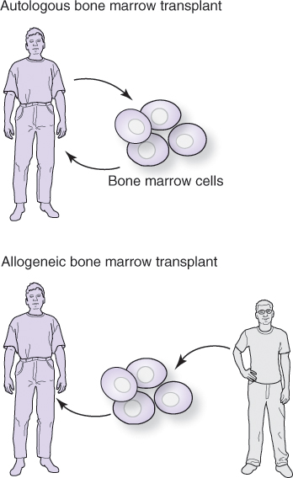
Engraftment Testing Using S T R
  Allogeneic bone marrow transplants (B M T) are effective treatments for cancer and diseases of the immune system
B M T are monitored using S T R
  A recipient with donor marrow is a chimera
Notes:
Two approaches to B M T are shown: autologous (replacement of patient bone marrow cells with their own purged or treated cells) and allogeneic (replacement of patient cells with hematopoietic stem cells from a donor). In allogeneic B M T, S T Rs are used for monitoring the engraftment of donor cells in the recipient. There are two parts to chimerism testing: pretransplant informative analysis and post-transplant engraftment analysis. Ongoing studies are also testing S N P s for this application.

Slide 28
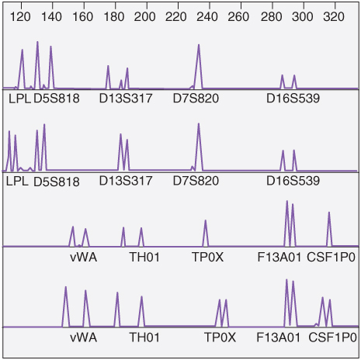
Engraftment Testing Using S T R:
Pretransplant S T R Informative Analysis
S T R’s are scanned to find informative loci (donor alleles that differ from recipient alleles)

Slide 29
Engraftment Testing Using S T R:
Pretransplant S T R Informative Analysis (continued)
There are different degrees of informativeness
With the most informative loci, recipient bands or peaks do not overlap
Stutter in donor bands or peaks should be avoided as well
  Stutter is a technical artifact of the P C R reaction in which a minor product of n-1 repeat units is produced
Notes:
Stutter peaks are short peaks to the left of the S T R peak as can be seen in markers D5S818 and D13S317 recipient peaks and D5S818 and D7S820 donor peaks in the previous slide.

Slide 30


Post-Transplant Engraftment Analysis
Using informative loci, peak areas (A) are determined in fluorescence units
A(R) = recipient; A(D) = donor
Notes:
These formulae would be used directly if the locus is homozygous in the donor and the recipient. The formula is modified with heterozygous peaks and shared alleles. Peak areas in fluorescence units are provided by the electrophoresis system.

Slide 31
Post-Transplant Engraftment Analysis (continued)
Example: Donor and recipient are homozygous for locus L P L
Recipient peak area: 17,387 fluorescent units
Donor peak area: 68,751 fluorescent units

Slide 32
Summary
Four types of polymorphisms are used for a variety of purposes in the laboratory: R F L P, V N T R, S T R, and S N P
  Polymorphisms are used for human identification and parentage testing
S T R alleles (number of repeat units) are easily identified using P C R
S T R polymorphisms are used for parentage testing, forensics, and engraftment after allogeneic bone marrow transplants

Slide 33
Summary (continued_1)
Y-S T R haplotypes are paternally inherited; maternal relatives have the same mitochondrial D N A alleles
Mitochondrial types are maternally inherited
S N P’s are detected by sequencing, melt-curve analysis, or other methods
S N P’s can be used for the same applications as other polymorphisms

Slide 34
Summary (continued_2)
S T R are used to distinguish donor/recipient cells after allogeneic bone marrow transplant

