Slide 1

Chapter 11
Detection and Identification of Microorganisms

Slide 2
Objectives
Identify advantages and disadvantages of using molecular-based methods as compared with traditional culture-based methods in the detection and identification of microorganisms.
Explain the value of controls, particularly amplification controls, in ensuring the reliability of P C R results.

Slide 3
Objectives (continued)
List the genes involved in the emergence of antimicrobial resistance that can be detected by nucleic acid amplification methods.
Interpret pulse-field gel electrophoresis patterns to determine whether two isolates are related to or different from each other.
Compare and contrast the molecular methods that are used to type bacterial strains in epidemiological investigations.

Slide 4
Target Microorganisms for Molecular-Based Testing
Those that are difficult or time-consuming to isolate
for example, Mycobacteria
Hazardous organisms
for example, Histoplasma, Coccidioides
Those without reliable testing methods
for example, HIV, hepatitis C virus (H C V)
High-volume tests
for example, S. pyogenes, N. gonorrhoeae,
C. trachomatis

Slide 5
Applications of Molecular-Based Testing
Rapid or high-throughput identification of microorganisms
Detection and analysis of resistance genes
Genotyping
Classification
Discovery of new microorganisms

Slide 6
Specimen Collection
Preserve viability/nucleic acid integrity of target microorganisms
Avoid contamination
Appropriate time and site of collection (blood, urine, other)
Use proper equipment (coagulant, wood or plastic swab shafts)
Commercial collection kits are available

Slide 7
Specimen Collection (continued)
The Clinical and Laboratory Standards Institute (C L S I) has guidelines for proper specimen handling

Slide 8
Sample Preparation
Consider the specimen type (for example, stool, plasma, cerebrospinal fluid [C S F])
More rigorous lysis procedures are required to penetrate cell walls
Consider the number of organisms in the sample
Inactivate inhibitors (acidic polysaccharides in sputum or polymerase inhibitors in C S F)
Inactivate R N ases

Slide 9
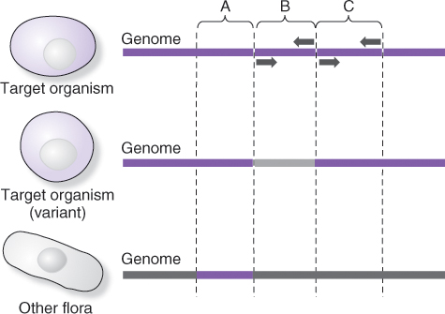
P C R Detection of Microorganisms:
Target Selection
Notes:
Sequences in microorganisms may be common or nonspecific (A), specific to related variants (C), or type-specific (B). Screening tests may use (C) or even (A) to detect the presence of flora, whereas (B) would likely be used to confirm the presence of a target organism.

Slide 10
P C R Detection of Microorganisms:
Quality Control
P C R and other amplification methods are extremely sensitive and very specific
For accurate test interpretation, use proper controls:
  Positive control: positive template
  Negative control: negative template
  Amplification control: omnipresent
Template unrelated to target:
  Reagent blank: no template present

Slide 11
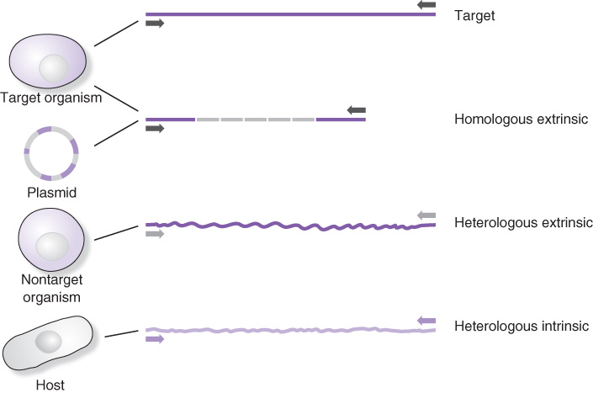
P C R Quality Control: Internal Controls
Homologous extrinsic
  Controls for amplification
Heterologous extrinsic
  Controls for extraction and amplification
Heterologous intrinsic
  Human gene control
Notes:
The purpose of internal controls is to monitor proper nucleic acid isolation, amplification, and detection.

Slide 12
Quality Control: False Positives
Contamination: check reagent blank
Dead or dying organisms: retest 3 to 6 weeks after antimicrobial therapy
Detection of less than clinically significant levels
Notes:
False positives may occur due to the sensitivity and robust nature of nucleic acid–amplification methods. D N A or RNA from organisms that are no longer viable may be detected for a time after treatment. The minimum presence of organisms may not be clinically significant but may be detectable by amplification methods.

Slide 13
Quality Control: False Negatives
Improper collection, specimen handling
Extraction/amplification failure: check internal controls
Technical difficulties with chemistry or instrumentation: check method and calibrations
Notes:
Internal controls aid in detecting and finding the reason for or source of the false-negative results.

Slide 14
Viruses
“Classic methods” of detection include antibody detection, antigen detection, and culture
Molecular methods of detection include target, probe, and signal amplification
Test are designed for identification of virus, determination viral load (number of viruses per milliliter of fluid), and genotyping by sequence analysis
Notes:
Viruses can be difficult to culture and may be hazardous to the laboratory scientist. Amplification methods decrease the time of detection as well as exposure to viral pathogens.

Slide 15
Viral Load
Number of viruses per milliliter of body fluid
Measured by quantitative polymerase chain reaction (q P C R), digital P C R (d P C R), or other methods
Measurements by different methods may not be equivalent
  Technical variability
  Biological variability
Notes:
qP C R measurements that differ by less then 0.3 cycles are considered equivalent. (Cobb BR, Vaks JE, Do T, Vilchez RA. Evolution in the sensitivity of quantitative HIV-1 viral load tests. J Clin Virology. 2001;582:S77–S82.)

Slide 16
Test Performance Features for Viral Load Measurement
Characteristic | Description
Sensitivity | Lowest level detected at least 95% of the time
Accuracy | Ability to determine true value
Precision | Reproducibility of independently determined test results
Specificity | Negative samples are always negative, and positive results are true positives
Linearity | A serial dilution of standard curve closely approximates a straight line
Flexibility | Accuracy of measurement of virus regardless of sequence variations

Slide 17
Antimicrobial Agents
Inhibit growth (-static), for example, bacteriostatic, fungistatic
Kill organisms (-cidal), for example, bacteriocidal, fungicidal, viricidal
Antimicrobial agents are classified by:
  -static/-cidal
  Mode of action
  Chemical structure

Slide 18
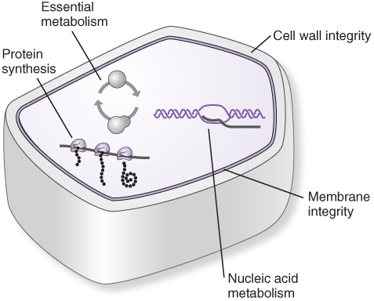
Sites of Action of Antimicrobial Agents
Notes:
Antimicrobial agents are designed to counter the growth and survival requirements of target organisms.

Slide 19
Mechanisms for Development of Resistance to Antimicrobial Agents
Enzymatic inactivation of agent
Altered target
Altered transport of agent in or out
Acquisition of genetic factors from other resistant organisms
Notes:
Organisms react to antimicrobial agents through generation/selection of genetic changes or acquisition of plasmids carrying resistance genes, such as enzymes that inactivate therapeutic agents.

Slide 20
Viral Genotyping
Viral genes mutate to overcome antiviral agents
  Gene mutations are detected by sequencing
Primary resistance mutations affect drug sensitivity but may slow viral growth
Secondary resistance mutations compensate for the primary resistance growth defects

Slide 21
Advantages of Molecular Detection of Resistance to Antimicrobial Agents
Mutated genes are strong evidence of resistance
Rapid detection without culturing
Direct comparison of multiple isolates in epidemiological investigations
Notes:
Nucleic acid analysis detects and identifies new resistance factors. Matrix-assisted laser desorption/ionization (MALDI) may also be used to detect the peptide products of enzymatic resistance.

Slide 22
Molecular Epidemiology
Epidemic—rapidly spreading outbreak of an infectious disease
Pandemic—a disease that sweeps across wide geographical areas
Epidemiology—collection and analysis of environmental, microbiological, and clinical data
Notes:
Molecular epidemiology is applied to the identification and source of pathogenic microorganisms in specific locations or populations.

Slide 23
Molecular Epidemiology (continued)
Phenotypic analysis measures biological characteristics of organisms
Molecular epidemiology is a genotypic analysis targeting genomic or plasmid D N A
  Species-, strain-, or type-specific D N A sequences are the sources of genotype information

Slide 24
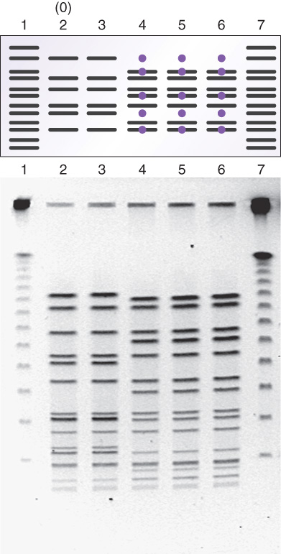
Pulsed-Field Gel Electrophoresis (P F G E)
Notes:
Digestion of genomic D N A of cultured organisms with restriction enzymes and resolution by P F G E will produce unique band patterns. Changes are counted as the gain or loss of bands compared with the reference (outbreak) strain.

Slide 25
Criteria for P F G E Pattern Interpretation: Rule of Three
Category | Genetic Differences* | Fragment Differences* | Epidemiological Interpretation
Indistinguishable | 0 | 0 | Test isolate is the same strain as the outbreak strain
Closely related | 1 | 2–3 | Test isolate is closely related to the outbreak strain
Possibly related | 2 | 4–6 | Test isolate is possibly related to the outbreak strain
Different | >3 | >6 | Test isolate is unrelated to the outbreak
*Compared to the outbreak strain

Slide 26
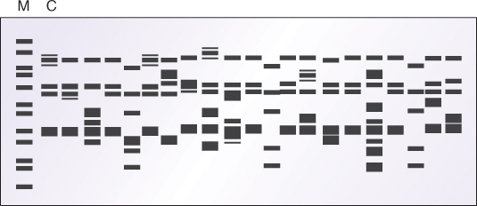
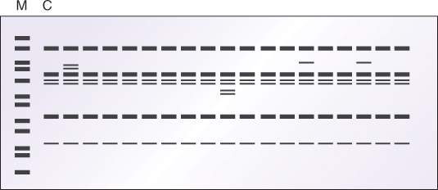
Arbitrarily Primed P C R: Random Amplification of Polymorphic D N A (R A P D)
Notes:
R A P D is another comparative method to compare test strains to reference or outbreak strains. Differences in band patterns indicate differences in strains. The band patterns produced by this method are often complex and may be difficult to interpret.

Slide 27
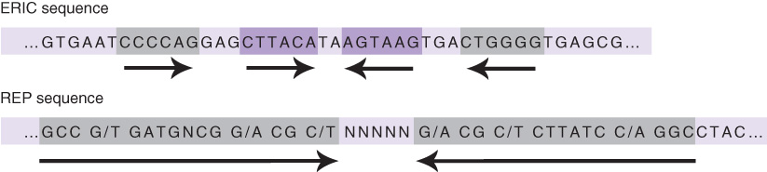
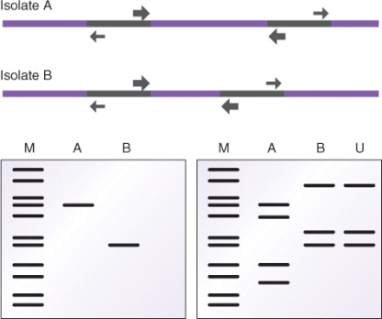
Interspersed Repetitive Elements
P C R amplification priming outward from repetitive elements generates strain-specific products:
Notes:
Amplification from repetitive elements reveals differences in sizes of unique sequences between the elements. The unknown strain is strain B.

Slide 28
Other Genotypic Methods Used to Type Organisms
Plasmid fingerprinting with restriction enzymes
R F L P analysis
Amplified fragment length polymorphism (A F L P)
Interspersed repetitive elements
Ribotyping
spa typing
Multi-locus sequence typing
Notes:
Various methods have been developed for epidemiological analyses. The choice of method will depend on the organisms to be tested and the available sample.

Slide 29
Comparison of Molecular Epidemiology Methods
Method | Typing Capacity | Discriminatory Power | Reproducibility | Ease of Use | Ease of Interpretation
Plasmid analysis | Good | Good | Good | High | Good
P F G E | High | High | High | Moderate | Good–Moderate
Genomic R F L P | High | Good | Good | High | Moderate–Poor
Ribotyping | High | High | High | Good | High
P C R-R F L P | Good | Moderate | Good | High | High
R A P D | High | High | Poor | High | Good–High
A F L P | High | High | Good | Moderate | High
Repetitive Elements | Good | Good | High | High | High
Sequencing | High | High | High | Moderate | Good–High

Slide 30
Summary
Molecular-based methods offer sensitive and direct detection of microorganisms
Specimen collection and handling are critical for successful molecular analysis
Quantitative viral load testing requires proper validation for accuracy
Due to high sensitivity and specificity, proper quality control is critical for molecular testing

Slide 31
Summary (continued)
Molecular methods are used to type bacterial strains in epidemiological investigations

