Slide 1
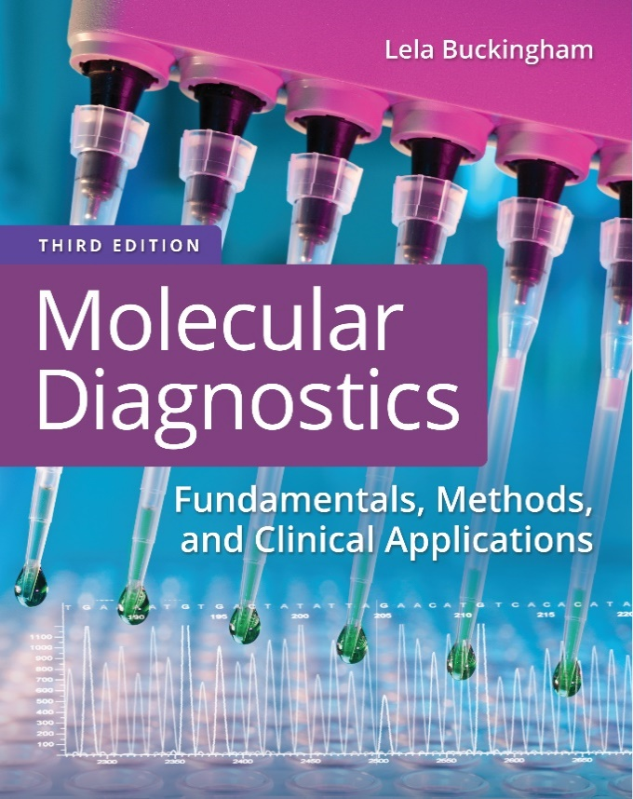
Chapter 13
Molecular Oncology

Slide 2
Objectives
Identify checkpoints in the cell division cycle that are critical for regulated cell proliferation.
List molecular targets that are useful for diagnosing and monitoring solid tumors.
Contrast cell-specific and tumor-specific molecular targets.

Slide 3
Objectives (continued)
Show how clonality is detected using antibody and T-cell receptor gene rearrangements.
Interpret data obtained from the molecular analysis of patients’ cells, and determine if a tumor population is present.

Slide 4
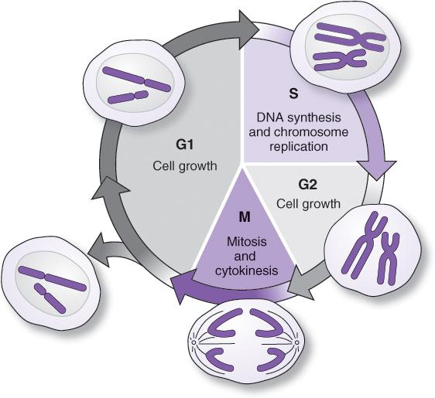
The Cell Division Cycle Is Regulated at Checkpoints
G1-S
  Cells arrest in G1 prior to D N A synthesis (S)
G2-M
  Cells arrest in G2 prior to mitosis (M)
Cancer results when the cell division cycle proceeds from G1 to S or G2 to M phase inappropriately
Notes:
Oncogenes promote cell division. Oncogenes include cell membrane receptors that are bound by growth factors, hormones, and other extracellular signals. These receptors transduce signals through the cell membrane into the cytoplasm through a series of protein modifications that ultimately reach the nucleus and activate factors that initiate D N A synthesis (move the cell from G1 to S phase of the cell cycle) or mitosis (move from G2 to M).

Slide 5
Cancer Is Caused by Nonlethal Genetic Mutations Affecting Certain Genes
Oncogenes, as proto-oncogenes, normally promote cell division or cell survival
  Oncogene mutations are usually a gain of function and dominant
Tumor suppressors—genes that normally arrest cell division
  Tumor-suppressor gene mutations are usually a loss of function and recessive

Slide 6
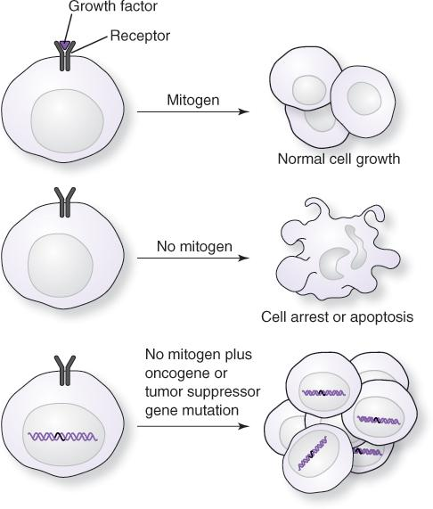
Cancer Is Caused by Nonlethal Genetic Mutations
Notes:
Cells normally grow (proceed through G1 and G2 checkpoints) only upon stimulation with a mitogen, that is, a nutrient, growth factor, or other stimulant of D N A synthesis and cell division. In the absence of mitogen, cells arrest growth or undergo apoptosis. Cancer cells grow and divide in the absence of normal signals, making more cells with the same inability to arrest growth.

Slide 7
Molecular Detection of Disease
Targets:
  Tissue-specific markers (antigens, gene rearrangements)
  Disease-specific markers (translocations, point mutations, polymorphisms in tumor suppressor or oncogenes)
  Viruses (Epstein–Barr virus [E B V], hepatitis C virus [H C V], human T-cell leukemia virus, type 1 [H T L V-1])
Notes:
Medical laboratory methods test for normal molecules that are in the wrong place or present at the wrong time or in abnormal amounts. Some cancers have cancer-specific molecules that can be detected. Viruses embedded in the D N A of cancer cells may also be targets for testing.

Slide 8
Molecular Detection of Disease (continued)
Methods:
  Hybridization, blotting
  Standard polymerase chain reaction (P C R), electrophoresis, quantitative P C R (q P C R, q R T-P C R)
  Sequencing
Notes:
Medical laboratory methods test for normal molecules that are in the wrong place or present at the wrong time or in abnormal amounts. Some cancers have cancer-specific molecules that can be detected. Viruses embedded in the D N A of cancer cells may also be targets for testing.

Slide 9
Gene and Chromosome Abnormalities Observed in Cancer
Gene mutations (oncogenes, tumor-suppressor genes)
Chromosome structural abnormalities (translocations, deletions, insertions)
Chromosome number abnormalities (aneuploidy, polysomy)
Notes:
All abnormalities ultimately affect oncogenes or tumor-suppressor genes.

Slide 10
Mutations in Cancer
Somatic mutations
  Caused by environmental factors
  Sporadic occurrence, not clustered in families or populations
Genetic mutations
  Inherited as cancer risk
  Clustered in families and populations
  May also have environmental components

Slide 11
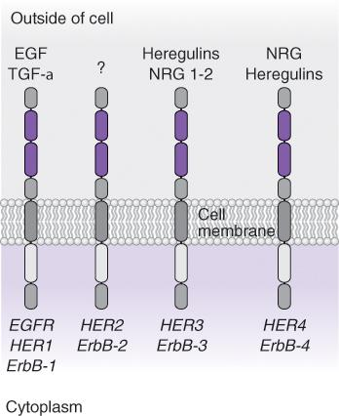
Examples of Somatic Targets: The E G F R Gene Family
Notes:
The E G F R gene family is an example of cell surface receptors that start growth signals through the cell. These receptors are sometimes abnormally expressed or mutated in solid tumors. H E R2 is well known for overexpression in breast cancer.

Slide 12
H E R2/neu
The H E R2/neu gene encodes one of a family of human epidermal growth factor receptors
This gene is frequently amplified in breast cancer cells, resulting in increased amounts of H E R2 cell surface protein
H E R2-expressing tumors are sensitive to Herceptin, a monoclonal antibody therapy
H E R2 protein is detected by immunohistochemistry (I H C)

Slide 13
H E R2/neu (continued)
H E R2/neu gene amplification is detected by fluorescence in situ hybridization (F I S H)

Slide 14
E G F R
The E G F R oncogene encodes another of the same family of epidermal growth factor receptors
This gene is mutated or amplified in several types of cancer cells
Tumors with activating mutations in E G F R are sensitive to tyrosine kinase inhibitors (T K I’s)
E G F R protein is detected by I H C

Slide 15
E G F R (continued)
E G F R gene and chromosome abnormalities are detected by F I S H
E G F R gene mutations are detected by single-strand conformation polymorphism (S S C P), sequence-specific primer P C R (S S P-P C R), or direct sequencing

Slide 16
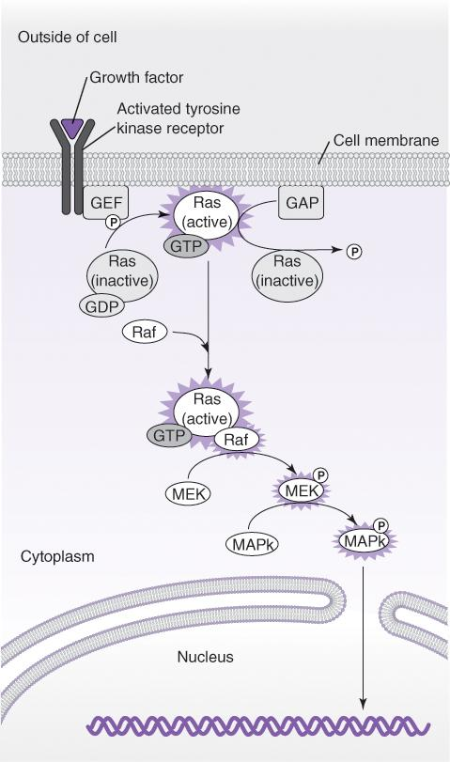
Somatic Targets in Solid Tumors: Downstream Signals
Notes:
In order for the signals from receptors to reach the nucleus for stimulation of cell growth, the signal must be transduced through the cytoplasm by various pathways. The Ras-Raf pathway is one of them.

Slide 17
K R A S
The Kirsten rat sarcoma viral oncogene (K R A S) encodes a key component of cell signaling
Mutations in K R A S are the most common oncogene mutations in cancer
K R A S mutations are associated with tumor malignancy and may affect response to some therapies
K R A S gene mutations are detected by P C R, q P C R, or direct sequencing

Slide 18
B R A F
V-Raf murine sarcoma viral oncogene homolog B1 (B R A F) encodes a key component of cell signaling
Mutations in B R A F can stimulate the Ras-Raf pathway in the absence of K R A S mutations
B R A F may affect response to some therapies
Mutated B-raf protein is also a therapeutic target

Slide 19
B R A F (continued)
B R A F gene mutations are detected by P C R, q P C R, or direct sequencing

Slide 20
Other Somatic Mutations Associated With Solid Tumors
Ewing sarcoma, E W S
Synovial sarcoma translocation, chromosome 18; synovial sarcoma breakpoint 1 and 2, S Y T-S S X1, SYT-S S X2
Paired box–Forkhead in rhabdomyosarcoma, P A X3-F K H R, P A X7-F K H R
Ataxia telangiectasia mutated gene, A T M
Von Hippel–Lindau gene, V H L

Slide 21
Other Somatic Mutations Associated With Solid Tumors (continued)
V-myc avian myelocytomatosis viral-related oncogene, neuroblastoma-derived, M Y C N or n-myc
Rearranged during transfection (R E T) protooncogene

Slide 22
T P53
The 53-kilodalton protein encoded by tumor protein (T P53) is a transcription factor
  T P53 is mutated in half of all types of cancer
  Loss of T P53 function is an indicator of poor prognosis in colon, lung, breast, and other cancers
Mutant p53 protein is detected by I H C
T P53 gene mutations are detected by a variety of methods, including I H C and direct sequencing

Slide 23
Inherited Cancer Gene Mutations
Inherited mutations in tumor-suppressor genes are recessive for the malignant phenotype
Mutations in tumor-suppressor genes are dominant with respect to increased risk of malignancy
  Loss of heterozygosity exposes the recessive mutant allele in a hemizygous state
  This is explained by the two-hit hypothesis

Slide 24
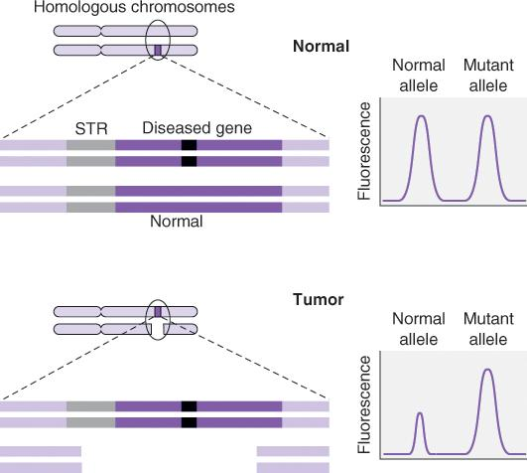
Loss of Heterozygosity Can Be Detected by Short Tandem Repeat (S T R) Analysis
Loss of a linked heterozygous S T R implicates a concurrent loss of one gene allele
Notes:
Loss of the STR allele linked to the normal gene allele is observed by capillary gel electrophoresis.

Slide 25
Inherited Breast Cancer Risk
B R C A1 and B R C A2 are tumor-suppressor genes encoding proteins that participate in D N A repair
  Inherited mutations in B R C A1 or B R C A2 significantly increase the risk of breast cancer at an early age
Frequently occurring mutations, including 187del A G and 5382ins C in B R C A1 and 6174del T in B R C A2, are detected by S S P-P C R, sequencing, and other methods

Slide 26
Inherited Breast Cancer Risk (continued)
Most mutations are detected by direct sequencing of both genes

Slide 27
Lynch Syndrome (L S)
Formerly hereditary nonpolyposis colorectal carcinoma (H N P C C)
  Inherited cancer accounts for about 5% of colon cancer
L S is associated with mutations in genes encoding components of the mismatch repair (M M R) system

Slide 28
Replication Error (R E R)
Microsatellites (1- to 2-base tandem repeats) are sensitive to errors during D N A replication
These errors are normally corrected by the M M R system

Slide 29

Microsatellite Instability (M S I)

Slide 30
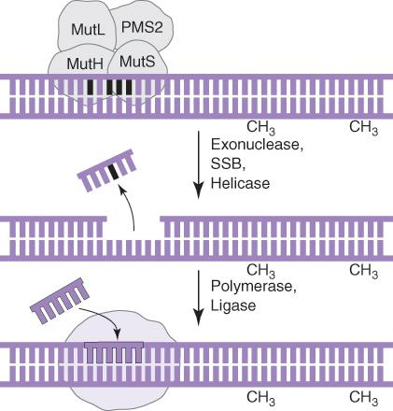
The Mismatch Repair (M M R) System
Notes:
The M M R system recognizes a mismatch (top) in the newly synthesized unmethylated strand of D N A. The complex of proteins recruits exonucleases, single-stranded D N A binding proteins (SSBs), and helicases to remove the erroneous base (center). Polymerases and D N A ligase then replace the missing bases.

Slide 31
L S and M S I
85%–90% of L S colon tumors have M S I (loss of M M R)
  M S I is also a prognostic factor in endometrial cancer
Mutations in genes of the M M R system (loss of function) are inferred by testing for M S I
  M S I analysis determines gene function
  Direct sequencing is used to detect the actual gene mutation

Slide 32
L S and M S I (continued_1)
M S I is analyzed by assessing stability of at least five microsatellite loci as recommended by the National Cancer Institute
Marker | Repeating unit
B A T25 | Mononucleotide
B A T26 | Mononucleotide
D5S346 | Dinucleotide
D2S123 | Dinucleotide
D17S250 | Dinucleotide

Slide 33
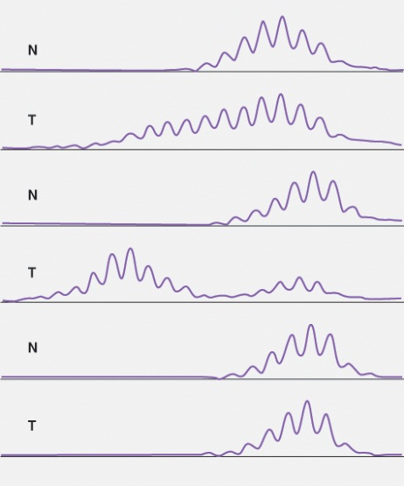
L S and M S I (continued_2)
M S I is detected by comparing P C R amplicons of the microsatellite loci
Unstable loci appear as extra products in tumor tissue compared to normal tissue

Slide 34
Liquid Biopsy
Circulating tumor cells can be assessed for diagnostic and prognostic mutations
  Specialized collection methods may be used to collect cells by cell surface markers or eliminate white blood cells
  Amplification methods are used to detect mutations

Slide 35
Liquid Biopsy (continued)
Cell-free D N A, R N A
  Free nucleic acid, exosomes
  Specialized isolation systems (bead, column concentration)
  Targeted: directed at specific mutations
  Untargeted: gene panels or whole exomes assessed from all nucleic acid collected

Slide 36
Molecular Detection of Leukemia and Lymphoma
Targets:
  Antibodies, gene rearrangements, translocations, point mutations, polymorphisms, viruses
Methods:
  Hybridization, blotting
  Standard P C R, R T-P C R, electrophoresis
  P C R with heteroduplex analysis, S S C P
  Real-time P C R with gene- or patient-specific probes

Slide 37
Gene Rearrangements (G R’s)
Gene rearrangements are normal events that occur in lymphocytes
Antibody genes (immunoglobulin heavy-chain genes, immunoglobulin light-chain genes [κ, λ]) and T-cell receptor genes (α, β, γ, δ) rearrange
Rearrangement occurs independently in each cell

Slide 38
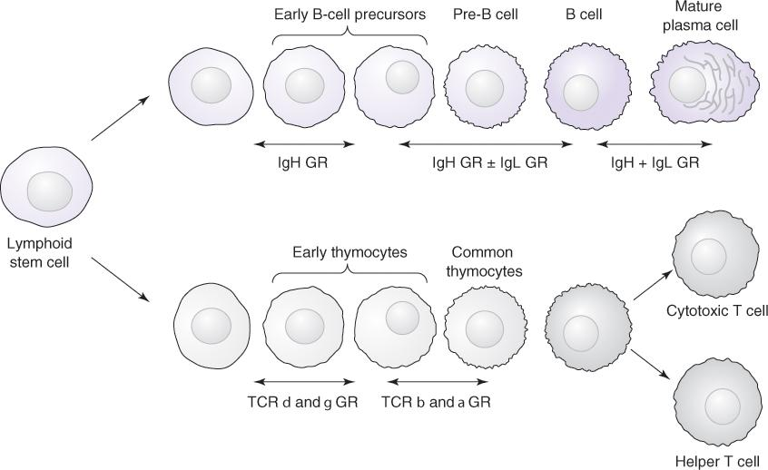
Immunoglobulin and T-Cell Receptor G R’s
Notes:
G R’s are normal processes that occur in B and T lymphocytes as they mature from lymphoid stem cells. The genes coding for immunoglobulin heavy and light chains (IgH and IgL, respectively) begin the rearrangement process in early B cells and pre–B cells. The T-cell receptor (TCR) genes rearrange in the order δ, γ, β, and α chains.

Slide 39
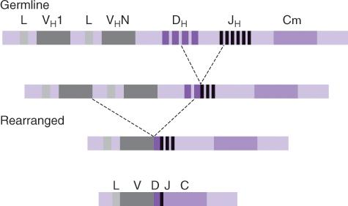
Immunoglobulin Heavy-Chain (I g H) G R
Notes:
The immunoglobulin heavy-chain gene on chromosome 14 consists of a series of variable (V), diversity (D), and joining (J) gene segments (germline configuration). The V segments are accompanied by a short leader region (L). One of each type of segment, V, D, and J, is selected and combined by an intrachromosomal recombination event, first D and J, then V and D. The C (constant) segments are joined through splicing or a secondary recombination event, class switching.

Slide 40
Gene Rearrangements
G R may be used to detect leukemias and lymphomas arising from cells that have rearranged their immunoglobulin (I g) or T-cell receptor (T C R) genes

Slide 41
Clonality
Normal lymphocyte populations are polyclonal (polytypic) with respect to I g and T C R genes
A leukemia or lymphoma is monoclonal (monotypic) with regard to I g or T C R rearranged genes

Slide 42
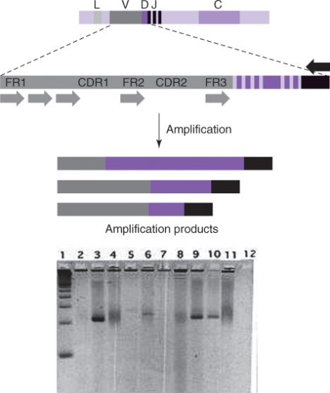
Detection of Monoclonal Lymphocyte Populations by P C R
Monoclonal populations are detected by sharp bands unique to the tumor cell population

Slide 43
Translocations (Leukemia)
Translocations are diagnostic and can be used for monitoring of hematological tumors. Examples:
PreB A L L t(1;19)
B-cell leukemia t(2;8), t(8;14), t(8;22), t(11;14)
Acute T C L L t(11;14)
A M L/M D S t(11q23)
A M L (M2) t(8;21), t(6;9)
Notes:
Translocations are tumor-specific markers allowing more sensitive detection of minimum disease because there is no background from normal cells.

Slide 44
Translocations (Leukemia) (continued)
A P L (M3) t(15;17)
A M M L (M4) t(11;21)
A M o L (M5) t(9;11)
C M L t(9;22), t(11;22)
A L L t(9;22), t(12;21), t(8;14), t(2;8), t(8;22), t(11q)
Notes:
Translocations are tumor-specific markers allowing more sensitive detection of minimum disease because there is no background from normal cells.

Slide 45
Translocations (Lymphoma, Myeloma)
Burkitt t(8;14), t(2;8), t(8;22)
D L B C L t(3q27), t(14;18); t(8;14)
T C L t(8;14)
Follicular t(14;18), t(8;14)
M C L t(11;14)
M M t(14q32)
Notes:
Translocations can have multiple breakpoints in different tumor clones. Molecular methods must accommodate the range of possible breakpoints.

Slide 46
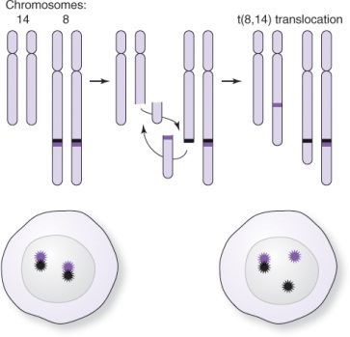
Detection of Hematological Tumors
Translocations and other abnormalities in chromosome structure and number are detected by F I S H
Translocation detection using F I S H breakaway probe

Slide 47
Translocations Are Detected With Higher Sensitivity Using P C R
P C R or q P C R may be used to quantify tumor load during patient monitoring
F I S H is recommended for initial diagnosis; P C R is better for monitoring
  P C R may not detect all translocation breakpoints
  F I S H and karyotyping assess large D N A regions, including all breakpoints

Slide 48
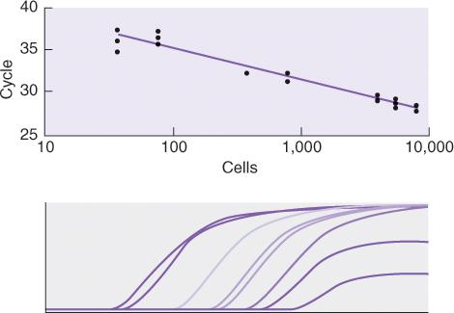
Quantification by q P C R (TaqMan®)
For q P C R, use a standard curve of tumor cells diluted into normal cells
For R T-q P C R, use a standard curve of transcripts of known copy numbers diluted into normal R N A

Slide 49
Translocations Used in Diagnosis and Monitoring of Hematological Tumors: t(14;18)
t(14;18), a reciprocal translocation between the long arms of chromosomes 14;18, is found in 90% of follicular lymphoma cases and 20%–30% of large-cell lymphomas
With translocation, the B-cell leukemia and lymphoma (B C L2) gene is moved from chromosome 18 to chromosome 14
B C L2 is dysregulated and overexpressed when moved to chromosome 14

Slide 50
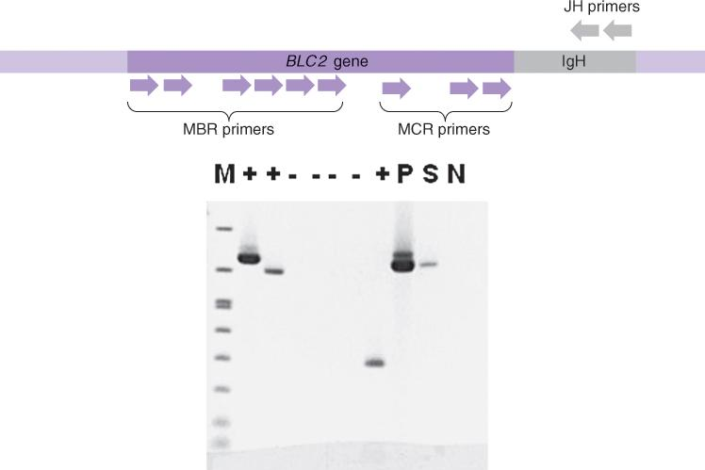
P C R Detection of t(14;18)
The forward primer hybridizes to chromosome 18, and the reverse primer hybridizes to chromosome 14
The translocation is indicated by the presence of a P C R (or q P C R) product

Slide 51
Translocations Used in Diagnosis and Monitoring of Hematological Tumors: t(9;22)
t(9;22), a reciprocal translocation between the long arms of chromosomes 9;22, is found in chronic myelogenous leukemia and acute lymphoblastic leukemia
This translocation forms a chimeric gene between the breakpoint cluster region (B C R) gene on chromosome 22 and the Abelson leukemia virus (A B L) gene on chromosome 9

Slide 52
Translocations Used in Diagnosis and Monitoring of Hematological Tumors: t(9;22) (continued_1)
The translocated chromosome is the Philadelphia chromosome

Slide 53
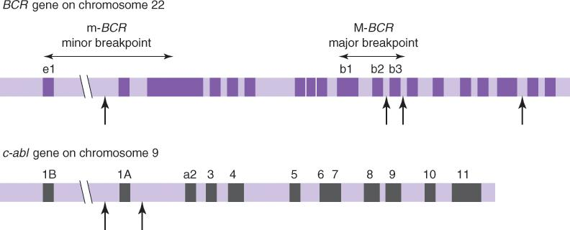
Translocations Used in Diagnosis and Monitoring of Hematological Tumors: t(9;22) (continued_2)
The chimeric gene, B C R-A B L, produces an abnormal protein that drives the tumor cell phenotype
Notes:
The chimeric R N A is detected by R T-q P C R. D N A is not used as the translocation takes place in large introns and the translocated D N A forms a product too large for efficient amplification by P C R.

Slide 54
Detection of Gene Mutations in Hematological Malignancies: Acute Myeloid Leukemia (A M L) Prognosis
F M S-related tyrosine kinase 3 (F L T3)
  Internal tandem duplications (I T D’s) close to the transmembrane domain
  Point mutations affecting an aspartic acid residue in the kinase domain (D835 mutations)
Nucleophosmin (N P M1)
C A A T-binding protein (C E B P A)
Notes:
If the karyotype is normal with an NPM1 mutation but no FLT3 ITD, or with a CEBPA mutation, the prognosis is favorable.

Slide 55
Detection of Gene Mutations in Hematological Malignancies: Myeloproliferative Disorders
Janus kinase 2 (J A K2) gene codes for a kinase enzyme and activates the Signal Transducer and Activator of Transcription (S T A T) pathway
  Dominant mutation at position 617of the J a k2 protein (V617F)
Notes:
Although the exon 12 mutations are not found in essential thrombocythemia, mutations in the MPL gene may be present, suggesting a molecular differentiation between polycythemia and thrombocythemia.

Slide 56
Detection of Gene Mutations in Hematological Malignancies: Myeloproliferative Disorders (continued)
A high proportion of patients with polycythemia vera, essential thrombocythemia, or idiopathic myelopfibrosis carry J A K2 mutations
  Four mutations in exon 12: F537-K539delinsL, K539L, H538QK539L, N542E543del
Myeloproliferative leukemia (M P L) mutations are found in thrombocythemia
Notes:
Although the exon 12 mutations are not found in essential thrombocythemia, mutations in the MPL gene may be present, suggesting a molecular differentiation between polycythemia and thrombocythemia.

Slide 57
The Catalogue of Clinically Important Mutations Has Expanded
For example, acute myelogenous leukemia
F L T3 | B R A F | K R A S
N P M1 | C E B P A | H R A S
C-K I T | E T V6 | M L L
D N M T3A | I D H | N R A S
A S X L1 | P D G F R A | T P53
W T1 | R U N X1 | T E T2
 | S E T B P1
Notes:
The list of clinically important genes and mutations within known genes is rapidly expanding. Single gene testing may be used for frequent or known mutations, however, tumor heterogeneity may result in the presence of additional molecular targets, requiring more comprehensive testing methods, such as arrays or NGS.

Slide 58
Cancer Gene Panel Testing
Next-generation sequencing (M G S)
  Disease-specific panels
  Whole-exome sequencing
Arrays
  Comparative genomic hybridization (C G H)
  Gene expression
Notes:
The list of clinically important genes and mutations within known genes is rapidly expanding. Single gene testing may be used for frequent or known mutations, however, tumor heterogeneity may result in the presence of additional molecular targets, requiring more comprehensive testing methods, such as arrays or NGS.

Slide 59
Multiple-Gene Panels
Hot spot—frequently occurring known variants in different tumor types
Tumor specific—profiles, hematology panels
Large gene panels—500–1,700 genes
Single-nucleotide polymorphism (S N P) detection by mass spectometry
Notes:
The list of clinically important genes and mutations within known genes is rapidly expanding. Single gene testing may be used for frequent or known mutations, however, tumor heterogeneity may result in the presence of additional molecular targets, requiring more comprehensive testing methods, such as arrays or NGS.

Slide 60
Molecular Oncology Testing: Complexities of Interpretation
Tumor heterogeneity
Mutations have hierarchy (for example, P M L-R A R A, p53 in acute leukemia)
Variant allele fractions (for example, F L T3)
Variants of unknown significance
New advances in immunotherapy activate innate immune responses against tumor cells
Notes:
The list of clinically important genes and mutations within known genes is rapidly expanding. Single gene testing may be used for frequent or known mutations, however, tumor heterogeneity may result in the presence of additional molecular targets, requiring more comprehensive testing methods, such as arrays or NGS.

Slide 61
Summary
Molecular testing analyzes tissue-specific and tumor-specific (mutation) targets
Genome, chromosome, and gene mutations are useful targets for diagnosis and detection of solid tumors
Microsatellite instability is a test for function of the D N A mismatch repair system, which may be mutated in hereditary colon cancer

Slide 62
Summary (continued)
I g and T C R gene rearrangements are tissue-specific markers for certain lymphomas and leukemias
Translocations are tumor-specific markers for some hematological disorders
N G S is frequently used to detect the growing number of clinically significant mutations in cancer

