Slide 1

Chapter 14
D N A-Based Tissue Typing

Slide 2
Objectives
Describe the structure and function of the major histocompatibility complex (M H C) locus.
Compare and contrast the levels of typing resolution that are achieved by different laboratory methods:
  Serology testing
  D N A-based testing

Slide 3
Objectives (continued)
Explain how combining different test methods to identify human leukocyte antigens (H L A’s) increases resolution and resolves ambiguities.
Relate the use of H L A typing for confirming disease diagnosis and predisposition.

Slide 4
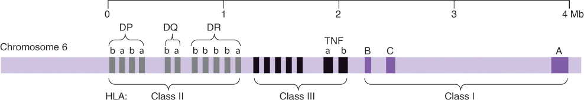
The Major Histocompatability Complex (M H C)
The M H C locus on chromosome 6
The M H C locus includes the human leukocyte antigen (H L A) and other genes
Notes:
The M H C is polymorphic; that is, the sequence differs among individuals. The M H C locus on chromosome 6 covers about 4 Mb of D N A, depending on the individual. Class I genes are 3 to 6 kb long, and class II genes are 4 to 11 kb in length. T N F-α and T N F-β are not part of the polymorphic H L A’system.

Slide 5
Genes of the M H C Locus
M H C region | Gene products | Tissue location | Function
Class 1 | H L A-A, H L A-B, H L A-C | All nucleated cells | Identification and destruction of abnormal or infected cells by cytotoxic T cells
Class 2 | H L A-D | B lymphocytes, monocytes, macrophages, dendritic cells, activated T cells, activated endothelial cells, skin (Langerhans cells) | Identification of foreign antigen by helper T cells
Class 3 | Complement C2, C4, B | Plasma proteins | Defense against extracellular pathogens
Cytokine genes | T N F-α, T N F-β | Plasma proteins | Cell growth and differentiation

Slide 6
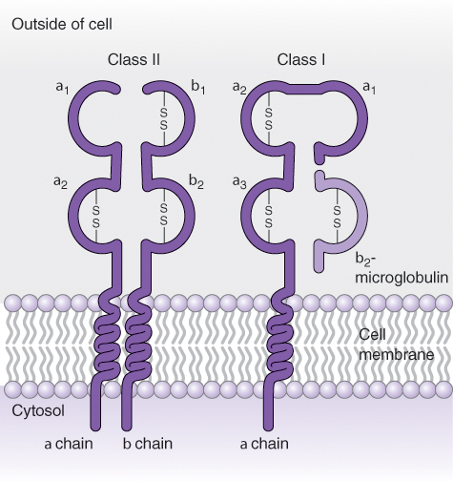
Human Leukocyte Antigens (H L A’s)
H L A’s, the M H C gene products, are membrane proteins that are responsible for recognition of non-self cells and tissues
Notes:
Class II (left) and class I (right) polypeptides. Class II antigens consist of two chains, α and β. Class I antigens consist of a heavy chain and a light chain associated together with a molecule of β-2 microglobulin.

Slide 7
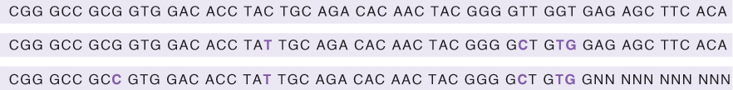
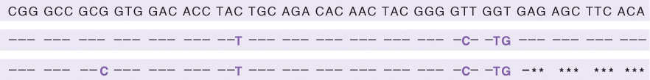
Human Leukocyte Antigens (H L A’s) (continued)
H L A–gene sequences differ from one individual to another at single base pairs
Also written as:
Each sequence is a different allele
Notes:
The initial sequence (D R B1*01:01) is written at the top of panel A. Aligned underneath are two alleles of this region, D R B1*01:02 and D R B*01:03. The bases in color are those that differ from D R B1*01:01. “N” indicates unknown or unsequenced bases. Panel B shows a different way of presenting the alleles. A dash indicates identity to D R B1*01:01. Only the polymorphic bases are written. The asterisk indicates unknown or unsequenced bases.

Slide 8
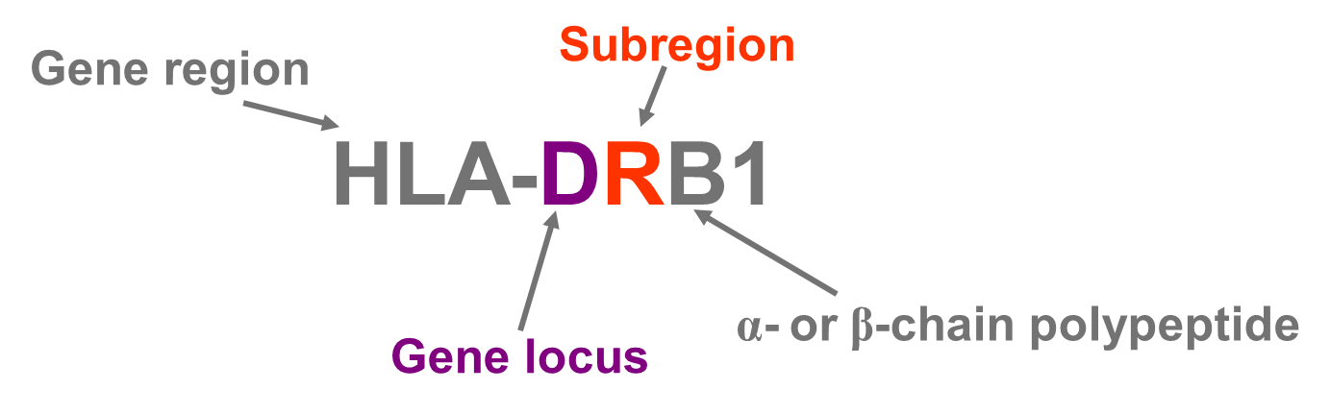
H L A Allele Nomenclature
A standard nomenclature has been established by the World Health Organization (W H O) Nomenclature Committee
A small “w” is included in H L A-C, H L A B-4, and H L A B-6 allele nomenclature: H L A-C w, H L A B w-4, H L A B w-6

Slide 9
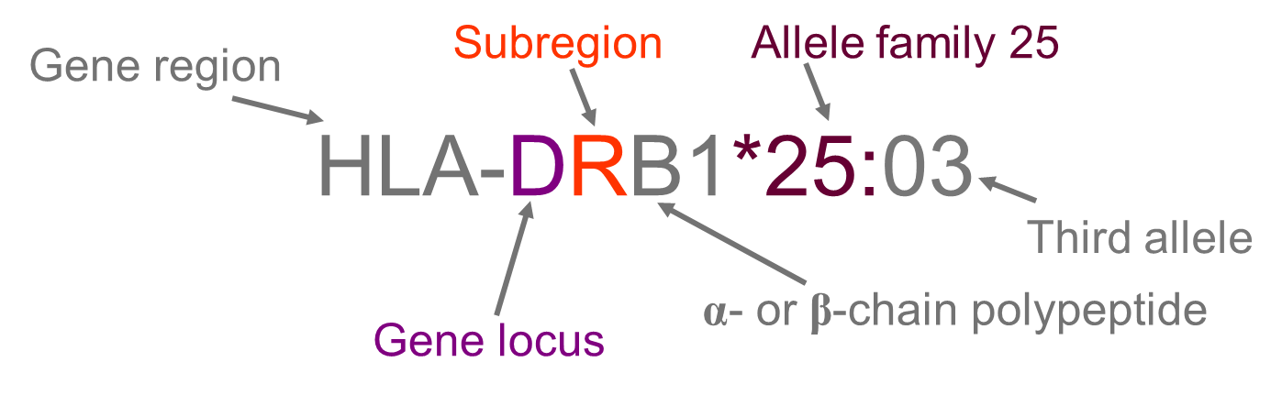
H L A Allele Nomenclature (continued)
H L A typing at the D N A level requires nomenclature for specific D N A sequences
Increasing numbers of H L A alleles are being identified

Slide 10
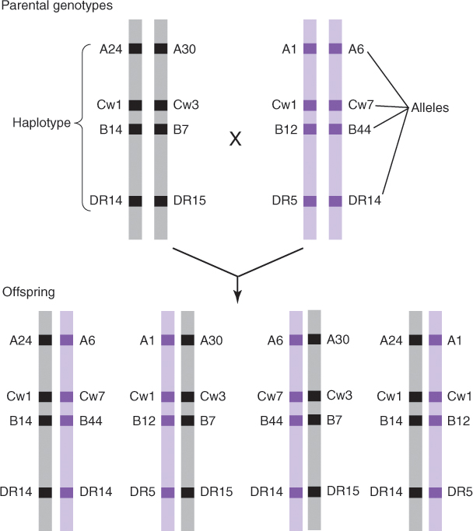
H L A Alleles Are Inherited in Blocks as Haplotypes
Notes:
A haplotype is the combination of alleles that are inherited together. In this example, parental genotypes (top) can produce four possible genotypes in the offspring (bottom).

Slide 11
H L A Typing
Every person (except identical twins) has different sets of H L A alleles
Transplanted organs are allografts, in which the donor organ and the recipient are genetically different
Compatibility (matching) of the H L A of the donor and the recipient increases the chance for a successful engraftment

Slide 12
H L A Typing (continued)
Matching is determined by comparing alleles
Resolution is the level of detail with which an allele is determined

Slide 13
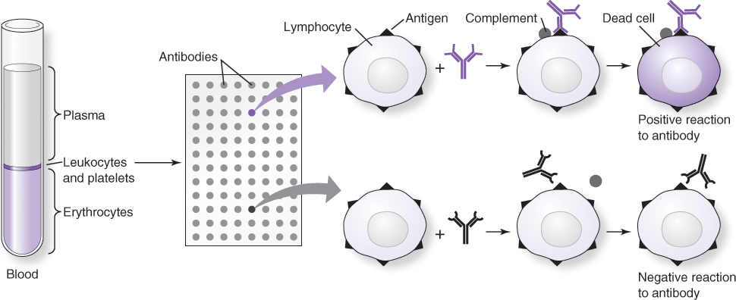
Serological Typing
Lymphocytes are H L A typed by crossmatching to panel reactive antibodies (P R A) using the complement-dependent cytotoxicity (C D C) test.
Notes:
Serological typing is the phenotypic identification of cell antigens by recognition of serum antibodies. In the illustration, crossmatching to known antibodies is performed on lymphocytes (buffy coat, left) in a 96-well plate format where each well contains different known antibodies. If the antibody matches the cellular antigen (positive reaction, top), complement-dependent cytotoxicity will occur, and the dead cell will take up stain (green). If the antibody does not match the cellular antigen, there is no cytotoxicity.

Slide 14
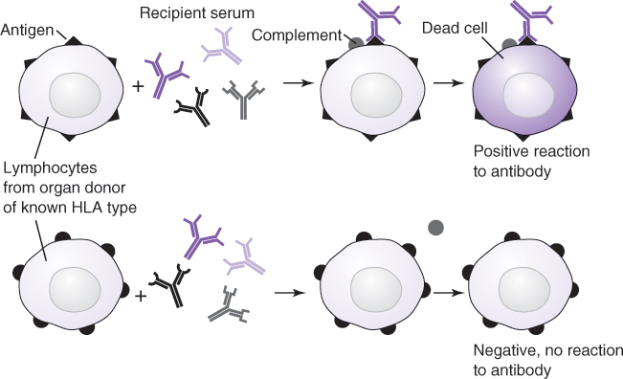
Serological Typing (continued)
Recipient antihuman antibodies are assessed by crossmatching to donor lymphocytes
Notes:
In the crossmatch by CDC assay, the recipient serum is the source of antibodies to type lymphocytes from potential organ donors. The antibodies in the recipient serum can be identified if the H L A type of the lymphocytes is known.

Slide 15
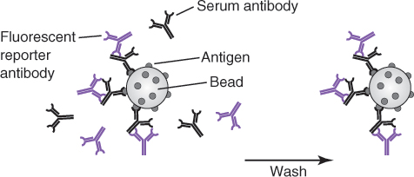

Serological Typing Using Bead Arrays
Recipient antihuman antibodies are assessed by crossmatching to known lymphocyte antigens conjugated to microparticles
Results are assessed by flow cytometry
Notes:
Antibodies or antigens can be typed with known reactive antigens or antibodies. In this example, separate preparations of beads are conjugated to two different known antigens. The patient serum tested contains an antibody to the antigen on the beads in A but not the antigen on the beads in B. A secondary antibody targeting the bound serum antibody generates a fluorescent signal detected by flow cytometry. If a matching antibody is not present in the test serum, as in B, no antibody will be bound.

Slide 16
Other Serological Typing Methods
Cytotoxic and noncytotoxic methods with flow cytometry detection
Enzyme-linked immunosorbent assay (E L I S A) with solubilized H L A antigens
Mixed lymphocyte culture measuring growth of lymphocytes activated by cross-reactivity
Measure of H L A-protein mobility differences in one-dimensional gel isoelectric focusing or two-dimensional gel electrophoresis

Slide 17
D N A-Based Typing Methods
Early D N A typing focused on the most polymorphic loci in the M H C, H L A-B, and H L A-D R B
Whole-blood patient specimens collected in anticoagulant are used for D N A typing
Cell lines of known H L A type are used for reference samples

Slide 18
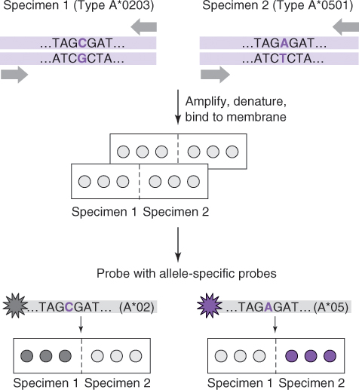
D N A-Based Typing Methods: S S O P
Sequence-specific oligonucleotide probe hybridization (S S O P, S S O P H)
Notes:
An H L A gene region is amplified from specimen D N A using generic primers (top). The amplicons are immobilized on a membrane and probed with labeled sequences complementary to specific alleles. Signal from the bound probe will indicate the allele of the immobilized D N A.

Slide 19
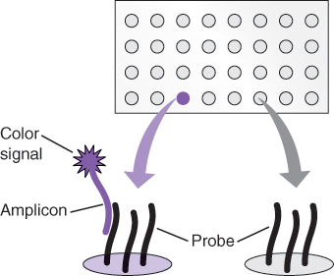
D N A-Based Typing Methods: S S O P (continued)
Immobilized probes can be used to identify patient alleles by hybridization
Probes immobilized on fluorescent beads is the basis for bead-array S S O P
Notes:
In reverse-dot-blot S S O P, the probe is immobilized on the membrane. Patient D N A is amplified using primers covalently bound to biotin or digoxygenin at the 5’ end. The amplicons are then hybridized to panels of probes immobilized on a membrane (top). If the sequence of the amplicon matches and hybridizes to that of the probe, a secondary reaction with enzyme-conjugated avidin or antidigoxygenin will produce a color or light signal when exposed to substrate. If the sequence of the amplicon differs from that of the probe, no signal is generated (bottom right).

Slide 20
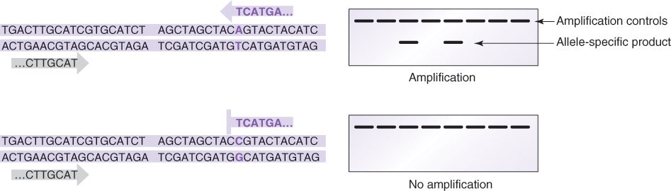
D N A-Based Typing Methods: S S P-P C R
Sequence-specific P C R (S S P-P C R) is performed with allele-specific primers
Notes:
S S P-P C R relies on the requirement of complementarity between the 3’ base of the primer and the template. The sequence-specific primer ending in AGTACT will be extended only from a template carrying the polymorphism shown.

Slide 21
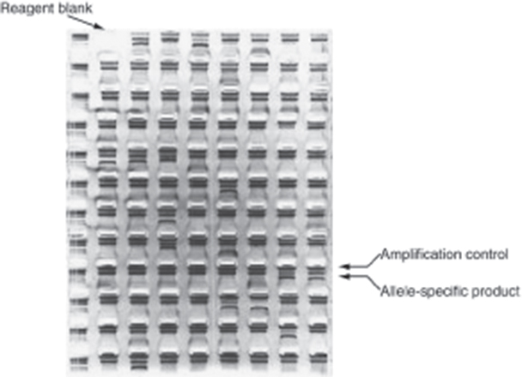
D N A-Based Typing Methods: S S P-P C R (continued)
Primers recognizing different alleles are supplied in a 96-well plate format
Notes:
Results of an S S P-P C R of 95 primer sets detected by agarose gel electrophoresis shows the presence of specific alleles as allele-specific P C R products. An amplification control (top band in each well) is included with each reaction to avoid false-negative results due to amplification failure. Contamination is monitored by a reagent blank.

Slide 22

D N A-Based Typing Methods: Sequence-Based Typing
Sequence-based typing (S B T) is high resolution
Polymorphic regions are amplified by P C R and then sequenced
Notes:
P C R primers (outer large arrows) are used to amplify the region of interest. The P C R product is then sequenced using four different primers (inner small arrows) in separate sequencing reactions.

Slide 23
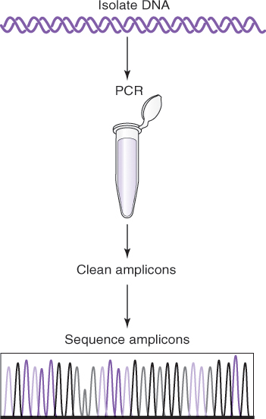
D N A-Based Typing Methods: Sanger Sequence-Based Typing
Notes:
For Sanger sequence–based typing, H L A regions from patient D N A are amplified using the outer primers. The P C R products are then purified from unused P C R reaction components by alcohol precipitation or column or gel purification methods. The amplicons are then sequenced using the inner sequencing primers to detect polymorphisms.

Slide 24
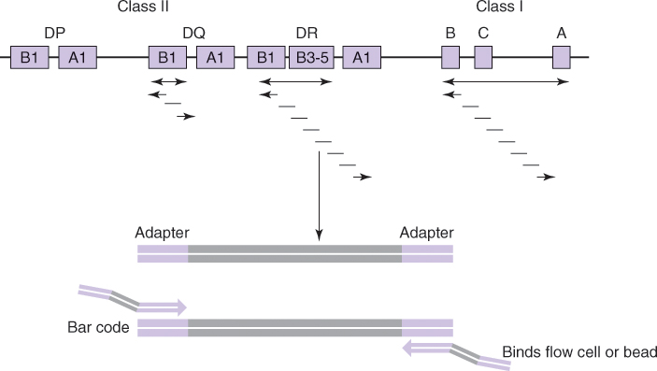
Next-Generation Sequencing (N G S)–Based Typing
Notes:
N G S libraries are produced from M H C regions selected by long-range P C R (double arrows). These 7- to 10-kb fragments are fragmented or amplified for the generation of shorter fragments. The fragments are ligated to adapters and then tagged by P C R using primers tailed with bar codes for patient identification and sequencing primer-binding sites. In dye terminator sequencing, sequencing reactions are performed from polonies immobilized on a sequencing chip (flow cell). For ion conductance, sequencing reactions are performed on beads in wells of the sequencing chip.

Slide 25
Typing Discrepancies
D N A sequence changes do not always affect epitopes
Serology does not recognize every allele detectable by D N A
New antigens recognized by serology may be assigned to a previously identified parent allele by S B T
Serology antibodies may be cross-reactive for multiple alleles

Slide 26
Typing Discrepancies (continued)
Due to new allele discovery, retyping results may differ from typing performed before the new allele was known

Slide 27
Resolution Levels of H L A Typing Methods
Low-resolution methods | Intermediate-resolution methods | High-resolution methods
C D C (Serology) | P C R-S S P | P C R-S S P
P C R-S S P | P C R-S S O P | P C R-S S O P
P C R-S S O P | P C R-R F L P | S S P-P C R + P C R-R F L P
 |  | S S O P-P C R + S S P-P C R
 |  | S B T
C D C = complement-dependent cytotoxicity; P C R-R F L P = polymerase chain reaction restriction fragment length polymorphism
Notes:
The acceptance of donors based on typing resolution varies with patients, donors, and organs to be transplanted. Organ transplants (e.g., heart) may not allow high-resolution donor selection. Bone marrow transplant donors may be selected by high-resolution methods.

Slide 28
Combining Typing Results
S S P-P C R followed by P C R-R F L P
S S O P followed by S S P-P C R
S B T results clarified by serology
Notes:
Results from serological and D N A-based methods can be combined to improve resolution and further define H L A types. Sequential use of S S P-P C R and P C R-R F L P or S S O P-P C R and S S P-P C R increases the typing resolution of D N A-based tests. Serological testing can be used to clarify or confirm the phenotype of alleles detectable by D N A-based methods. The choice of method will depend on the demand for high- or low-resolution typing.

Slide 29
Summary
M H C is a polymorphic locus encoding the H L A genes
Antigens encoded by the H L A genes are responsible for allograft tissue and organ rejection; identifying and matching alleles increases the chance of successful organ and tissue transplant

Slide 30
Summary (continued)
H L A antigens and their corresponding sequence alleles are determined by serological and D N A-based methods
Serology identifies functional antigen recognition, whereas sequence analysis identifies genetic alleles with high resolution

