Slide 1
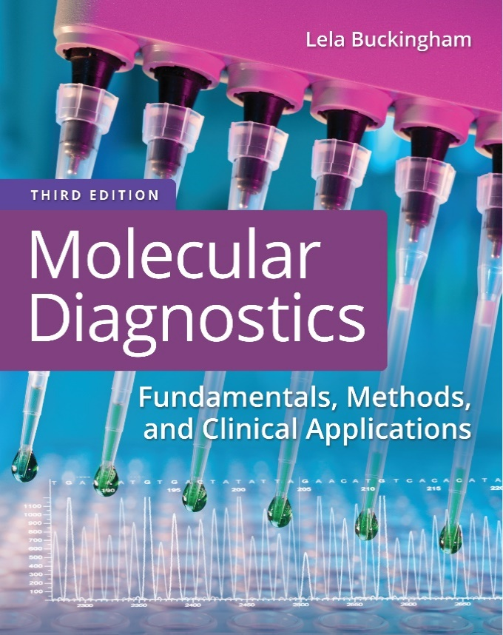
Chapter 15
Quality Assurance and Quality Control in the Molecular Laboratory

Slide 2
Objectives
Describe proper specimen accession, handling, and storage for molecular testing.
Explain the basic components of molecular test performance, including quality assurance and controls.
Describe recommendations for the preparation and use of reagents in the molecular laboratory.

Slide 3
Objectives (continued)
Explain documentation and reporting of results, including gene-sequencing results.

Slide 4
Specimen Accession
Preanalytical error is the consequence of erroneous or misleading results caused by events that occur prior to sample analysis
The condition of the specimen and, if necessary, the chain of custody is reviewed upon receipt in the laboratory

Slide 5
Specimen Accession (continued)
No specimen is accepted without proper labeling and identification
If a specimen is unacceptable, the disposal or retention of the specimen is documented

Slide 6
Precautions
All specimens are potentially infectious and should be handled with standard precautions using proper personal protective equipment (P P E)
  Gloves: part of standard precautions
  Protect nucleic acids
  Absolutely required for handling of R N A
Notes:
Gloves are highly recommended not only as part of standard precautions but also to protect nucleic acids from nuclease degradation. Gloves are absolutely required for the handling of R N A.

Slide 7
Precautions (continued)
Transmission-based precautions, including respirators, are used with airborne- or contact-transmissible agents
Contact precautions are designed for direct patient care
Notes:
Gloves are highly recommended not only as part of standard precautions but also to protect nucleic acids from nuclease degradation. Gloves are absolutely required for the handling of R N A.

Slide 8
Specimens for Molecular Testing
Specimens of minimal cellular content are often analyzed
  Cross-contamination must be avoided
Inspect blood samples for hemolysis
  If cell lysis has occurred, D N A and R N A yield will be reduced
Solid tissues are best analyzed from fresh or frozen tissues

Slide 9
Specimens for Molecular Testing (continued)
The quality of nucleic acid from fixed tissue depends on the fixing process and the fixative used

Slide 10
Specimen Collection: Anticoagulants for Molecular Tests
Additive | Color | Testing
None | Red | Chemistry, serum, viral antibody studies
Sodium heparin (freeze dried) | Green | Immunology, virology studies
Sodium heparin | Brown | Cytogenetic studies, molecular studies
Tripotassium E D T A (7.5%–15% solution) | Lavender | Virology, molecular biology
Acid citrate dextrose (A C D) solution | Yellow | Molecular biology, human leukocyte antigen (H L A), microbiology

Slide 11
Specimen Holding and Storage: D N A
Specimens
  Blood, bone marrow, fluids
    <1 day, 23 degrees Centigrade; 3 days, 4 degrees Centigrade
    White blood cells (W B C’s), >1 year, –20 degrees Centigrade or –70 degrees Centigrade
  Tissue
    23 degrees Centigrade (not recommended)
    <1 day, 4 degrees Centigrade
    >2 weeks, –20 degrees Centigrade
    >2 years, –70 degrees Centigrade
Notes:
Depending on the test, blood and other fluids may be stored for up to 72 hours (3 days) refrigerated. Tissue should be fixed or frozen if not used within 24 hours. The stability of isolated D N A depends on the purity of the preparation. A very pure preparation is stable at room temperature; however, to assure high-quality D N A, storage at refrigerator or freezer temperatures is recommended.

Slide 12
Specimen Holding and Storage: D N A (continued)
Isolated D N A
    <26 weeks, 2–25 degrees Centigrade
    1–3 years, 4 degrees Centigrade
    <7 years, –20 degrees Centigrade, –70 degrees Centigrade (not frost-free)
Notes:
Depending on the test, blood and other fluids may be stored for up to 72 hours (3 days) refrigerated. Tissue should be fixed or frozen if not used within 24 hours. The stability of isolated D N A depends on the purity of the preparation. A very pure preparation is stable at room temperature; however, to assure high-quality D N A, storage at refrigerator or freezer temperatures is recommended.

Slide 13
Specimen Holding and Storage: R N A
Specimens
  Blood, bone marrow, fluids
    <2 hours, 23 degrees Centigrade or 4 degrees Centigrade
    5 days, 23 degrees Centigrade; 7 days, 4 degrees Centigrade in denaturant
    1–2 weeks, –70 degrees Centigrade in denaturant
    W B C’s, 2–4 weeks, –20 degrees Centigrade; >6 months, –70 degrees Centigrade
  Tissue
    <2 hours, 4 degrees Centigrade
    Snap frozen, –70 degrees Centigrade, ≥ 2 years
    Nitrogen vapor –140–150 degrees Centigrade, ≥ 2 years
Notes:
Due to the presence of RNases, R N A is not stable at room temperature, unless collected in “R N A tubes” containing specialized denaturants. R N A is most stable when stored in ethanol at –70°C; however, this is not practical for most laboratories.

Slide 14
Specimen Holding and Storage: R N A (continued)
Isolated R N A
    2–25 degrees Centigrade (not recommended)
    <30 days, –20 degrees Centigrade in RNase-free (R N F) water
    <30 days, –70 degrees Centigrade in R N F water
    >6 months, –70 degrees Centigrade in ethanol
Notes:
Due to the presence of RNases, R N A is not stable at room temperature, unless collected in “R N A tubes” containing specialized denaturants. R N A is most stable when stored in ethanol at –70°C; however, this is not practical for most laboratories.

Slide 15
Laboratory Preparation for R N A Analysis
Bench, equipment
  Separate laboratory area designated RNase-free (R N F)
Disposables, reagents
  Certified R N F
Reactions
  Add RNase inhibitors
Notes:
Most tubes, pipet tips, and other disposables, as well as reagents, are certified nuclease-free by the manufacturer. Because these items and solutions are not touched with bare hands or otherwise compromised, they should remain nuclease-free.

Slide 16
Test Performance
Federal regulations from the Food and Drug Administration (F D A) require validation of the performance of clinical test methods and reagents in accurately detecting or measuring analytes prior to use in human testing

Slide 17
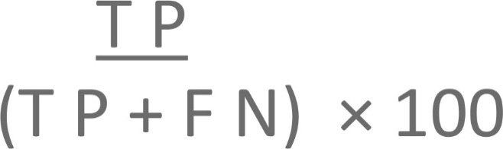
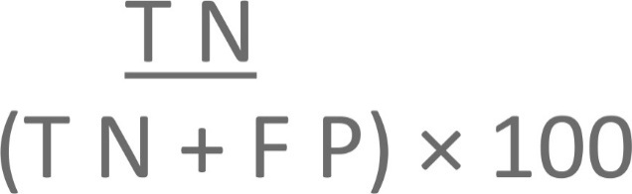
Analytical Criteria for Assessment of Test Performance Versus “Gold Standard”
The analytical sensitivity of an assay equals:
The analytical specificity of an assay equals:
T P = true positive, T N = true negative,
F N = false negative, F P = false positive

Slide 18
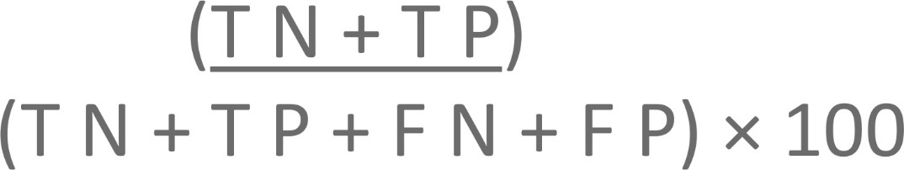
Criteria for Assessment of Test Performance
The analytical accuracy of an assay equals:

Slide 19



Criteria for Assessment of Test Performance Versus Non–Reference Standard or Clinical State
Patient disease state | Positive | Negative
New test result positive | A | B
New test result negative | C | D
P P A = Positive percent agreement
N P A = Negative percent agreement
O R A = Overall rate/percent agreement

Slide 20
Criteria for Assessment of Quantitative Test Performance
Criteria | Definition
Detection limit, lower limit of detection | Least detectable presence of the analyte
Precision | Agreement between independent test results
Reproducibility | Consistency of test results produced from the same procedure
Analyte measurement range (A M R) | The range within which a specimen may be measured directly (without dilution or concentration)
Reportable range | The range within which test results are considered to be valid (with or without dilution)
Reference range | Expected analyte frequency or levels from a population of individuals
Linearity | Quantitative correlation between test result and actual amount of analyte

Slide 21
Criteria for Assessment of Next-Generation Sequencing (N G S) Performance
Validation parameters for N G S cover:
Description of the analytical target (exons, genes, targeted regions)
Bioinformatics used for analysis
Sample pooling methods (indexing) designed to maintain individual sample identity

Slide 22
Criteria for Assessment of N G S Performance (continued_1)
Criteria and thresholds for variant calling:
Minimum coverage depth
Base or variant quality scores
Allelic frequency percentage

Slide 23
Criteria for Assessment of N G S Performance (continued_2)
Performance characteristics for variants:
Sensitivity, specificity, accuracy
Precision (reproducibility)
Examples of the different variant types
(single nucleotide variants, indels, copy-number and other structural variants)
Limits of detection for variants in samples

Slide 24
Criteria for Assessment of N G S Performance (continued_3)
For somatic analyses of solid tumors, sensitivity and limit of detection will be affected by the tumor cell percentages in the tested tissue

Slide 25
Test Validation
Test validation is performed on specimens of types that will be encountered in the routine use of the test
The number of specimens tested varies with the procedure and the availability of test material
Results from the new test methodology are compared to results from established procedures or correlated to the clinical diagnosis

Slide 26
Test Validation (continued_1)
Commercially developed and F D A-approved molecular methods are verified by using the purchased reagent sets to test validation specimens in the laboratory
If the commercial test is modified, validation is required to show equal or superior performance of the modified procedure

Slide 27
Test Validation (continued_2)
Once a procedure has been established, the method is documented in the laboratory according to Clinical and Laboratory Standards Institute (C L S I) guidelines

Slide 28
Proficiency Testing
Proficiency testing refers to external specimens from a reference source supplied to independent laboratories
The College of American Pathologists (C A P) and other organizations supply specimens for molecular analysis

Slide 29
Proficiency Testing (continued)
If proficiency specimens are not commercially available, laboratories can exchange blinded split specimens, or blinded specimens can be measured or documented by independent means (for example, chart review) and can be tested within the laboratory.

Slide 30
Controls
Controls are samples of known type or amount that are treated like and run with patient specimens
With qualitative tests, a positive, negative, and in some cases, a sensitivity control, are required
In quantitative methods, high-positive, low- positive, and negative controls are included
Notes:
Controls are different from calibrators used for equipment maintenance.

Slide 31
Controls (continued_1)
For amplification procedures, amplification controls are required to avoid false-negative results
Quantitative P C R methods that automatically analyze results require a standard curve or dilution series of a reference standard
Notes:
Controls are different from calibrators used for equipment maintenance.

Slide 32
Controls (continued_2)
In methods requiring detection of a target-specific product or relative amounts of target, internal controls are run simultaneously, preferably in the same reaction mix as the test specimen
  For example, housekeeping genes, centromere probes, amplification controls

Slide 33
Quality Assurance
Periodic review and documentation of test results are required
Molecular quantitative methods should have a defined dynamic range, sensitivity level, and accuracy
Assay levels that distinguish positive from negative results (cutoff values) must also be well defined and verified at regular intervals

Slide 34
Instrument Maintenance
Manufacturers supply recommendations for routine maintenance
The laboratory maintains a schedule and instructions for all routine maintenance
There are limits of user-recommended repairs when service calls are indicated

Slide 35
Instrument Maintenance (continued)
Regular calibration, or fitting an instrument or test system output with the actual concentration of a reference analyte, is required for detection systems

Slide 36
Reagents
Instructions on the preparation of reagents and the quantities used in each assay are included in the written laboratory protocol
The sequences of primers and probes are documented
Primer-binding sites and sizes of expected amplicons are documented

Slide 37
Analyte-Specific Reagents
Analyte-specific reagents (A S R’s) are probes, primers, antibodies, or other test components that detect a specific target
Most A S R’s used in the molecular laboratory are class I, not subject to special controls by the F D A
Class 2 and 3 A S R’s include those used by blood banks to screen for infectious diseases or those used in the diagnosis of certain contagious diseases, such as tuberculosis

Slide 38
In Vitro Diagnostic Reagents
In vitro diagnostic (I V D) reagents target a specific disease or condition
I V D reagents include products used to collect, prepare, and examine specimens collected from patients
I V D reagents are classified according to performance risk and requirements for surveillance and verification, from class 1 (lowest risk) to class 3 (highest risk)

Slide 39
Other Types of Test Reagents
In vitro analytical test (I V A T) reagents target a specific disease or condition
  F D A will approve only the analytical validity of the test, with no claims of clinical utility
Research use only (R U O) reagents are not intended for diagnostic use
Investigational use only (I U O) reagents may be used on patients with proper institutional review and informed consent, for example, in clinical trials

Slide 40
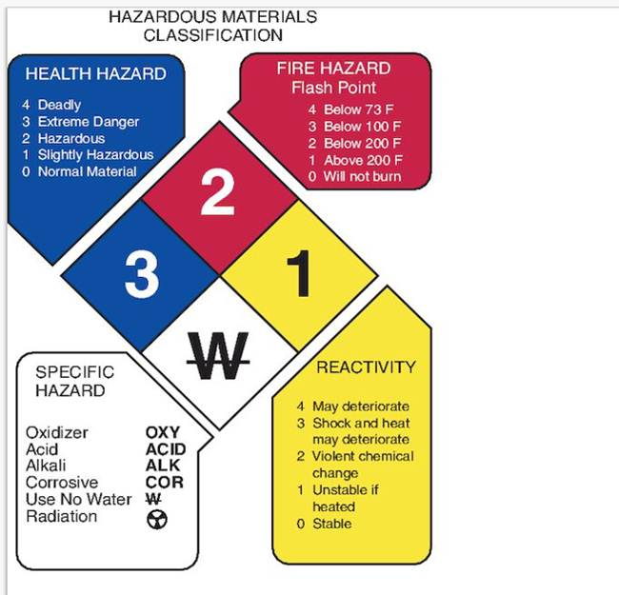
Hazardous Chemicals
The National Fire Protection Association has developed a series of warning labels for universal use on all chemical containers

Slide 41
Hazardous Chemicals: Transport and Storage
Secondary or reinforced containers are required for the transport and handling of dangerous chemicals such as concentrated acids or phenol
Volatile and flammable reagents are stored in properly vented and explosion-proof cabinets or refrigeration units

Slide 42

Biological Hazards: Transport and Storage
Secondary containers are required for the transport and handling of biological specimens (for example, tissue, blood, D N A)
  Temperature controls (refrigeration packs, dry ice) are required for stability of temperature-sensitive targets
Potentially infectious specimens are labeled appropriately

Slide 43

Hazardous Chemicals: Radioactive Material
The Nuclear Regulatory Commission (N R C) requires that laboratories working with radioactive reagents maintain a radiation safety manual providing procedures for the safe handling of radioactive substances
Radioactive reagents are used and stored in designated areas

Slide 44
Documentation of Test Results
Test results in the form of electropherograms, gel images, or autoradiograms should be of sufficiently high quality that results are unequivocal
Documentation of assay conditions, reagent lot numbers, and quality and quantity of the isolated D N A or R N A is required
In situ results such as F I S H are correlated with histological findings (stained sections) of tissue morphology

Slide 45
Documentation of Test Results (continued)
Raw data are retained with the final report and clinical interpretation of the test results

Slide 46
Reporting Test Results
The test report contains pertinent patient, laboratory, and signee identification
The test result is accompanied by the method or commercial kit used; the locus, mutation, or organism tested; the analytical interpretation of the raw data; and the clinical interpretation of the analytical result
  The potential for false positives or false negatives may also be included

Slide 47
Reporting Test Results (continued)
The clinical significance of the test result and references are also indicated on the report

Slide 48
Reporting Test Results: Disclaimer
When Class I A S R’s are used in an analytical method, the following disclaimer is included in the test report:
“The F D A has determined that such clearance or approval is not necessary. This test is used for clinical purposes. It should not be regarded as investigational or for research. This laboratory is certified under the Clinical Laboratory Improvement Amendments of 1988 (C L I A-88) as qualified to perform high complexity clinical laboratory testing.”

Slide 49
Reporting Test Results: Disclaimer (continued)
Test reports (and related data) are Protected Health Information and should be maintained by secure electronic or physical storage

Slide 50
Summary
Proper specimen handling is required for accurate test results
  Specimens should be held and stored under conditions that will preserve nucleic acids
Molecular test performance is monitored by the use of quality controls
Safety rules, protective equipment, and chemical storage and labeling apply to all areas of testing

Slide 51
Summary (continued)
Reagents are prepared, stored, and used as recommended by manufacturers and/or laboratory protocol
Raw data should be documented and results clearly reported

