Slide 1
Enzymes

Slide 2
Topic 4: Enzymes
Objectives
Define the following terms: catalyst, cofactor, holoenzyme, apoenzyme, coenzyme, and prosthetic group.
Differentiate the four types of enzyme specificities.
List and define the five classes of enzyme reactions.
Explain the effects of pH, temperature, substrate and enzyme concentrations on enzyme kinetics.
Describe the Michaelis-Menten plot and equation including definition of terms.
Discuss the purpose of the Lineweaver-Burk plot.

Slide 3
Objectives cont….
Differentiate first-order and zero-order kinetics and relate the two to laboratory assays.
Describe the effects of the following types of inhibitors on enzyme reactions: competitive, non-competitive, and uncompetitive.
Discuss the role of NAD and NADH in enzyme reactions including the appropriate wavelength for monitoring these reactions.
Define the International Unit in terms of enzyme activity.
Differentiate the following types of reaction rate measurements: end-point, multiple-point, and continuous.
Describe the enzyme elevations that are characteristic of myocardial infarction.

Slide 4
Objectives cont….
Discuss the use of troponin measurements in possible heart disease.
Describe the compound myoglobin. Discuss its measurement as diagnostic tool.
Describe B-type natriuretic peptide and discuss its use in diagnosing heart failure.
Describe each of the following enzymes including the normal reaction catalyzed, clinical assays, significance of isoenzymes, organ of origin, and clinical significance:

Slide 5
Objectives cont….
  aspartate aminotransferase (AST)
  alanine aminotransferase (ALT)
  creatine kinase (CK)
  lactate dehydrogenase (LDH)
  alkaline phosphatase (ALP)
  acid phosphatase (ACP)
  amylase (AMS)
  lipase (LPS)
  gamma-glutamyl transferase (GGT)
  glucose-6-phosphate dehydrogenase (G6PD)
  pseudocholinesterase (ChE)

Slide 6
Enzymes are Protein Catalysts
A catalyst is a substance that increases the rate of a particular chemical reaction without being consumed or permanently altered. Enzymes lower the activation energy of the reaction.
For max. catalysis a nonprotein substance (cofactor) may be required such as an organic compound called a coenzyme (ex: NAD ⁺ and NADP⁺) or an inorganic ion called an activator (Cl⁻, Mg²⁺).
Cofactors that are so tightly bound are called prosthetic groups (ex: heme portion of peroxidase)
It is possible to dialyze away the loosely held cofactors from some enzymes and still retain some activity this gives an apoenzyme.
A holoenzyme is the complete enzyme-cofactor complex

Slide 7
Chemical Reactions
May occur spontaneously if the free energy/available kinetic energy is higher for the reactants than for the products.
Proceed toward the lower energy if the reactant molecules possess enough EXCESS ENERGY (activation energy) to break their chemical bonds and collide to form new bonds

Slide 8
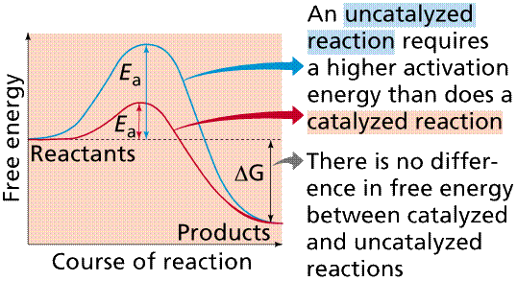
Activation Energy
Energy required to raise all the molecules in 1 mole of a compound to the Transition State at the peak of the energy barrier

Slide 9
Enzyme classification
Class
1.Oxidoreductases | Catalyze electron transfer or redox reactions (ex: LD) or the addition or removal of H⁺
2.Transferases | Catalyze the transfer of a group such as an amino, carboxyl, glucosyl, methyl or phosphoryl (ex: ALT)
3.Hydrolases | Catalyze the cleavage of C-O, C-N, C-C with the addition of water (ex:ALP) A-B + H₂O A-OH + B-H
4.Lyases or synthase | Catalyze the hydrolysis of C-O, C-N, C-C bonds by elimination with the formation of a double bond or catalyze the addition of a group to a double bond (ex: fructose biphosphate aldolase)
5.Isomerase(epimerases or mutase) | Catalyze structural of geomertrical changes within a molecule (ex: glucose phosphate isomerase)
6.Ligases or Synthetases | Two molecules are joined, coupled with hydrolysis of the pyrophosphate in ATP. (ex:glutamine Synthetase

Slide 10
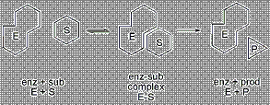
Enzyme Active center(specificity)

Slide 11
Enzyme Active center
Some enzymes are extremely specific while others accept a broad range of substrate structures (although the various substrates will not react equally well.)
Active site is:
small < 5 % of the total a.a. in the molecule
Is a 3-D structure (as a result of the overall tertiary structure of the protein)
Occur in clefts & crevices in the protein
Complements the structure of the substrate molecule
Attraction between E & S is noncovalent bonding (Hydrogen bonding, electrostatic and hydrophobic interactions and Van Der Waals forces)

Slide 12
4 Enzyme Specificities
Absolute Specific: enzyme combines with only one substrate ( catalyzes only one reaction)
Group Specific: enzyme combines with all substrates containing a particular chemical group
Bond Specific: enzyme combines with substrates that exhibit a specific chemical bond regardless of the rest of the chemical structure
Stereoisometric Specific: enzyme combines predominantly with only one optical isomer of a certain compound.

Slide 13
Factors that Affect the Rate of Enzyme Catalyzed Reactions
[E] = enzyme concentration (directly proportional to rate)
[S] = substrate concentration (1st order –proportional to rate, zero order-only dependent on [E] )
Inhibitors
Activators
Temperature
pH

Slide 14
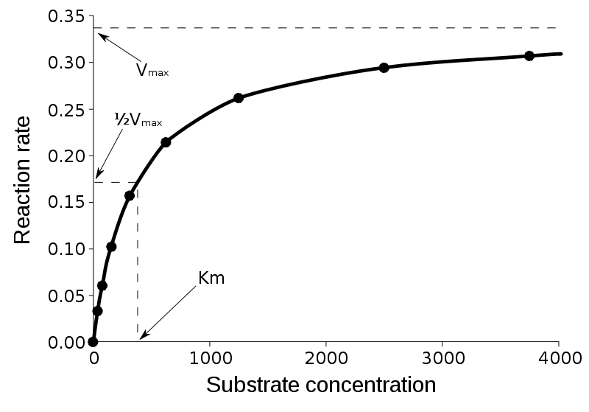
Michaelis-Menten Curve
Where Km is called the Michaelis –Menten constant of enzyme for a specific [S]
The value of km is given by the [S] at which one half of the maximum velocity is obtained

Slide 15
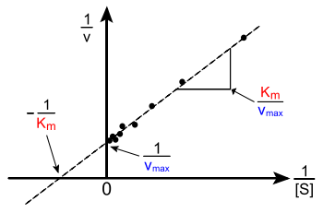
Line-weaver-Burk plot

Slide 16


Michaelis-Menten Curve hyperbolic curve
Hard to calculate Vmax and Km at high [S]
Line-weaver-Burk plot
straight line (reciprocal of equation)
Easy to calculate Vmax and Km even at high [S]

Slide 17
1st order Kinetics
[S] readily binds to free enzyme at low [S]
Reaction rate steadily increase as more [S] is added (linear part of reaction curve)
Reaction rate is directly proportional to [S]

Slide 18
Zero Order Kinetics
When Substrate finally saturates all available enzyme (plateau on reaction curve)
When reaction velocity reaches its maximum (Vmax)
Therefore whenever [P] is formed –the newly free enzyme immediately combines with free [S]
Reaction rate depends only on [E]

Slide 19
Competitive Inhibitors
Compete with the [S] for the enzymes’s active site
Counteracted by increased [S]
Reaction has slower rate but same Vmax
Km appears to increase

Slide 20
Non-competitive Inhibitors
Binds at location other than active site
Can bind enzyme only or the ES complex
Maybe reversible or irreversible
Adding more [S] has no effect
Km is unchanged
Vmax cannot be reached

Slide 21
Uncompetitive Inhibitors
Binds to ES complex
Increasing [S] increases inhibition
Maximum velocity cannot be reached
Km appears decreased

Slide 22
Temperature
The rate of an enzymatic reaction is directly proportional to its reaction temperature
Thermal inactivation & denaturation is instantaneous at temperatures of 60 ° C to 70 ° C
Different enzymes have different optimal temperatures
Most of analytical systems operate at 37° C
Accurate temp. control to within +/- 0.1 ° C during the enzymatic reaction is essential
Low temp. reversibly inactivates enzyme

Slide 23
pH
Many of the enzymes in blood plasma show maximum activity in vitro in the pH range from 7-8
Both pH & ionic environment will have an effect on the 3-D conformation of the protein on the enzyme activity (may be irreversibly denatured at extreme values of pH )
Enzyme assays should be conducted at the pH of optimal activity
Use buffer solutions to control pH

Slide 24
Measurement of Enzyme Activity
Activity is related to [E]
Measurement monitored by product formation or [S] depletion over time
Older methods are photometric
Newer methods are ultraviolet optical properties of coenzymes as they are altered by enzyme activity
NADH absorbs light at 340 nm
NAD⁺ does not

Slide 25
NAD/NADH
Acts as a reagent for a coupled-enzyme assay
Measurement of increase or decrease of NADH @ 340 nm
International Unit (IU):
Amount of enzyme that will catalyze the reaction of 1 micromol of [S] /min under specified conditions of temp.,pH, substrates, and activators

Slide 26
NAD/NADH
More than 1 enzyme is added in excess
Multiple reactions are catalyzed
A specific enzyme catalyzes a specific reaction
Product becomes substrate for intermediate auxiliary enzyme
The product becomes the substrate for the final reaction
The final reaction is catalyzed by an indicator enzymes involving the conversion of NAD⁺ to NADH or vice versa

Slide 27
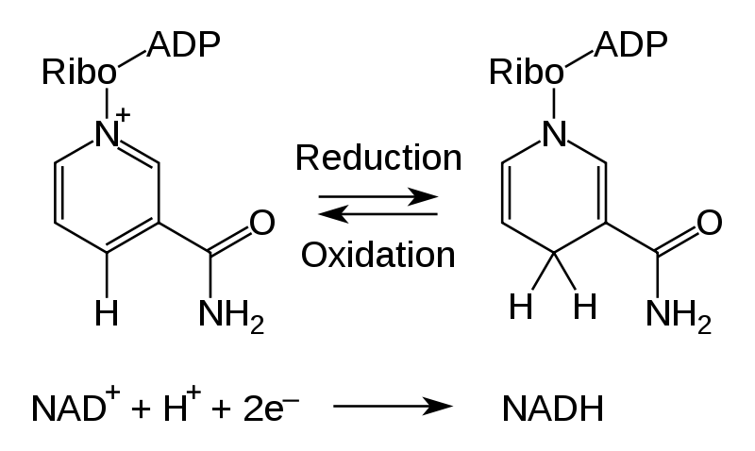
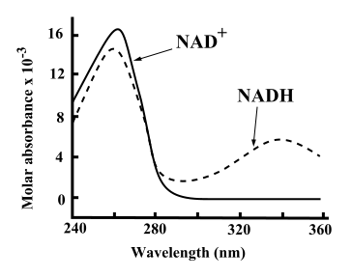
NADH absorbs light at 340 nm and NAD⁺ does not

Slide 28
The equilibrium is achieved in minutes with the first reaction whereas it is achieved in years for the second reaction!!!
Would the absorbance increase or decrease ?
LD
1. Pyruvate + NADH + H⁺ L-Lactate + NAD⁺
No enzyme
2. Pyruvate + NADH + H⁺ L-Lactate + NAD⁺

Slide 29
End-Point Measurement
Reactants are allowed to incubate for a predetermined time before the absorbance is read
Activity is calculated by comparing absorbance readings with a standard solution
Assumed that the reaction progresses linearly and follows zero-order kinetics

Slide 30
Multiple-Point Measurement
Several absorbance readings are taken @ specific times during the reaction
This method allows verification of linearity

Slide 31
Continuous Monitoring
Measurement
Uses a recording spectrophotometer to trace the reaction over time
Constant monitoring not just @ fixed times
The slope of the linear portion of the progress curve is used for enzymes activity
Elevated enzyme activity may cause the need for a dilution

Slide 32
Enzyme | Abbreviation | Principal Sources of Enzyme in Blood | Clinical Applications
Alanine aminotransferase | ALT | Liver | Hepatic parenchymal diseases
Alkaline phosphatase | ALP | Liver, bone, intestinal mucosa, placenta | Bone diseases, hepatobiliary diseases
Amylase | AMY | Salivary glands, pancreas | Pancreatic diseases
Aspartate aminotransferase | AST | Liver, skeletal muscle, heart, erythrocytes | Hepatic parenchymal disease, muscle disease
Cholinesterase | CHS | Liver | Organophosphorus insecticide poisoning, suxamethonium sensitivity, hepatic parenchymal diseases
Creatine kinase | CK | Skeletal muscle, heart | Muscle diseases (myocardial infarction)
γ-Glutamyl transferase | GGT | Liver | Hepatobiliary diseases, marker of alcohol abuse
Lactate dehydrogenase | LDH | Heart, liver, skeletal muscle, erythrocytes, platelets, lymph nodes | Hemolysis, hepatic parenchymal diseases, tumor marker
Lipase |  | Pancreas | Pancreatic diseases
5′-Nucleotidase |  | Liver | Hepatobiliary diseases
Trypsin |  | Pancreas | Pancreatic diseases

Slide 33
Cardiac Biomarkers
Clinical laboratory tests which are useful in detecting and monitoring cardiac disease; most commonly in cases of AMI
AMI (Acute Myocardial Infarction):
  Diagnostic tools include history of chest pain/presence of typical AMI symptoms or ECG changes/a pattern indicative of ischemia; Q waves, AND typical rise and fall pattern of cardiac markers
  Most common AMI biomarkers: Troponin, CKMB, Myoglobin

Slide 34
Troponin
Complex made of 3 isomers (Tn-I, Tn-T, & Tn-C)
Complex helps muscle fibers convert ATP into mechanical work (muscle contraction); regulate muscle contraction
NOT found in serum of healthy adults
Cardiac troponin subunits are very specific to myocardium
Association with AMI: Rise and Fall Pattern
  Levels begin to increase within 4 hours
  Levels can remain elevated for greater than 7 days

Slide 35
CK-MB
Isoenzyme of Creatine Kinase (CK)
  3 Isoenzymes: CK-MM, CK-MB, CK-BB
  CK-MB predominantly found in myocardium
Increases can be due to heart damage or to an increase in total CK
  Skeletal muscle damage can cause an extreme elevation in CK, and therefore in CK-MB as it is a fraction of the total
  CK-MB >5% of total CK due to heart damage
Association with AMI: Rise and Fall Pattern
  Increases within 4-9 hours
  Returns to baseline levels within 2-3 days

Slide 36
Myoglobin
Located in skeletal and heart muscle
More sensitive than CK-MB in first hrs after onset of chest pain
Association with AMI: Rise and Fall Pattern
  Rises in 1-4 hr
  Peaks in 6-9 hr
  Returns to normal in 18-24 hr
If it remains w/in the normal range 8 hr after onset of chest pain (not AMI) → Negative predictor; used to rule out AMI

Slide 37
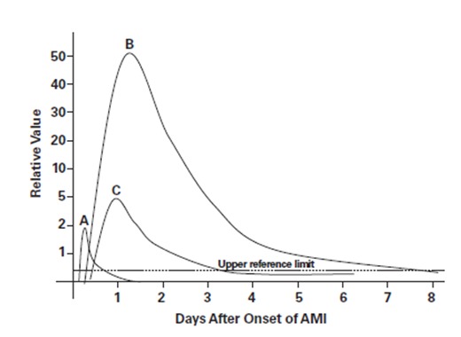

Cardiac Markers in AMI

Slide 38
B-type Natriuretic Peptide
Peptide hormone secreted primarily by the cardiac ventricles; released in response to cardiac stretch
Stimulates natriuresis (Na excretion) and diuresis (water excretion), decreasing vascular tone and stress on the heart
Increased in diseases with increased fluid volume (renal failure, aldosteronism & CHF), reduced renal clearance of peptides, or stimulation of peptide production

Slide 39
Congestive Heart Failure
(CHF)
Abnormality of cardiac function that is responsible for the failure of the heart to pump sufficient blood to satisfy the requirements of the metabolizing tissues
Ineffective pumping of blood leads to fluid accumulation in the lungs
BNP helps in diagnosing patients with CHF (results >100 considered abnormal) and is associated with poor prognosis after AMI

Slide 40
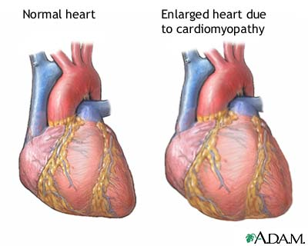
CHF

Slide 41
Enzyme | Function/Clinical Use
Creatine Kinase (CK) | Catalyzes the formation of ATP from ADP + creatine phospate in muscle Levels related to muscle mass and function
Lactate Dehydrogenase (LD/LDH) | Catalyzes a hydrogen transfer that causes the oxidation of lactate to pyruvate and vice versa 5 isoenzymes found throughout the body
Acid Phosphatase (ACP) | Phosphatase that catalyzes the removal of a phosphate group from its substrate Found in greatest concentrations in bone, prostate, spleen, plts.
Amylase (AMY) | Hydrolase that catalyzes the hydrolysis of 1,4-α-glucosidic linkages in polysaccharides Found primarily in salivary glands and pancreas
Lipase (LIP) | Hydrolyzes glycerol esters of long chain fatty acids Primarily found in pancreas Marker for pancreatic damage/pancreatitis
Cholinesterase | Hydrolyzes acetylcholine (a neurotransmitter); mediates transmission of neural impulse across synapse Found in RBCs, lungs, spleen, gray matter of brain, nerve endings
Pseudocholinesterase | Has a different substrate; hydrolyzes butyrylcholine (an acetylcholine-like molecule) Found in liver, pancreas, heart, white matter of brain Deficiency causes problems when given certain muscle relaxants (succinylcholine)
Glucose-6-Phosphate Dehydrogenase (G6PD) | Catalyzes the conversion of glucose-6-phosphate to 6-phosphogluconate, generating ATP Deficiency causes hemolysis associated with oxidative stress

